Slide 1
Project Progress - Checkpoint 1
Purchase Intent Prediction - Hazel T. Chikara

Slide 2
Recap of Project Pitch
Problem - predict purchase intent for better targeting and conversion.
Importance - improves ROI and user experience.
Challenges - noise, imbalance, leakage, missing values.
Task - supervised classification on tabular data.

Slide 3
Data Overview
Training shape - 177086 rows, 23 columns.
Target column - Result.
Quality checks - dtypes, missingness, duplicates, value ranges.

Slide 4
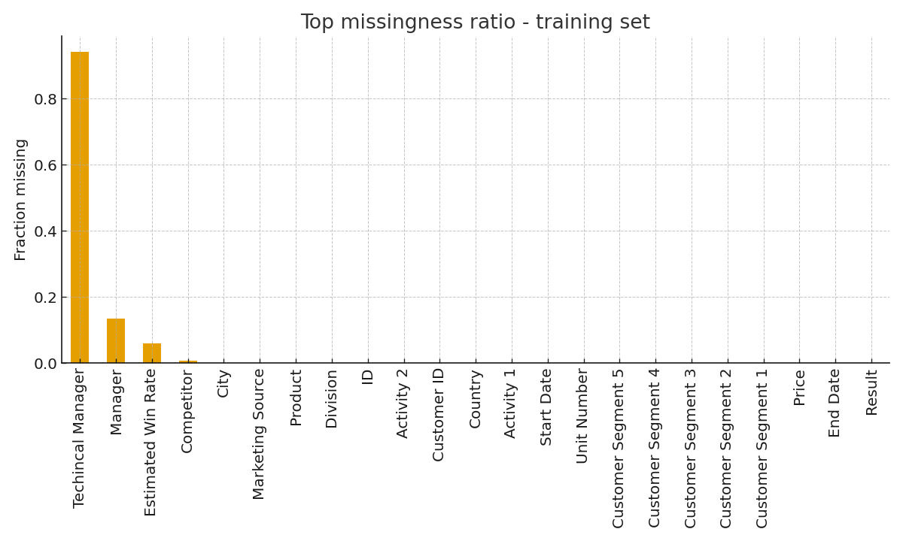
EDA - Missingness Train

Slide 5
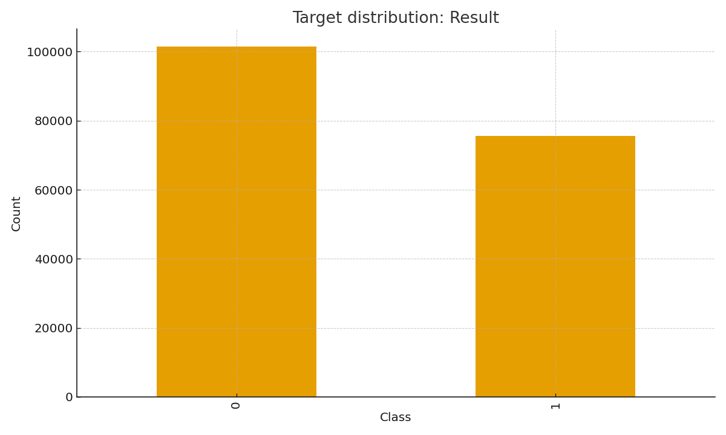
EDA - Target Distribution

Slide 6
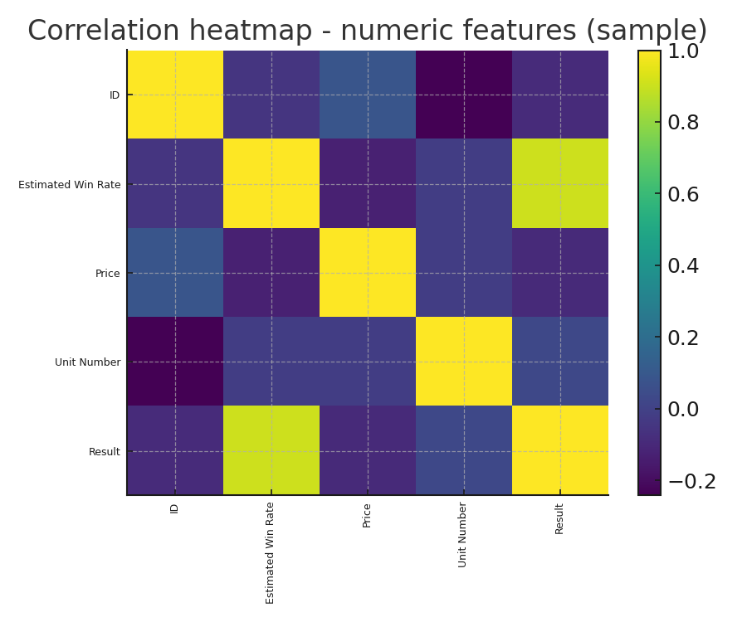
EDA - Corr Heatmap

Slide 7
Preliminary Pipeline
Data cleaning - type casting, outlier checks, missing value handling.
Feature prep - numeric imputation, plan one-hot for categoricals.
Validation - stratified split and cross-validation.
Metrics - accuracy, ROC AUC, precision, recall, F1.

Slide 8
Issues and Next Steps
Check class balance and adjust thresholds or weights.
Run leakage audit on time or session identifiers.
Add gradient boosting models for CP2.
Plan SHAP insights and error slice analysis.

