Slide 1
Purchase Intent Prediction — Checkpoint 2
Data Mining (CSE 511)
Team: Your Names
≤ 15 minutes

Slide 2
Project Pitch Recap
Problem: Predict whether a lead converts (Result = 1)
Importance: Focus sales efforts; raise conversion rate
Task: Binary classification; Course dataset
Notes:
~1 min recap.

Slide 3
Data & Feature Engineering
Engineered Journey_Duration and date parts (Start/End Year, Month)
Excluded ID-like columns from learning
Imputation: median (num), most_frequent (cat); One-Hot for categoricals
Notes:
Explain why each step helps the target.

Slide 4
Validation (10k Sample) — Model & Metrics
Model: Logistic Regression (10k stratified sample)
Accuracy: 0.698 | Precision: 0.639 | Recall: 0.671
F1: 0.655 | ROC-AUC: 0.756
Notes:
Keep numbers on screen while narrating what improved since CP1.

Slide 5
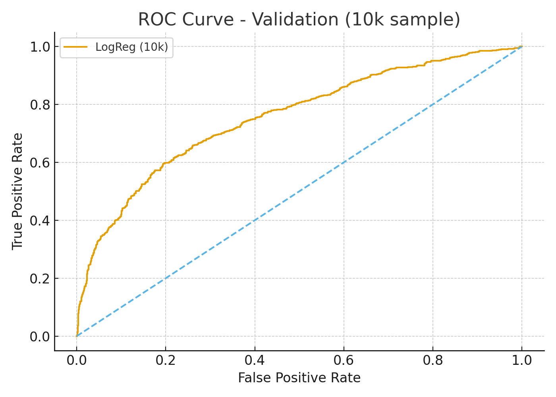
ROC Curve (Validation — 10k Sample)

Slide 6
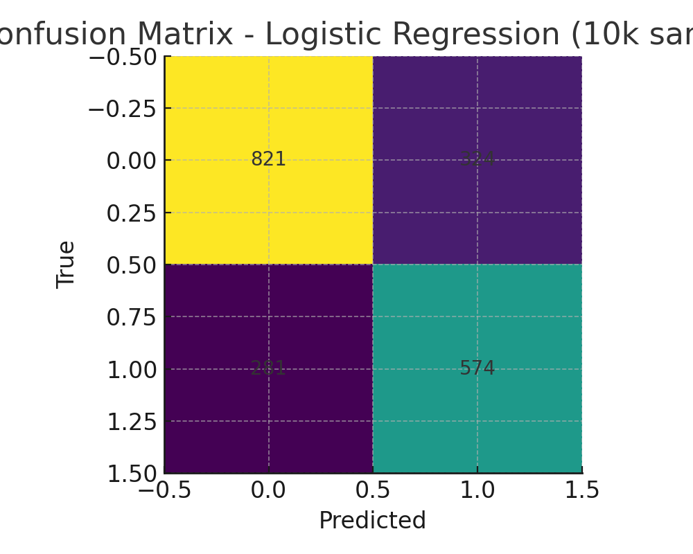
Confusion Matrix — Logistic Regression (10k Sample)

Slide 7
Improvements from CP1 & Next Steps
Added time-based features; unified preprocessing pipeline
Next: hyperparameter tuning; try tree-based models & stacking
Interpretability (SHAP) and deployment plan (batch scoring)

