Slide 1

SIGN UP

Slide 2
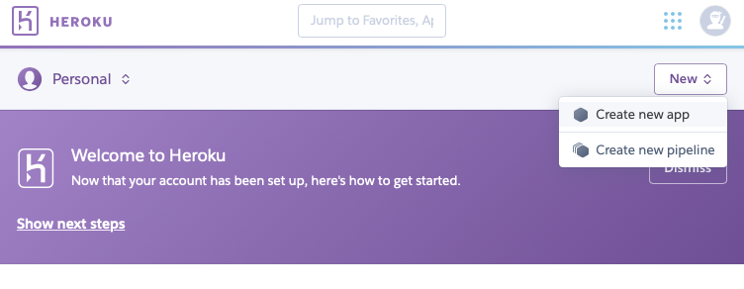
Create a new app

Slide 3
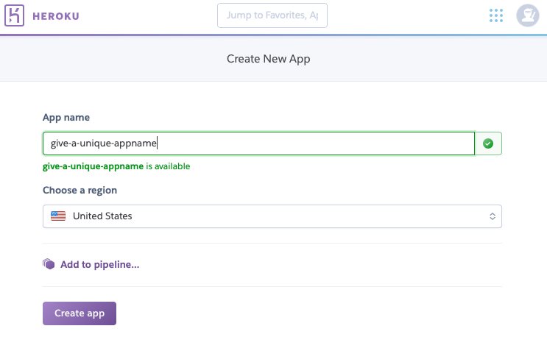
Name your app

Slide 4
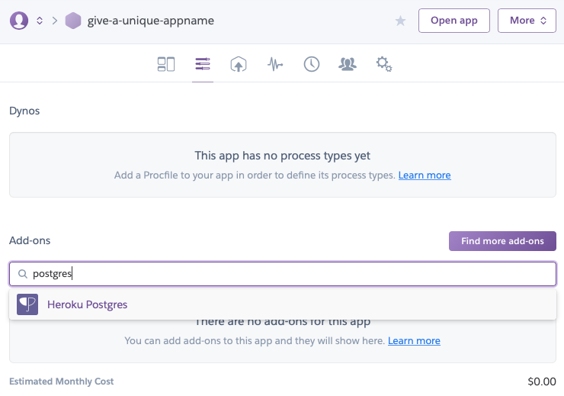

Slide 5
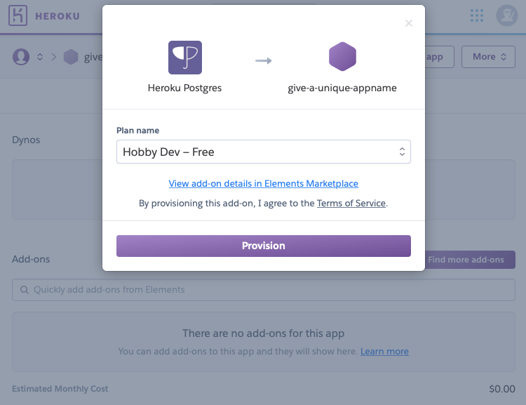

Slide 6
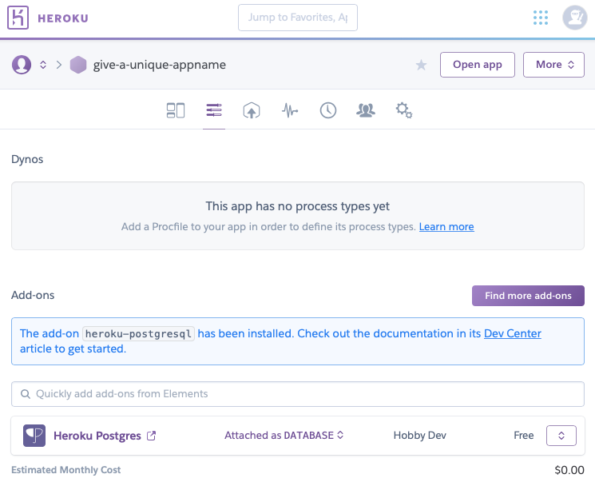

Slide 7
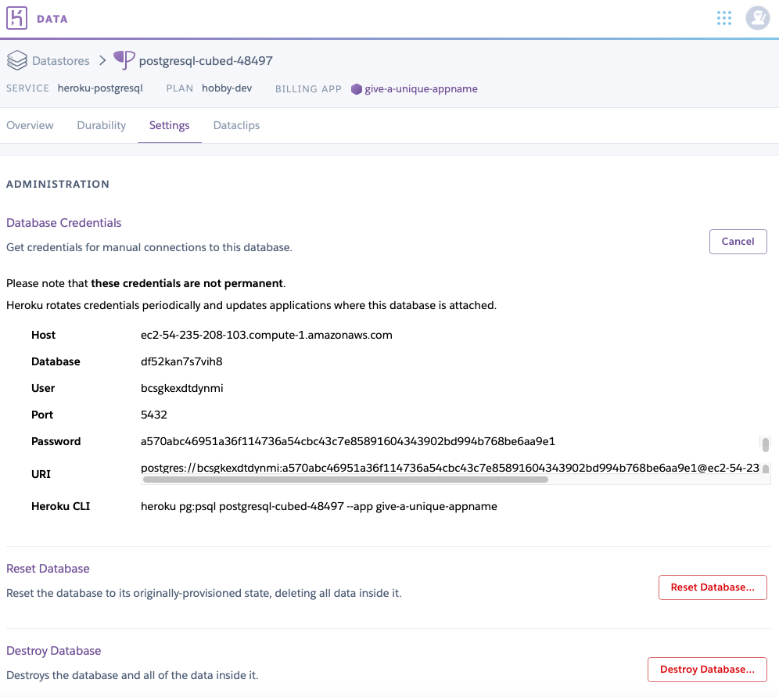
Paste your DB host in Google Form, in order for RI IT department to allow Postgres traffic from school network
https://tinyurl.com/y483hubw

Slide 8
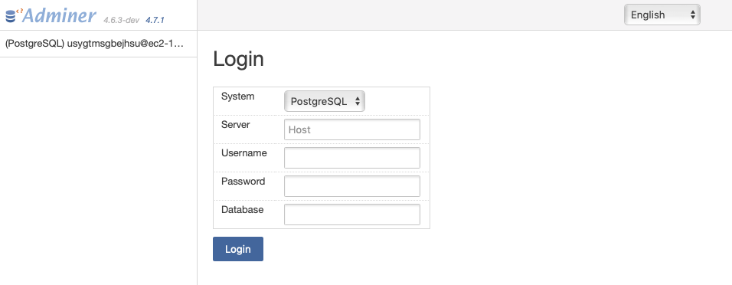
GUI DB administration https://adminer.cs50.net

Slide 9
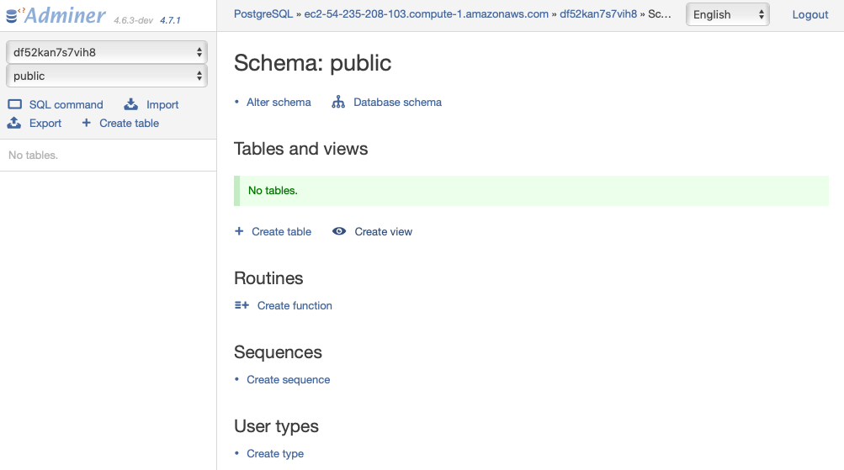

Slide 10
Relational Databases
Structured Query Language
PostgreSQL

Slide 11
origin | destination | duration
New York | London | 415
Shanghai | Paris | 760
Istanbul | Tokyo | 700
New York | Paris | 435
Moscow | Paris | 245
Lima | New York | 455

Slide 12
Data Types
INTEGER
DECIMAL
SERIAL
VARCHAR
TIMESTAMP
BOOLEAN
ENUM
Notes:
Serial – Auto-increment
Varchar – variable length of characters
Enum – one of finite discrete values e.g. [‘Mon’, ‘Tue’, ‘Wed’, ’Thu’, ‘Fri’, ‘Sat’, ‘Sun’]

Slide 13
CREATE.sql

Slide 14
CREATE syntax
CREATE TABLE table_name (
column_name TYPE column_constraint
);
CREATE TABLE employees (
id serial PRIMARY KEY,
first_name VARCHAR (50),
last_name VARCHAR (50),
birth_date DATE CHECK (birth_date > '1900-01-01’),
joined_date DATE CHECK (joined_date > birth_date),
salary numeric CHECK(salary > 0)
);
Column Constraint
NOT NULL – the value of the column cannot be NULL.
UNIQUE – the value of the column must be unique across the whole table. However, the column can have many NULL values because PostgreSQL treats each NULL value to be unique. Notice that SQL standard only allows one NULL value in the column that has the UNIQUE constraint.
PRIMARY KEY – this constraint is the combination of NOT NULL and UNIQUE constraints. You can define one column as PRIMARY KEY by using column-level constraint. In case the primary key contains multiple columns, you must use the table-level constraint.
CHECK – enables to check a condition when you insert or update data. For example, the values in the price column of the product table must be positive values.

Slide 15
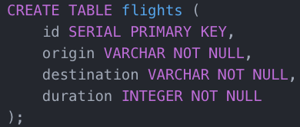
CREATE

Slide 16
SELECT.sql

Slide 17
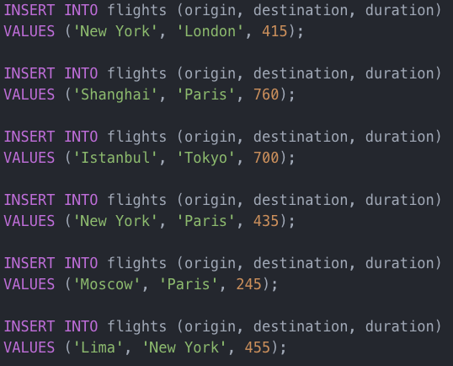
INSERT
INSERT INTO table(column1, column2, …)
VALUES (value1, value2, …);

Slide 18

id | origin | destination | duration
1 | New York | London | 415
2 | Shanghai | Paris | 760
3 | Istanbul | Tokyo | 700
4 | New York | Paris | 435
5 | Moscow | Paris | 245
6 | Lima | New York | 455

Slide 19
id | origin | destination | duration
1 | New York | London | 415
2 | Shanghai | Paris | 760
3 | Istanbul | Tokyo | 700
4 | New York | Paris | 435
5 | Moscow | Paris | 245
6 | Lima | New York | 455

Slide 20
id | origin | destination | duration
1 | New York | London | 415
2 | Shanghai | Paris | 760
3 | Istanbul | Tokyo | 700
4 | New York | Paris | 435
5 | Moscow | Paris | 245
6 | Lima | New York | 455

Slide 21
id | origin | destination | duration
1 | New York | London | 415
2 | Shanghai | Paris | 760
3 | Istanbul | Tokyo | 700
4 | New York | Paris | 435
5 | Moscow | Paris | 245
6 | Lima | New York | 455

Slide 22
id | origin | destination | duration
1 | New York | London | 415
2 | Shanghai | Paris | 760
3 | Istanbul | Tokyo | 700
4 | New York | Paris | 435
5 | Moscow | Paris | 245
6 | Lima | New York | 455

Slide 23

id | origin | destination | duration
1 | New York | London | 415
2 | Shanghai | Paris | 760
3 | Istanbul | Tokyo | 700
4 | New York | Paris | 435
5 | Moscow | Paris | 245
6 | Lima | New York | 455

Slide 24

id | origin | destination | duration
1 | New York | London | 415
2 | Shanghai | Paris | 760
3 | Istanbul | Tokyo | 700
4 | New York | Paris | 435
5 | Moscow | Paris | 245
6 | Lima | New York | 455

Slide 25

id | origin | destination | duration
1 | New York | London | 415
2 | Shanghai | Paris | 760
3 | Istanbul | Tokyo | 700
4 | New York | Paris | 435
5 | Moscow | Paris | 245
6 | Lima | New York | 455

Slide 26

id | origin | destination | duration
1 | New York | London | 415
2 | Shanghai | Paris | 760
3 | Istanbul | Tokyo | 700
4 | New York | Paris | 435
5 | Moscow | Paris | 245
6 | Lima | New York | 455

Slide 27
Functions
SUM
COUNT
MIN
MAX
AVG
…

Slide 28
UPDATE

Slide 29

id | origin | destination | duration
1 | New York | London | 415
2 | Shanghai | Paris | 760
3 | Istanbul | Tokyo | 700
4 | New York | Paris | 435
5 | Moscow | Paris | 245
6 | Lima | New York | 455
430

Slide 30
id | origin | destination | duration
1 | New York | London | 415
2 | Shanghai | Paris | 760
3 | Istanbul | Tokyo | 700
4 | New York | Paris | 435
5 | Moscow | Paris | 245
6 | Lima | New York | 455
430

Slide 31
DELETE.sql

Slide 32

id | origin | destination | duration
1 | New York | London | 415
2 | Shanghai | Paris | 760
3 | Istanbul | Tokyo | 700
4 | New York | Paris | 435
5 | Moscow | Paris | 245
6 | Lima | New York | 455
id | origin | destination | duration
1 | New York | London | 415
2 | Shanghai | Paris | 760
4 | New York | Paris | 435
5 | Moscow | Paris | 245
6 | Lima | New York | 455

Slide 33
CLAUSES.sql

Slide 34
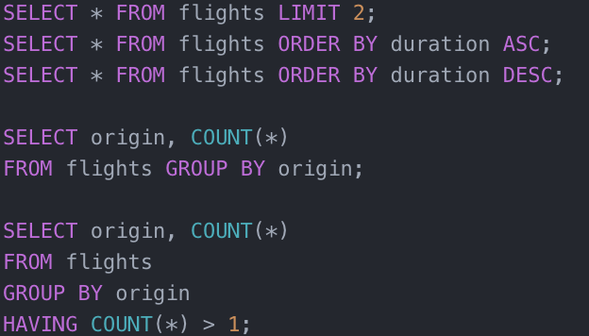

Slide 35
Foreign Key

Slide 36
flights
id | origin | destination | duration
1 | New York | London | 415
2 | Shanghai | Paris | 760
3 | Istanbul | Tokyo | 700
4 | New York | Paris | 435
5 | Moscow | Paris | 245
6 | Lima | New York | 455

Slide 37
flights
id | origin | origin_code | destination | destination_code | duration
1 | New York | JFK | London | LHR | 415
2 | Shanghai | PVG | Paris | CDG | 760
3 | Istanbul | IST | Tokyo | NRT | 700
4 | New York | JFK | Paris | CDG | 435
5 | Moscow | SVO | Paris | CDG | 245
6 | Lima | LIM | New York | JFK | 455
Notes:
Notice that there are repeated data --> redundancy

Slide 38
locations
id | code | name
1 | JFK | New York
2 | PVG | Shanghai
3 | IST | Istanbul
4 | LHR | London
5 | SVO | Moscow
6 | LIM | Lima
7 | CDG | Paris
8 | NRT | Tokyo

Slide 39
flights
id | origin_id | destination_id | duration
1 | 1 | 4 | 415
2 | 2 | 7 | 760
3 | 3 | 8 | 700
4 | 1 | 7 | 435
5 | 5 | 7 | 245
6 | 6 | 1 | 455
Notes:
Seems harder to read for humans, but database can handle it really well.

Slide 40
passengers
id | name | flight_id
1 | Alice | 1
2 | Bob | 1
3 | Charlie | 2
4 | David | 2
5 | Erin | 4
6 | Frank | 6
7 | Grace | 6

Slide 41
Joins
Combining data from multiple tables

Slide 42
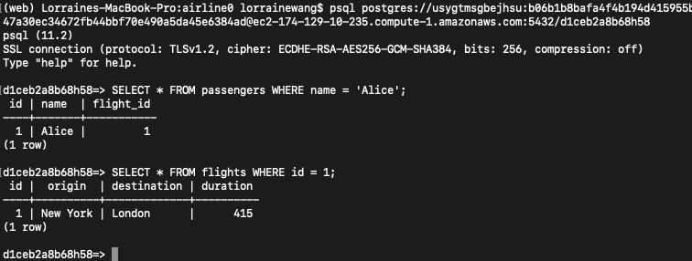
Finding out which flight Alice is on
Would be good if I can join these 2 queries into 1??

Slide 43
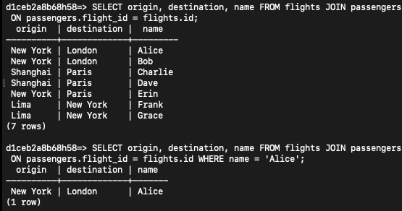
Using JOINS (also known as INNER JOINS)

Slide 44
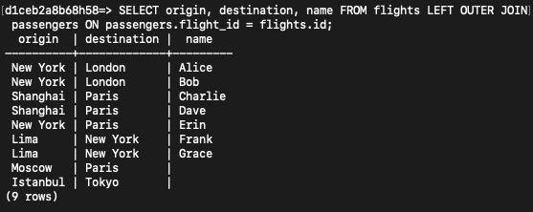
What about returning all flight information, including flights that do not have any passengers

Slide 45
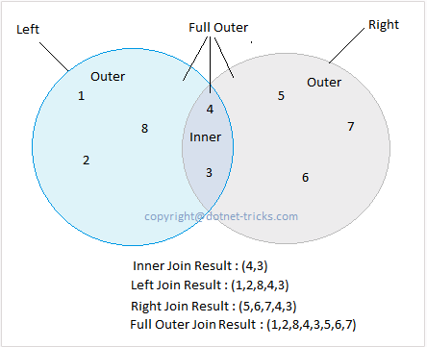
JOINS
JOIN / INNER JOIN
LEFT OUTER JOIN
RIGHT OUTER JOIN
FULL OUTER JOIN

Slide 46
CREATE INDEX
The CREATE INDEX statement is used to create indexes in tables.
Indexes are used to retrieve data from the database very fast. The users cannot see the indexes, they are just used to speed up searches/queries.
Notes:
Why won’t you create indexes for every column in the table? Extra space will be used to create the indexes. While index speeds up the lookup speed of the query, it degrades update and insert queries as the indexes will need to be updated accordingly. So that is always a trade-off. No free lunch.

Slide 47
Nested Queries
Combine multiple queries

Slide 48
flights
id | origin | destination | duration
1 | New York | London | 415
2 | Shanghai | Paris | 760
3 | Istanbul | Tokyo | 700
4 | New York | Paris | 435
5 | Moscow | Paris | 245
6 | Lima | New York | 455

Slide 49
passengers
id | name | flight_id
1 | Alice | 1
2 | Bob | 1
3 | Charlie | 2
4 | David | 2
5 | Erin | 4
6 | Frank | 6
7 | Grace | 6

Slide 50
SELECT flight_id FROM passengers GROUP BY flight_id HAVING COUNT(*) > 1;
id | name | flight_id
1 | Alice | 1
2 | Bob | 1
3 | Charlie | 2
4 | David | 2
5 | Erin | 4
6 | Frank | 6
7 | Grace | 6
flight_id
1
2
6

Slide 51
SELECT flight_id FROM passengers GROUP BY flight_id HAVING COUNT(*) > 1;
flight_id
1
2
6

Slide 52
SELECT * FROM flights WHERE id IN (SELECT flight_id FROM passengers GROUP BY flight_id HAVING COUNT(*) > 1);
id | origin | destination | duration
1 | New York | London | 415
2 | Shanghai | Paris | 760
3 | Istanbul | Tokyo | 700
4 | New York | Paris | 435
5 | Moscow | Paris | 245
6 | Lima | New York | 455
flight_id
1
2
6

Slide 53
SELECT * FROM flights WHERE id IN (SELECT flight_id FROM passengers GROUP BY flight_id HAVING COUNT(*) > 1);
id | origin | destination | duration
1 | New York | London | 415
2 | Shanghai | Paris | 760
3 | Istanbul | Tokyo | 700
4 | New York | Paris | 435
5 | Moscow | Paris | 245
6 | Lima | New York | 455
flight_id
1
2
6

Slide 54
Security

Slide 55
SQL Injection

Slide 56
Username
Password
What query will you construct to check if the user is a valid user in your system?

Slide 57
SELECT * FROM myusers
WHERE (username = username)
AND (password = password);

Slide 58
SELECT * FROM myusers
WHERE (username = 'alice')
AND (password = '1' OR '1' = '1');

Slide 59
Username
alice
Password
1’ OR ‘1’ = ‘1

Slide 60
SELECT * FROM myusers
WHERE (username = username)
AND (password = password);

Slide 61
SELECT * FROM myusers
WHERE (username = 'alice')
AND (password = '1' OR '1' = '1');

Slide 62
Race Conditions

Slide 63
Race Conditions
Bank Account
$100
SELECT balance FROM bank
WHERE user_id = 1;
100
UPDATE bank
SET balance = balance – 100
WHERE user_id = 1;
$100

Slide 64
Race Conditions
Bank Account
$100
SELECT balance FROM bank
WHERE user_id = 1;
SELECT balance FROM bank
WHERE user_id = 1;
100
100
UPDATE bank
SET balance = balance – 100
WHERE user_id = 1;
UPDATE bank
SET balance = balance – 100
WHERE user_id = 1;
$100
$100

Slide 65
SQL Transactions
BEGIN
COMMIT

Slide 66
SQL Transactions
BEGIN
COMMIT

Slide 67
SQLAlchemy

Slide 68
list.py
Fetching data from Postgres DB

Slide 69
import.py
Batch insert

Slide 70
passenger.py
Successive queries on the database over multiple tables

Slide 71
airline0

Slide 72
airline1

