Slide 1
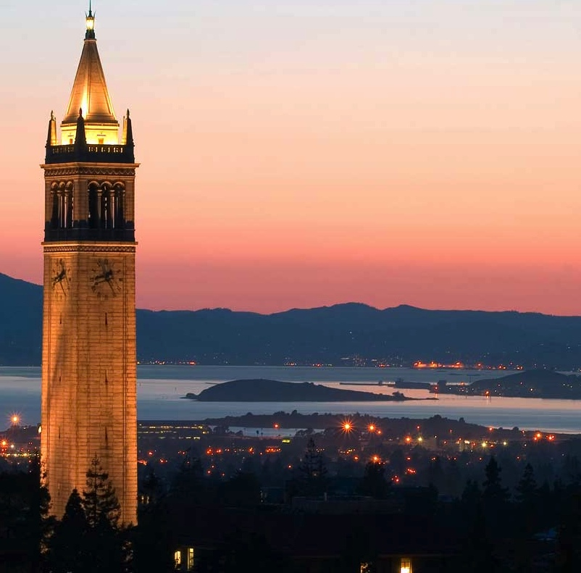


Data-X Master Class
Reflection and Next Steps
Hong Kong Jan 2018
Ikhlaq Sidhu Chief Scientist & Founding Director Sutardja Center for Entrepreneurship & Technology Department of Industrial Engineering & Operations Research IEOR Emerging Area Professor Award
Notes:
Welcome
* Introduce self and each other
* Parts of Talk:
Data Models (Biz)
ML Topics (slightly technical, but will make it understandable)
Then considerations for Organizations and Leadership/Innovation

Slide 2
Reflection and Next Steps
Continue in context of project discussion if time permits …
Learning Summary and Discussion – reflect on valuable portions to you.
Future Roadmap – what are your next challenges?
More materials at data-x.blog
Staying Connected – How can we continue to help with networks, student projects, or other ideas?

Slide 3
 | Day 1: Breadth | Day 2: Depth
Session 1 9 - 10.20am | Program Introduction with Objectives (20mins) Executive Level Overview of AI, ML, and Research (40mins) Introduction to tools and installations (20mins) | Innovation Leadership Overview (30mins) Getting and Working with Data (50mins)
Session 2 10.40 - noon | Define Projects A. Learning basics B. Defining Work Project C. Improving Existing Project Finalize projects | Architecture Discussion / Feedback with Lowtech demo presentations (80mins)
Lunch 12 - 1.30pm | Possible discussion and work sessions | Possible discussion and work sessions
Session 3 1.30 - 3.00pm | Standard AI Development Stack: Numpy, pandas, matplotlib Includes a Breakout HW Session | Advanced Topics: Neural Networks, TensorFlow, Computer Vision, Keras and Cats vs Dogs! (75mins) Q&A on Advanced topics in Data Science (15mins)
Session 4 3.30 - 5.00pm | Machine Learning in Python: Real World Data and Example (60 mins) ML Algorithm Comparison (20mins) Reflection and Q & A | Reflection and Next Steps: Learning Summary and Discussion Future Roadmap Staying Connected
Homework | Assigned Lowtech demo for Day 2 Be prepared to discuss challenges in project implementation
Our Agenda and Purpose
2-Day Version of full course
Learn the ML tools/stack
Code samples / basic theory
Starting point to go further
Project Options:
Learning basics
Defining Work Project
Improving Existing Project
Additional Goals:
Teams – meet each other
Diversity in perspective
Pay it forward
Global resources
Staying connected

Slide 4
