Slide 1

CompTIA Network +
Chapter 1
Introducing Computer Networks

Slide 2

Objectives
What is the purpose of a network?
What are some examples of network components?
How are networks defined by geography?
How are networks defined by topology?
How are networks defined by resource location?

Slide 3

Introducing Computer Networks
What comes to mind when you thinks of a computer network?
Is it the Internet?
Is it e-mail?
Is it the wireless connection that lets you print to your printer from your laptop?
Whatever your current perception of a computer network , this chapter and book, as a whole, helps you gain a deep appreciation and understanding of networked computing.

Slide 4
Defining a Network
A (computer) network is an interconnection of two or more computing devices.
It can serve a variety of purposes including:
File sharing between two computers
Video chatting across different parts of the world
Surfing the Web
Instant messaging (IM) between computer with IM software installed.
E-mail
Voice over IP (VoIP)
A converged network is one that transports multiple forms of traffic (video, voice, and data)

Slide 5
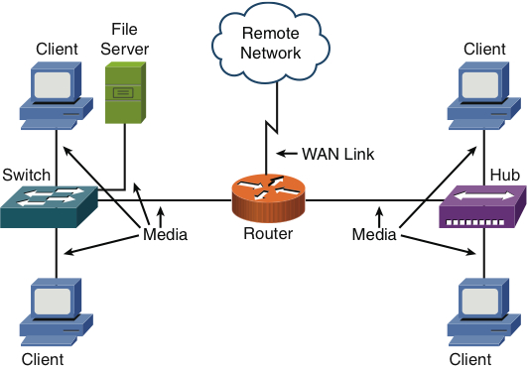
Overview of Network Components
Figure 1-1 Sample Computer Network

Slide 6
Overview of Network Components
Client: The term client defines the device an end user uses to access a network.
Server: A server provides resources to a network. (Email, Web pages, or files)
Hub: A hub is an older technology that interconnects network components. A hub broadcasts messages to all connected devices other than the recipient.

Slide 7
Overview of Network Components
Switch: A switch interconnects network components. Unlike a hub, a switch makes forwarding decisions based on physical addresses.
Physical Address is burned into the NIC, usually a MAC Address
Router: A router is connection device that makes forwarding decisions based on logical network addresses.
Logical Address is determined by physical location, usually an IP Address
Media: The media is the physical substance on which the information of the system travels, such as copper wire for carrying electronic signals.
WAN link: Most networks connect to one or more other networks. The link that interconnects those networks is typically referred to as a wide-area network (WAN) link.

Slide 8
Network Defined by Geography
Local-area network (LAN)
Wide-area network (WAN)
Campus-area network (CAN)
Metropolitan-area network (MAN)
Personal-area network (PAN)

Slide 9
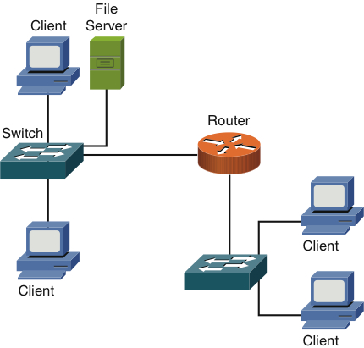
LAN
Figure 1-2 Sample LAN Topology

Slide 10
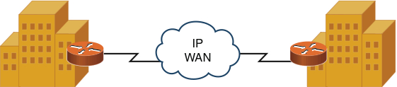
WAN
Figure 1-3 Sample WAN Topology

Slide 11
Other Area Networks
CAN: A CAN is created from interconnecting multiple LANs
MAN: A MAN is between a LAN and a WAN, typically covering a metropolitan area such as three office branches in the same city.
PAN: A PAN is created from the interconnection of personal devices such as a phone, headset, and portable tablet.

Slide 12
Network Defined by Topology
In addition to classifying networks based on the geographical placement of their components, another approach to classifying a network is to use the networks topology.
There are two major topology groupings
Physical Topology
Logical Topology

Slide 13
Network Defined by Topology
Physical Versus Logical Topology
Physical Topology -- how components are physical interconnected determines the physical topology
Logical Topology -- the actual traffic flow determines the logical topology

Slide 14
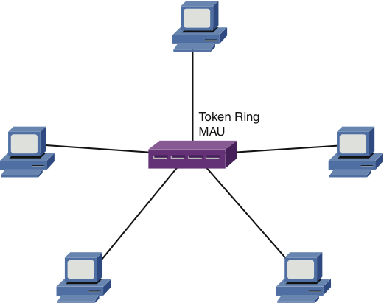
Network Defined by Topology
Figure 1-4 Physical Star Topology

Slide 15
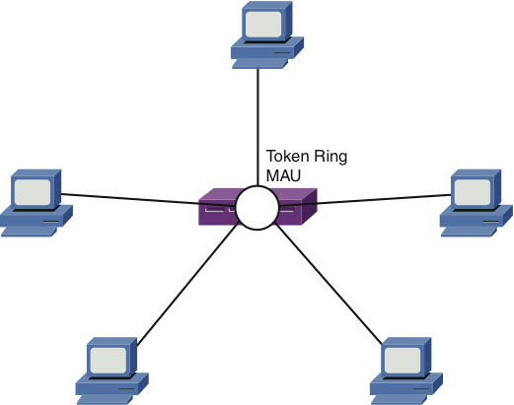
Network Defined by Topology
Figure 1-5 Logical Ring Topology

Slide 16
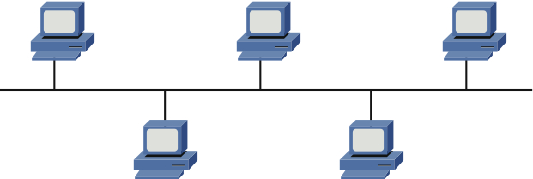
Bus Topology
Figure 1-6 Bus Topology

Slide 17
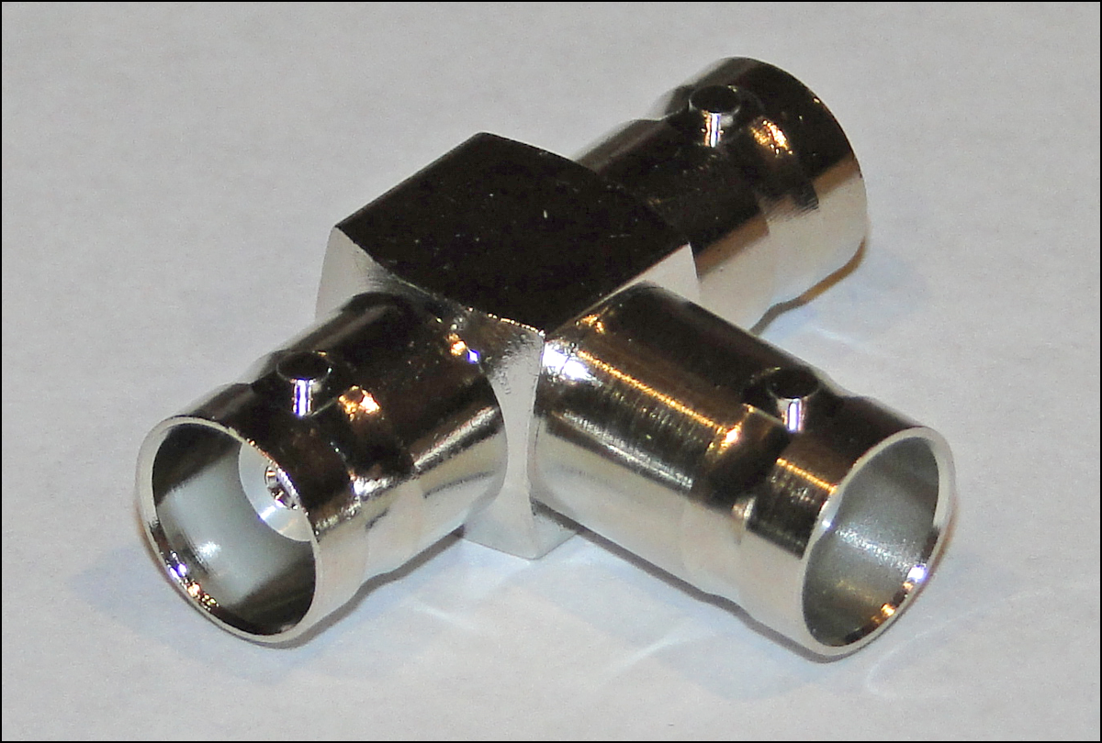
Bus Topology
Figure 1-7 T Connector

Slide 18
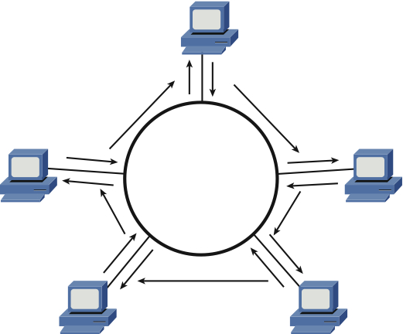
Ring Topology
Figure 1-8 Ring Topology

Slide 19
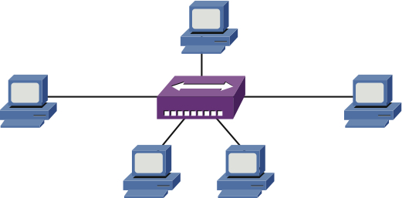
Star Topology
Figure 1-9 Star Topology

Slide 20
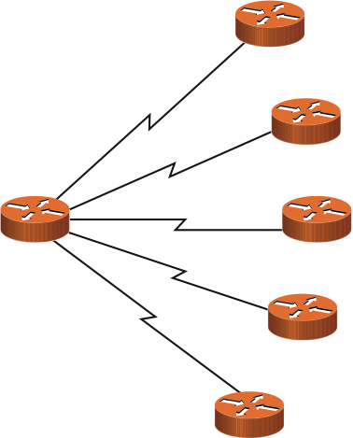
Hub-and-Spoke Topology
Figure 1-10 Hub-and-Spoke Topology

Slide 21
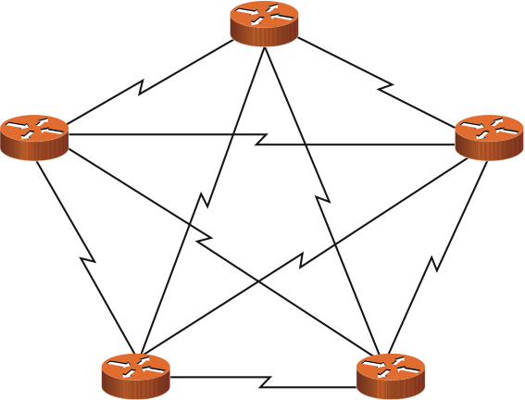
Full-Mesh Topology
Figure 1-11 Full-Mesh Topology

Slide 22
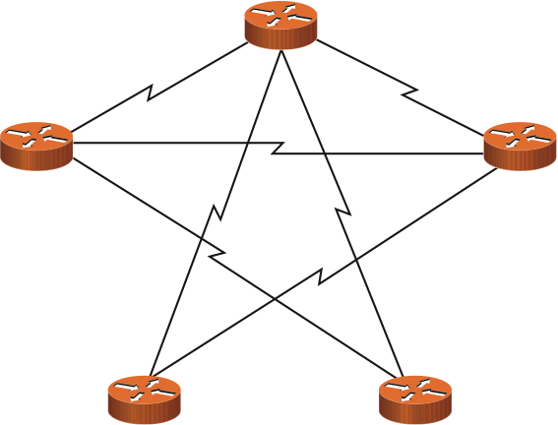
Partial-Mesh Topology
Figure 1-12 Partial-Mesh Topology

Slide 23
Network Defined by Resource Location
Yet another way to categorize networks is based on where network resources reside.
Network that have all the resources residing in a server are called client –server networks.
Network that have their resources on several clients and no server is called a peer-to-peer network

Slide 24
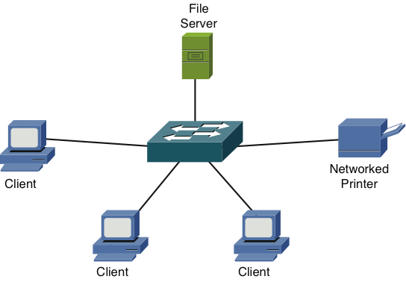
Client-Server Network
Figure 1-13 Client-Server Network Example

Slide 25
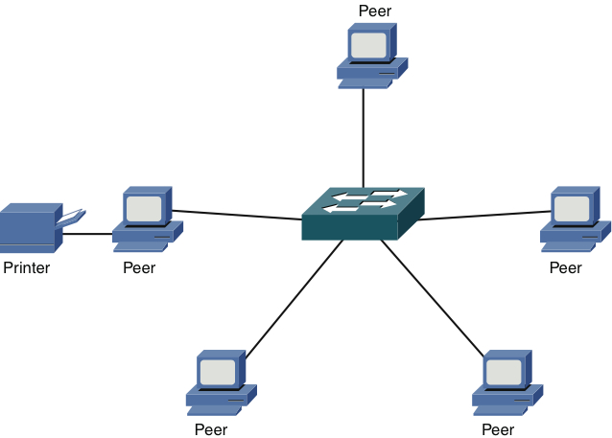
Peer-to-Peer Network
Figure 1-14 Peer-to-Peer Network Example

