Slide 1

CompTIA Network +
Chapter 10
Using Command-Line Utilities

Slide 2

Objectives
What are some of the more useful Microsoft Windows command for configuring and troubleshooting network client and servers?
What are some of the more useful UNIX/LINUX command for configuring and troubleshooting network client and servers?

Slide 3
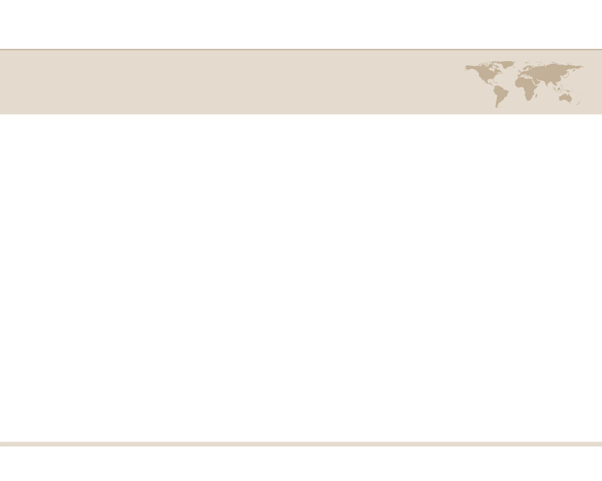
Using Command-Line Utilities
Your configuration and troubleshooting of networks will undoubtedly involve issuing command at an operating system (OS) prompt of an end-user computer (a client) or a server.
Some commands, you will notice, exist on both Microsoft Windows and UNIX/LINUX platforms.

Slide 4
Windows Commands
arp -- this command can be used to see what a Layer 2 MAC address corresponds to a known Layer3 IP address.
ipconfig – this command can be used to display IP address configuration parameters on a Windows PC.

Slide 5
Windows Commands
nbtstat – this command display NetBIOS information for IP-based networks.
netstat – command can be used to display various information about IP-based connection on a PC.
You can view information about current sessions, including source and destination IP address and port numbers.

Slide 6
Windows Commands
nslookup – this command can be used to resolve an FQDN to an IP address.
ping – this command is used to check IP connectivity between two network devices.

Slide 7
Windows Commands
route – command can display a PC’s current IP routing table.
tracert – this command pings every router hop from the source to the destination and reports the round-trip time for each router hop.

Slide 8
Unix Commands
man – this command is used to find information how to use a UNIX command.
arp -- this command can be used to see what a Layer 2 MAC address corresponds to a known Layer3 IP address.

Slide 9
Unix Commands
dig and nslookup – these commands can be used to resolve FQDNs to IP addresses.
The dig command returns more information
host – is another command that will resolve FQDNs to IP addresses.

Slide 10
Unix Commands
ifconfig – this command can be used to display IP address configuration parameters on a Windows PC.
traceroute – this command pings every router hop from the source to the destination and reports the round-trip time for each router hop.

Slide 11
Unix Commands
netstat – command can be used to display various information about IP-based connection on a PC.
You can view information about current sessions, including source and destination IP address and port numbers.
ping – this command is used to check IP connectivity between two network devices.
Unlike the windows version you must give a count or the number of pings to conduct.

Slide 12

Summary
A collection of Windows CLI commands can be useful to monitor and troubleshoot a network. These commands include arp, ipconfig, nbtstat, netstat, nslookup, ping, route, and tracert.
A collection of UNIX CLI commands include man, arp, ifconfig, netstat, host, dig, nslookup, ping, route, and traceroute.

