Slide 1

CompTIA Network +
Chapter 12
Securing a Network

Slide 2

Objectives
What are the goals of network security, and what sorts of attacks do you need to defend against?
What best practices can be implemented to defend against security threats?
What are the characteristics of various remote-access security technologies?

Slide 3
Objectives
How can firewalls be used to protect an organization’s internal network, while allowing connectivity to an untrusted network, such as the Internet?
How can virtual private networks (VPN) be used to secure traffic as that traffic flows over an untrusted network?
What is the difference between intrusion prevention and intrusion detection systems, and how do they protect an organization form common security threats?

Slide 4

Securing a Network
Today’s networks are increasingly dependent on connectivity with other networks.
However, connecting an organization’s trusted network to untrusted network’s such as the Internet, introduces security risks.
To protect your organization’s data from malicious users, you need to understand the types of threats against which you might have to defend.

Slide 5
Security Fundamentals
For most of today’s corporate networks, the demands of e-commerce and customer contact require connectivity between internal corporate networks and the outside world.
All networks require network security

Slide 6
Three Primary Goals of Network Security
Confidentiality – keeping the data private
Integrity – ensures that data has not been modified
Availability – the data is accessible when needed

Slide 7
Security Fundamentals
C I A
Availability
Confidentiality
Data
Integrity

Slide 8
Security Fundamentals
Confidentiality can be provided by encryption.
Encryption has two basic forms:
Symmetric encryption -- implies that the same key is used by both the sender and receiver to encrypt and decrypt a packet.
DES is an old, insecure protocol
3DES and AES are much better
Asymmetric encryption -- uses different keys for the sender and receiver of a packet
RSA is the most common system, used by HTTPS

Slide 9
Security Fundamentals
Integrity can be provided by hashing
Hash value is like a fingerprint of the data
Any alteration in data changes the hash
Ethernet uses CRC32 to detect transmission errors
MD5 is an old, insecure hash function
SHA-1, SHA-2, and SHA-3 are newer and more secure

Slide 10
Security Fundamentals
Availability can be provided by fault tolerance
Attacks on availability are called Denial of Service (DoS) attacks
A DoS attack from many machines is called a Distributed Denial of Service (DDoS) attack

Slide 11
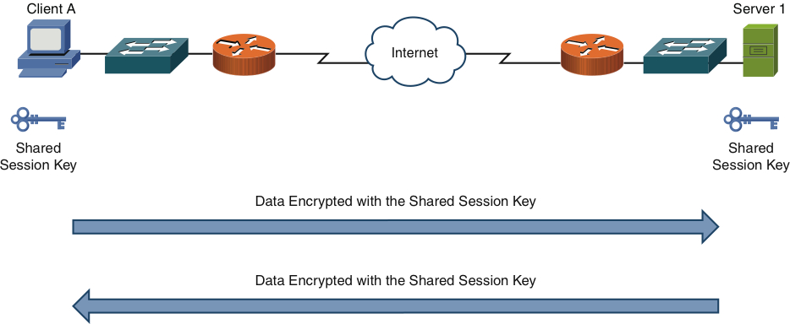
Security Fundamentals
Figure 12-1 Symmetric Encryption Example

Slide 12
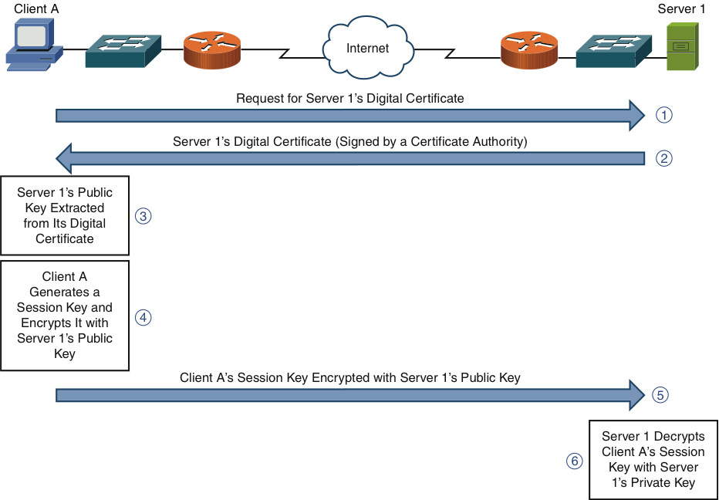
Security Fundamentals
Figure 12-2 Asymmetric Encryption Example

Slide 13
Security Fundamentals
Categories of Network Attacks
Confidentiality Attacks
Makes confidential data visible to an attacker
Integrity Attacks
Alters data in transit or at rest
Availability Attacks
Makes system unavailable to authorized users

Slide 14
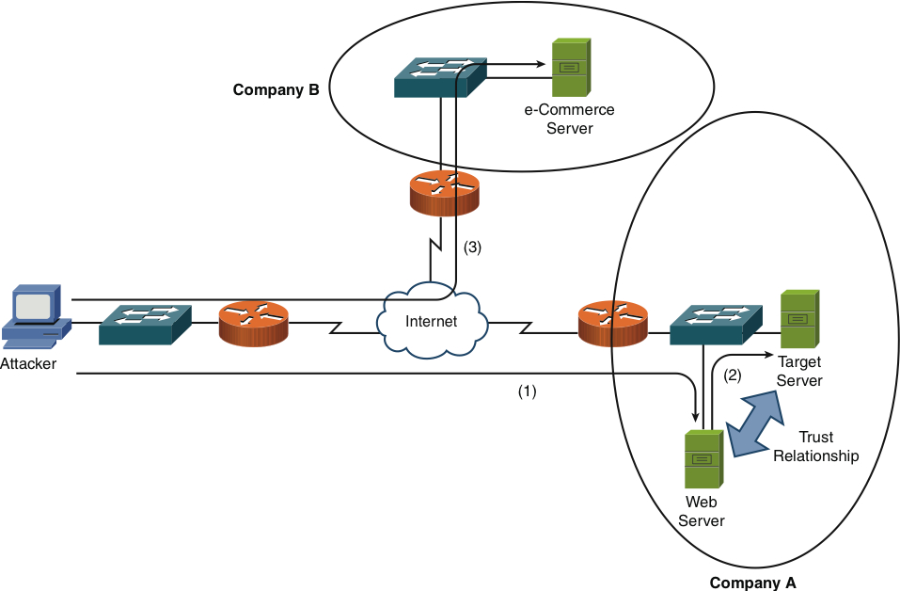
Security Fundamentals
Figure 12-3 Confidentiality Attack Example
Attacker compromises the Web server, then pivots to attack the database server

Slide 15
Security Fundamentals
Attack techniques
Packet capture
Ping sweep and port scan
Dumpster diving
Electromagnetic emanations
Wiretapping telephone lines
Social engineering
Steganography
Covert channels
Bouncing attack

Slide 16
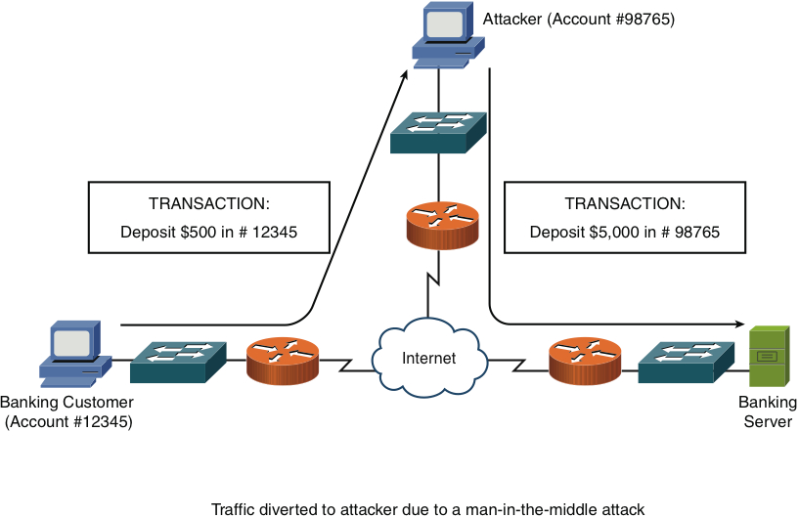
Security Fundamentals
Figure 12-4 Integrity Attack

Slide 17
Security Fundamentals
Integrity Attack Methods
Salami attack (many small alterations)
Data diddling (changes data before it is stored)
Virus (attached to an EXE file)
Worm (travels through a network)
Trojan (masquerades as innocent software)
Trust relationship exploitation
Botnet
Session hijacking

Slide 18
Security Fundamentals
Password attacks
Keylogger (steal keypresses)
Packet capture
Brute force (guess all possible passwords)
Dictionary (try passwords from a dictionary)

Slide 19
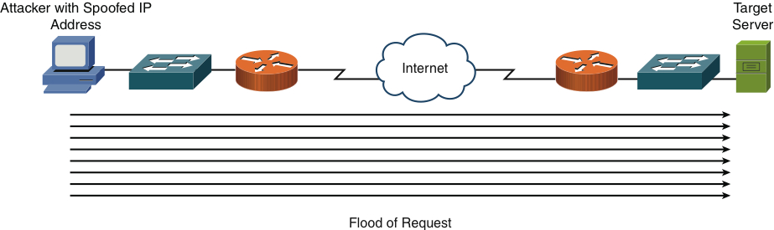
Security Fundamentals
Figure 12-5 DoS Attack

Slide 20
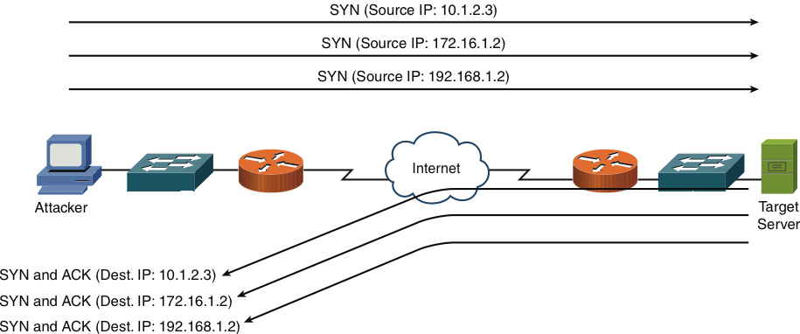
Security Fundamentals
Figure 12-6 TCP SYN Flood Attack Example

Slide 21
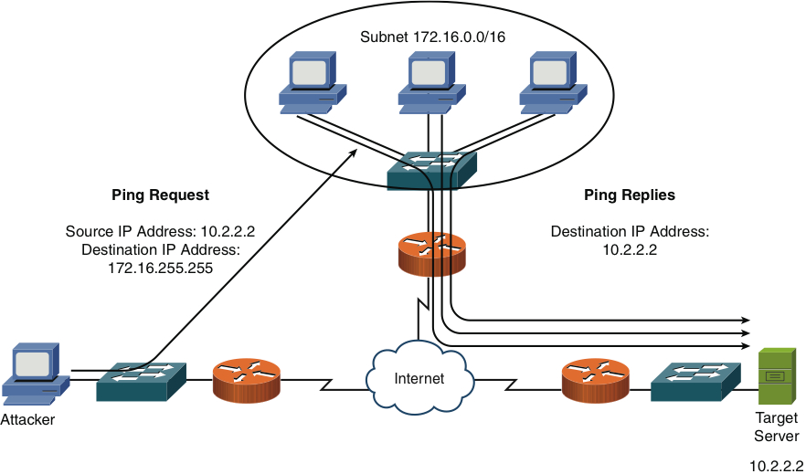
Security Fundamentals
Figure 12-7 Smurf Attack Example

Slide 22
Security Fundamentals
Availability Attacks
DoS
DDoS
SYN flood
Buffer overflow
ICMP flood (Smurf attack)

Slide 23
Security Fundamentals
Electrical Disturbances
At a physical level, an attacker could launch an availability attack by interrupting or interfering with electrical service available to a system, such as the following:
Power Spikes
Electrical surges
Power faults
Blackouts
Power sag
Brownout
To combat these threats, you might want to install uninterruptable power supplies (UPS) and generator backup for strategic devices in your network.

Slide 24
Security Fundamentals
Attacks on a System’s Physical Environment
Attackers could also intentionally damage computing equipment by influencing the equipment’s physical environment.
Temperature
Humidity
Gas
Consider the following recommendations to mitigate such environmental threats:
Computing facilities should be locked.
Access should require access credentials
Access point should be visually monitored.
Climate control system should be monitored.
Fire detection and suppression systems should not do damage to computer equipment if possible.

Slide 25
Defending Against Attacks
Now that we have an understanding of security fundamentals, it is now time to talk about how to defend against security threats using network devices.
User Training
Many attacks require user intervention in order to be carried out.
For example a user needs to execute an application containing a virus before the virus takes any actions.
Similarly, social engineering requires a user to give sensitive information to an attacker in order for the attacker to access the user’s account.

Slide 26
Defending Against Attacks
User Training (cont.)
As a result, several potential attacks can be thwarted through effective user training.
As a few examples, users could be trained on using polices such as the following:
Never give your password to anyone, even if they claim to be from IT.
Do not open e-mail attachments from unknown sources.
Select strong passwords, consisting of at least eight characters and containing a mixture of alphabetical (upper- and lowercase), numeric, and special characters.
Change your password monthly (or more often)

Slide 27
Defending Against Attacks
Patching
Some attacks are directed at vulnerabilities known to exist in various Oss and applications.
As these are discovered, the vendors of the OSs, or application often respond by releasing a patch.
A patch is designed to correct a known bug of fix a know vulnerability in a piece of software
A network administrator should have a plan for implementing patches as they become available.

Slide 28
Defending Against Attacks
Security Policies
One of the main reasons security breaches occur within an organization is the lack of a security policy or, if a security policy is in place, the lack of effectively communicating/enforcing that security policies to all concerned.
A security policy is a continually changing document that dictates a set of guidelines for network use.
The main purpose of a security policy is to protect the asset of an organization.
Asset – intellectual property, processes and procedures, sensitive customer data, and specific server functions.

Slide 29
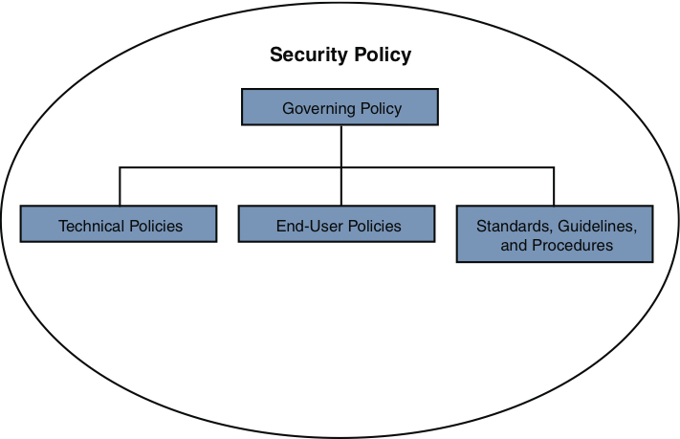
Defending Against Attacks
Figure 12-8 Components of a Security Policy

Slide 30
Security Fundamentals
Incident Response
Everyone will get hacked
Respond effectively
Contain damage
Reverse harm
Improve security to prevent repeated attack

Slide 31
Defending Against Attacks
Vulnerability Scanners
After you deploy your network-security solution, components of that solution might not behave as expected.
Additionally, you might not be aware of some of the vulnerabilities in your network devices.
You should periodically test your network for weakness.
These test can be performed using application designed to check for a variety of known weakness.
These application are known as vulnerability scanners.
Nessus is a full vulnerability scanner
Nmap (actually just a port scanner, not a full vulnerability scanner)

Slide 32
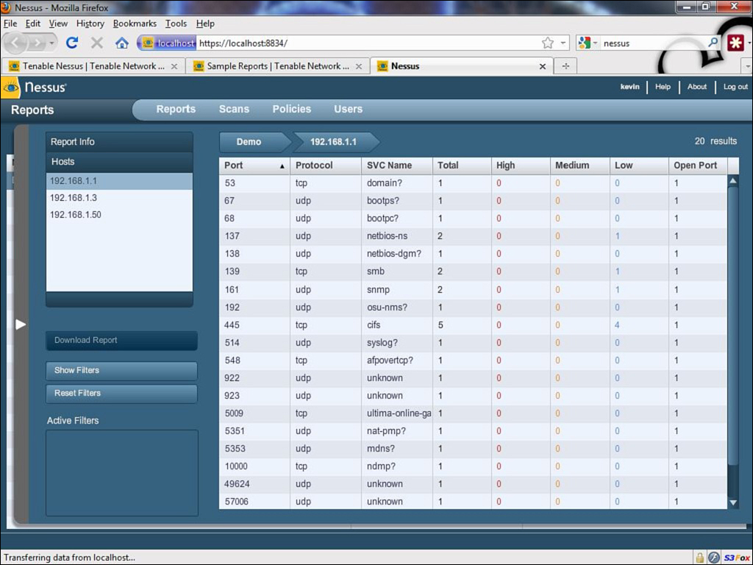
Defending Against Attacks
Figure 12-9 Nessus

Slide 33
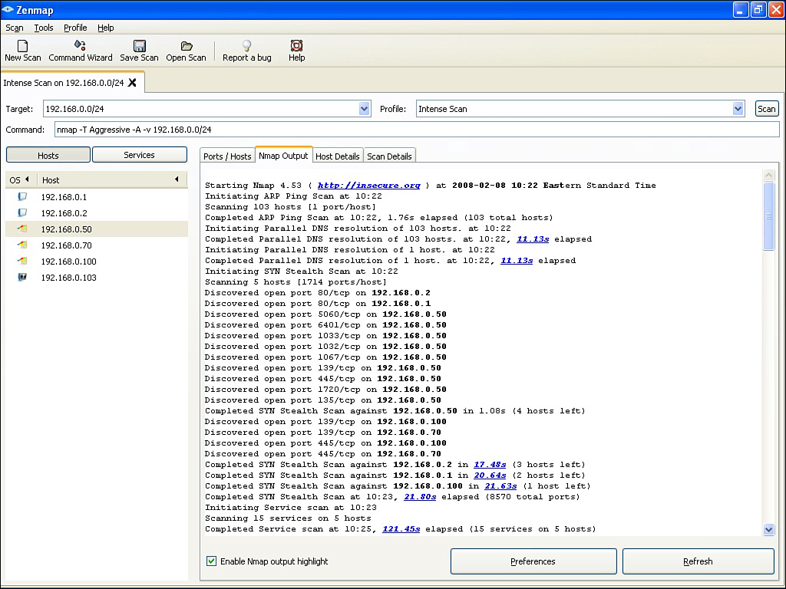
Defending Against Attacks
Figure 12-10 Nmap

Slide 34
Defending Against Attacks
Honey Pots and Honey Nets
A honey pot acts as a distracter. Specifically, a system designated as a honey pot appears to be an attractive target.
The attacker then use their resources attacking the honey pot, the end result of which is the they leave the real servers alone.
honey pot -- signal machine that draws they attacker attention.
Honey net -- multiple machines that draw the attacker attention.
A honey pot/net can also be used to study how attackers conduct their attacks.

Slide 35
Defending Against Attacks
Access Control List (ACL)
ACLs are rules, typically applied to router interfaces, that specify permit or deny traffic.
ACL’s filtering criteria:
Source IP
Destination IP
Source Port
Destination Port
Source MAC
Destination MAC

Slide 36
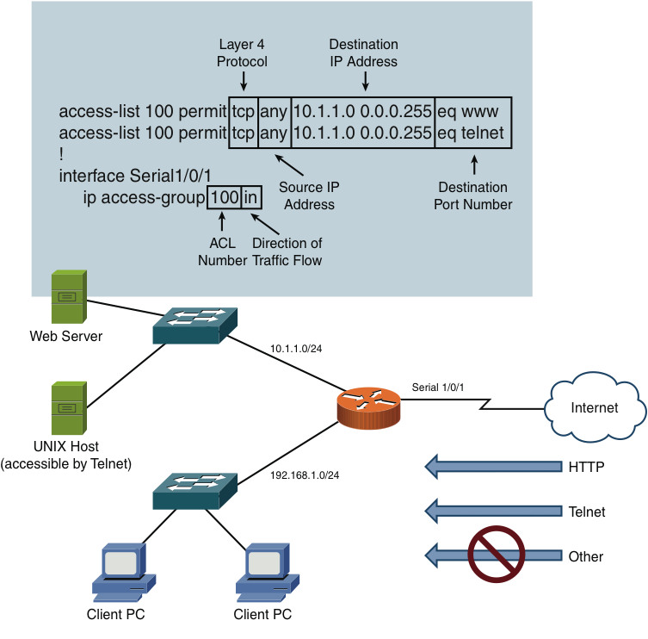
Defending Against Attacks
Figure 12-11 ACL Example

Slide 37
Defending Against Attacks
Remote Access Security
Although ACLs can be used to permit of deny specific connection flowing through a router, you also need to control connections to network devices.
Many of these remote-access security methods have been introduced in preceding chapters

Slide 38
Remote Access Security Methods
RAS
RDP
PPPoE
PPP
SSH
Kerberos
AAA
RADIUS
TACACS+
NAC
802.1x
CHAP
MS-CHAP
EAP
Two-factor authentication
Single sign-on

Slide 39
Defending Against Attacks
Firewalls
At this point, we have introduced various security threats, along with best practices to protect your network form those threats.
Now we are going to cover three additional layers of security that can be applied to a network.
The additional layers consist of firewalls, virtual private networks, and intrusion detection and prevention systems.

Slide 40
Defending Against Attacks
Firewall Types
A firewall defines a set of rules to dictate which types of traffic are permitted of denied as that traffic enters of exits a firewall interface.
Software firewall -- can be used to protect a signal system or can be software loaded in a computer with more that one NIC, controlling traffic between them.
Hardware firewall – is an appliance that acts as the firewall.
Firewall Inspection Types
Packet-filtering firewall (stateless) -- inspect traffic solely on a packet’s header. One at a time.
Stateful firewall – recognize that a packet is part of a session that might have originated inside the LAN or outside the LAN

Slide 41
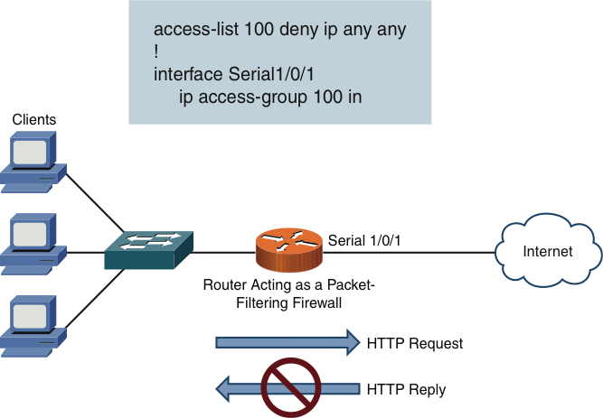
Defending Against Attacks
Figure 12-12 Packet-Filtering Firewall

Slide 42
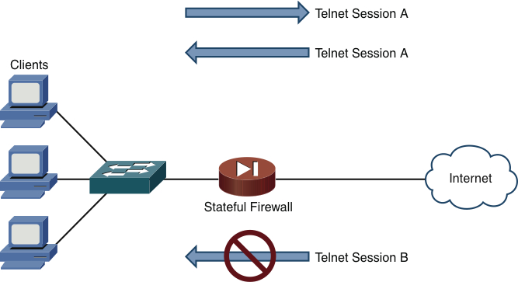
Defending Against Attacks
Figure 12-13 Stateful Firewall

Slide 43
Defending Against Attacks
Firewall Zones
A firewalls interface can be defined as belonging to different firewall zones.
After the zones are created, you then set up rules based on those zones.
Typical zones names:
Inside
Outside
DMZ

Slide 44
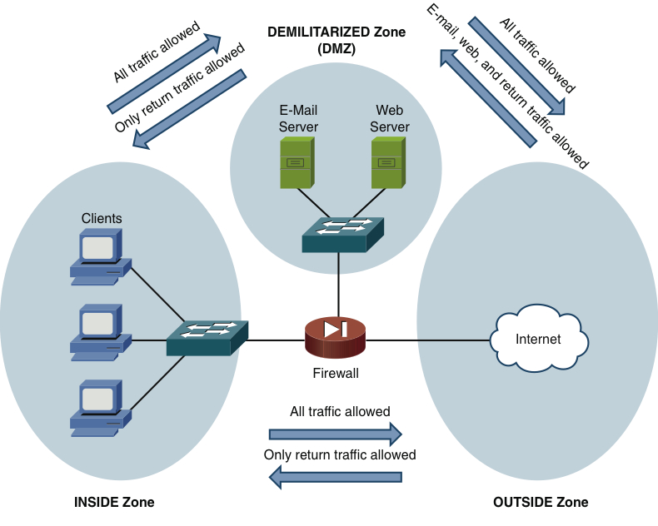
Defending Against Attacks
Figure 12-14 Firewall Zone Example

Slide 45
Defending Against Attacks
Virtual Private Networks (VPN).
Much of today’s workforce is located outside of a corporate headquarters location.
Some employees work in remote offices, while other telecommute, and other travel as part of their job.
These employees need a secure method to connect back to the headquarters (HQ).
WAN technologies could be used but would be expensive to implement.
A VPN supports secure communication between two sites over an untrusted network.

Slide 46
Defending Against Attacks
VPN (cont.)
There are two primary categories of VPNs
Site to Site -- interconnects two sites, as an alternative to a leased line, at a reduced cost.
Client to Site – interconnects a remote user with a site, as an alternative to dial-up or ISDN connectivity, at a reduced cost.

Slide 47
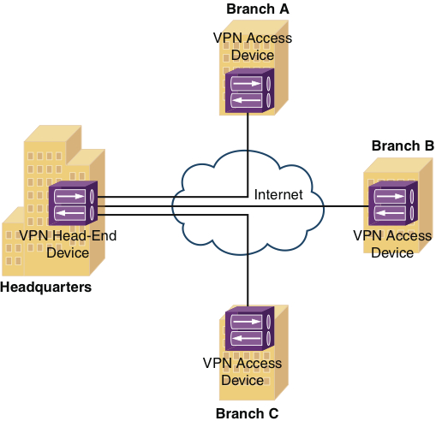
Defending Against Attacks
Figure 12-15 Sample Site-to-Site VPN

Slide 48
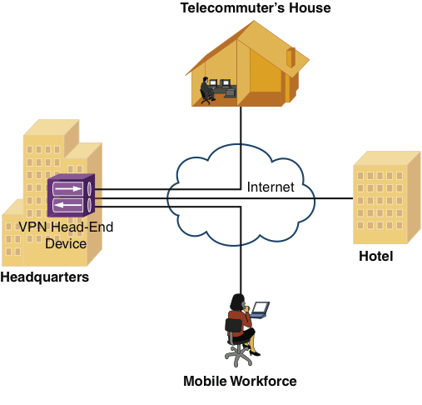
Defending Against Attacks
Figure 12-16 Sample Client-to-Site VPN

Slide 49
Defending Against Attacks
Overview of IPsec
Broadband technologies, such as cable and DSL, in addition to other VPN transport mechanisms, often traverse and untrusted network, such as the Internet.
IPsec VPNs offer strong security features, such as the following:
Confidentiality
Integrity
Authentication
IKE Modes and Phase
IPsec use a collection of protocols to provide features. One of the primary protocols the IPsec uses is the Internet Key Exchange

Slide 50
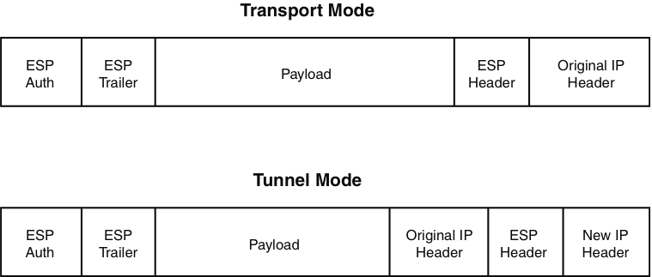
Defending Against Attacks
Transport mode encrypts only the payload
Tunnel mode encrypts the whole packet

Slide 51
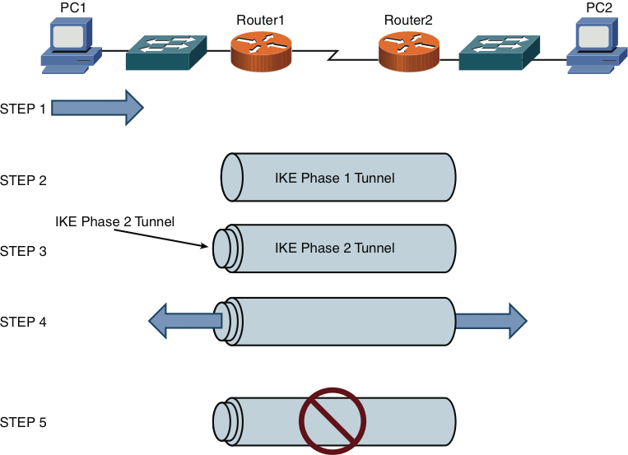
Defending Against Attacks
Figure 12-18 IPsec VPN Steps

Slide 52
Defending Against Attacks
VPN Protocols
SSL/TLS
Strong, used by HTTPS
L2TP / IPSec
L2F
Old tunneling protocol from Cisco, no encryption
PPTP
Old Microsoft VPN protocol, weak encryption

Slide 53
Defending Against Attacks
Intrusion Detection and Prevention
When an attacker launches an attack against a network, intrusion detection systems (IDS), and intrusion prevention systems (IPS) technologies are often able to recognize the attack and respond appropriately.
Attacks might be recognizable by comparing incoming data streams against a database of well-known attack signatures.
IDS Versus IPS
IDS, sits parallel to the network, is a passive device, that monitors all traffic and sends alerts.
IPS, sits in-line to the network, is an active device, that monitors all traffic and sends alerts and deals with the offending traffic.

Slide 54
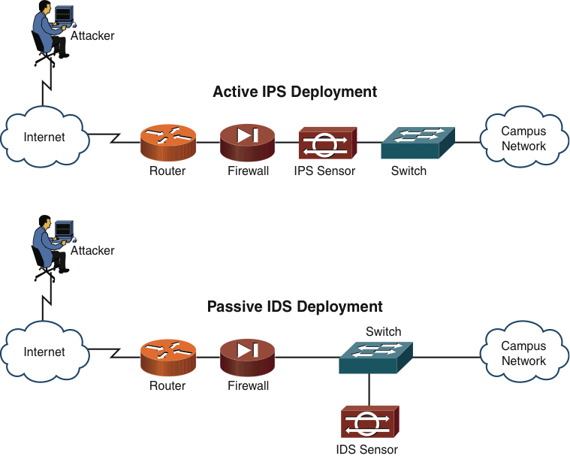
Defending Against Attacks
Figure 12-19 IDS and IPS Network Placement

Slide 55
Defending Against Attacks
IDS and IPS Device Categories
IDS and IPS device can be categorized based on how they detect malicious traffic.
Detection Methods
Signature-based detection
Policy-based detection
Anomaly-based detection
Deploying Network-Based and Host-Based Solutions
NIPS and HIPS solutions can work in tandem. This help further protect the system.

Slide 56
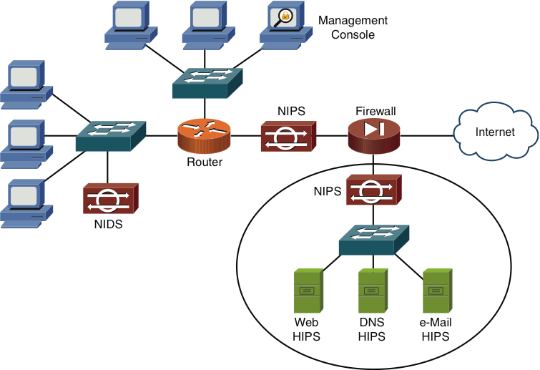
Defending Against Attacks
Figure 12-20 NIDS, NIPS, and HIPS Deployment Example

