Slide 1
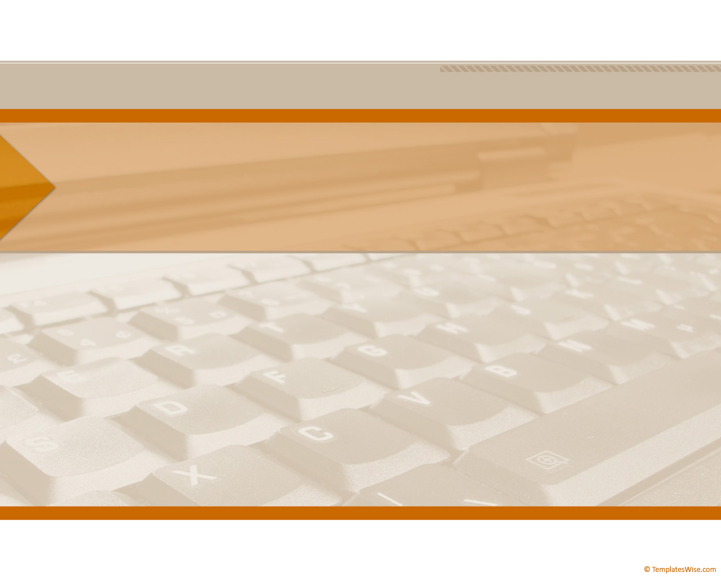
CompTIA Network +
Chapter 13
Troubleshooting Network Issues

Slide 2
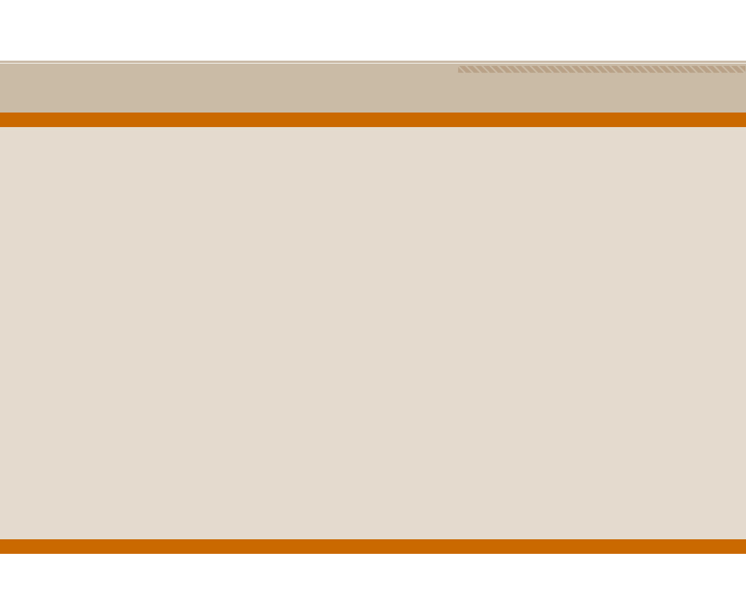
Objectives
What are the elements in a structured troubleshooting model?
What common physical layer troubleshooting issues might you encounter?
What potential Layer2 issues are you most likely to face when troubleshooting a network containing Ethernet switches?

Slide 3
Objectives
Aside form routing protocols troubleshooting, what Layer 3 troubleshooting issues are common in a routed network?
How do characteristics unique to wireless network impact your troubleshooting of a network containing wireless access points?

Slide 4
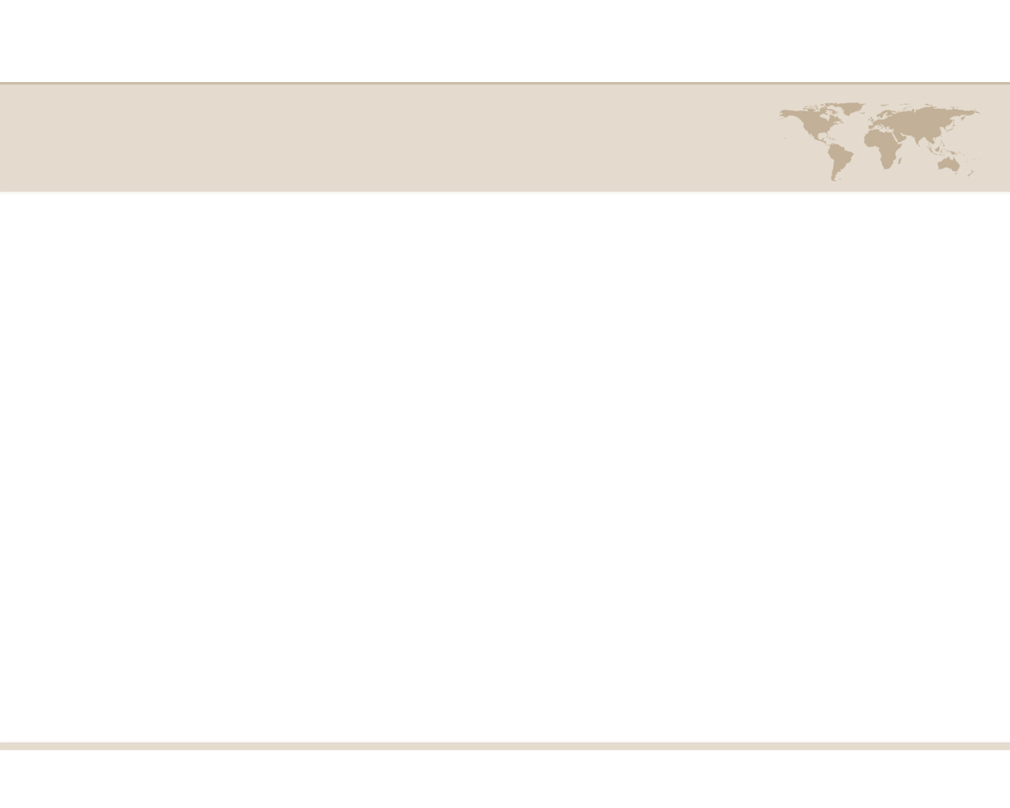
Troubleshooting Network Issues
As you perform your day-to-day tasks of administering a network, a significant percentage of your time will be dedicated to resolving network issues.
Without a plan, your efforts might be inefficient, as you try one thing after another, possibly causing other issues in the process.

Slide 5
Troubleshooting Network Issues
Although your troubleshooting efforts can most definitely benefit from a structured approach, realize that troubleshooting is part art and part science.
Specifically, your intuition and instincts play a huge role in isolating an issue.
To help you start developing, or continue honing, your troubleshooting skills, this chapter begins by presenting you with a formalized troubleshooting methodology, which can act a guide for addressing most any network issue

Slide 6
Troubleshooting Basics
The process of troubleshooting, at its essence, is the process of responding to a problem report (sometimes in the form of a trouble ticket), diagnosing the underlying cause of the problem, and resolving the problem.
Figure 13-1 Simplified Troubleshooting Flow

Slide 7
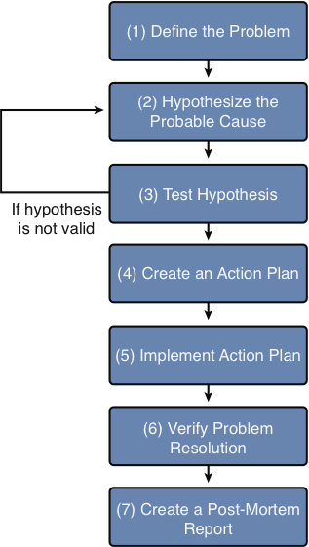
Structured Troubleshooting Methodology
Figure 13-2 Structured Troubleshooting Approach

Slide 8
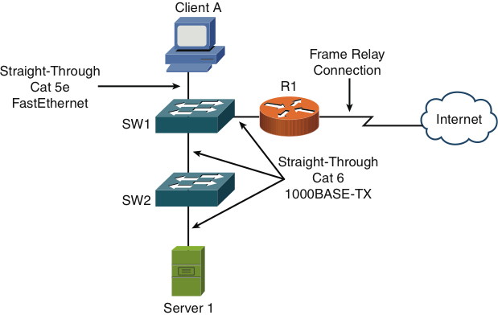
Physical Layer Troubleshooting
Figure 13-3 Physical Layer Troubleshooting: Sample Topology

Slide 9
Data Link Layer Troubleshooting
When troubleshooting Layer 2 and above, we must remember that, in these devices there is the flow of the user’s data, we call the data plan.
Then there is the controls that we place on this data, called the control plan.

Slide 10
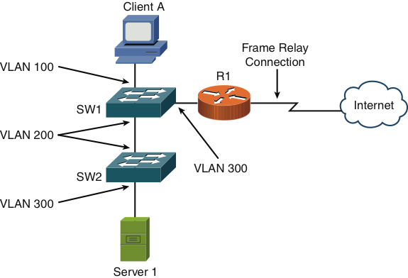
Data Link Layer Troubleshooting
Figure 13-4 Data Link Layer Troubleshooting: Sample Topology

Slide 11
Network Layer Troubleshooting
When troubleshooting connectivity issues for and IP-based network, the network layer (Layer 3) is often an appropriate place to begin your troubleshooting efforts.
To better troubleshoot Layer 3 we must understand how our routing protocols affect how the router moves the IP packet.

Slide 12
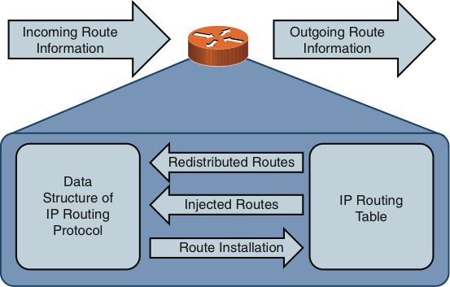
Network Layer Troubleshooting
Figure 13-5 Interaction Between IP Routing Protocol Data Structures and IP Routing Tables

Slide 13
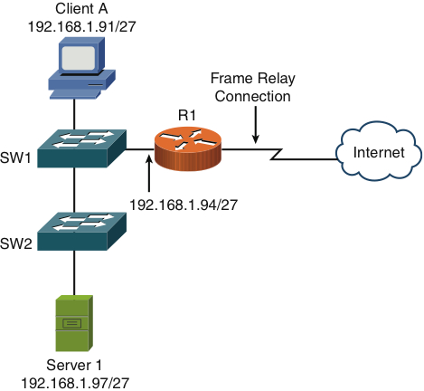
Network Layer Troubleshooting
Figure 13-6 Network Layer Troubleshooting: Sample Topology

Slide 14
Wireless Troubleshooting
Troubleshooting wireless networks can require a variety of skill sets. For example, some troubleshooting scenarios might require an understanding of antenna theory and the radio frequency spectrum.
Again remember that we have a data plan and a control plan in this device also.

Slide 15
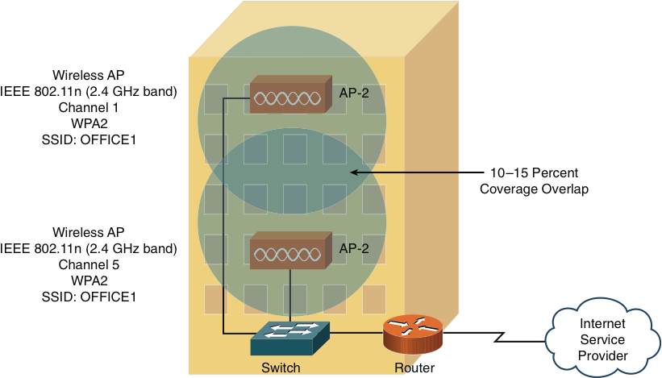
Wireless Troubleshooting
Figure 13-7 Wireless Network Troubleshooting: Sample Topology

