Slide 1
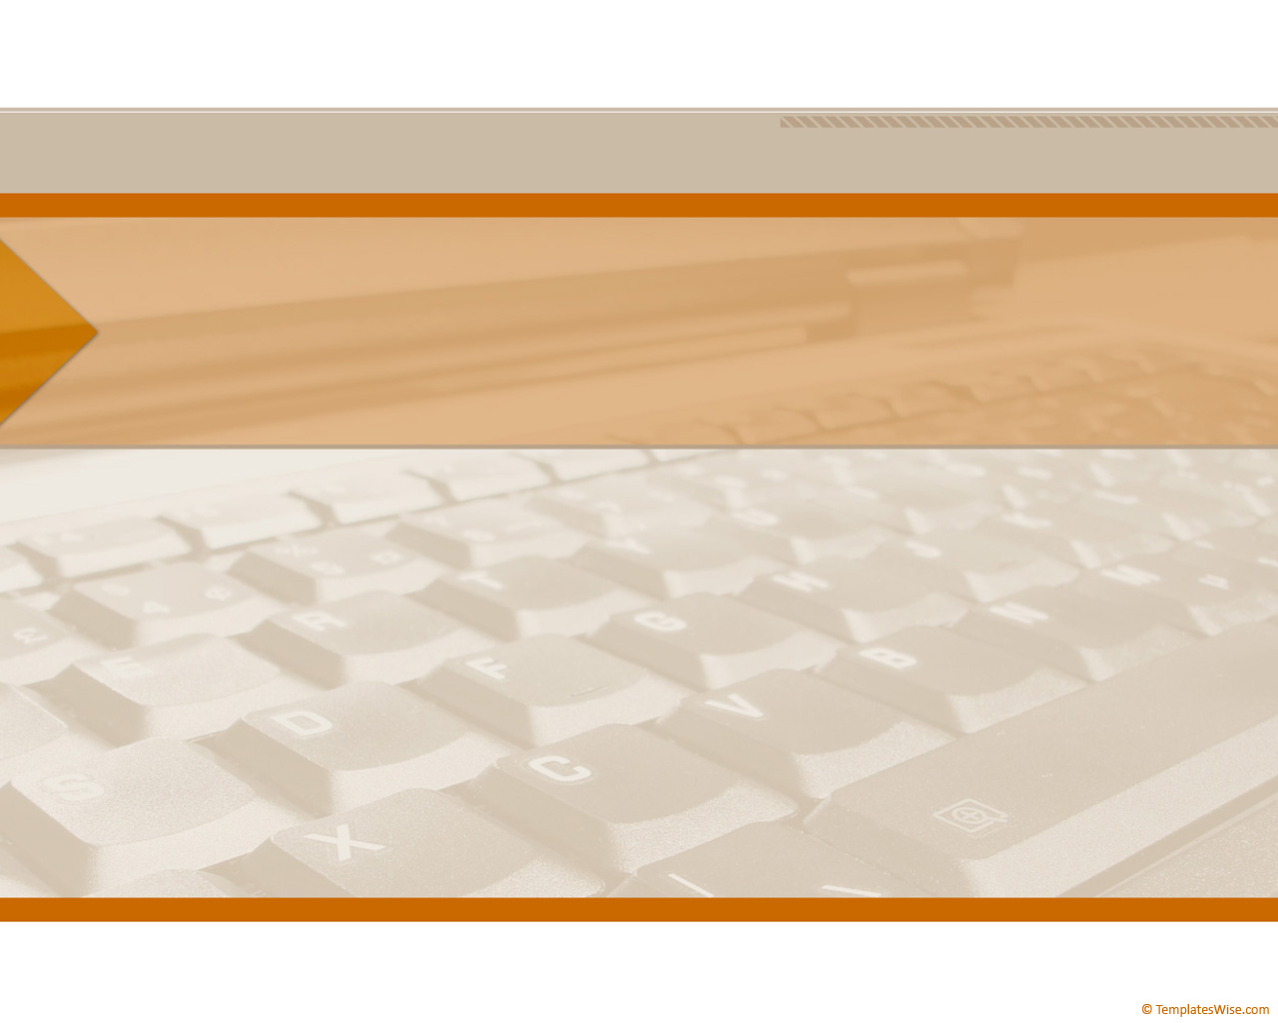
CompTIA Network +
Chapter 2
Dissecting the OSI Model

Slide 2
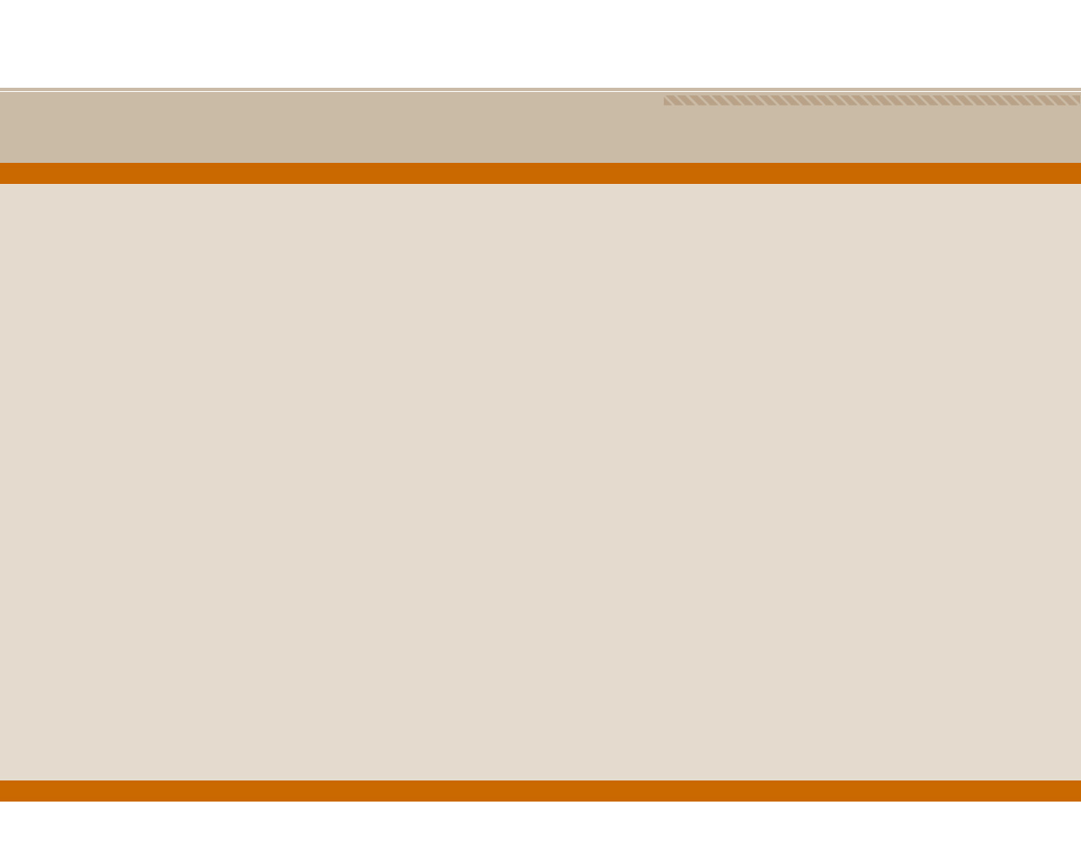
Objectives
What is the purpose of a Network model?
What are the layers of the OSI model?
What are the characteristics of each layer of the OSI model?
How does the TCP/IP stack compare to the OSI model?
What are the well-known TCP and/or UDP port numbers for a given collection of common applications

Slide 3
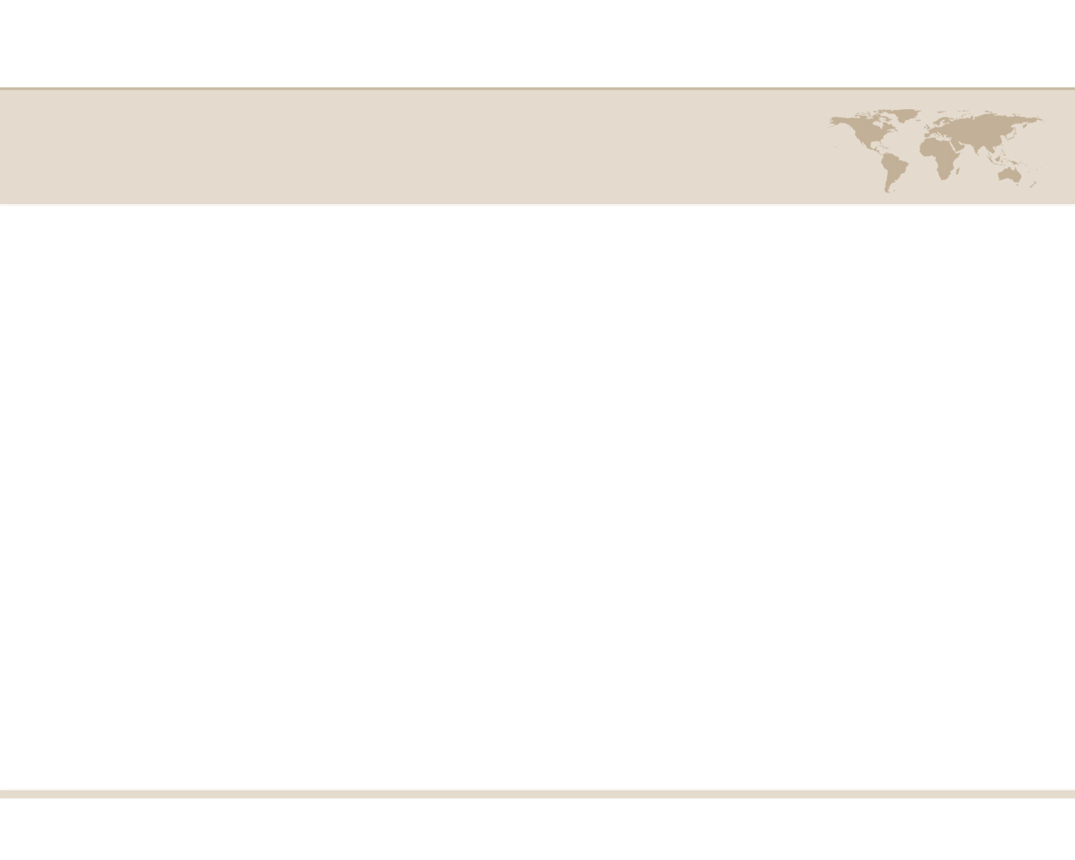
The Purpose of Reference Models
It breaks network communication into smaller, simpler parts that are easier to develop.
It facilitates standardization of network components to allow multiple-vendor development and support.
It allows different types of network hardware and software to communicate with each other.
It prevents changes in one layer from affecting the other layers so that they can develop more quickly.
It breaks network communication into smaller parts to make learning it easier to understand.

Slide 4
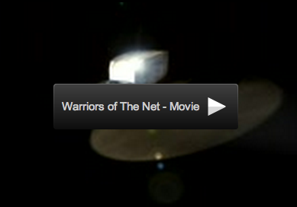
Warriors of the Net

Slide 5
The OSI seven-layer model
Application
7
Presentation
6
Session
5
Transport
4
Network
3
Data Link
2
Physical
1
Figure 2-2 OSI Stack

Slide 6
Mnemonics for the OSI Model
Away
Pizza
Sausage
Throw
Not
Do
Please
All
People
Seem
To
Need
Data
Processing

Slide 7
Protocol Data Unit (PDU)
Application
Presentation
Session
Transport
Segments
Network
Packets
Data Link
Frames
Physical
Bits
Figure 2-3 PDU Names

Slide 8
Quick Summary of Layers 1-4
Transport
TCP & UDP Ports
Service
4
Network
Routers, IP Address
WAN
3
Data Link
Switches, MAC Address
LAN
2
Physical
Cables
1

Slide 9
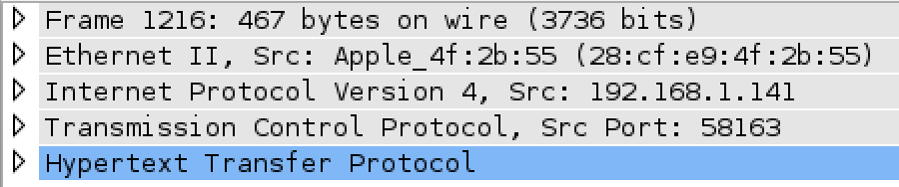
OSI Layers in Wireshark
1
2
3
4
7

Slide 10
Physical Layer
Application
Presentation
Session
Transport
Network
How Bits are represented on the medium
Wring standards for connectors and jacks
Physical topology
Synchronizing bits
Bandwidth usage
Multiplexing strategy
Data Link
Physical
Figure 2-4 Layer 1: Physical Layer

Slide 11
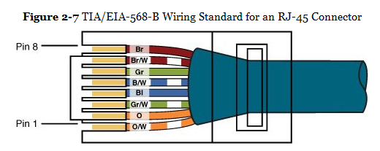
Wiring Standards

Slide 12
Asynchronous and Synchronous Communications
Synchronizing Bits
Two devices must agree on when one bit stops and another bit starts
Asynchronous
Uses start and stop bits
Synchronous
Internal clocks are synchronized at each end of the cable

Slide 13
Bandwidth Usage
Broadband
Multiple channels share the same medium
Ex: cable TV uses frequency division multiplexing (each channel uses a different frequency range)
Baseband
The whole medium is used for one transmission
Example: Ethernet

Slide 14
Time-Division Multiplexing (TDM)
Each channel gets the same amount of time on the wire
AAAA
B_B_
ABCA_CABCA_C
CCCC

Slide 15
Statistical Time-Division Multiplexing (StatTDM)
Busy channels get more time on the wire
AAAA
B_B_
ABCACABCAC
CCCC

Slide 16
Frequency Division Multiplexing (FDM)
Example: signals sent with different colors through the same fiber optic cable
AAAA
AAAA
AAAA
B_B_
B_B_
B_B_
CCCC
CCCC

Slide 17
Layer 1 Devices
Cables
Wireless access points
Hubs
Because they don’t pay any attention to addresses, they just deliver signals to every connected device like a crossover cable

Slide 18
Data Link Layer
Application
Presentation
Session
Physical Addressing
Logical topology
Method of transmitting on the media
Transport
MAC
Network
Data Link
Physical
Connection Services
Synchronizing transmissions
LLC
Figure 2-8 Layer 2: The Data Link Layer

Slide 19
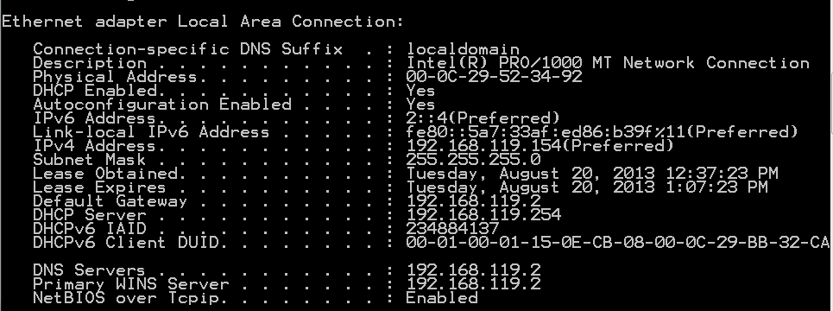
MAC Addresses
IPCONFIG /ALL
Physical Address
Built into the network interface

Slide 20
Connection Services
Flow control
Prevents sender from sending data faster than the client can accept it
Error control
When a frame is received, a checksum is used to detect errors
Usually a Cyclic Redundancy Check (CRC)
If the receiver's checksum does not match the sender's checksum, the frame is discarded and resent

Slide 21
Layer 2 Devices
Switches
Bridges
Network Interface Cards (NICs)

Slide 22
Network Layer
Application
Presentation
Session
Logical addressing
Switching
Route discovery and selection
Connection services
Bandwidth usage
Multiplexing strategy
Transport
Network
Data Link
Physical
Figure 2-9 Layer 3: The Network Layer

Slide 23
IP Address
Logical address
Changes when the device is moved

Slide 24
Switching
Packet switching
Data is broken into packets
Many packets travel along network connections like cars on a freeway
Circuit switching
A physical line is dedicated to each connection
Ex: old copper landline phone systems
Message switching
Store-and-forward, like email

Slide 25
Layer 3 Devices
Routers
Multilayer Switches

Slide 26
Transport Layer
Application
Presentation
Session
TCP/UDP
Windowing
Buffering
Transport
Network
Data Link
Physical
Figure 2-10 Layer 4: The Transport Layer

Slide 27
TCP and UDP
Transmission Control Protocol (TCP)
Connection-oriented and reliable
Handshake makes sure both ends are ready
Segments are acknowledged and resent if necessary
User Datagram Protocol (UDP)
Connectionless and unreliable
No handshake
Best-effort delivery, no acknowledgements

Slide 28
TCP Sliding Window
Figure 2-11 TCP Sliding Window

Slide 29
ICMP (Internet Control Message Protocol)
At layer 4
Used by ping and traceroute, and to indicate errors such as dropped packets

Slide 30
Session Layer
Application
Presentation
Setting up a session
Maintaining a session
Tearing down a session
Session
Transport
Network
Data Link
Physical
Figure 2-12 Layer 5: The Session Layer

Slide 31
Example of a Session
User logs in with a username & password
All data now has a special significance until that user logs off, or the session times out, or is terminated some other way
Layer 6 Protocol
H.323 (voice or video)
NetBIOS (file sharing)

Slide 32
Presentation Layer
Application
Data formatting
Encryption
Presentation
Session
Transport
Network
Data Link
Physical
Figure 2-13 Layer 6: The Presentation Layer

Slide 33
Application Layer
Application
Application services
Service advertisement
Presentation
Session
Transport
Network
Data Link
Physical

Slide 34
Application Layer
Closest to the user
Hands data to an application in the format it expects, with no addresses or other transmission artifacts
Examples: a downloaded file, an email message

Slide 35
The TCP/IP Stack
Application
Transport
Internet
Network Interface

Slide 36
The TCP/IP and OSI Models Compared
OSI Stack
TCP/IP Stack
Application
Application
Presentation
Session
Transport
Transport
Network
Internet
Data Link
Network Interface
Physical
Figure 2-15 TCP/IP Stack

Slide 37
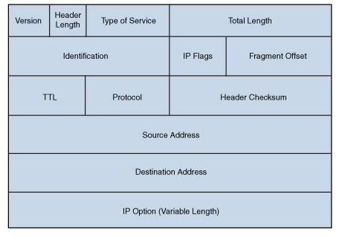
IP Ver4 Header

Slide 38
TTL (Time-to-Live)
TTL decreases by one each time the packet is forwarded by a router
If TTL reaches zero, the packet is discarded
This eliminates packets trapped in routing loops

Slide 39
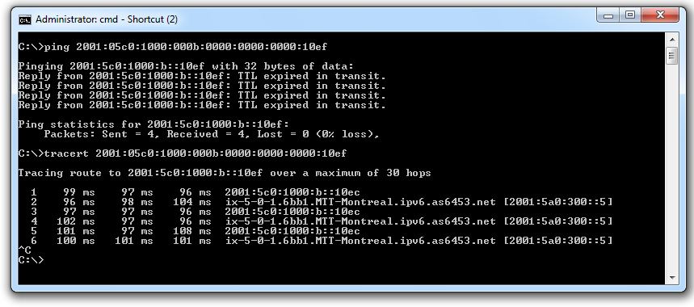
Demo: Routing Loop

Slide 40
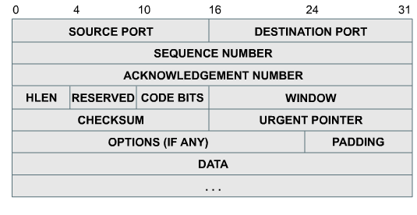
TCP Header
Figure 2-17 TCP Segment Format

Slide 41
TCP Header Fields
Port numbers
Indicate which program on the end device should receive the data
Examples: Port 25 for email, 80 for HTTP
Window size
Number of bytes that can be sent before waiting for an ACK

Slide 42
TCP Header Fields
Sequence and Acknowledgement numbers
Used to put packets in order to reassemble files and other large messages
Flags like SYN and ACK are used for the TCP handshake and to acknowledge data received

Slide 43
UDP Header
0 | 16 |  | 31
SOURCE PORT |  | DESTINATION PORT
LENGTH |  | CHECKSUM
No handshake, acknowledgements, sequencing, or flow control

Slide 44
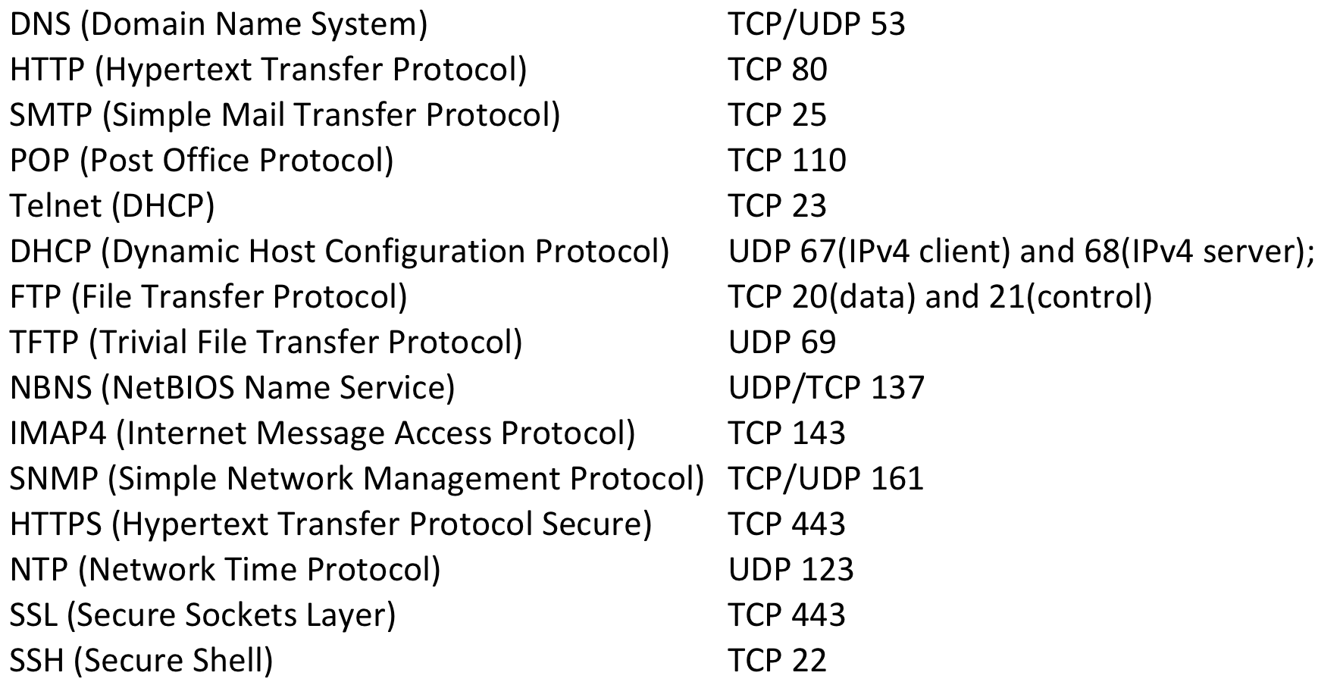
Common Ports Link Ch 2d for flash cards

Slide 45
Port Types
Port numbers are assigned in various ways, based on three ranges:
System Ports (0-1023), System Ports are assigned by IETF process for standards-track protocols, as per RFC6335. Also known as well-known-ports
User Ports (1024-49151) ,User Ports are assigned by IANA using the "Expert Review" process, as per RFC6335
Dynamic and/or Private Ports (49152-65535), Dynamic Ports are not assigned, they are dynamically created as your computer need them. Also known as ephemeral ports.

Slide 46
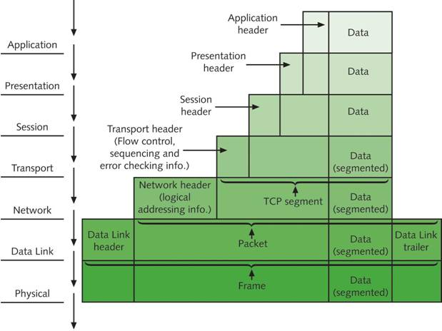
Communication Between Two Systems

