Slide 1

CompTIA Network +
Chapter 3
Identifying Network components

Slide 2

Objectives
What are the characteristics of various media types?
What is the role of a given network infrastructure component?
What features are provided by specified specialized network devices?
How are virtualization technologies impacting traditional corporate data center designs?
What are some of the primary protocols and hardware components found in a Voice over IP(VoIP) network?

Slide 3

Identify Network Components
Many modern networks contain a daunting number of devices.
It is our job to understand the function of each device and how they work with each other.
The interconnection of these devices uses one of a variety of media (cables) types.

Slide 4
The Media
By definition, a network is an interconnection of devices. Those interconnections occur over some type of media.
The media might be physical, such as a copper and fiber-optic cable or it might be the air, through which radio waves propagate.

Slide 5
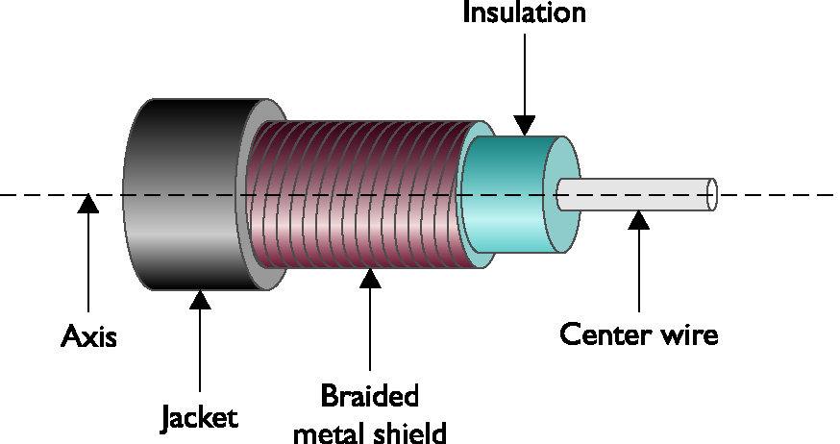
Coaxial Cable
Coaxial Cable is composed of two conductors.
The inner, insulated conductor or center wire, passes the data.
The outer, braided metal shield, which helps protect the data.

Slide 6
Coaxial Cable
Three of the most common types of coaxial cables are;
RG-6: Commonly used by local cable companies to connect individual homes.
RG-58: This type of coaxial cable was popular with early 10BASE2 Ethernet networks.
RG-59: Typical used to carry composite video between two nearby devices. (i.e. cable box to TV)
Although RG-58 was commonplace in early networks, coaxial cables role in modern computer networks is as the media used by cable modems

Slide 7
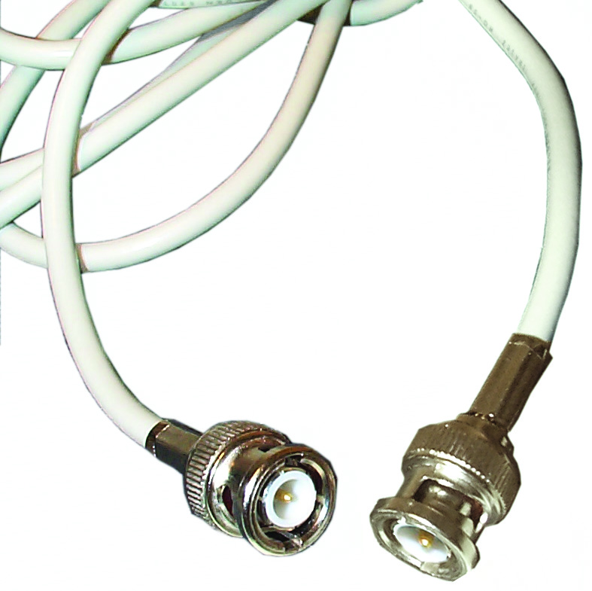
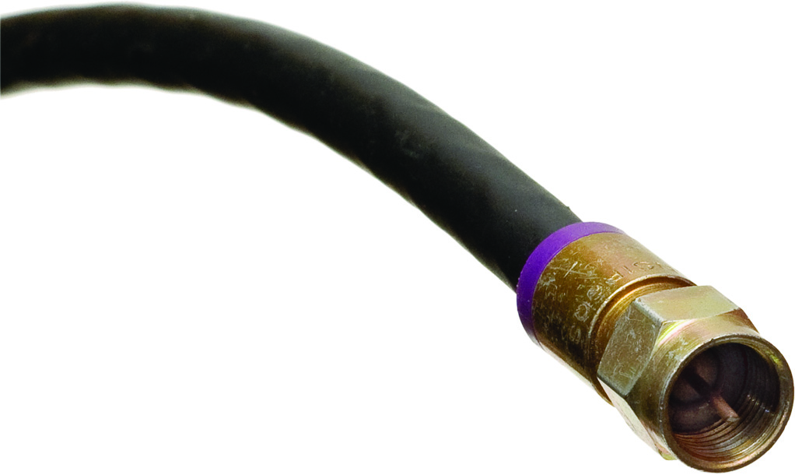
Coaxial Cable
Common connectors used on coaxial cables:
BNC F-connector

Slide 8
Twisted-Pair Cable
The most popular LAN media type is twisted-pair cable, where individually insulated copper strands are intertwined into pairs.
There are two categories of twisted pair:
UTP – Unshielded Twisted Pair
STP – Shielded Twisted Pair

Slide 9
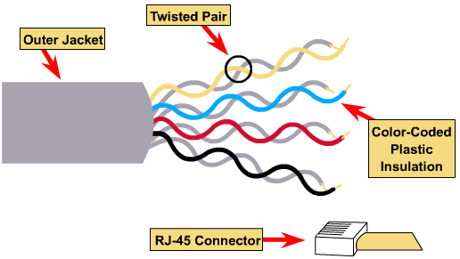
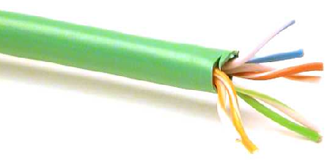
Unshielded Twisted-Pair Cable

Slide 10
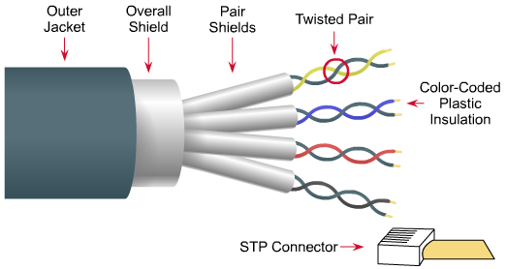
Shielded Twisted-Pair Cable

Slide 11
CAT Ratings
Categories:
CAT 3 (Category 3): up to 10 Mbps of data
CAT 5 (Category 5): up to 100 Mbps throughput
CAT 5e (Enhanced Category 5): higher twist ratio, up to 1000 Mbps throughput
CAT 6 (Category 6): six times the throughput of CAT 5, used for 1000BASE-T
CAT 6e (Enhanced Category 6): reduced attenuation and crosstalk, used for 10GBASE-T networks

Slide 12
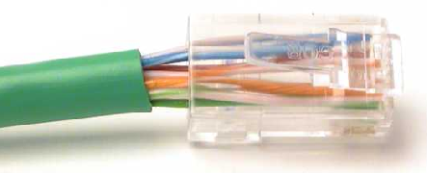
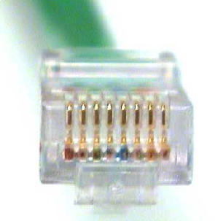
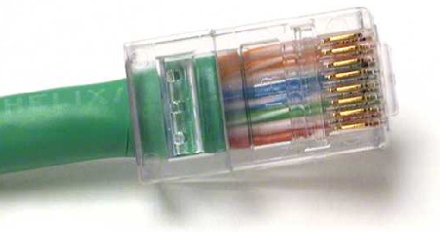
RJ-45

Slide 13
Cable Fire Ratings
Underwriters Laboratories and the National Electrical Code (NEC)
Polyvinyl chloride (PVC) rating has no significant fire protection
Lots of smoke and fumes
Plenum-rated cable
Less smoke and fumes
Costs three to five times as much as PVC-rated cable
Riser-rated cable for vertical runs

Slide 14
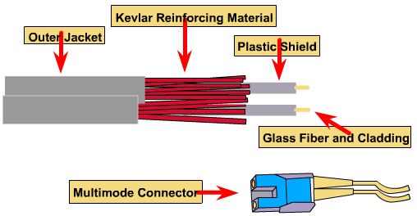
Fiber-Optic Cables
Contains glass or plastic fibers at core surrounded by layer of glass or plastic cladding
Reflects light back to core

Slide 15
Fiber-Optic Cables
Benefits over copper cabling:
Nearly unlimited throughput
Very high resistance to noise
Excellent security
Ability to carry signals for much longer distances before requiring repeaters than copper cable
Industry standard for high-speed networking

Slide 16
Multimode Fiber (MMF)
Uses a core with larger diameter than a single-mode fiber
Common size 62.5 microns
Laser or LED generated light pluses travel at different angles.
Common uses
Cables connecting router to a switch
Cables connecting server on network backbone

Slide 17
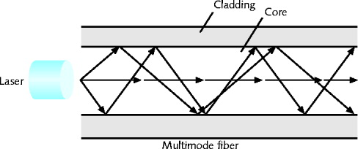
Multimode Fiber (MMF)
Transmission over multimode fiber-optic cable

Slide 18
Single-Mode Fiber (SMF)
Uses a narrow core (< 10 microns in diameter)
Laser generated light pluses travels over one path.
Little reflection
Light does not disperse
Accommodates
Higher bandwidth, longer distances
Connects carrier’s two facilities
Cost prohibit typical LANs, WANs use

Slide 19
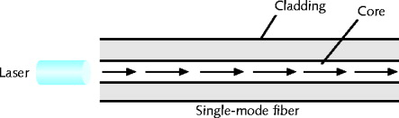
Single-Mode Fiber (SMF)
Transmission over single-mode fiber-optic cable

Slide 20
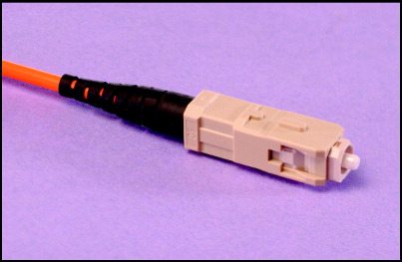
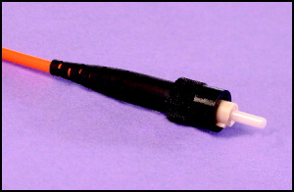
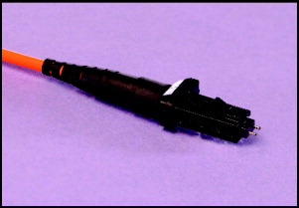
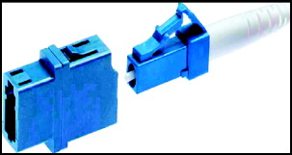
Common Connectors for Fiber
SC (subscriber connector or standard connector)
ST (straight tip) connector
MT-RJ (mechanical transfer-register jack) connector
LC (local connector)

Slide 21
Cabling Distribution
Cable plant
Hardware making up enterprise-wide cabling system
Standard
TIA/EIA joint 568 Commercial Building Wiring Standard

Slide 22
Cabling Distribution
Components
Entrance facilities
MDF (main distribution frame)
Cross-connect facilities
IDF (intermediate distribution frame)
Backbone wiring
Telecommunications closet
Horizontal wiring
Work area

Slide 23
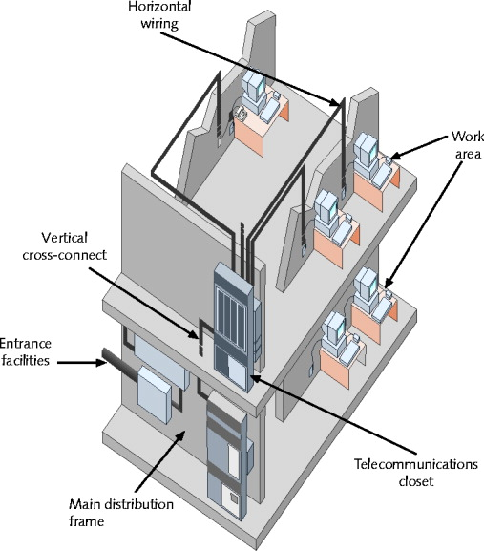
Cabling Distribution
TIA/EIA structured cabling in a building

Slide 24
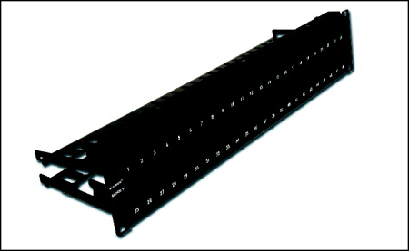
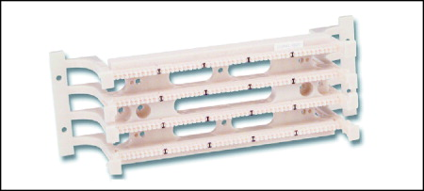
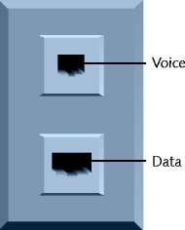
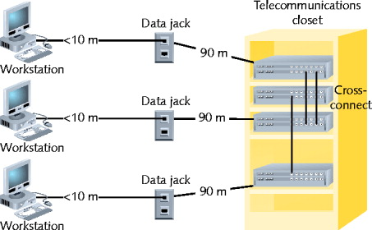
Cabling Distribution
Patch panel
Patch panel
A standard TIA/EIA outlet
Horizontal wiring

Slide 25
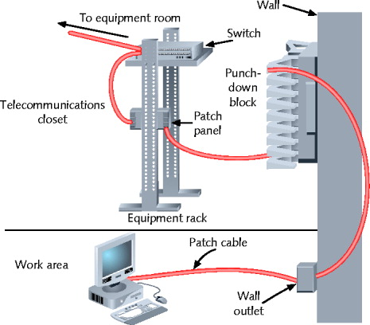
Cabling Distribution
A typical UTP cabling installation

Slide 26
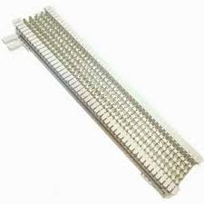
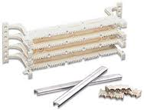
Cabling Distribution
66-block patch panel
110-block patch panel

Slide 27
Wireless Technologies
Not all media is physical, as in the case of wireless network technologies.
All wireless devices connecting to the dame AP (Access Point) are considered to be on the same shared network segment.

Slide 28
Network Infrastructure Devices
The devices used in a network infrastructure can vary on the layer 1 technology used.
For example, a Token Ring network might use a multistation access unit (MSAU), while an Ethernet network might use a switch.
Because Ethernet-based networks are dominant today’s LANs, the infrastructure devices presented here lend themselves to networking using Ethernet as the Layer 1 transport.

Slide 29
HUB
A HUB is at layer 1 of the OSI model.
A HUB does not make forwarding decisions.
A HUB receives bits in on one port and then retransmits those bits out all other ports.
HUB most often use UTP cabling to connect to other network devices.
Three basic types of Ethernet HUBs exist.
Passive HUB
Active HUB
Smart HUB (with SNMP)

Slide 30
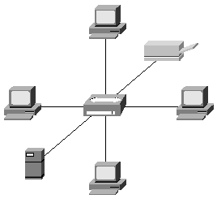
HUB
Regenerate and repeat signals
Used as network concentration points
Multiport repeater

Slide 31
Bridges
A bridge joins together two or more LAN segments, typically two Ethernet LAN segments.
Each LAN segment is a separate collision domain.
A bridge makes intelligent forwarding decisions based on the destination MAC address present in a frame.
A bridge analyzes source MAC address information on frames entering the bridge and populates an internal MAC address table based on learned information.

Slide 32
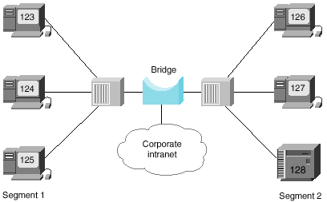
Bridges
Designed to create two or more LAN segments, each of which is a separate collision domain

Slide 33
Switches
Like a bridge, switch can dynamically learn the MAC address attached to various ports by looking at the source MAC address on frames coming into a port.
Initially, however the switch is unaware of what MAC address reside off of which ports.
When a switch receives a frame destined for a MAC address not yet present in the switch’s MAC address table, the switch floods that frame out of all of the switch port, other than the port on which the frame arrived.

Slide 34
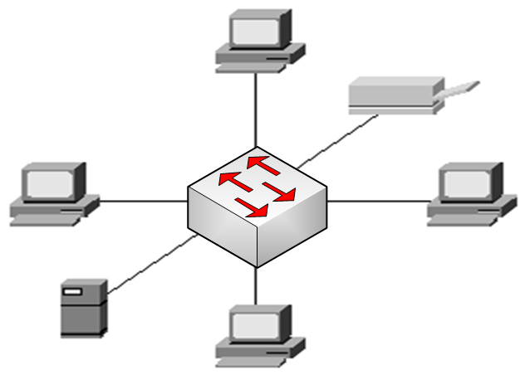
Switches
Designed to create two or more LAN segments, each of which is a separate collision domain

Slide 35
Multilayer Switches
Although a Layer 2 switch, makes forwarding decisions based on MAC address information, a multilayer switch can make forwarding decisions based on upper-layer information.
A multilayer switch could function as a router, and make forwarding decisions on IP address information.

Slide 36
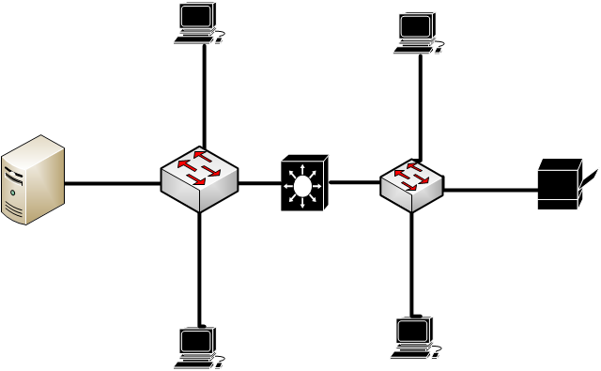
Multilayer Switches
Eight collision Domains, Two Broadcast Domain

Slide 37
Routers
A Router is a layer 3 device, meaning that it makes forwarding decisions based on logical network address information. Such as IP addresses.
A router has the capability to consider high-layer traffic parameters in making its forwarding decisions.
Each port on a Router is a separate collision domain and a separate broadcast domain.
Routers are typically more feature-rich and support a broader range of interface types.

Slide 38
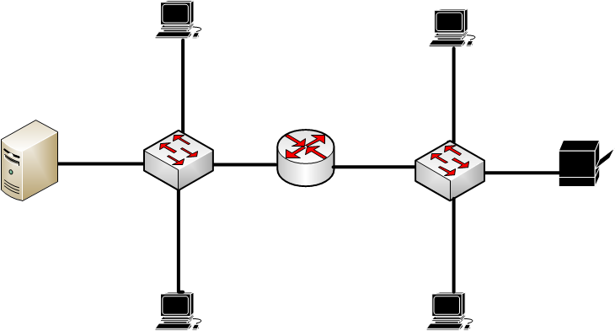
Routers
Eight collision Domains, Two Broadcast Domain

Slide 39
Infrastructure Devices Summary
Device | Number of Collision Domain Possible | Number of Broadcast Domains Possible | OSI Layer of Operation
HUB | 1 | 1 | 1
Bridge | 1 per port | 1 | 2
Switch | 1 per port | 1 | 2
Multilayer switch | 1 per port | 1 per port | 3+
Router | 1 per port | 1 per port | 3+

Slide 40
Chapter 3
Identifying Network components
PART II

Slide 41
VPN Concentrator
Companies with locations spread across multiple sites require secure communications between those sites.
One method is to create secure connections through an untrusted network, such as the Internet.
Such a secure tunnel is called a virtual private network (VPN).
The device that terminating these VPN tunnels, is a VPN Concentrator.
A VPN concentrator performs the processor-intensive process required to terminate multiple VPN tunnels.

Slide 42
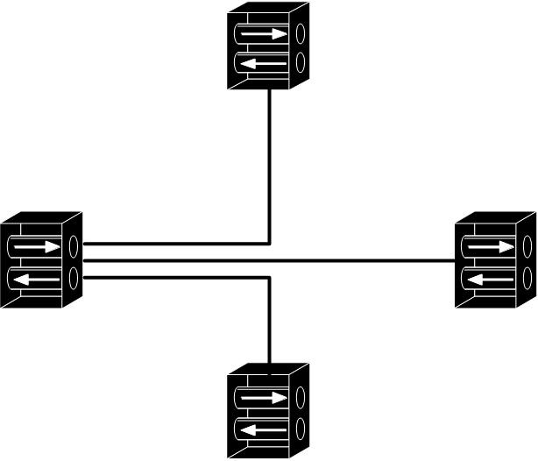
VPN Concentrator
Branch A
VPN
Concentrator
Branch B
VPN
Concentrator
VPN
Concentrator
Headquarters
VPN
Concentrator
Branch C

Slide 43
Firewalls
A Firewall is primarily a network security appliance, is stands guard at the door of your network, protecting it from malicious Internet traffic.
There are many types of firewalls, a stateful firewall is one example.

Slide 44
Firewalls
Stateful Firewall

Slide 45
DNS Servers
A Domain Name System (DNS) server performs the task of taking a domain name like, www.ciscopress.com and resolving that name into a corresponding IP address.
Computers and the internet use numbers not names, but people recall names better than numbers.
www.ciscopress.com is an example of a fully-qualified domain name (FQDN)
An FQDN is a series of strings delimited by periods. The right-most string represents the root domain.

Slide 46
DNS Servers

Slide 47
DNS Hierarchy

Slide 48
DHCP Servers
Most modern networks have IP address assigned to networking devices, and those logical Layer 3 addresses are used to route traffic between networks.
IP address can be statically configured on each host, however such process is time consuming and error prone (Manual).
A far more efficient method of IP address assignment is to dynamically assign IP addresses to network devices (Automatic).
This process assigns the; IP Address, Subnet Mask, Default Gateway, DNS Server to the host.

Slide 49
DHCP Servers

Slide 50
Proxy Servers
A Proxy Server is a device that makes request on behalf of its client.
Clients are configured to forward their packets, which are seemingly destined for the Internet, to a proxy server.
The proxy server evaluates the request, if it has a copy of the information the client is looking for it replies with it.
If the requested page is not in the server it forwards the request to the Internet.

Slide 51
Proxy Servers

Slide 52
Content Engines & Switches
Some networks do not use proxy servers, instead use a dedicated appliance to perform this content caching.
These appliances are commonly referred to as caching engines or content engines.
The Content Switches is also known as a load balancer, distributing incoming request across the various servers in the server farm.

Slide 53
Content Engines

Slide 54
Content Switch

Slide 55
Virtual Network Devices

Slide 56
VoIP Protocols & Components

