Slide 1

CompTIA Network +
Chapter 4
Understanding Ethernet

Slide 2

Objectives
What are the characteristics of Ethernet networks, in terms of media access, collisions domains, broadcast domains, and distance/speed limitations of various Ethernet Standards?
What functions are performed by Ethernet switch features, such as VLANs, trunks, Spanning Tree Protocol, link aggregation, Power over Ethernet, port monitoring, user authentication, and first-hop redundancy?

Slide 3

Understanding Ethernet
Odds are, when you are working with local-area networks (LAN), you are working with Ethernet as the Layer 1 technology.
Over the years, Ethernet has evolved. Several Ethernet standards exist in modern LANs, with a variety if distance and speed limitations.

Slide 4
Principles of Ethernet
Ethernet was fist developed by Xerox Corporation. The original intent was to create a technology to allow computers to connect with laser printers.
From this humble beginnings, Ethernet rose to be used to interconnect such devices as computers, printers, wireless access points, servers, switches, routers, video-game systems, and more.

Slide 5
Ethernet Origins
IEEE 802.3, in general this is interchangeable with the term Ethernet.
In the early days, it was called 10BASE5.
10 = 10 Mbps (10 million bits per second)
BASE = Baseband, one signal on the line at a time.
5 = 500 meters of cable max
The cable use was RG-6, became known as thicknet.

Slide 6
Ethernet Origins
Another early Ethernet implementation was 10BASE2.
10 = 10 Mbps (10 million bits per second)
BASE = Baseband, one signal on the line at a time.
2 = 185 meters of cable max
The cable use was RG-58, became known as thinnet.
10BASE5 and 10BASE2 networks are rarely, if ever, seen today. Other than their 10-Mbps bandwidth limitation, the cables used by these network have been replaced with either UTP or STP cables.

Slide 7
Carrier Sense Multiple Access Collision Detect (CSMA/CD)
Ethernet was based on the philosophy that all networked device should be eligible at any time, to transmit on a network
At the core of this philosophy is the bus topology in which Ethernet was designed to operate.
Ethernet permits only a single frame to be on a network segment at any one time.

Slide 8
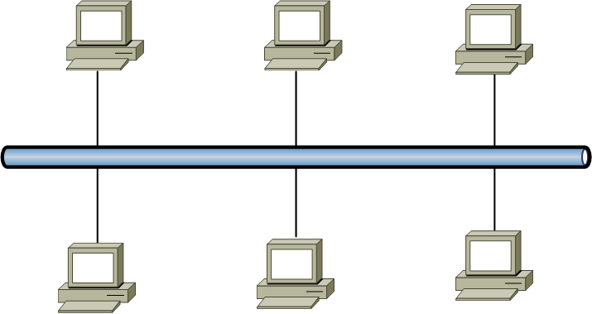
Ethernet Network Using a Shared Bus

Slide 9
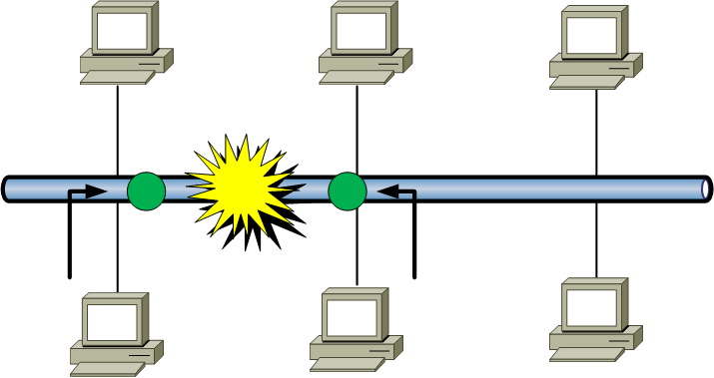
Collision on an Ethernet Segment

Slide 10
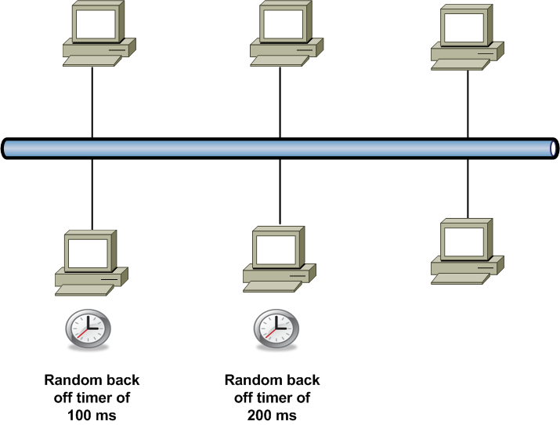
Recovering from a Collision with Random Back Off Timers

Slide 11
CSMA/CD (Carrier Sense Multiple Access with Collision Detection)
Network access method
Controls how nodes access communications channel
Necessary to share finite bandwidth
Carrier sense
Ethernet NICs listen, wait until free channel detected
Multiple access
Ethernet nodes simultaneously monitor traffic, access media

Slide 12
CSMA/CD (cont’d.)
Collision
Two nodes simultaneously:
Check channel, determine it is free, begin transmission
Collision detection
Manner nodes respond to collision
Requires collision detection routine
Enacted if node detects collision
Jamming
NIC issues 32-bit sequence
Indicates previous message faulty

Slide 13
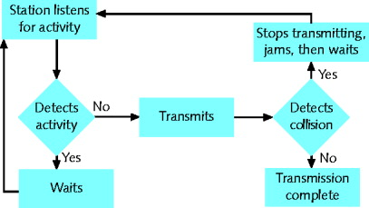
CSMA/CD Process

Slide 14
General Definition
A collision domain -- is a set of network interface cards (NICs) for which a frame sent by one NIC could result in a collision with a frame sent by any other NIC in the same network segment.
A broadcast domain – is a set of NICs for which a broadcast frame sent by one NIC will be received by all other NICs in the same broadcast domain

Slide 15
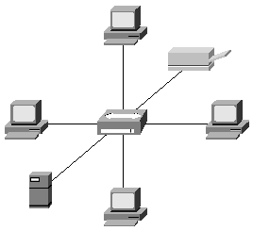
HUB
One collision Domain

Slide 16
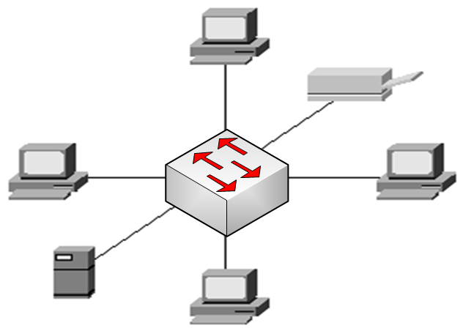
Switches
Six Collision Domains

Slide 17
Simplex, Half-Duplex, and Duplex
Simplex
Signal transmission: one direction
Half-duplex transmission
Signal transmission: both directions
One at a time
One communication channel
Shared for multiple nodes to exchange information
Full-duplex
Signals transmission: both directions simultaneously
Used on data networks

Slide 18
Distance and Speed Limitations
Ethernet Types | Bandwidth Capacities
Standard Ethernet | 10 Mbps: 10 million bits per second (that is 10 megabits per second)
FastEthernet | 100 Mbps: 100 million bits per second (that is 100 megabits per second)
Gigabit Ethernet | 1 Gbps: 1 billion bits per second (that is 1 gigabits per second)
10-Gigabit Ethernet | 10 Gbps: 10 billion bits per second (that is 10 gigabits per second)
100-Gigabit Ethernet | 100 Gbps: 100 billion bits per second (that is 100 gigabits per second)
The type of cabling used in your Ethernet work influences the bandwidth capacity and the distance limitation of your network. See table 4-2, page 115

Slide 19
Virtual LANs (VLAN)
Ethernet Switch Features
Most every Enterprise network today uses the concept of virtual LANs (VLAN).
Before understanding VLANs, you must have a very specific understanding of the definition of a LAN
What is a LAN?
A LAN consists of all devices in the same broadcast domain.

Slide 20
VLANs
All ports on a switch form a single broadcast domain.
To create VLANs the switch separates the ports into many broadcast domains based on configuration settings.

Slide 21
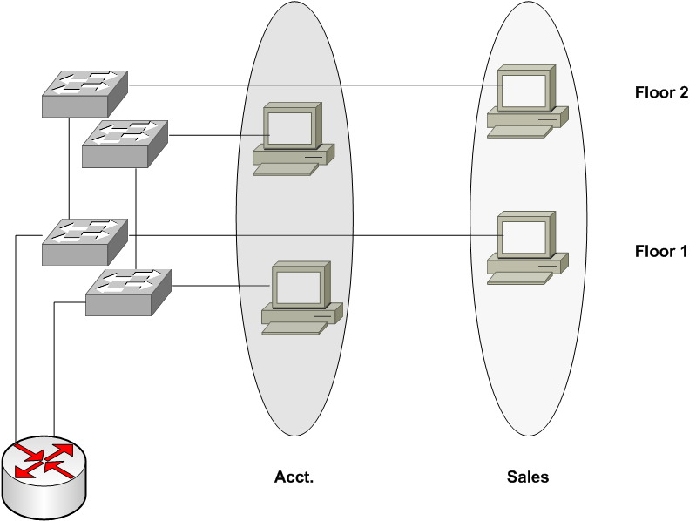
All Ports on a Switch belong to the same Subnet

Slide 22
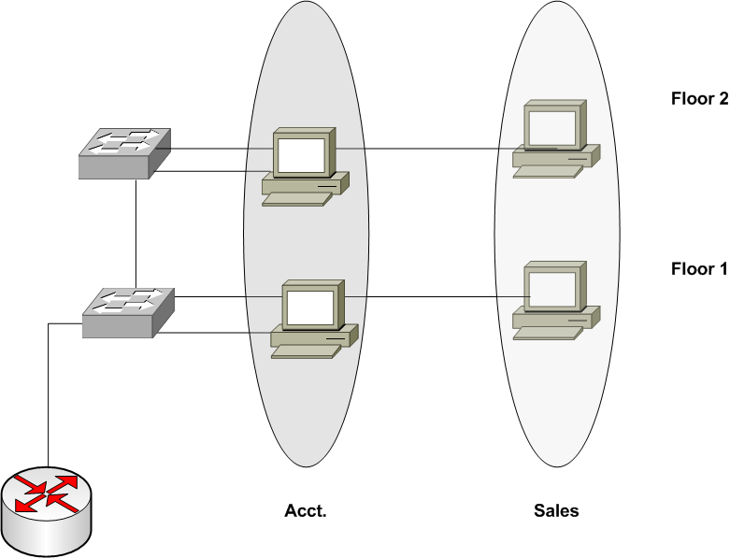
Ports on a Switch belong to the Different VLANs

Slide 23
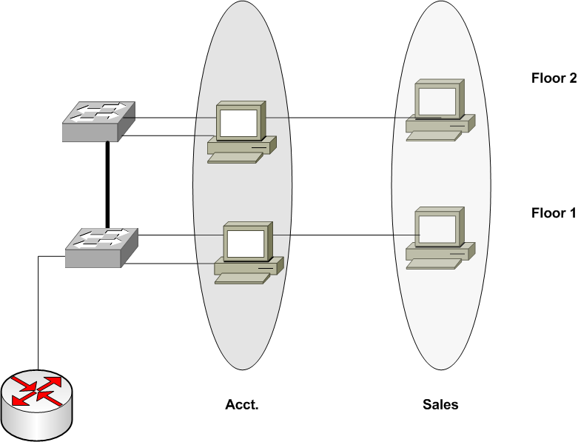
Trunking Between Switches

Slide 24
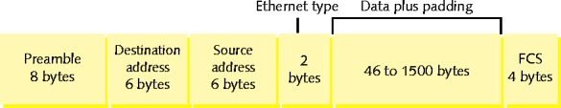
Ethernet Frame
Ethernet_II (DIX) frame

Slide 25
Ethernet Frame with an 802.1q tag
Dest
Src
Len/E-type
Data
FSC
Segment
Frame
Dest
Src
E-type
Tag
Len/E-type
Data
FSC
Tagged
Frame
Priority
VLAN-ID

Slide 26
Spanning Tree Protocol
Without the Spanning Tree Protocol (STP), frames would loop for an indefinite period of time in networks with physically redundant links.
STP blocks some ports form forwarding frames so that only one active path exists between any pair of LAN segments.

Slide 27
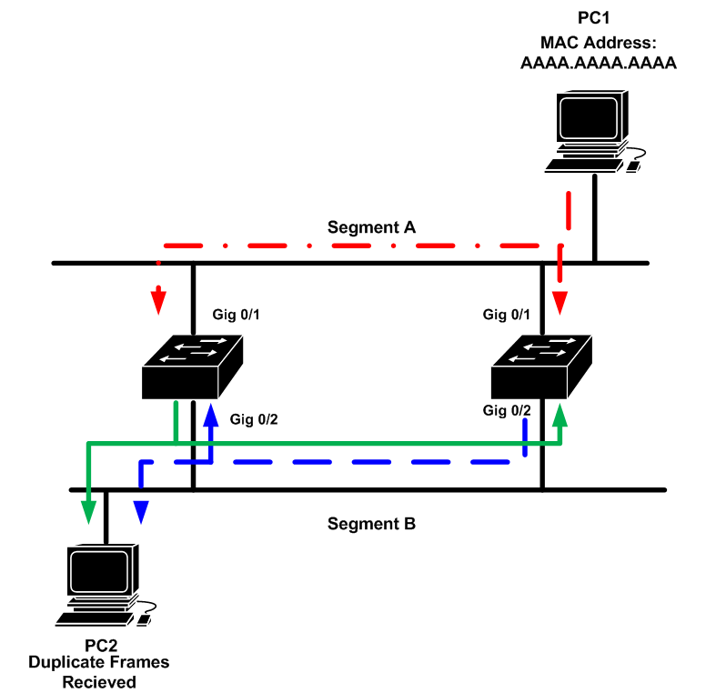
MAC Address Table Corruption
Switch A’s MAC Address Table
Port | Mac Addresses
Gig 0/1 | AAAA.AAAA.AAAA
Gig 0/2 | AAAA.AAAA.AAAA
Switch B’s MAC Address Table
Port | Mac Addresses
Gig 0/1 | AAAA.AAAA.AAAA
Gig 0/2 | AAAA.AAAA.AAAA

Slide 28
Broadcast Storm

Slide 29
STP Terms
Root Switch
Non-root Switch
Administrative Cost
Root Port
Designated Port
Bridge ID
Hello BPDU

Slide 30
How Spanning Tree Works
First STP uses Hello messages, also called switch Protocol Data Units (BPDUs).
Each switch and switch claims to be the root switch, and the one with the lowest bridge ID is elected root.
The Bridge ID is a combination of a priority (2-byte) and a MAC address on the switch (6-byte).
STP places all ports on the root switch into a forwarding state.
The ROOT Switch continually sends Hello BPDUs.
Each non-root switch receives and modifies the BPDUs and passes them on with a new cost inserted.
Cost – port cost assigned to that interface plus the cost listed in a received Hello message..
Each non-root switch uses the cost to find the lowest cost path back to the root.

Slide 31
STP: Reasons for Forwarding State
Characterization of Port | STP STATE | Explanation
All the root switch’s ports | Forwarding | The root switch is always the designated switch on all connected segments.
Each non-root switch’s root port | Forwarding | The port through which the switch has the least cost to reach the root switch.
Each LAN’s designated port | Forwarding | The switch forwarding the lowest-cost BDPU onto the segment is the designated switch for that segment.
All other ports | Blocking | The port is not uses for forwarding frames, nor are any frames received on these interfaces considered for forwarding.

Slide 32
Other STP states
Listening – Listens to incoming Hello messages to ensure that there are no loops, but does not forward traffic or learn MAC addresses on the interface. This is an interim state between blocking and forwarding.
Learning – Still listens to BPDUs, plus leans MAC addresses from incoming frames. It does not forward traffic. This is an interim state between blocking and forwarding.
Disabled – Administratively down.

Slide 33
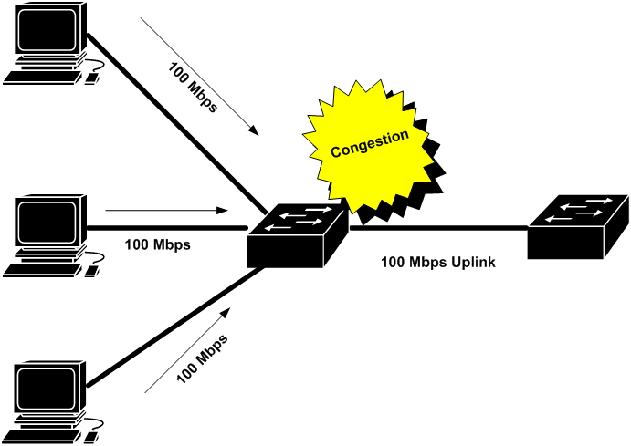
Link Aggregation
If all port on a switch are operating at the same speed, the most likely ports to experience congestion is a port connecting to another switch or router up line from the device.

Slide 34
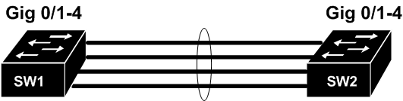
Link Aggregation
To alleviate congested links between switches, you can logically combine multiple physical connection into a single logical connection.

Slide 35
Power over Ethernet (PoE)
Switch applied 2.8 -10V DC to two pairs of leads to detect a 25k Ohm resister in the attached device.
Next the switch must determine is how much power the attached device need. It does this by applying 15.5 – 20.5V DC, for a brief period.
Now the switch can apply the correct voltage, 44–57V DC

Slide 36
Port Monitoring
For troubleshooting purposes you might want to analyze packets flowing over the network.
To accomplish this we need to attach a network sniffer to the network.
A network sniffer is a protocol analyzer, like Wireshark
A sniffer works best if attached to a hub, but most network don’t use them today.
To attach a sniffer to a switch we need to set the switch for port mirroring, which allow the switch to copy all packets to a designated port on the switch.

Slide 37
User Authentication
For security purposes, some switches and AP’s might require users to authenticate themselves before gaining access to the rest of the network.
With 802.1X enabled, a switch or AP requires a client to authenticate before communicating on the network.
802.1X terminology
Supplicant: the device that wants to gain access.
Client: the device that forwards the supplicant request to the server
Authenticator: the server that does the authentication.

Slide 38
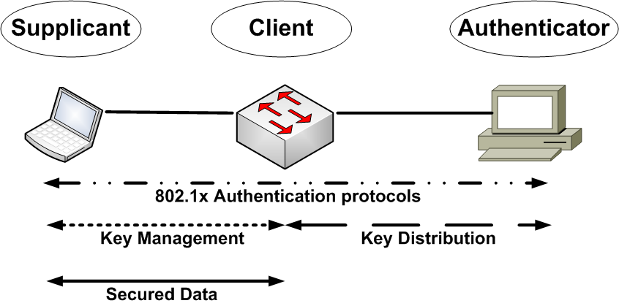
User Authentication

Slide 39
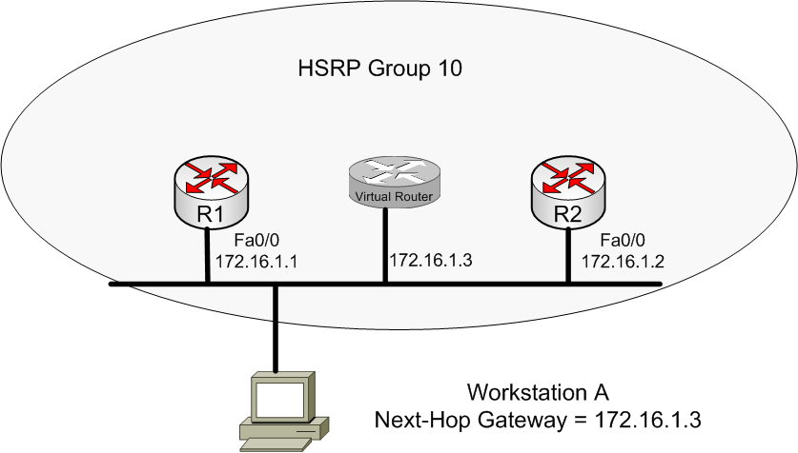
First Hop Redundancy

Slide 40

Summary
The origins of Ethernet, which included a discussion of Ethernet’s CSMA/CD features.
A variety of Ethernet standards were contrasted in terms of media type, network bandwidth, and distance limitation.
Various features that might be available on modern Ethernet switches. These features include VLANs, trunking, STP, link aggregation, PoE, port monitoring, user authentication, and first hop redundancy.

