Slide 1

CompTIA Network +
Chapter 5
Working with IP Addresses

Slide 2
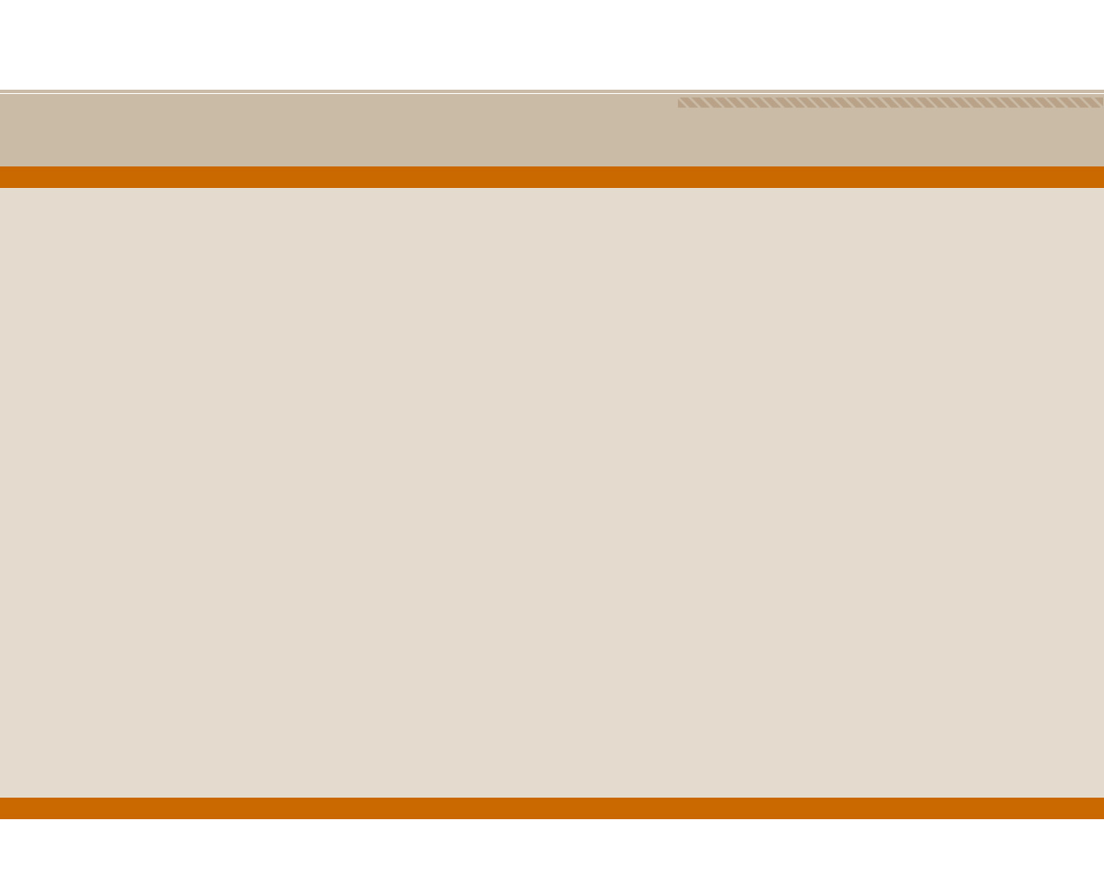
Objectives
What is the format of an IP version 4 (IPv4) address, and what are the distinctions between unicast, broadcast and multicast addresses?
Which options are available for assigning IP addresses to network devices?
Given a subnet design requirement (for example, a number of required subnets and a number of required hosts per subnet), how do you determine the appropriate subnet mask for a network?
What are the primary characteristics of IPv6?

Slide 3
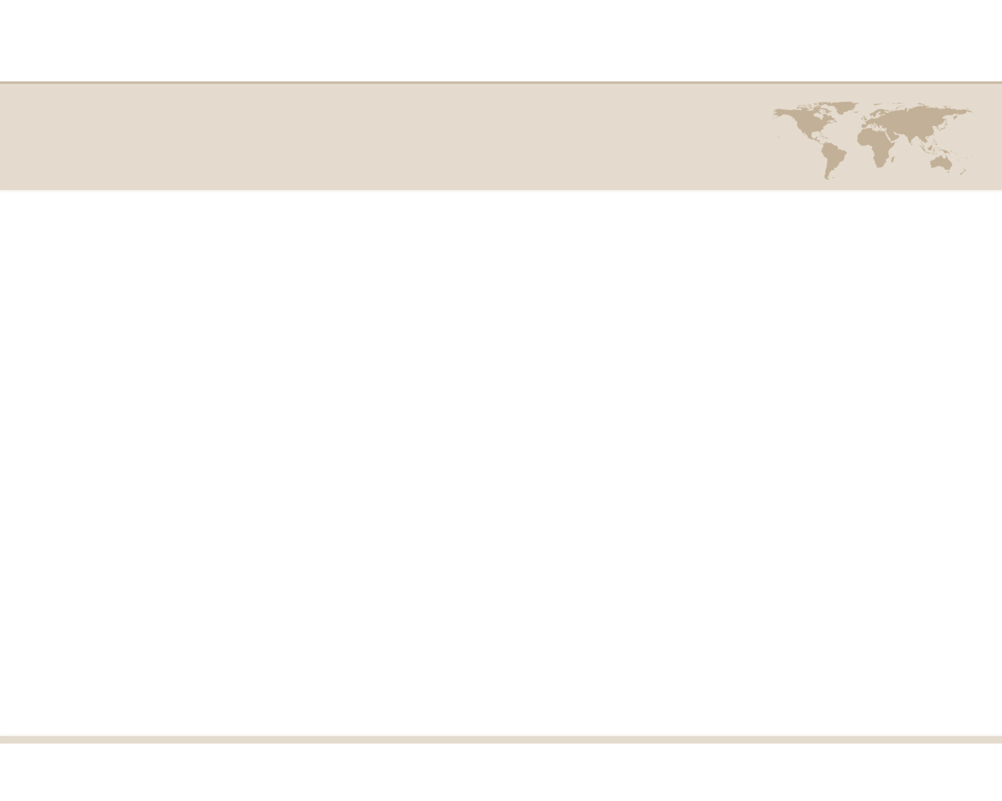
Working with IP Addresses
When two devices on a network want to communicate, they need logical addresses.
Most modern networks use Internet Protocol (IP) addressing, as opposed to other Layer 3 addressing.
Two versions of IP addressed, first we will discuss how IP concepts are applied to IP version 4 (IPv4).
Next, various options for assigning IP addresses to end stations are contrasted.

Slide 4
IPv4 Addressing
Although IPv6 is increasingly being adopted in corporate networks, IPv4 is by far the most popular Layer 3 addressing scheme in today’s networks.
Devices on an Ipv4 network use unique IP addresses to communicate with one another.
An IPv4 address is a 32-bit address. That is typically written in dotted-decimal notation. Such as 10.1.2.3

Slide 5
IPv4 Addressing
Notice that the IP address is divided into four separate numbers, separated by periods.
Each of these four divisions represents 8 bits, and are called octets.
IP addressing
Unique IP address per host
Unique address per logical network
Communicate between LANs without broadcasts

Slide 6
IPv4 Address Structure
IP Addresses (IPv4 only]
32-bit value
Example: 11000000101010000000010000000010
Broken into four groups of eight 11000000.10101000.00000100.00000010
Each 8-bit value converted into a decimal number between 0 and 255, 192.168.4.2

Slide 7
IPv4 Address Structure
IP Addresses in Action
IP must do three things
Give each LAN its own identifier
Allow routers connecting LANs to use network identifiers to send packets to the right network
Give each computer a way to understand when a packet is intended for a computer on the local LAN or for a computer on the WAN

Slide 8
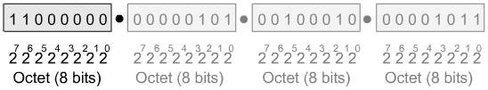
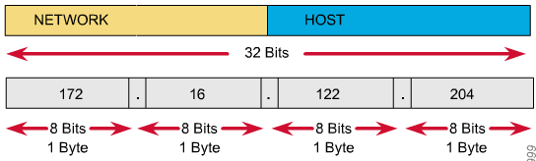
IPv4 Address Structure

Slide 9
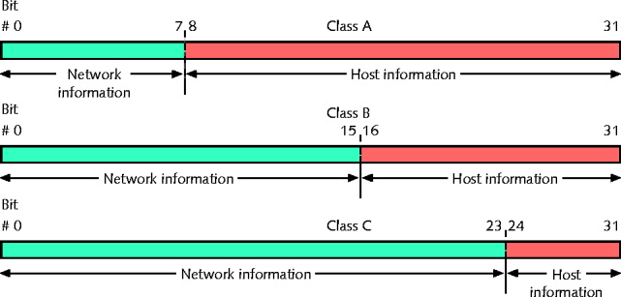
IPv4 Address Structure
IP must give each LAN its own identifier
Network IDs
All computers on same LAN must have same network ID
Each computer on same LAN must have a unique host ID

Slide 10
IPv4 Address Structure
Network information (network ID)
First 8 bits in Class A address
First 16 bits in Class B address
First 24 bits in a Class C address
Host information
Last 24 bits in Class A address
Last 16 bits in Class B address
Last 8 bits in Class C address

Slide 11
IPv4 Subnet Masks
Identifies how network subdivided
Indicates where network information located
Subnet mask bits
1: corresponding IPv4 address bits contain network information
0: corresponding IPv4 address bits contain host information

Slide 12
IPv4 Address Structure
Example Class A network address: 114.56.20.33, 255.0.0.0
Network information = 114.
Host information = 56.204.33
Example Class B network address: 147.12.38.81, 255.255.0.0
Network information = 147.12.
Host information = 38.81
Example Class C network address: 214.51.42.7, 255.255.255.0
Network information = 214.57.42.
Host information = 7

Slide 13
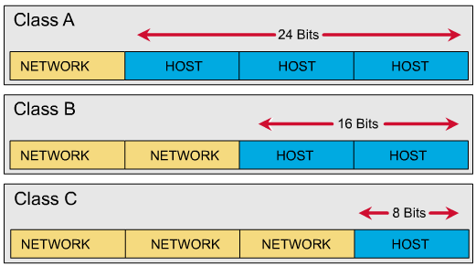
IPv4 Address Classes

Slide 14
IPv4 Address Classes
Address Class | Value in First Octet | Classful Mask (Dotted Decimal) | Classful Mask (Prefix Notation)
Class A | 1 -126 | 255.0.0.0 | /8
Class B | 128 -191 | 255.255.0.0 | /16
Class C | 192 - 223 | 255.255.255.0 | /24
Class D | 224 – 239 | N/A | N/A
Class E | 240 – 255 | N/A | N/A

Slide 15
IPv4 Special Address
Private Address
Address Class | Address Range | Default Subnet Mask
Class A | 10.0.0.0 – 10.255.255.255 | 255.0.0.0
Class B | 172.16.0.0 – 172.31.255.255 | 255.255.0.0
Class B | 169.254.0.0 – 169.254.255.255 | 255.255.0.0
Class C | 192.168.0.0 – 192.168.255.255 | 255.255.255.0

Slide 16
IPv4 Special Address
Loopback Address
Address Class | Address Range | Default Subnet Mask
Class A | 127.0.0.1 – 127.255.255.255 | 255.0.0.0

Slide 17
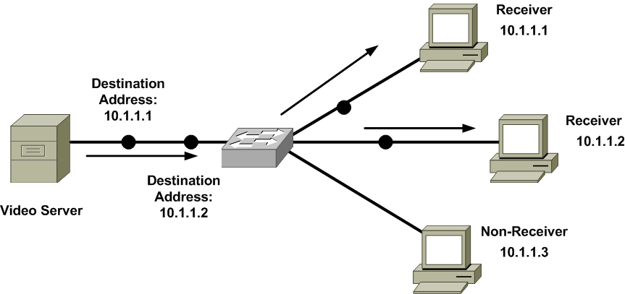
Types of Addresses
Unicast
meaning that traffic travels from a single source device, to a single destination device.

Slide 18
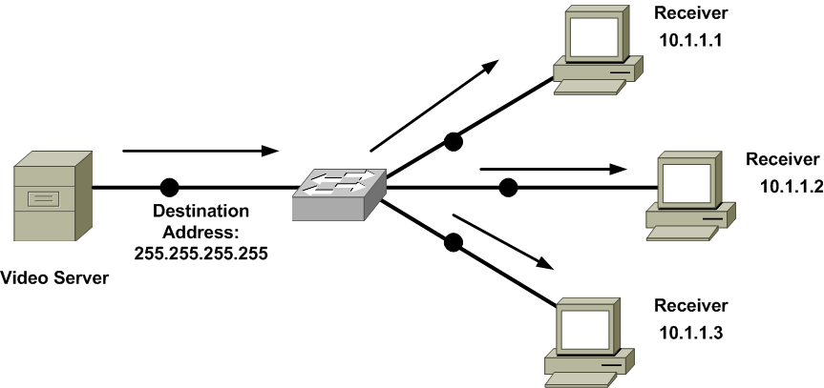
Types of Addresses
Broadcast
meaning that traffic travels from a single source device, to all destination device.

Slide 19
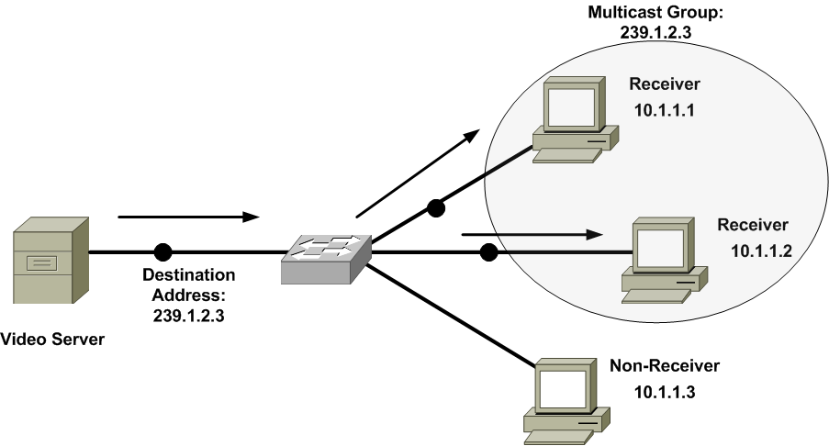
Types of Addresses
Multicast
meaning that traffic travels from a single source device, to multiple, yet specific, destination devices.

Slide 20
Assigning IPv4 Addresses
At this point, you should understand that network each devices need an unique IP address.
However, beyond just and IP address, what other IP address-related information does a host need to communicate?
And how do does it get them?

Slide 21
Assigning IPv4 Addresses
IP address parameters required by each host to be able to communicate on the LAN and beyond.
IP address
Subnet mask
Default gateway
DNS server address

Slide 22
Assigning IPv4 Addresses
A simple way of configuring a PC, with IP address parameters is to statically configure that information.
This is time consuming, prone to human errors, and is not practical in large enterprise networks.
Instead of static IP address assignments, many corporate networks dynamically assign IP address parameters to their devices.

Slide 23
Assigning IPv4 Addresses
There are two options when using automatic assigning of IP addresses.
Bootstrap Protocol (BOOTP)
A method of assigning IP address, subnet mask and default gateway information to diskless workstation.
Dynamic Host Configuration Protocol (DHCP)
A method of assigning IP address, subnet mask, default gateway, DNS server, and more.

Slide 24
Assigning IPv4 Addresses
When a device does not have a static IP address configured and it can not contact a DHCP server, it still might be able to communicate on an IP network thanks to Automatic Private IP Addressing (APIPA).
APIPA allows a network device to self-assign an IP address from the 169.254.0.0/16 network.

Slide 25
Subnetting
Default subnet mask (that is, classful subnet mask) are not always the most efficient choice.
Fortunately we can add additional bits to a subnet masks (thereby extending the subnet mask) to create subnets within a classful network.
To create a subnet address, a network administrator borrows bits from the original host portion and designates them as the subnet field.

Slide 26
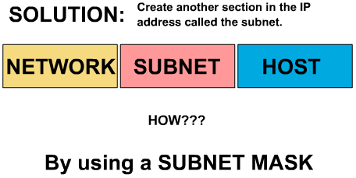
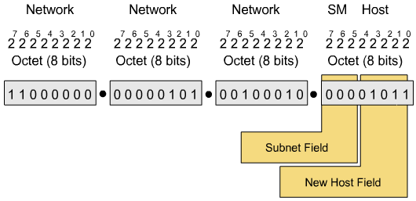

Slide 27
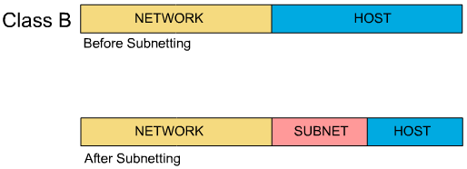
Subnet Addresses

Slide 28
Purpose of Subnetting
More efficient use of IP addresses than classful default
Enables separation of networks for security
Enables bandwidth control
Subnet mask is cornerstone of subnetting
Extend subnet masks of /8, /16, or /24 subnet by adding more ones (removing equal number of zeroes).

Slide 29
Subnetting (how-to)
The process
The class rules define the network part
The mask binary 0s define the host part
What’s left over defines the size of the subnet part.
Number of subnets = 2^{number-of-subnet-bits} – 2
Number of hosts per subnet = 2^{number-of-host-bits} – 2
IP addressing conventions define that two subnets per network should not be used and that two hosts per subnet should not be used.
This equates to the formula 2^{n}-2

Slide 30
IP Subnetting Guide
1. To subnet an IP address we need to setup our work sheet as follows: (this will aid you in completing the work.)
First, at the top of your work sheet lay out the number line as shown.
7 6 5 4 3 2 1 0 Power of 2 line
128 64 32 16 8 4 2 1 Answer line
Next, place the subnetting formula at the left of the number line.
Third, write down the base IP address that you will be subnetting, as shown.
Last, notice the box above the subnetting formula;
this is to place your power of two from the power line.
2 -2= 192.168.0.0

Slide 31
IP Subnetting Guide
It is time to start the process of subnetting an IP address.
a. The first thing that we must do is to decide how many subnets that you need. This is done by looking at how many ports are on your router. For example if your router has four ports on the back and three are going to be used for your network, we will need to subnet our base IP Address into three networks.
3. Turn to your work sheet; place the number 3 with a question mark next to the formula, as shown.
2 -2=3?

Slide 32
IP Subnetting Guide
4. Next, look at the bottom line on the sheet and find the number that is closest to your answer after subtracting 2 from it.
Then, look at the number above it and place it in the box. (by looking at the answer line and subtracting 2 from it, we find the 8-2=6 and the number above is 3, so 3 goes in the box) Then strike through your old answer
5. The next step is to calculate the new subnet mask number.
This is done by looking at the number that is in the box. (From this number we will be placing a one below the number line starting from the left, as shown).
Then take the numbers above the ones and add them up 128+64+32=224. Then combine them with the default subnet mask for that class address as shown.

Slide 33
IP Subnetting Guide
Now we have to figure out the network separation number. To do this look at the rightmost one; the number above it is your separation number.
This number is going to be used to set the beginning address for each of the three networks. In my example the number is 32. This is the number that we are going to use.
7. The next step is to create an IP Address for each of our router ports. This is generally the first usable IP Address after the network number.

Slide 34
IP Subnetting Guide
8. Now we need to find the broadcast address. This is always the last number in the range. To find it, subtract one from the next network number.
The last thing is to fill in between the router # and the broadcast #; this is called the VALID HOST RANGE.
10. Now you are done

Slide 35
Classless Inter-Domain Routing
Although subnetting is the process of extending a classful subnet mask (that is, adding 1’s to a classful mask), Classless Inter-Domain Routing (CIDR) does both.
CIDR, is used by our ISP’s in the world to control the addressing groups assigned to them by ARIN.

Slide 36
IPv6 Addressing
With the global proliferation of IP-based networks, available IPv4 address have run out.
Fortunately, IPv6 provides enough IP address for many generations to come.
IPv6 dramatically increases the number of available IP address. IPv6 offers approximately 5 * 10²⁸ IP address for each person on the plant.

Slide 37
IPv6 Addressing
IPv6 Features:
Simplified header
No broadcast
No fragmentation
Can coexist with IPv4

Slide 38
IPv6 Address Structure
Feature | IPv6
Size of address (bits or byes per octets) | 128 bits, 16 octets
Example address | 0000:0000:0000:0000:0000:FFFF:FFFF:0A01:0101
Number of possible address, ignoring reserved values | 2¹²⁸, or roughly 3.4 * 10³⁸

Slide 39
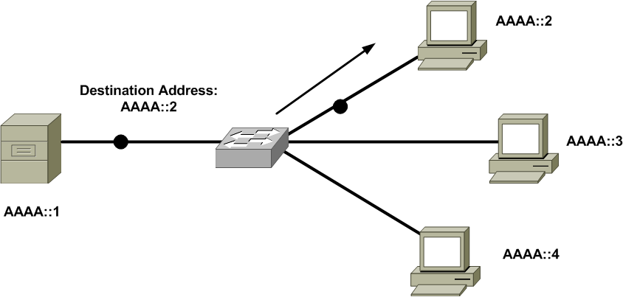
IPv6 Unicast

Slide 40
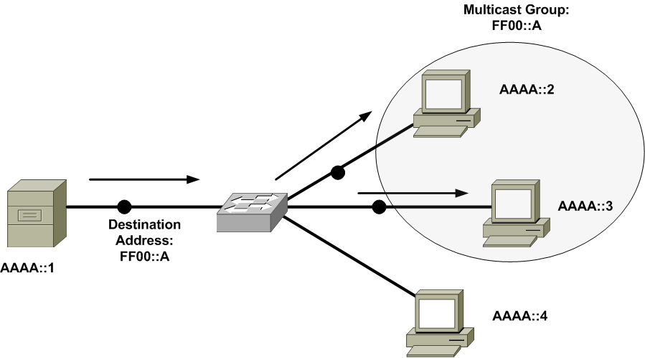
IPv6 Multicast

Slide 41
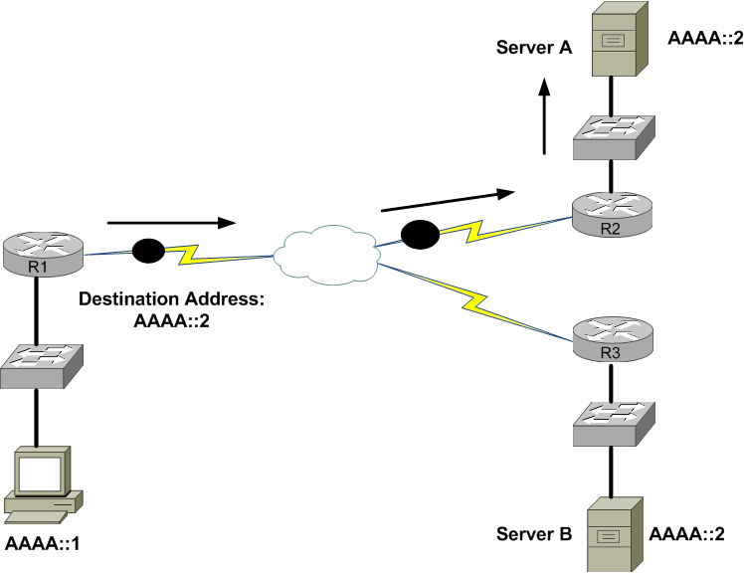
IPv6 Anycast

Slide 42
IP Address Management
Internet Corporation
for Assigned Names and Numbers
(ICANN)
North America
Out side North America
American Registry for Internet Numbers
(ARIN)
Internet Assigned Numbers Authority
(IANA)
ISP’s
(Comcast)
ISP’s
(Verizon)
YOU

Slide 43

Summary
The characteristics of IPv4 were presented, including IPv4’s address format and a contrast of unicast, broadcast, multicast data flows.
You examined various approaches for assigning IP information to network devices. These approaches included static assignments, dynamic assignment (BOOTP and DHCP), and APIPA.
Multiple examples and practice exercises were provided for various subnets calculations.
The characteristics of IPv6 were highlighted, including the IPv6 address format and IPv6 data flows (unicast, multicast and anycast).

