Slide 1

CompTIA Network +
Chapter 6
Routing Traffic

Slide 2

Objectives
How are source and destination IP addresses used to route traffic through a network?
What are sources for routing information used to populate a router’s routing table?
How do routed protocols differ from routing protocols?
When multiple routing protocols know how to reach a destination network, which route is chosen?
When a single routing protocols knows of multiple routes to reach a destination network, how is the preferred path (or paths) chosen?

Slide 3
Objectives
What is the distinction between IGP and EGP?
What are the primary differences between distance-vector and link-state routing protocols?
What are the characteristics of the following routing protocols: RIP, OSPF, IS-IS, EIGRP, and BGP?
How does NAT perform IP address translation, and how do the PAT, SNAT and DNAT approaches to NAT differ?
What protocols are used to route multicast traffic?

Slide 4
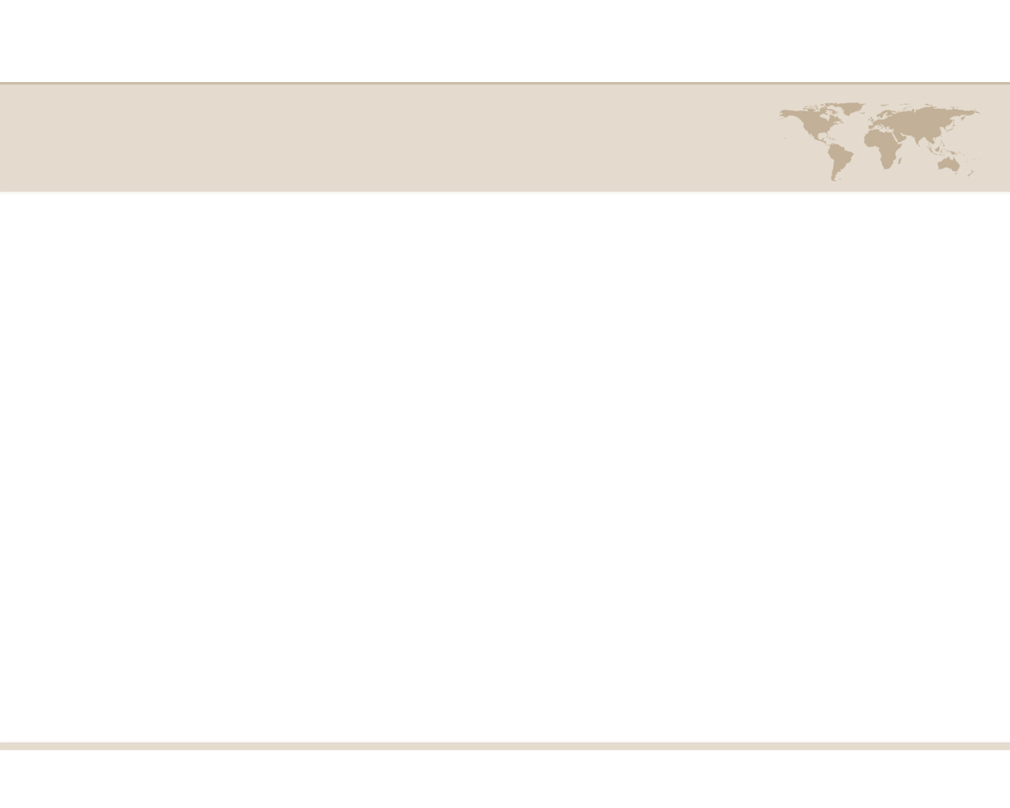
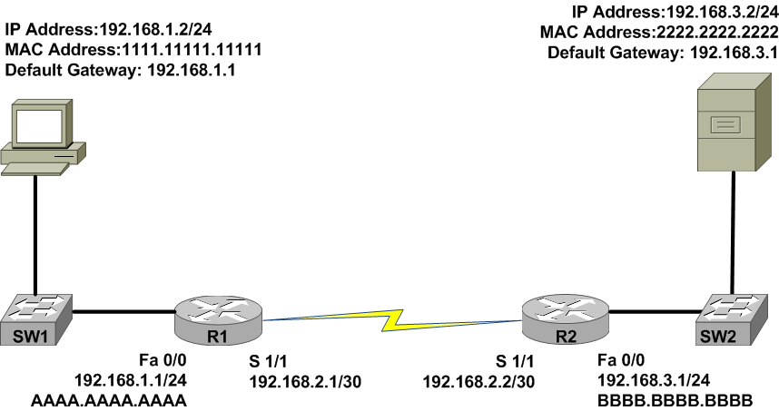
Basic Routing Processes

Slide 5
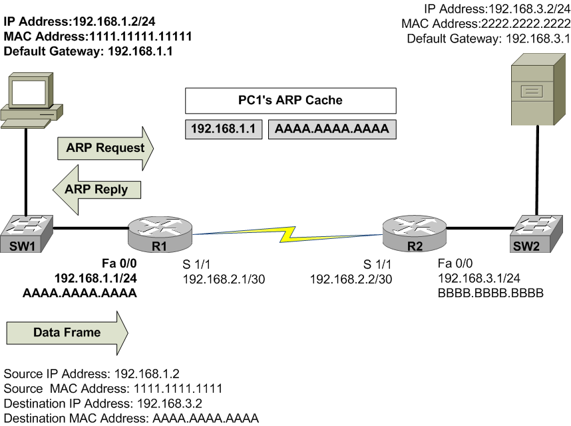
Basic Routing Processes

Slide 6
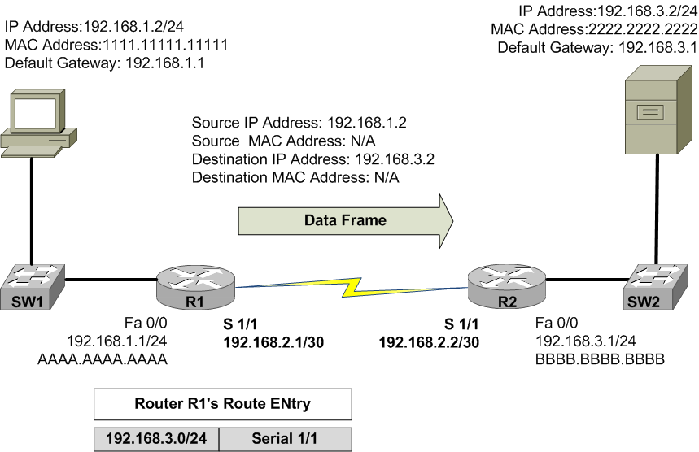
Basic Routing Processes

Slide 7
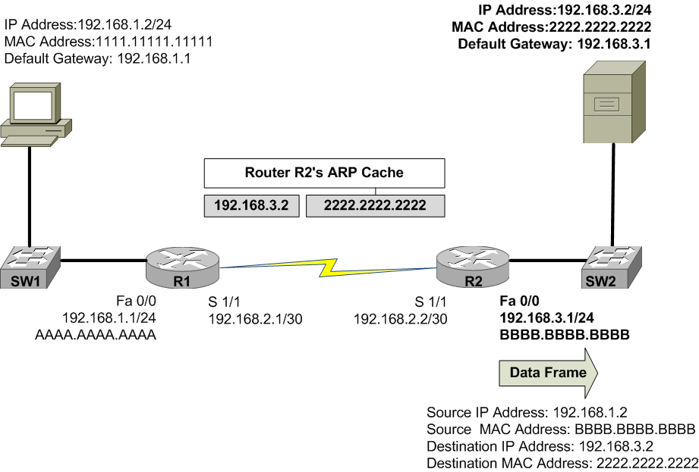
Basic Routing Processes

Slide 8
Source of Routing Information
Before a router can route an IP packet, it needs to populate its routing table. A Router’s routing table can be populated from the following sources.
From directly connected networks (configured interfaces)
Called a directly connected route
An administrator could statically configure a route table.
Called a static route, an/or default static route
A router could learn routes dynamically via routing protocols.
Called a dynamic route or learned route

Slide 9
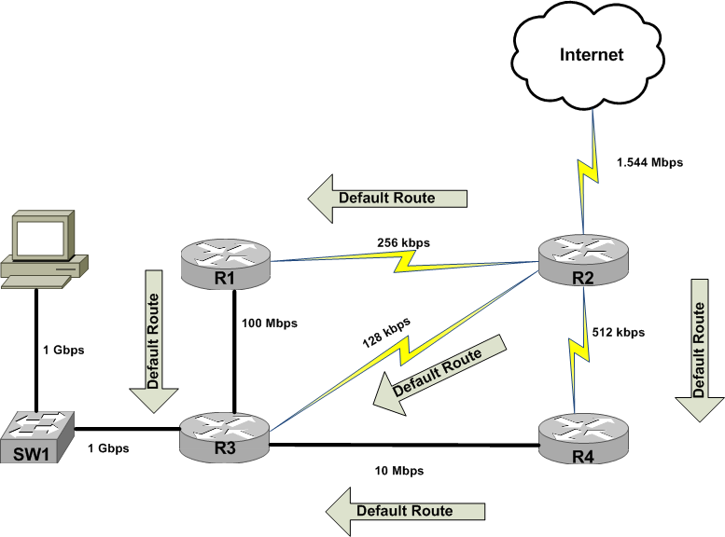
Sources of Routing Information

Slide 10
Routing Protocol Characteristics
Before we can examine the characteristics of routing protocols, we must under stand the following terms:
routed – is a protocol with an addressing scheme that defines different network
examples: IP, IPX, AppleTalk
routing – is a protocol that advertises route information between routers.
examples: RIP, OSPF, EIGRP, BGP

Slide 11
Routing Protocol Characteristics
Routing Protocol hierarchy:
Exterior Gateway Protocol (EGP’s)
Distance Victor
Boarder Gateway Protocol (BGP)
Link State
None
Interior Gateway Protocol (IGP’s)
Distance Victor
RIPv1
RIPv2
Link State
OSPF
Hybrid
EIGRP

Slide 12
Believability of a Route
If a network is running more than one routing protocol, which advertisement does the router believe?
Routing Information Source | Administrative Distance
Directly connected network | 0
Statically configured network | 1
EIGRP | 90
OSPF | 110
RIP | 120
External EIGRP | 170
Unknown or unbelievable | 255

Slide 13
Believability of a Route
The index of believability is called administrative distance (AD). The lower the AD values the more the router trust the information source.
If the routing protocol learns of more than one path to reach a remote network, it must choose one over the other, how?
It varies on the routing protocol and what that routing protocol uses as a metric.
A metric – is a value assigned to a route, and the lower the value, the better the route.

Slide 14
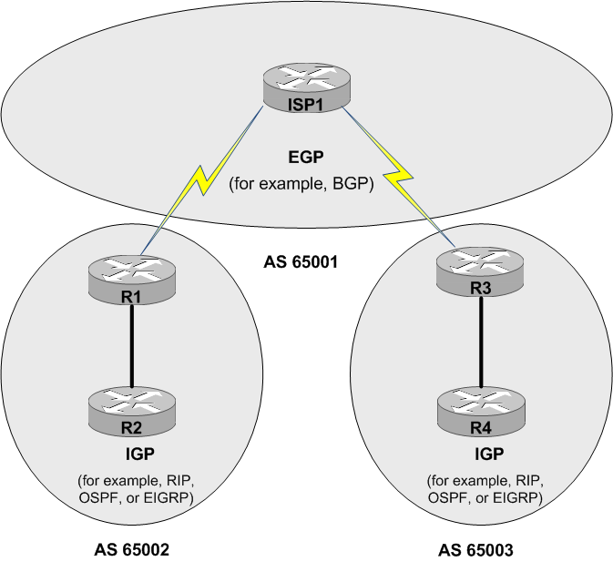
Interior versus Exterior Gateway Protocols

Slide 15
Route Advertisement Method
Routing Protocol hierarchy:
Distance Victor
Sends a full copy of its routing table to its directly connected neighbors.
This is a periodic advertisement, meaning that, at regular intervals, re-advertise its full routing table.
Slow convergence time.
Metric, equals hop count.
Uses hold down timers, split horizon, poison reverse for loop avoidance.

Slide 16
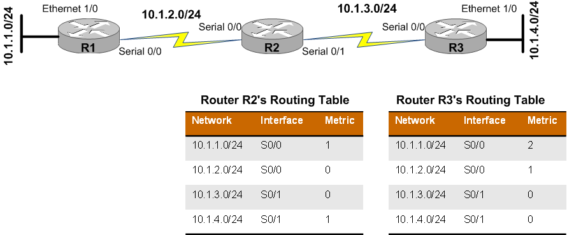
Route Advertisement Method

Slide 17
Route Advertisement Method
Routing Protocol hierarchy:
Link State
Rather than having neighboring routers exchange their full routing tables with one another, a link state protocol allows routers to build a topology map of the network.
They send link-state advertisements (LSA) to advertise the networks they know how to reach.
Router than use these LSAs to build a topology map.
From this map, using the Dijkstra’s Shortest Path First algorithm to build there route table.
New LSA’s our only sent when the topology changes.

Slide 18
Routing Protocol Examples
Interior Gateway Protocols
Router Information Protocol (RIP)
Open Shortest Path First (OSPF)
Enhanced Interior Gateway Routing Protocol (EGIRP)
Exterior Gateway Protocols
Intermediate System to Intermediate System (IS-IS)
Boarder Gateway Protocol (BGP)

Slide 19
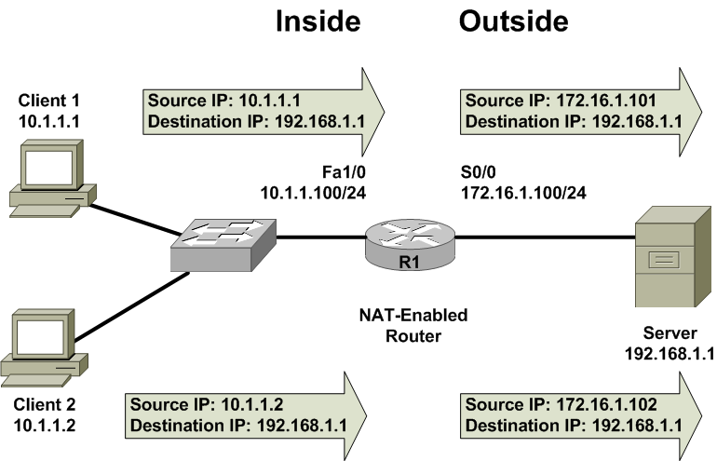
Address Translation
Router R1’s NAT Translation Table
Inside Local Address | Inside Global Address
10.1.1.1 | 172.16.1.101
10.1.1.2 | 172.16.1.102

Slide 20
Address Translation
Network Address Translation (NAT)
Dynamic NAT (DNAT) – assigns IP address from a pool of addresses, one to one translations.
Static NAT (SNAT) – assigns IP address manually, one to one translations
Port Address Translation (PAT) – assigns IP address using a many to one translation.

Slide 21
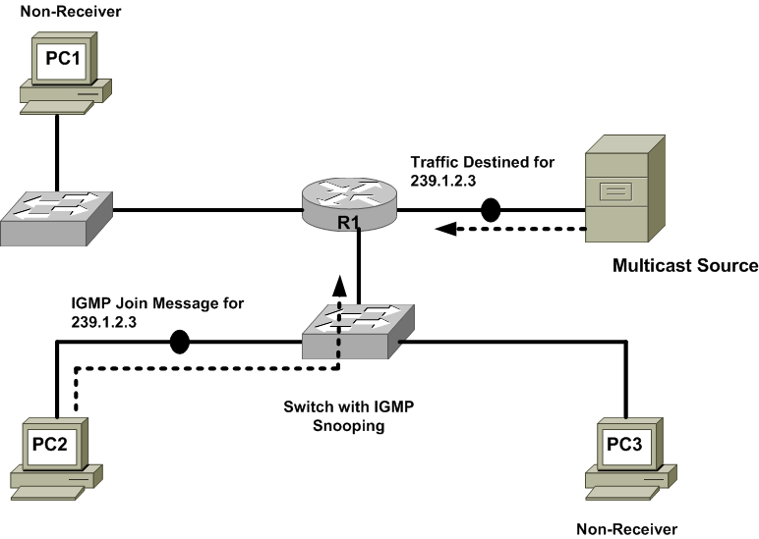
Multicast Routing

Slide 22
Multicast Routing
IGMP -- is a protocol used by clients to notify there nearby router that they wish to join a multicast group.
PIM -- is a protocol used by routers to advertise and control multicast routes.

Slide 23

Summary
How routers forward traffic through a network based on source and destination IP addresses
The source of route information used to populate a router’s routing table. These sources include directly connected routes, statically configured routes, and dynamically learned routes.
A distinction was made between routed protocols (for example, IP) and routing protocols (such as OSPF).
Some routing sources are more trustworthy than other routing sources, based on their administrative distances.
Different routing protocols use different metrics to select the best route in the presence of multiple routes

Slide 24
Summary
This chapter distinguished between IGPs (which run within an autonomous system) and EGPs (which run between autonomous systems).
The behavior of distance-vector and link-state routing protocols were contrasted and you saw how split-horizon, and poison reverse could prevent a routing loop in a distance-vector routing protocol environment
Today’s most popular routing protocols (including RIP, OSPF, EIGRP, and BGP) were presented, along with their characteristics.
NAT can be used to translate private IP addresses inside a network to publicly routable IP address.

Slide 25
Summary
This chapter discussed the IGMP and PIM protocols used in multicast networks. These protocols work together to allow a network to only forward multicast traffic over links needing that traffic

