Slide 1

CompTIA Network +
Chapter 7
Introducing Wide-Area Networks

Slide 2

Objectives
What are three categories of wide-area networks (WAN) connections?
How are data rates measured a various WAN technologies?
Which are the characteristics of the following WAN technologies: dedicated leased line, digital subscriber line (DSL), cable modem, Synchronous Optical Network (SONET), satellite, Plain Old Telephone Service (POTS), Integrated Services Digital Network (ISDN), Frame Relay, Asynchronous Transfer Mode (ATM), and Multiprotocol Label Switching (MPLS)?

Slide 3

Introducing Wide-Area Networks
In the early 1990s, computer-networking design guides invoked the Pareto Principle, which stated that 80% of your traffic stays local, while only 20% of your traffic leaves the local network. This was called the 80/20 Rule.
Today this is reversed, network traffic patterns are more closely approximated with 20/80 Rule.

Slide 4
WAN Properties
Some WAN connections are considered to be always-on, in that the connection is always available without having to first set up the connection.
Conversely, some WAN technologies are on-demand, meaning that the connection is not established until needed.

Slide 5
WAN Properties
WAN connection can generally be classified into one of three categories:
Dedicated leased Line
Circuit-switched Connection
Packet-switched Connection

Slide 6
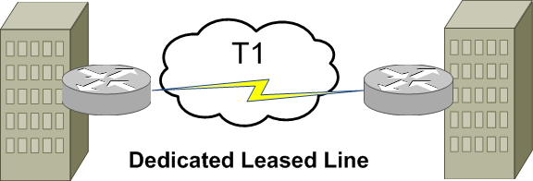
WAN Connection Types

Slide 7
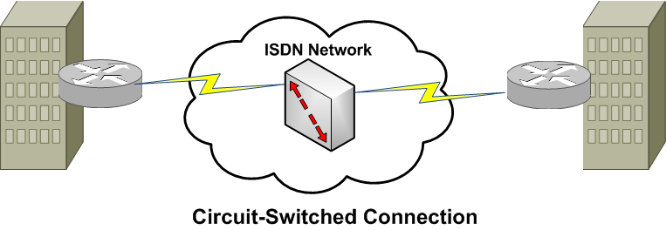
WAN Connection Types
Connection brought up when needed, like a phone call (virtual circuit)

Slide 8
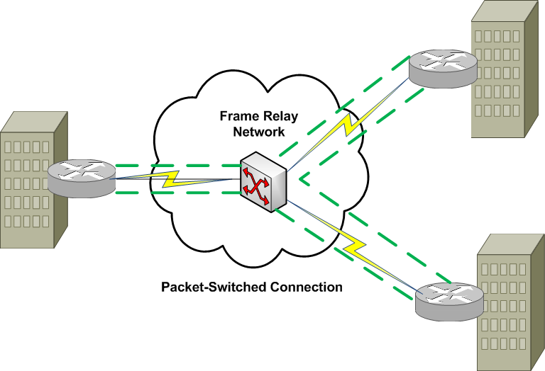
WAN Connection Types
Always on
Multiple customers share bandwidth

Slide 9
WAN Data Rates
WAN links are typically slower than LAN links; however, some WAN technologies boast a bandwidth capacity in tens of Gbps.
Error in textbook near table 7-1 faster -> slower
Aside from measuring bandwidth in kbps, Mbps or Gbps, high-speed optical networks often use optical carrier (OC) levels to indicate bandwidth.
OC-1 link is 51.84 Mbps

Slide 10
WAN Data Rates
WAN Technology | Typical Available Bandwidth
Frame Relay | 56 kbps – 1.544 Mbps
T1 | 1.544 Mbps
T3 | 44.736 Mbps
E1 | 2.048 Mbps
E3 | 34.4 Mbps
ATM | 155 Mbps – 622 Mbps
SONET | 51.84 Mbps (OC-1) – 159.25 Gbps (OC-3072)

Slide 11
WAN Media Types
Physical Media
Unshielded twisted pair (UTP)
Coaxial Cable
Fiber-optic cable
Electric power lines

Slide 12
WAN Media Types
Wireless Media
Cellular phone
LTE goes up to 100 Mbps
WIMAX is slower, and being replaced by LTE
Satellite
HSPA+
Wireless broadband up to 84 <bps

Slide 13
WAN Technologies
Dedicated Leased Line
A dedicated leased line is typically a point-to-point connection interconnecting two sites.
All the bandwidth on that line is available to those sites.
WAN technologies commonly used with dedicated leased lines include digital circuit, such as T1, T3 circuits.
A single 64-kbps channel is called a Digital Signal 0 (DS0)

Slide 14
WAN Technologies
T-carriers Single Levels
Carrier | Signal Level | # of T1 signals | # of Voice Channels | Speed
T1 | DS-1 | 1 | 24 | 1.544 Mbps
T1c | DS-1c | 2 | 48 | 3.152 Mbps
T2 | DS-2 | 4 | 96 | 6.312 Mbps
T3 | DS-3 | 28 | 672 | 44.736 Mbps
T4 | DS-4 | 168 | 4032 | 274.760 Mbps

Slide 15
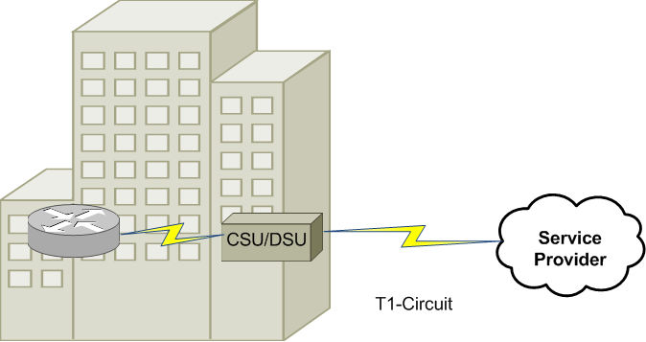
Channel Service Unit / Data Service Unit (CSU/DSU)
CSU/DSU Terminating a Synchronous Circuit

Slide 16
Point-to-Point Protocol
One of the common Layer 2 protocols used on dedicated leased lines is Point-to-Point Protocol (PPP).
Capability to simultaneously transmit multiple Layer 3 protocols.
PPP does this through the use of Control Protocols (CP).
Each Layer 3 CP runs an instance of PPP’s Link Control Protocol (LCP).
Multilink interface
Bonds several physical connections to a single logical interface
For load balancing
Looped link detection
Error detection
Authentication
PAP
CHAP

Slide 17
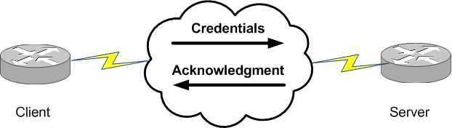
PAP
PAP Authentication

Slide 18
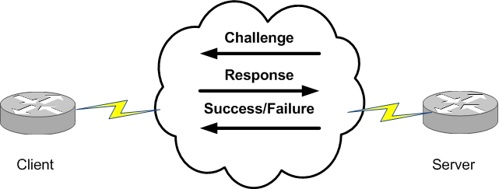
CHAP
CHAP Authentication

Slide 19
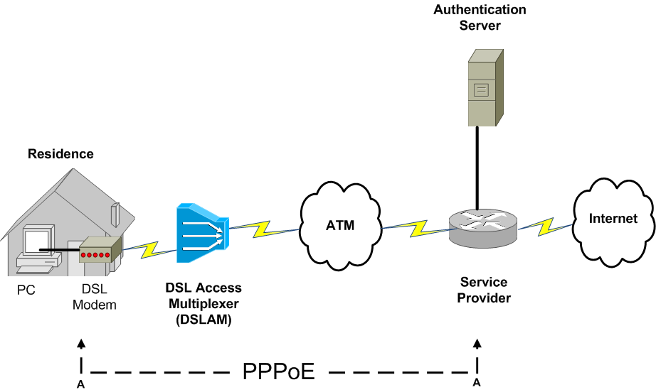
PPPoE

Slide 20
Digital Subscriber Line
Commonplace in many residential and small business locations (SOHO), digital subscriber line (DSL) is a group of technologies that provide high-speed data transmission over existing telephone wiring.
DSL has several variants, which differ in data rate and distance limitations.
Asymmetric DSL (ADSL)
Symmetric DSL (SDSL)
Very High Bit-Rate DSL (VDSL)

Slide 21
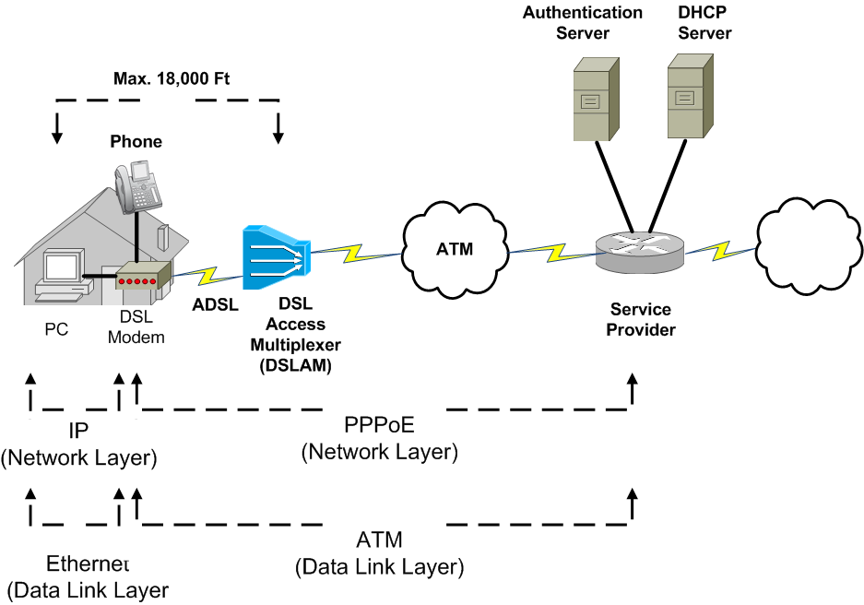
ADSL Sample Topology

Slide 22
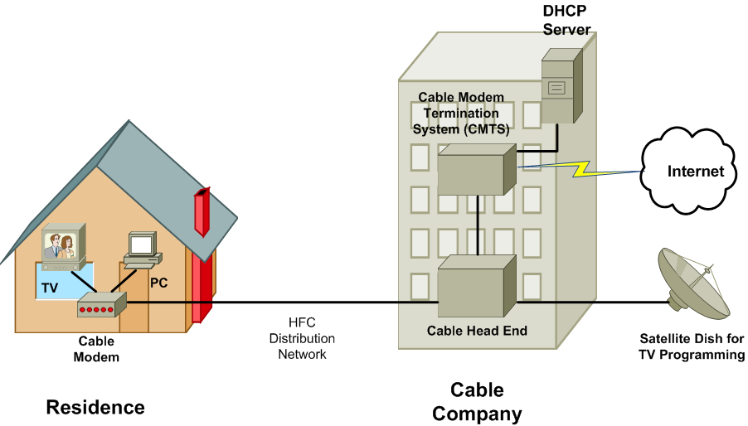
Cable Modem

Slide 23
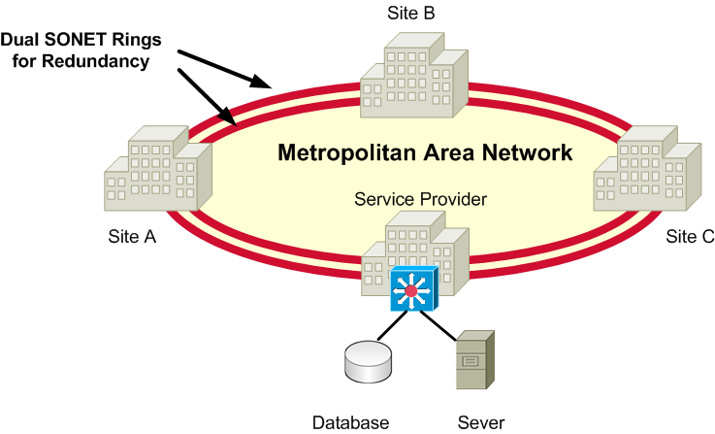
SONET

Slide 24
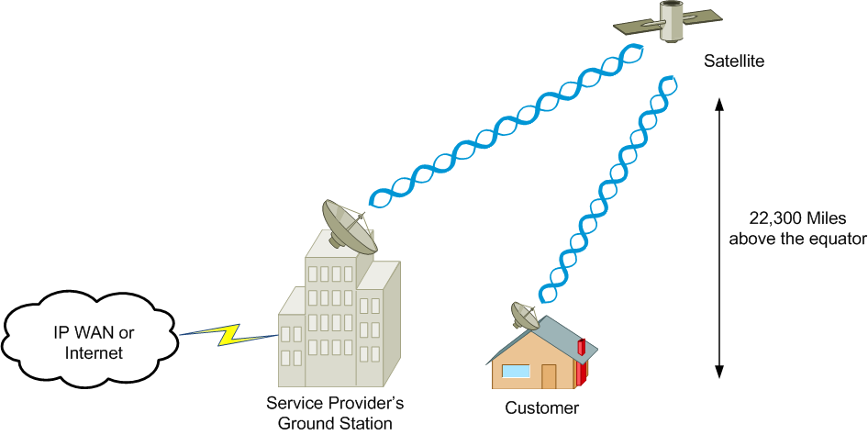
Satellite
High latency
Weather-sensitive

Slide 25
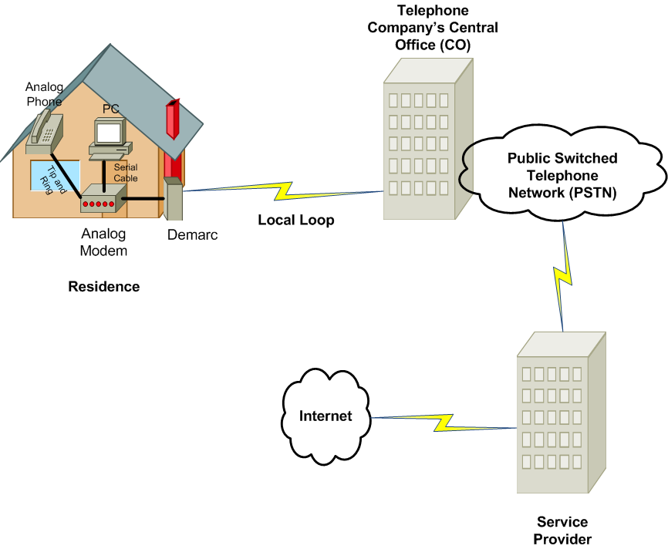
Plain Old Telephone Service

Slide 26
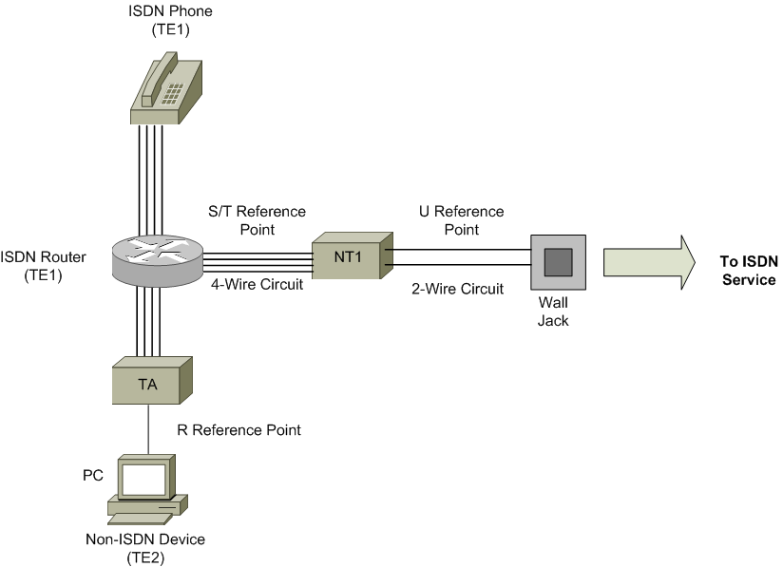
Integrated Services Digital Network
BRI: 128Kbps
PRI: 1.544 Mbps

Slide 27
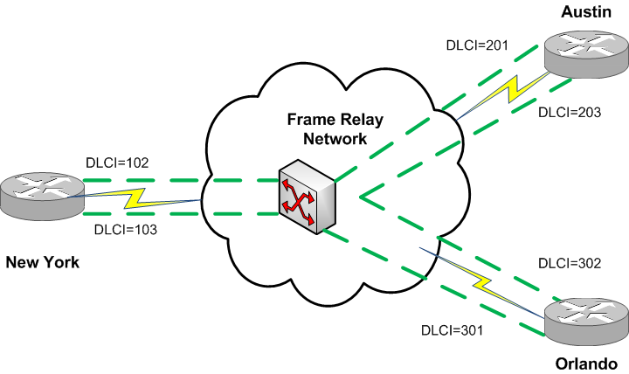
Frame Relay
Virtual circuits at layer 2
PVCs (permanent virtual circuits)
SVCs (switched virtual circuits)

Slide 28
Asynchronous Transfer Mode
Asynchronous Transfer Mode (ATM) is a Layer 2 WAN technology that operates using the concept of PVCs and SVCs.
ATM uses fixed-length cells as its protocol data unit (PDU).
An ATM cell contains a 48-byte payload and a 5-byte header.
5-Byte Header
48-Byte Payload

Slide 29
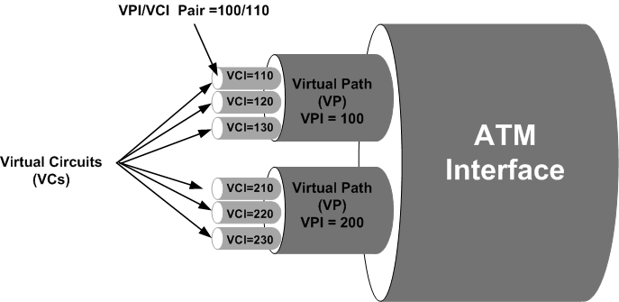
ATM

Slide 30
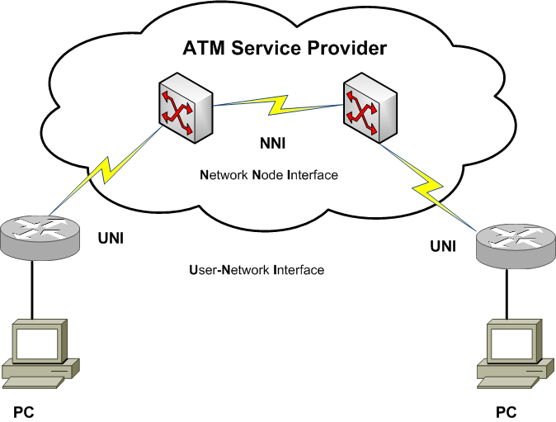
ATM

Slide 31
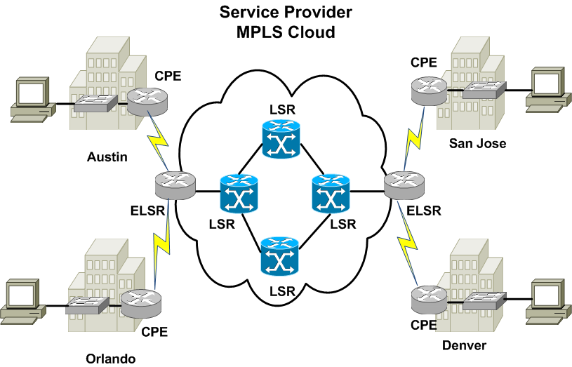
Multiprotocol Label Switching

