Slide 1
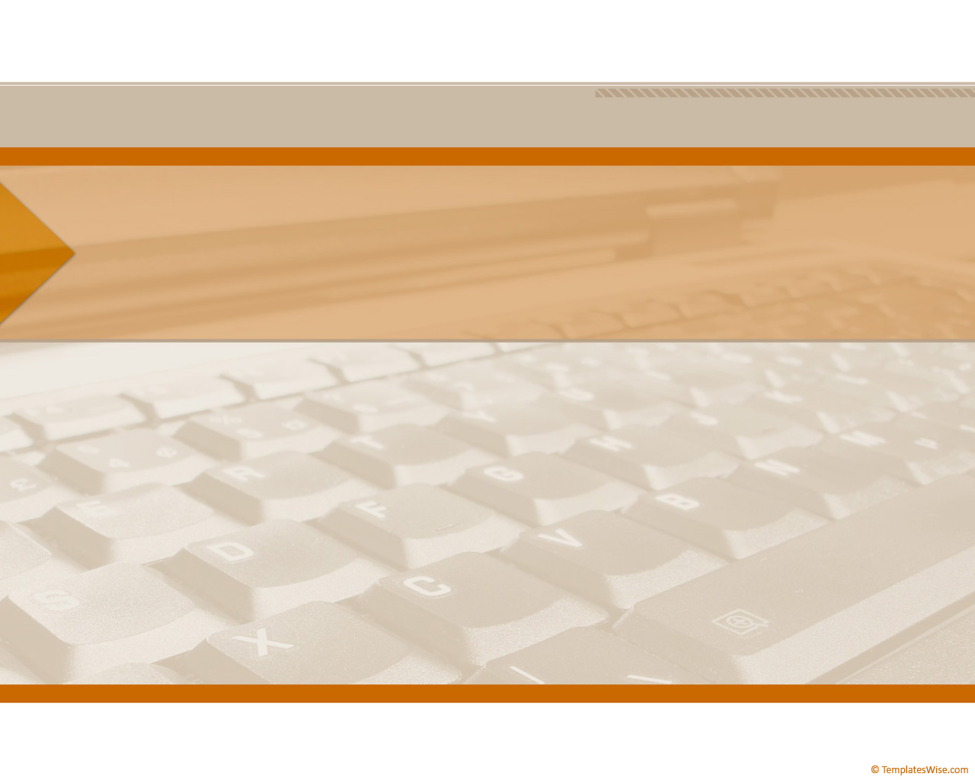
CompTIA Network +
Chapter 8
Connecting Wirelessly

Slide 2

Objectives
How do various wireless LAN (WLAN) technologies function, and what wireless standards are in common use?
What are some of the most important WLAN design considerations?
What WLAN security risks exist, and how can those risks be mitigated?

Slide 3
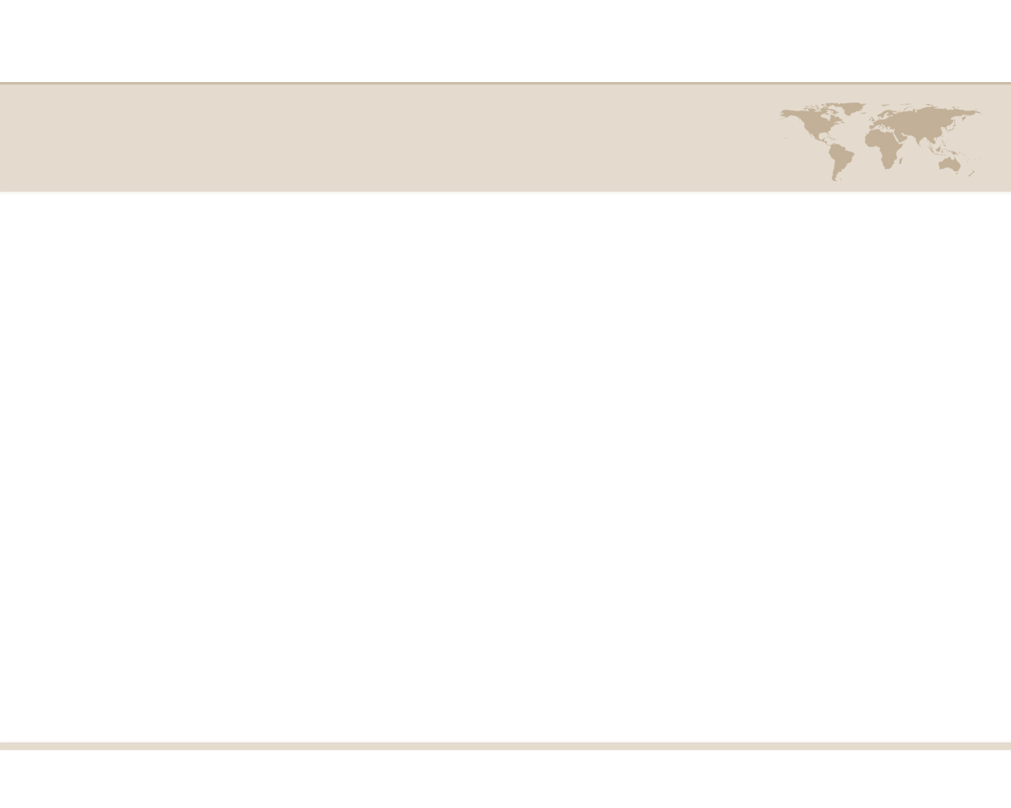
Introducing Wireless LANs
The popularity of wireless LANs (WLAN) has exploded over the past decade, allowing users to roam within a WLAN coverage area, allowing users to take their laptops with them and maintain network connectivity as they move throughout a building or campus environment.
Wireless device, such as laptops and smart phone, often have a built-in wireless card that allows those devices to communicate on a WLAN.

Slide 4
WLAN Concepts and Components
Wireless Routers
The wireless router obtains an IP address via DHCP from the Internet service provider(ISP).
The router uses PAT, to provide IP addressing services to devices attaching to it wireless or through a wired connection.
The process through which a wireless client attaches with a wireless router (or wireless AP) is called association.
All wireless devices associating with a single wireless router or AP share a collision domain.

Slide 5
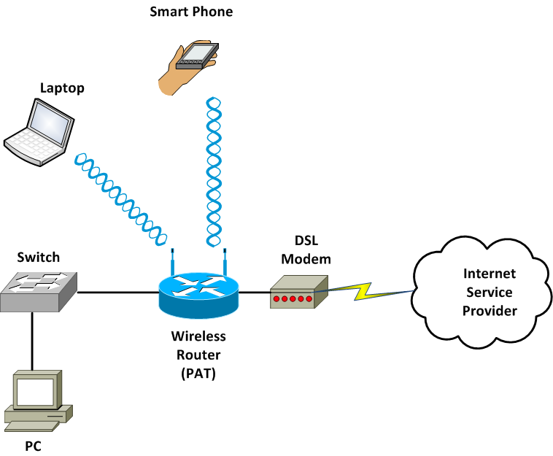
WLAN Concepts and Components

Slide 6
WLAN Concepts and Components
Wireless Access Point
A wireless access Point (AP) interconnects a wired LAN with a WLAN, it does not interconnect two networks
The AP connects to the wired LAN, and the wireless devices that connect to the wired LAN via the AP are on the same subnet as the AP.

Slide 7
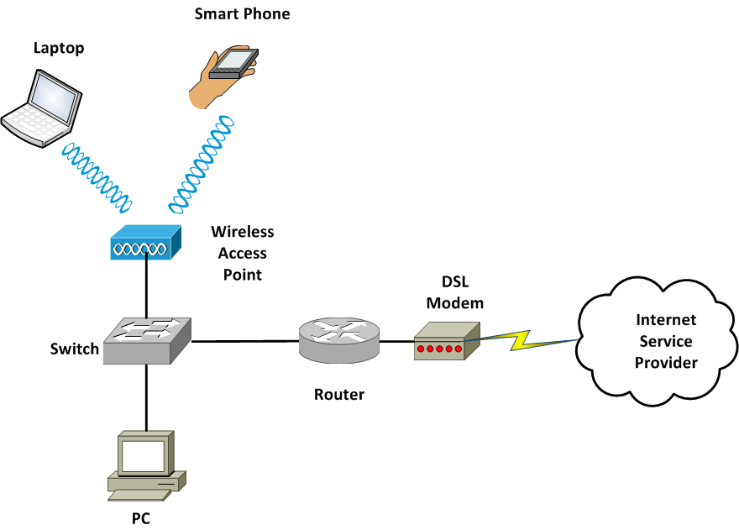
WLAN Concepts and Components

Slide 8
WLAN Concepts and Components
Antennas
The coverage area of a WLAN is largely determined by the type of antenna used on the wireless AP or wireless router.
Design goals to keep in mind when selecting an antenna include the following
Required distance between an AP and a wireless client.
Pattern of coverage area (for example, the coverage area might radiate out in all directions, forming a spherical coverage area around an antenna, or and antenna might provide increased coverage in only one or two directions.
Indoor or outdoor environment
Avoiding interference with other APs

Slide 9
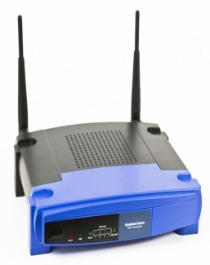
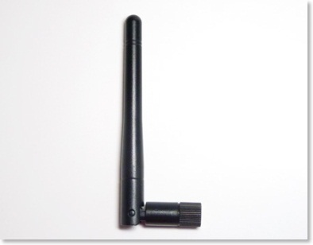
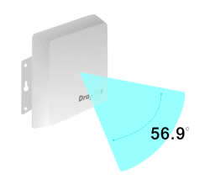
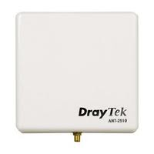
WLAN Concepts and Components
Omnidirectional: An omnidirectional antenna radiates power at relatively equal power levels in all directions.
Unidirectional: Unidirectional antennas can focus their power in a specific direction, thus avoiding interference with other wireless devices and perhaps reaching greater distances.

Slide 10
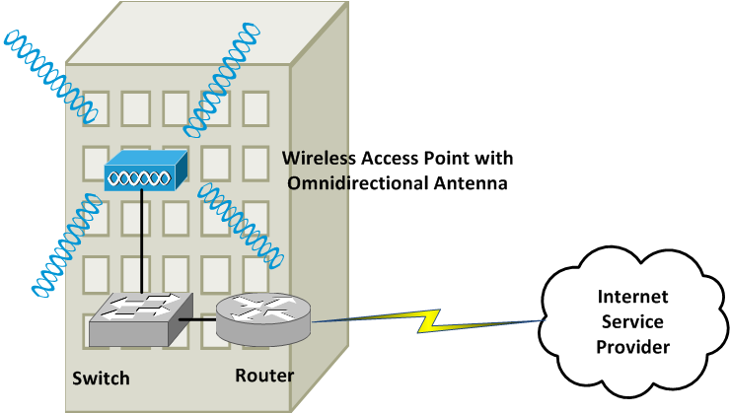
WLAN Concepts and Components

Slide 11
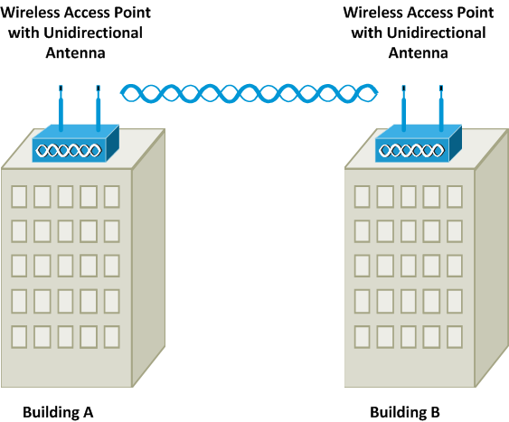
WLAN Concepts and Components

Slide 12
WLAN Concepts and Components
Frequencies and Channels
A characteristic to watch out for is the frequencies at which these standards operate.
There are some country-specific variations, certain frequency ranges (or frequency bands) have been reserved internationally for industrial, scientific, and medical purposes.
These frequency bands are called the ISM bands.
Two of these bands are commonly used for WLANs.
2.4 GHz – 2.5 GHz range. Referred to as the 2.4 GHz band.
5.75 GHz – 5.875 GHz range. Referred to as the 5 GHz Band
Within each band are specific frequencies (or channels) at which device operate.

Slide 13
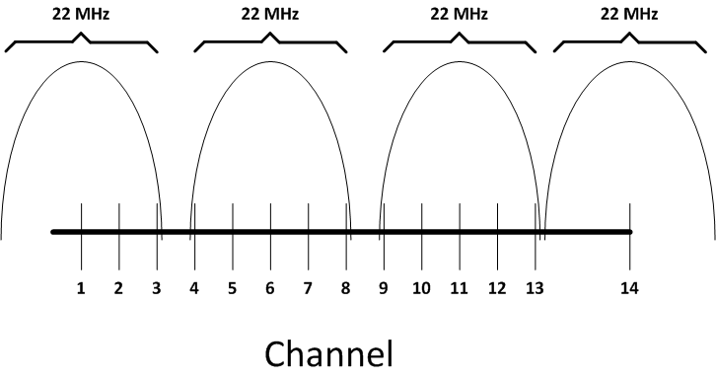
WLAN Concepts and Components
3 nonoverlapping channels in US: 1, 6, 11

Slide 14
WLAN Concepts and Components
CSMA/CA
We already learned that Ethernet’s carrier sense multiple access / collision detection (CSMA/CD) technology is used to control traffic on a wired network.
WLAN use a similar technology called carrier sense multiple access/collision avoidance (CSMA/CA).
A WLAN device listens for a transmission on a wireless channel to determine if it is safe to transmit.

Slide 15
WLAN Concepts and Components
Transmission Methods
Earlier you saw the frequencies used for various wireless channels.
Those frequencies are considered to be the center frequencies of a channel.
In actual operation, a channel uses more than one frequency, which is a transmission method called spread spectrum.
These frequency are, however, very close to one another, which is called narrowband transmission.

Slide 16
WLAN Concepts and Components
Transmission Methods
WLAN use one of the following types of spread-spectrum technology:
Direct-sequence spread spectrum (DSSS)
Modulates data over an entire range of frequencies.
Frequency-hopping spread spectrum (FHSS)
Allows the participants in a communication to hop between predetermined frequencies or channels.
Orthogonal frequency division multiplexing (OFDM)
Uses a relatively slow modulation rate, combined with the simultaneous transmission of data over 52 data streams.

Slide 17
WLAN Standard
Standard | Band | Max. Bandwidth | Transmission method | Max. Range
802.11 | 2.4GHz | 1 Mbps or 2 Mbps | DSSS or FHSS | 20m indoors/100 m outdoors
802.11a | 5 GHz | 54 Mbps | OFDM | 35m indoors/120m outdoors
802.11b | 2.4GHz | 11 Mbps | DSSS | 32m indoors/140m outdoors
802.11g | 2.4GHz | 54 Mbps | OFDM or DSSS | 32m indoors / 140m outdoors
802.11n | 2.4GHz or 5GHz (or both) | 130-150Mbps > 300 Mbps (with channel bonding) | OFDM | 70m indoors/250m outdoors

Slide 18
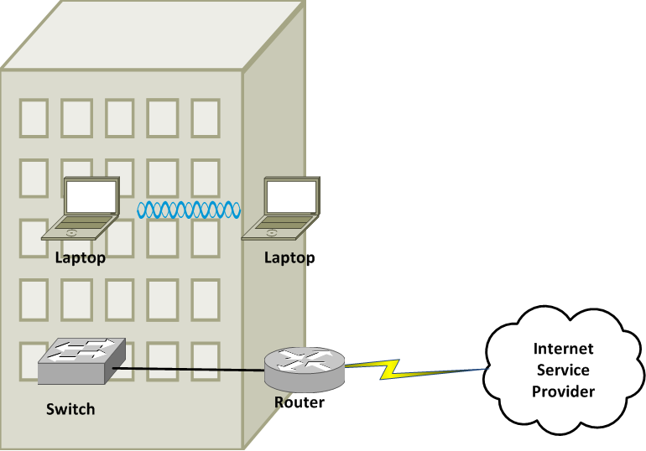
WLAN Standard
Independent Basic Service Set (IBSS) WLAN (ad-hoc)

Slide 19
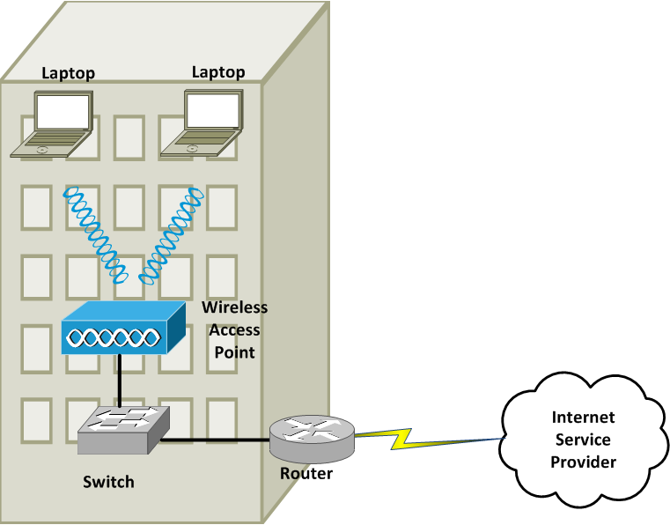
WLAN Standard
Basic Service Set (BSS) WLAN

Slide 20
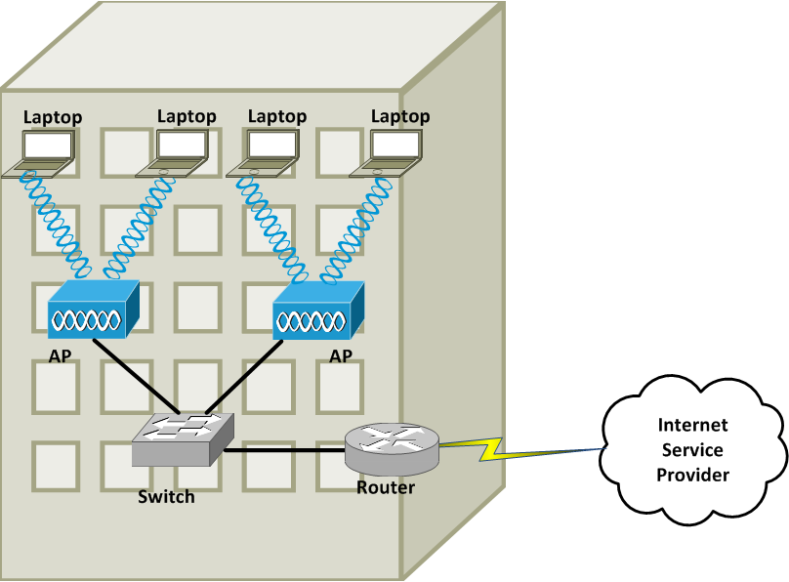
WLAN Standard
Extended Service Set (ESS) WLAN

Slide 21
Sources of Interference
A major issue for WLANs is radio frequency interference (RFI) caused by other devices using similar frequencies to the WLAN device.
Other WLAN devices
Cordless Phone/ Baby Monitors
Microwave ovens
Wireless security systems devices
Physical obstacles
Signal strength

Slide 22
Wireless AP Placement
WLAN using more than one AP (an ESS WLAN) require careful planning to prevent the Aps from interfering with one another, which still servicing a desired coverage area.
An overlapping of coverage between APs should exist to allow uninterrupted roaming from one WLAN cell (which is the coverage area provided by the AP) to another.
However, those overlapping coverage areas should not use overlapping frequencies.

Slide 23
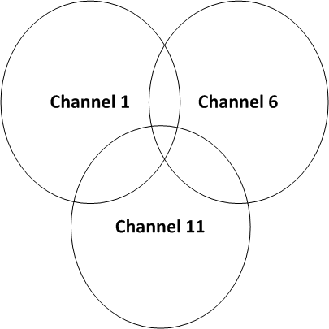
Wireless AP Placement
10-15 % Coverage Overlap in Coverage Area for
Non-overlapping Channels

Slide 24
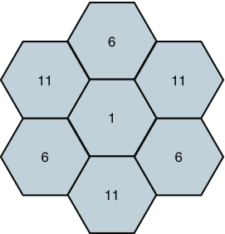
Wireless AP Placement
Non-overlapping Coverage Cells for the 2.4-GHz Band

Slide 25
Securing Wireless LANs
Security Issues
WLANs introduce some unique concerns to your network.
Improperly installed wireless APs, and routers are roughly equivalent to putting an Ethernet Port in a building’s parking lot, where anyone can drive up and have access to your network.
Today hackers and those who want to use free internet access perform reconnaissance, known as war driving, looking for unsecured WLANs

Slide 26
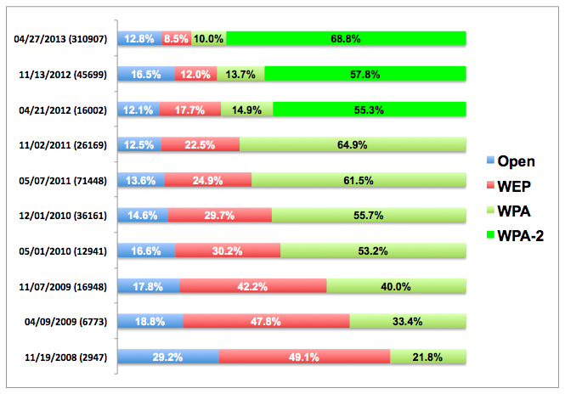
CCSF Wardriving

Slide 27
CCSF Wardriving
Thu., Nov. 7, 2013, 6 PM
Meet in MUB 180
Bring laptop or car if you have one
Install Vistumbler
Or just come with nothing

Slide 28
Securing Wireless LANs
Other WLAN security threat include the following
WEP cracking – WEP is worthless, easily cracked
My students crack WEP as a CNIT 123 project
WPA and WPA-2 are both very secure
WPS ruins it (Wi-Fi Protected Setup)
Rouge access points – A malicious user could set up his own AP to which legitimate users would connect.

Slide 29
Securing Wireless LANs
Approaches to WLAN Security
A WLAN that does not require any authentication or provide and encryption for wireless devices is said to be using open authentication.
To protect WLAN traffic from eavesdroppers, a variety of security standards and practices have been developed, including the following.
MAC address Filtering
Disabling SSID broadcast
Preshared Key
IEEE 802.1X

Slide 30
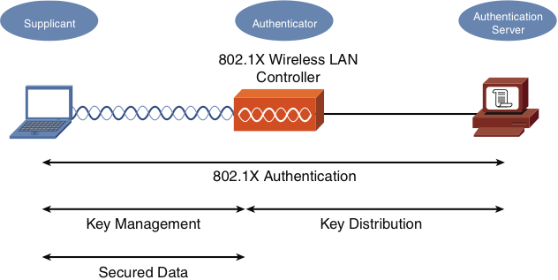
Securing Wireless LANs
IEEE 802.1x Security for a WLAN

Slide 31
Securing Wireless LANs
Security Standards
When configuring a wireless client for security, the most common security standards form which you can select are as follows:
Wired Equivalent Privacy (WEP)
Wi-Fi Protected Access (WPA)
Wi-Fi Protected Access version 2 (WPA2)

Slide 32
Securing Wireless LANs
WEP
40-bit WEP Key
APs and client must use the same key.
24-bit initialization vector (IV)
Sent in clear text.
It could be compromised with a brute-force attack.

Slide 33
Securing Wireless LANs
WAP
Can require a user to authenticated before keys are exchanged.
The keys used between a wireless client and an access point are temporary session keys.
Temporal Key Integrity Protocol (TKIP)
Message Integrity Check (MIC)
WAP2
Counter Mode with Cipher Block Chaining Message Authentication Code Protocol (CCMP)
Advanced Encryption Standard (AES)

