Slide 1

CompTIA Network +
Chapter 9
Optimizing Network Performance

Slide 2

Objectives
Why is high availability a requirement in today’s network designs, and what mechanisms can help provide that high availability?
What various technologies optimize network performance?
What QoS mechanisms can help optimize network performance?
Using what you have learned in this and previous chapters, how do you design a SOHO (Small Office/Home Office) network based on a set of requirements?

Slide 3

Optimizing Network Performance
Networks were once relegated to the domain of data, can now carry voice and video.
These additional media types, in addition to mission-critical data applications, need a network to be up and available for its users.
Beyond basic availability, today’s networks need optimization tools to make the most of their available bandwidth.
QoS, as one example, can give priority treatment to latency-sensitive traffic, such as Voice over IP (VoIP).

Slide 4
High Availability
If a network router or switch stops operating correctly (meaning that a network fault occurs), communication through the network could be disrupted, resulting in a network becoming unavailable to its users (a failure).
Therefor, network availability, called uptime, is a major design consideration.
The availability of a network is measured by its uptime during a year. For example if a network is said to have five nines of availability, it is up 99.999% of the time, which translates to a maximum of 5 minute of downtime per year.

Slide 5
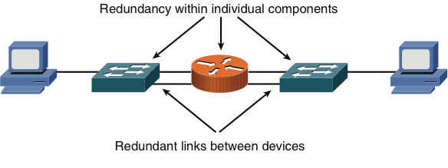
Fault-Tolerant Network Design
Figure 9-1 Redundant Network with Single Points of Failure

Slide 6
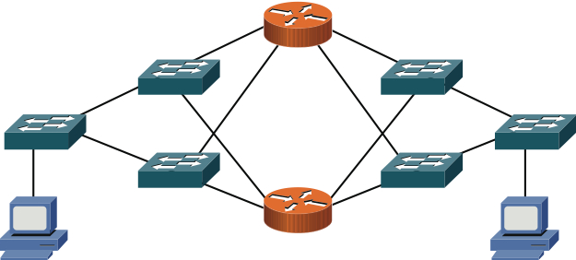
Fault-Tolerant Network Design
Figure 9-2 Redundant Network with No Single Point of Failure

Slide 7
Hardware Redundancy
Having redundant route processors in a switch or router chassis improves the chassis’ reliability.
An end system can have redundant NIC’s. The two modes of NIC redundancy are;
Active-active: both NIC are active at the same time.
Active-standby: one NIC is active and the other is waiting to take over, in the event of a failure.
Have redundant routers and switches improves the network’s reliability.
Hot standby Router Protocol (HSRP) (Cisco proprietary)
Common Address Redundancy Protocol (CARP) (Open)

Slide 8
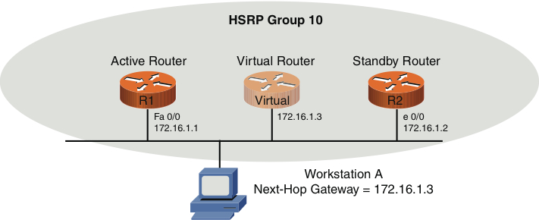
Hardware Redundancy
Figure 9-3 HSRP Sample Topology

Slide 9

LACP (Link Aggregation Control Protocol)
Combines multiple physical links into a single logical link

Slide 10
Design Considerations
When designing networks for high availability, answer the following questions:
Where will module and chassis redundancy be used?
What software redundancy features are appropriate?
What protocols characteristics affect design requirements?
What redundancy features should be used to provide power to an infrastructure device.
What redundancy features should be used to maintain environmental conditions.

Slide 11
High-Availability Best Practices
The following steps are five best practices for designing high-availability networks:
Examine technical goals.
Identify the budget to fund high-availability features.
Categorize business applications into profiles, each of which requires a certain level of availability.
Establish performance standards for high-availability solutions
Define how mange and measure the high-availability solution

Slide 12
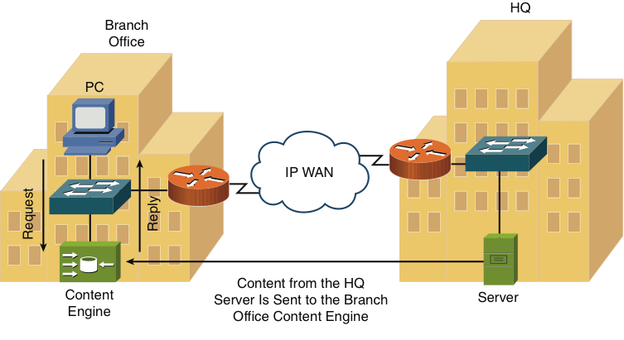
Content Caching
Figure 9-5 Content Engine Sample Topology

Slide 13
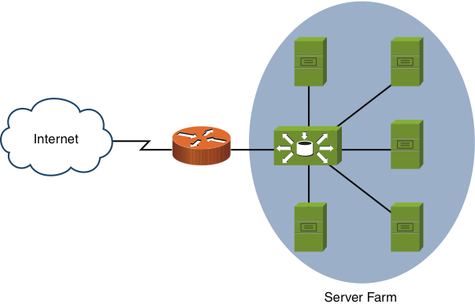
Load Balancing
Figure 9-6 Content Switching Sample Topology

Slide 14
QoS Technologies
Quality of Service (QoS) is a suite of technologies that allows you to strategically optimize network performance for select traffic types.
Through the use of QoS, you can identify which traffic types need to be sent first, how much bandwidth to allocate to various traffic types, which traffic types should be dropped first in the event of congestion, and how to make the most efficient use of the relatively limited bandwidth of an IP WAN.

Slide 15
QoS Technologies
Issue | Description
Delay | Delay is the time required for a packet to travel from its source to its destination.
Jitter | Jitter is the uneven arrival of packets.
Drops | Packets drops occur when a link is congested and a router’s interface queue overflows.

Slide 16
QoS Technologies
Fortunately, QoS features available on many routers and switches can recognize important traffic and treat it in a special way.
As a packet travels from its source to its destination, its effective bandwidth is the bandwidth of the slowest link along that path.

Slide 17
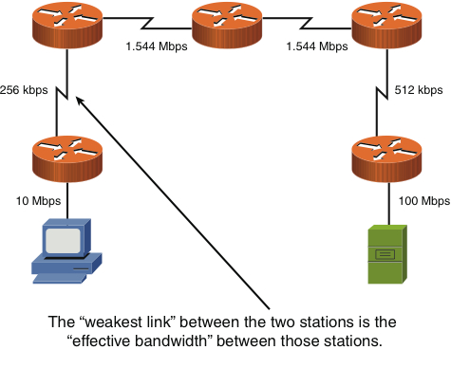
QoS Technologies
Figure 9-7 Effective Bandwidth of 256 kbps

Slide 18
QoS Configuration Steps
1. Determine network performance requirement for various traffic types.
Voice:
Video
Data
2. Categorize traffic into specific categories.
Low Delay
Low Priority
3. Document your QoS policy and make it available to your users.

Slide 19
QoS Components
Issue | Description
Best-effort | Best-effort treatment of traffic does not truly provide QoS to that traffic, because there is no reordering of packets. Best-effort uses FIFO queuing.
Integrated Services (IntServ) | IntServ is often referred to as hard QoS, because it can make strict bandwidth reservations. IntServ uses signaling among the network devices to provide bandwidth reservations.
Differentiated services | DiffServ, differentiates between multiple traffic flows. Specifically, packets are marked, and routers and switches can then make decisions based on those markings.

Slide 20
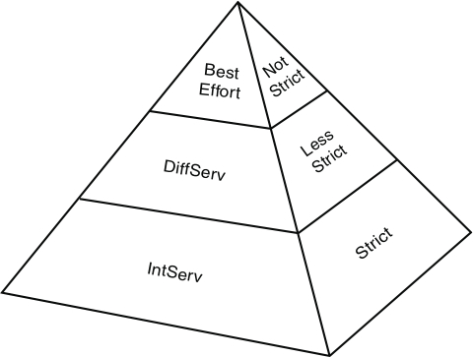
QoS Components
Figure 9-8 QoS Categories

Slide 21
QoS Mechanisms
The DiffServ approach to QoS marks traffic. However, for markings to impact the behavior of traffic, a QoS tool must reference those markings and alter the packets’ treatment based on them.
The following is a collection of commonly used QoS mechanisms:
Classification
Marking
Congestion management
Congestion avoidance
Policing and shaping
Link efficiency

Slide 22
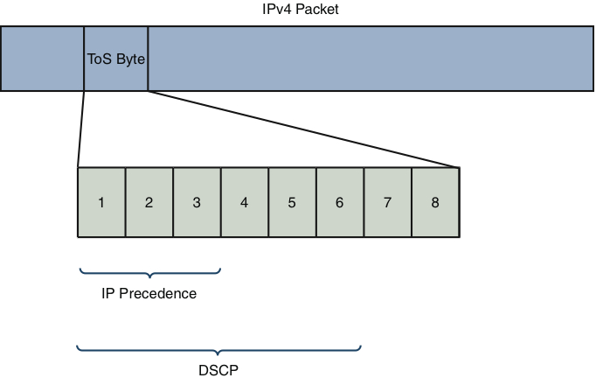
Marking
Figure 9-9 ToS Byte

Slide 23
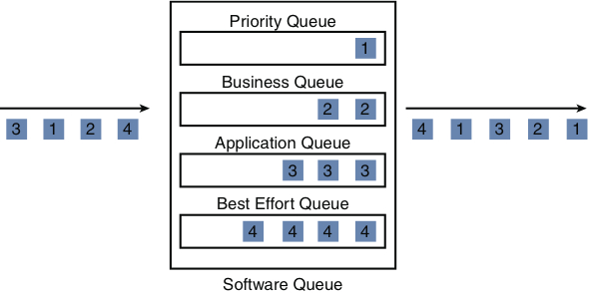
Congestion Management
Figure 9-10 Queuing Example

Slide 24
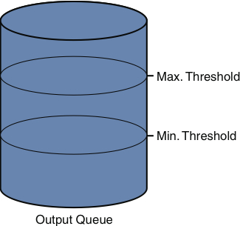
Congestion Avoidance
Figure 9-11 Random Early Detection (RED)

Slide 25
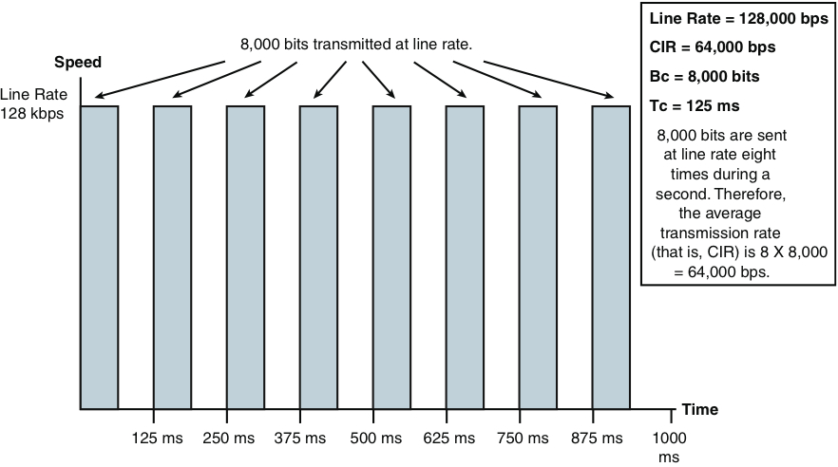
Policing & Shaping
Figure 9-12 Traffic Shaping

Slide 26
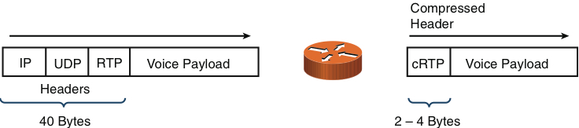
Link Efficiency
Figure 9-13 RTP Header Compression (cRTP)

Slide 27
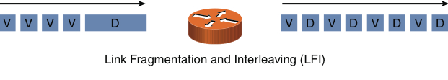
Link Efficiency
Figure 9-14 Link Fragmentation and Interleaving (LFI)

Slide 28
Case Study
You are to create a network design to meet a collection of criteria.
Network design is part science and part art, multiple design models can meet the specified requirements.
When designing a network keep the following in mind;
Meeting all requirements
Media distance limitations
Network device selection
Environmental factors
Compatibility with existing and future equipment

Slide 29
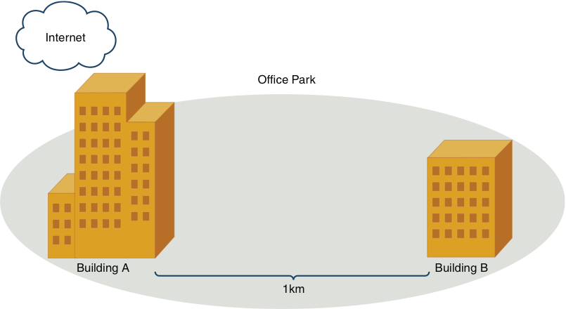
Case Study
Figure 9-15 Case Study Topology

Slide 30
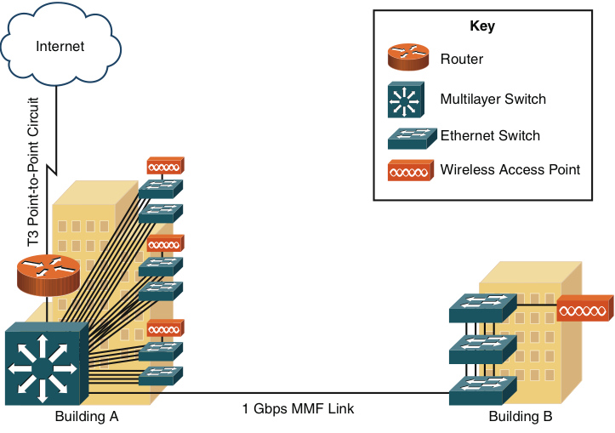
Case Study
Figure 9-16 Case Study Proposed Topology

