Slide 1




Isaac Goldman
Luke Osborne
Nick Rodriguez
Sami Shahin

Slide 2
Prepare to get REKT
Dodge the enemies!
Last through the waves!
Beat your previous best!
How long can you last, before you’re REKT??

Slide 3
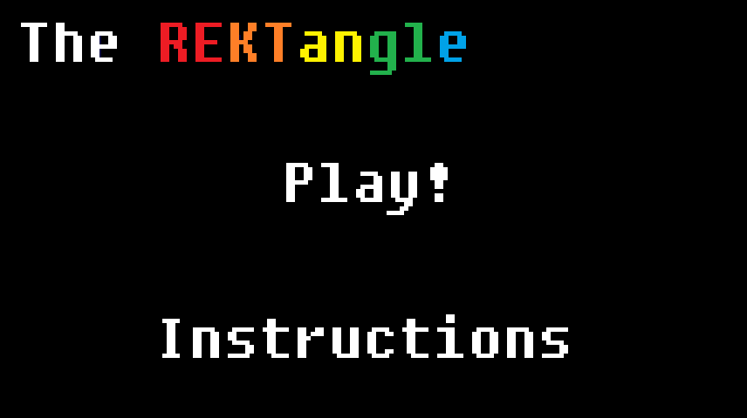
Menu

Slide 4
Architecture of menu

Slide 5
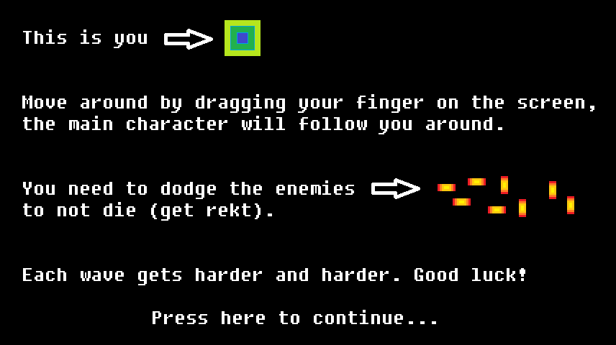
Instructions

Slide 6

Gameplay
You are the REKTangle
You avoid enemies, which come from all around the screen
The longer you last, the higher your score goes
The higher the score, the faster the enemies come
Get hit, and it’s game over

Slide 7
Handling movement and Collisions
Lots of back end work

Slide 8
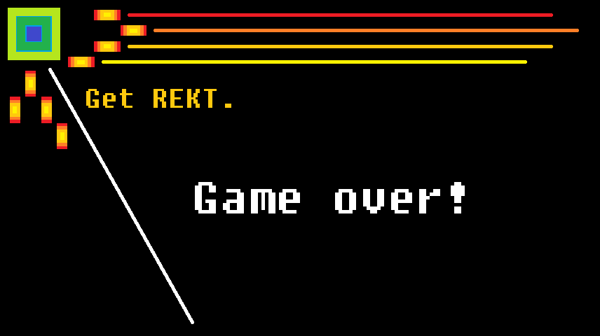
Game Over

