Slide 1

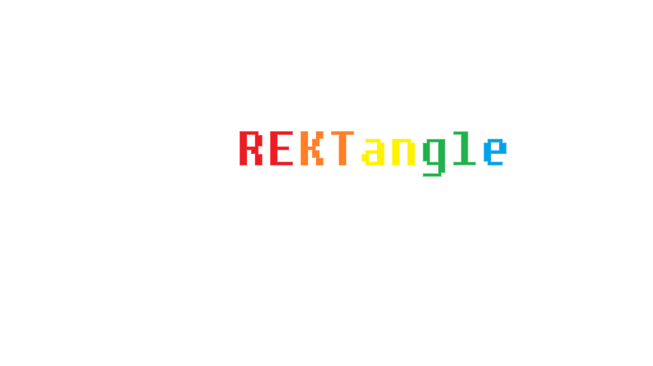


Isaac Goldman
Luke Osborne
Nick Rodriguez
Sami Shahin

Slide 2
Prepare to get REKT
Dodge the enemies!
Last through the waves!
Beat your previous best!
How long can you last, before you’re REKT??

Slide 3
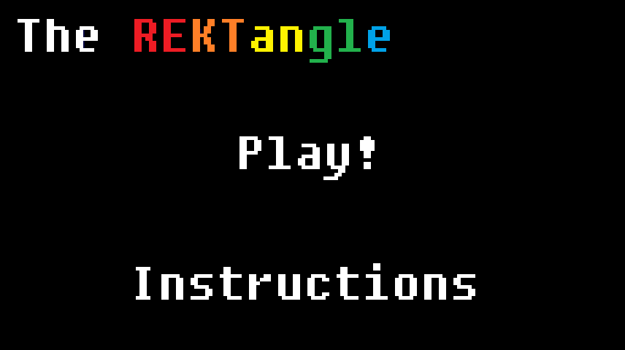
Menu
It’s the Main Menu
Press Play to play
Press Instructions to learn how to play

Slide 4
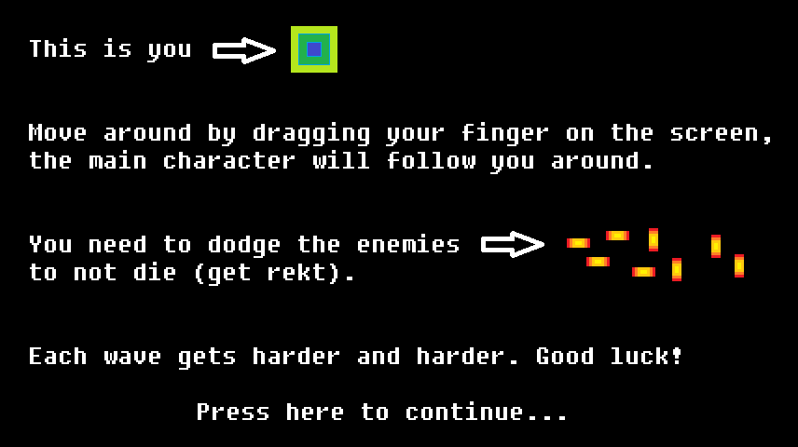
Instructions
You are the REKTangle
You avoid enemies coming from all around you
The longer you last, the higher your score goes
The higher the score, the faster the enemies come
Get hit, and it’s game over

Slide 5
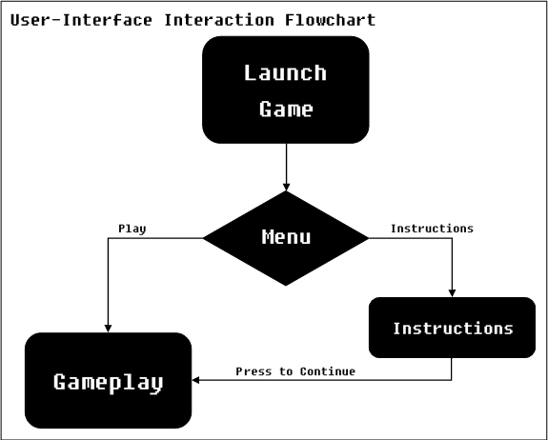
Menu flow
The menu screen has two options: play and instructions
Play brings you to the game
instructions tells you how to play, and tapping brings you to the game

Slide 6
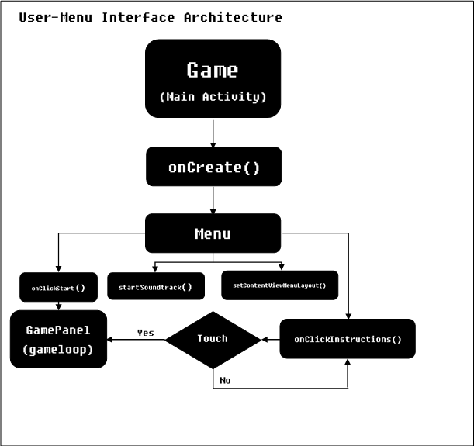
Menu Architecture
Game: Main Activity, sets the Menu layout as screen
Menu: controls menu music and sets the menu image
GamePanel: Starts gameplay

Slide 7
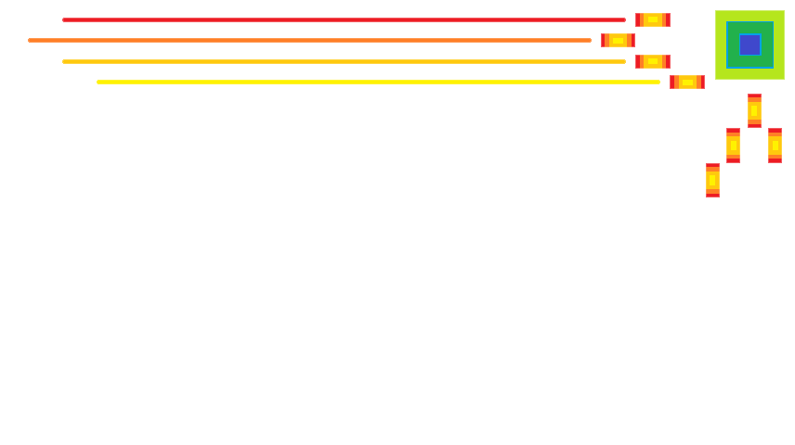
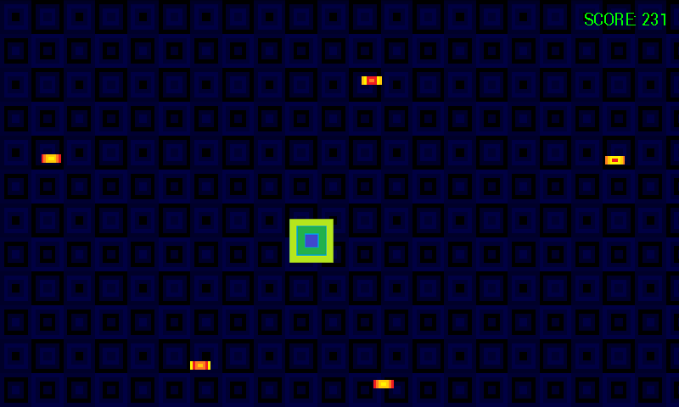
Gameplay
Enemies come from every side
To move, drag or press the screen
The REKTangle will follow you
The further you press from the REKTangle, the faster it moves, like a rubber band
This is you
This is the enemy

Slide 8
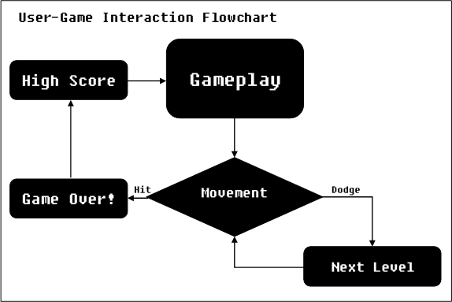
Game flow
General Progression
of the Game

Slide 9
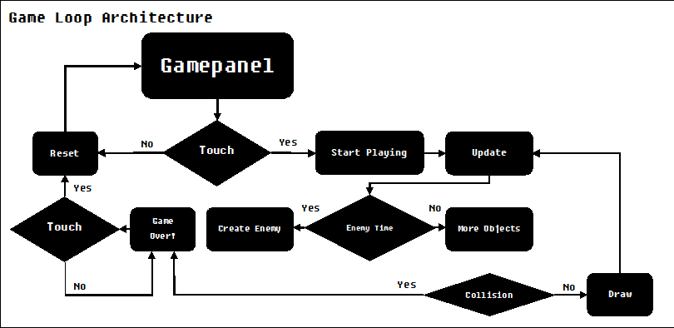
Handling movement and Collisions

Slide 10
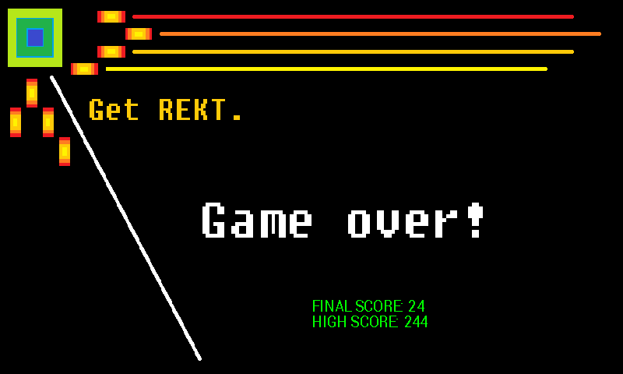
Game Over
Plays a death jingle
Displays your final score versus the high score
Tap to play again

