Slide 1
Usar este formato para el nombre de la presentación.
Escribir aquí los periodos de análisis

Slide 2
Using the template correctly
Slides de referencia – No Editar
Use short and meaningful titles.
2
Avoid changing colours or fonts.
Prefer icons and visuals over long paragraphs.
This template was designed to help you create clean, clear and on-brand presentations.
Here are a few things to keep in mind while editing your slides:
Keep one key idea per slide.
Stick to the layout: don't move or resize placeholders.

Slide 3
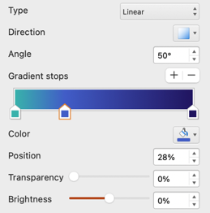
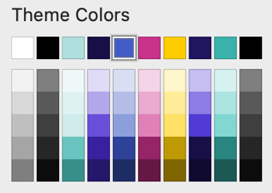
Colour Palette & Usage
Slides de referencia – No Editar
Primary Colours
Supporting Colours
Accent Colours
Use for title, key visual elements, and section highlights
Use to create hierarchy, group content, or background balance
Use for small details emphasis or highlight only
3
Deep Purple
Dark Deep Purple
Magenta
1
3
7
Turquoise
4
Sky Blue
Light Turquoise
Yellow
2
5
8
Light Sky Blue
Stick to brand colours to ensure clarity and consistency.
Use primary colours for structure, supporting tones for layout and grouping, and accent colours for emphasis.
Gradients should be used carefully to enhance your design.
6
Gradients
Use only for backgrounds or subtle accents. Avoid applying behind text. Stick to approved combinations.
Use the numbered swatches below to choose the correct colour on the palette.
Brand Gradient
Turquoise → Sky Blue → Deep Purple
5
3
2
7
8
1
4
6
Soft Turquoise Gradient
Turquoise → White
Soft Sky Gradient
Sky Blue → White

Slide 4



Text & Layout Guidelines
Slides de referencia – No Editar
Keep 1.0x line spacing for readability
Add space between paragraphs, don’t just hit Enter
Align Text to the left when possible
Recommendation
4
Use Arial Bold for Titles and highlight text
Title 24pt
Use Arial Regular for copy
Spacing | Before: 6pt
Subtitle 18pt
And Italic just for small information
Copy 12pt
Use brand-approved fonts and styles to ensure consistency and readability across all presentations.
Stick to the recommended sizes, weights and alignments.
Margins & white space
Leave generous space around all content — don’t let text touch edges
Avoid overcrowding the slide
One main idea per slide is more effective than many
Bullet points
Use simple bullet lists (max. 5 per slide)
Keep each point to one line if possible
Use parallel structure (start each point the same way)
Common mistakes to avoid
Tiny text below 8pt
Too many font weights or sizes
Wall of text without breaks
Inconsistent alignment across slides

Slide 5
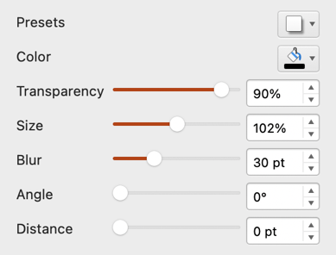
Shapes & Visual Elements
Slides de referencia – No Editar
5
Our brand uses a clean, structured shape system with soft geometry and consistent visual rhythm.
Hexagons, circles, and rounded boxes are key to our visual identity — always used with care and intention.
Shape | Use for | Notes
Hexagon | Visual highlights, icons, data | Signature shape – use consistently
Circle | Icons, numbering, simple callouts | Clean, focused
Rounded Rectangle | Grouping content, buttons | Use for layout structure
Sharp Rectangle | Section backgrounds or contrast | For strong framing – not decorative

Slide 6
Data visualization best practices
Slides de referencia – No Editar
When adding charts or tables, follow these best practices to make sure your message is clear and accessible:
Use colours from the official palette
1
Add clear titles and data labels
2
Never use more than 6 categories per chart
3
Avoid rotating axis labels
4

Slide 7
Usar este formato para separar capítulos

Slide 8
Usar este formato para separar Sub capítulos

Slide 9
Axión es la marca que apalanca el crecimiento en clientes, mientras que Blancox y Marca Propia son las marcas que más pierden clientes.
Ventas | Unidades | Clientes | Gasto por Cliente
$2,174.7 M | 203,412 | 97,471 | $ 19,363
$770.5 M | 67,118 | 47,308 | $ 13,915
$579.5 M | 176,543 | 79,210 | $ 5,815
$301.6 M | 17,851 | 12,719 | $ 20,383
$220.8 M | 19,074 | 10,441 | $ 16,539
$95.3 M | 1,354 | 873 | $ 90,036
$70.4 M | 6,566 | 5,386 | $ 11,501
$61.4 M | 5,710 | 3,870 | $ 13,642
$57.5 M | 2,264 | 1,406 | $ 32,499
$55.9 M | 1,379 | 845 | $ 50,815
+17.9% | +20.3% | +18.1% | -1.4%
-18.7% | -29.5% | -26.4% | +9.1%
-16.6% | -25.3% | -24.6% | +11.1%
+30.7% | -1.8% | -1.3% | +28.1%
+4.4% | -26.9% | -26.3% | +41.1%
-8.1% | -36.8% | -28.9% | +26.4%
-11.9% | -27.2% | -23.0% | +20.6%
-25.4% | -33.6% | -26.7% | +11.6%
+28.8% | +30.3% | +16.9% | +3.2%
-8.1% | +6.0% | +0.8% | -7.1%

Slide 10
Gracias a esto Axión gana 7 pts de participación y se fortalece como el líder de la categoría, tanto en ventas como en unidades.

Slide 11
Thank you.

