Slide 1

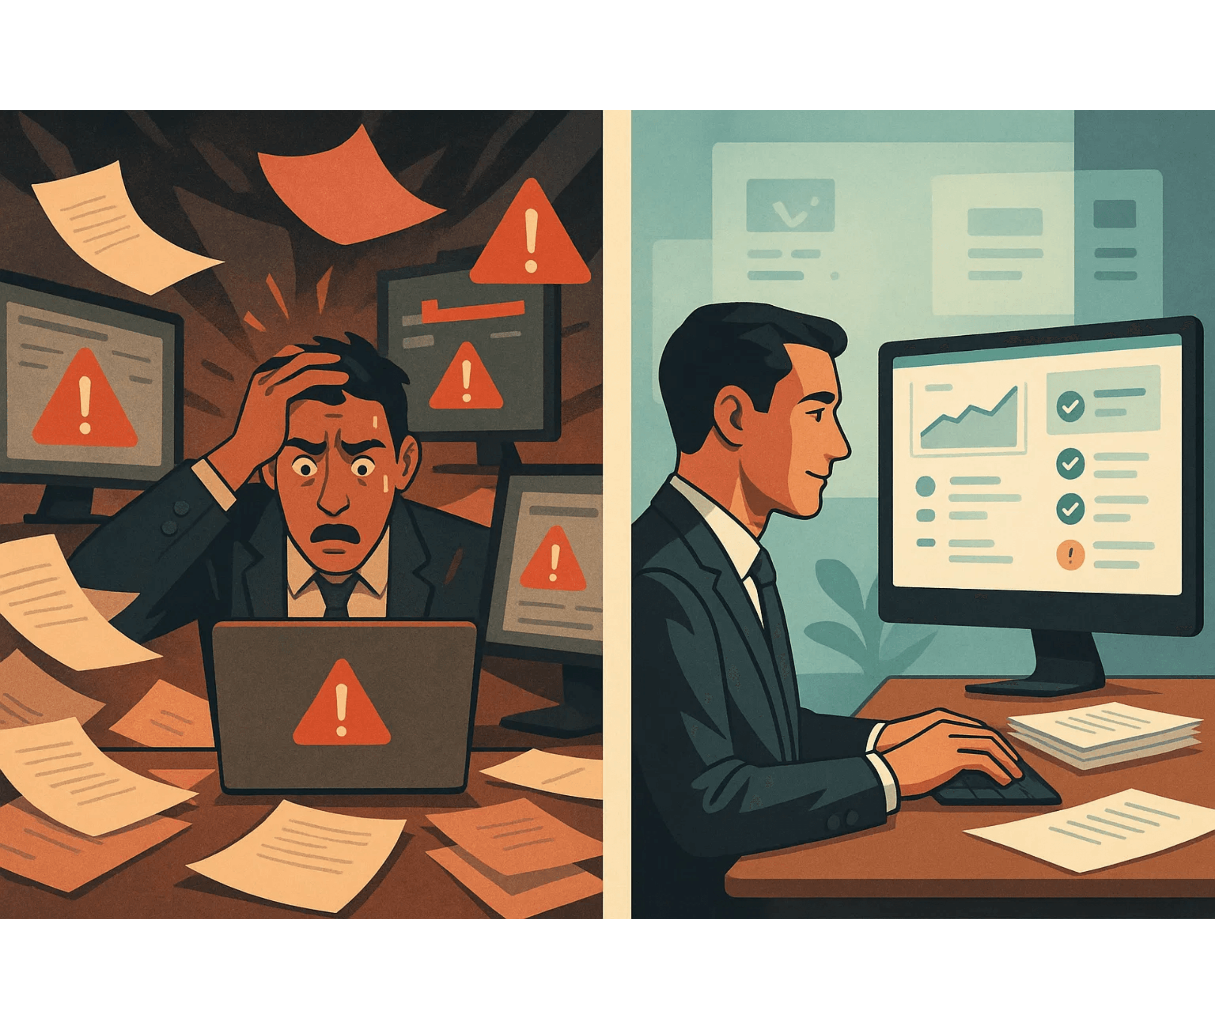
Chaos to
Control
Unified Dashboard with MCP Integration
Transforming fragmented complexity into actionable clarity for the Velocity project deployment

Slide 2

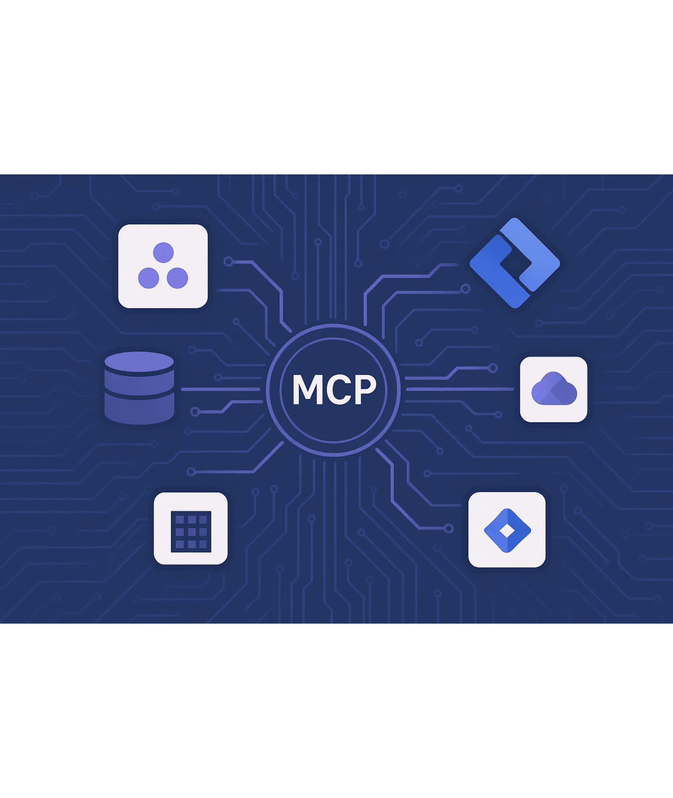

MCP—The Integration Layer That Makes Unified Dashboards Possible
What MCP Does
Standardized integration protocol to unify API data across systems
Hub-and-spoke: connect each tool once to MCP—no more point-to-point spaghetti
Real-time and batch updates ensuring dashboards reflect current reality while minimizing API rate limit issues
Why MCP is Critical for Velocity
Velocity must integrate with Jira, Asana, NetSuite, SAP, ATS, HRIS, and staffing agencies—MCP makes this manageable
Reduces integration complexity by 70-80% compared to custom API integrations
Enables the "Touch Once Principle" by ensuring data flows automatically across all systems

Slide 3

Dashboard Architecture—Five Data Sources, One Unified View
1
2
3
4
5
Deployment Progress
MVP Development
Budget & Procurement
Workforce & Onboarding
Risks & Blockers
Asana MCP: 165-project portfolio health
Jira MCP: Sprint velocity & bug tracking
NetSuite/SAP: Real-time spend & contracts
Cross-System: Aggregated risk scoring
Velocity/HRIS: Contractor lifecycle

Slide 4

Real-World Example—How the Dashboard Prevents a Crisis
Without Dashboard
With Dashboard
IT schedules Active Directory upgrade in isolated system. Six project managers unaware of the dependency. Monday morning: upgrade begins, 6 projects suddenly blocked.
IT creates upgrade task in Asana. Dashboard automatically scans 165 projects, identifies 6 dependencies.
72 hours before upgrade, proactive alerts sent to all 6 PMs. What-if analysis shows $2.3M in project value at risk.
Senior PM spends 4 hours in emergency meetings identifying impacts and re-planning timelines.
Senior PM reviews in 10 minutes, escalates with data. Team reschedules upgrade. Crisis averted, Monday demo proceeds.
Executives blindsided when Monday demo might be delayed due to infrastructure work they weren't aware of.
96% faster
0 projects
Zero surprise
Impact identification
Impacted (vs. 6)
Full executive visibility

Slide 5

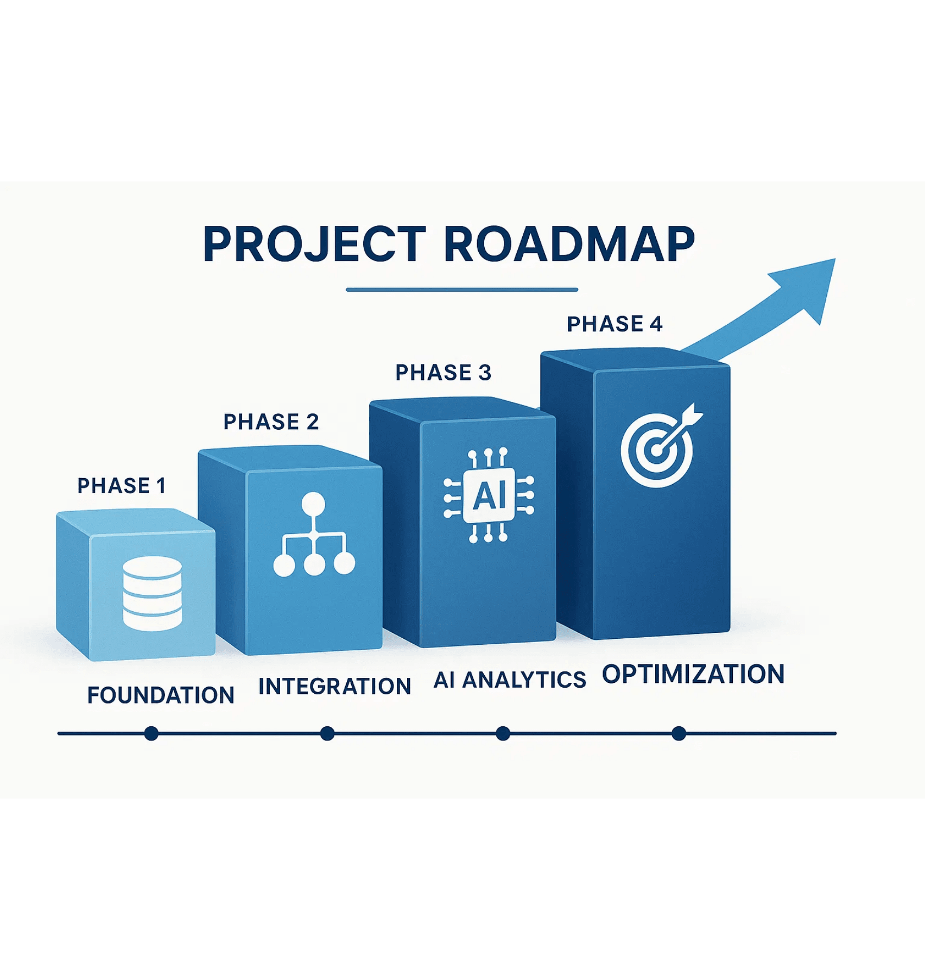
Implementation Roadmap—From Concept to Reality in 4 Phases
Phase 1
Foundation (Week 1-2)
Set up MCP servers for Asana and Jira, create PostgreSQL database with RLS, deploy minimal dashboard showing 165-project portfolio health
Phase 2
Expansion (Week 3-4)
Add NetSuite/SAP and HRIS integrations, implement hybrid search with pgvector, create automated Slack/Teams alerts, build executive KPI views
Phase 3
Intelligence (Week 5-6)
Integrate AI-powered predictive analytics, implement dependency analysis for cascading risks, add what-if scenario planning, create contractor performance scoring
Phase 4
Optimization (Week 7-8)
Fine-tune sync frequencies, implement caching for sub-2-second load times, add custom stakeholder views, conduct user training for 90%+ adoption
Success Metrics:Dashboard load <2s • 15-min data sync • 90%+ user adoption • 25+ hrs/week saved • Zero surprise delays

