Slide 1
DJANGO

Slide 2
What is full stack development?
It refers to the development of both front end(client side) and back end(server side) portions of web application.

Slide 3
What is a full stack Developer?
Full stack web developers have the ability to design complete web applications and websites. They work on the frontend, backend, database and debugging of web applications or websites.

Slide 4
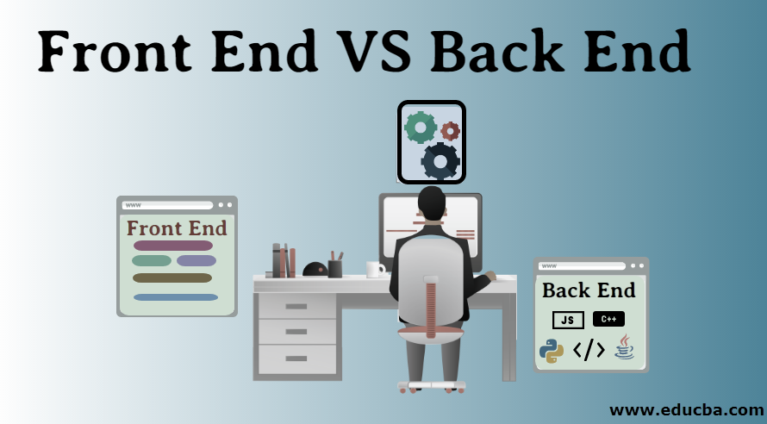

Slide 5
Frontend :
It is the visible part of website or web application which is responsible for user experience.
Backend :
It refers to the server-side development of web application or website with a primary focus on how the website works.
Database :
Database is the collection of inter-related data

Slide 6
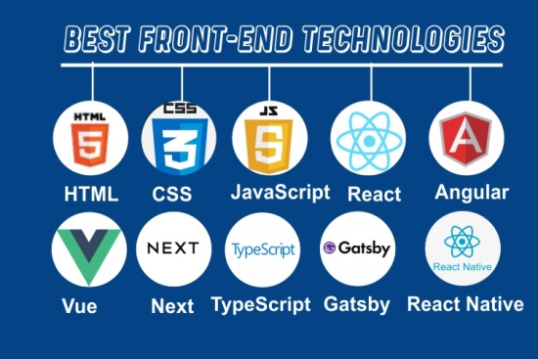

Slide 7
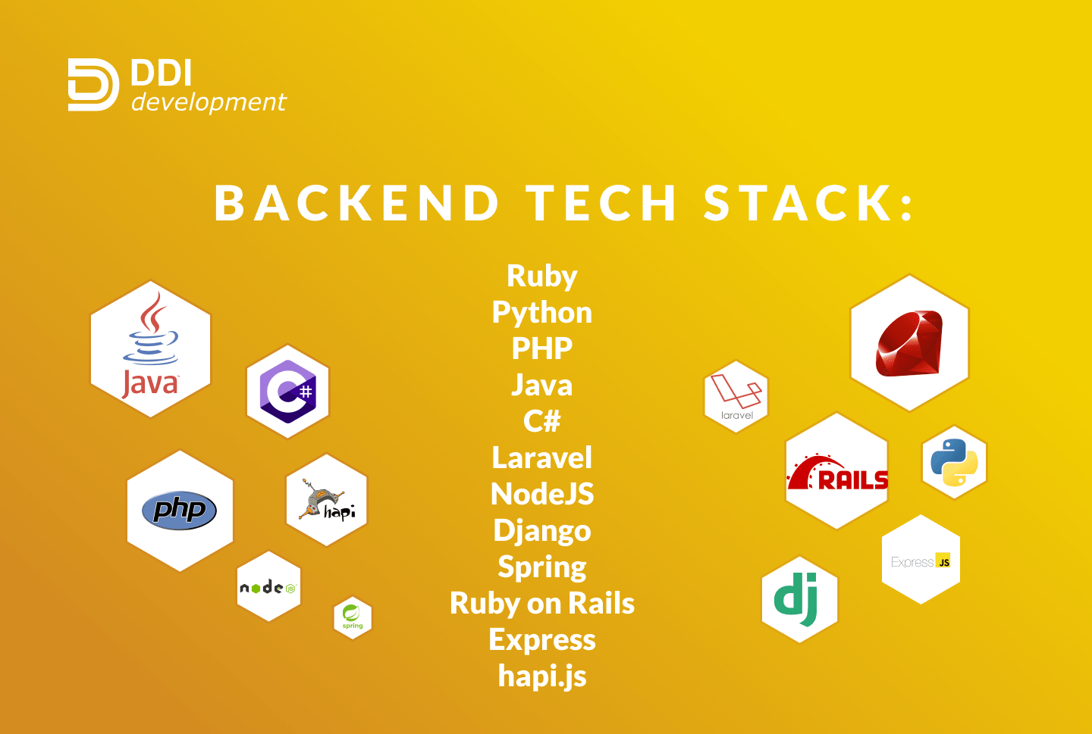

Slide 8
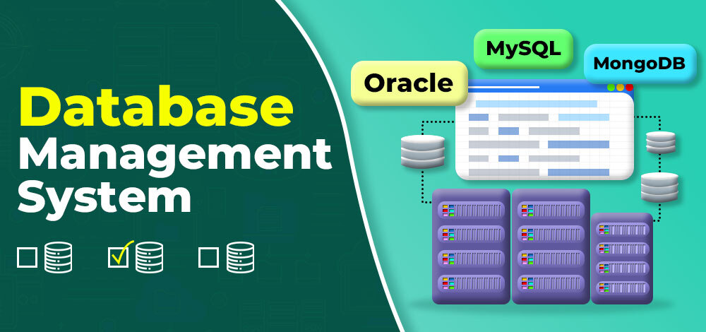

Slide 9
Popular Stacks
MEAN Stack
MERN Stack
Django Stack
Rails or Ruby on Rails
LAMP Stack

Slide 10
Introduction:
Django is a Python based web framework which allows us to quickly create a web application.
It was released in 2005.
There are others frameworks available which can be used in python. They are
Flask
Web2Py
Bottle
CherryPy etc…

Slide 11
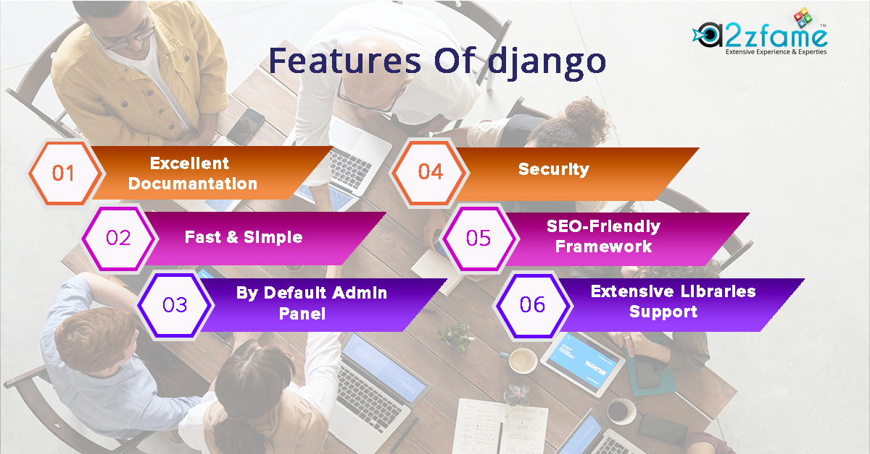

Slide 12
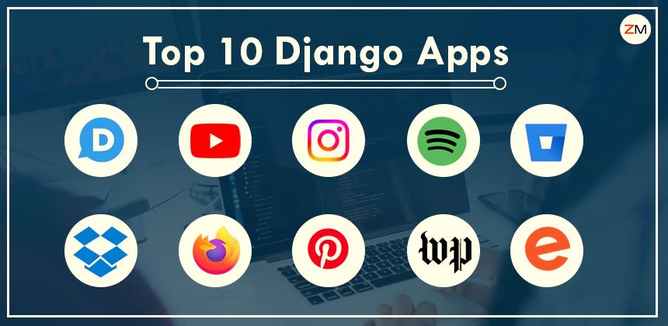

Slide 13
How Django works?
In a traditional data-driven website, a web application waits for HTTP requests from the web browser. When a request is received the application works out what is needed based on the url and possibly information in POST data or GET data.
Depending on what is required it may then read or write information from a database or perform other tasks required to satisfy the request.
The application will then return a response to the web browser, often dynamically creating an HTML page for the browser to display by inserting the retrieved data into placeholders in an HTML templates.

Slide 14
MVT Pattern:
MVT – Stands for Model View Template
MODEL:
The Model helps to handle database. It is a data access layer which handles the data.
View:
The View is used to execute the business logic and interact with a model to carry data and renders a template.
Template:
The Template is a presentation layer which handles User Interface part completely.

Slide 15
URLs → The URL mapper is used to redirect HTTP requests to the appropriate view based on the request URL.
Views → A View is a request handler for function, which receives HTTP requests and returns HTTP responses.
Templates → A template is a text file defining the structure or layout of a file, with placeholders used to represents actual content.
Models → Models are python objects that define the structure of an application’s data and provide mechanisms to manage (add, modify, delete) records in the database.

Slide 16
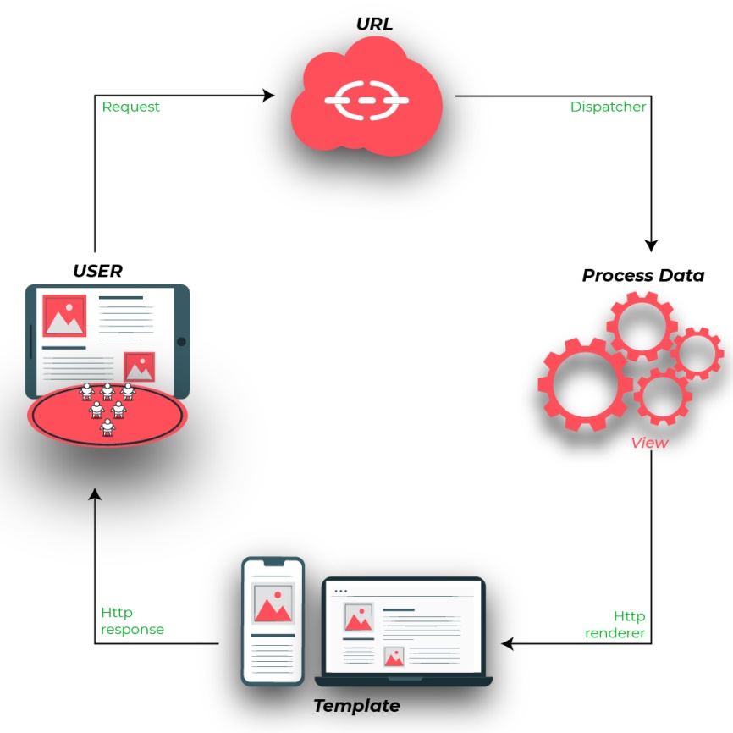

Slide 17
html

Slide 18
Introduction to HTML
HTML – Hyper Text Markup Language.
All the websites are usually written in HTML.
HTML is not a programming language but it is a Markup Language.
<tag>
</tag>

Slide 19
Syntax:
<!DOCTYPE html>
<html>
<head>
<title>Web page title</title>
</head>
<body>
</body>
</html>

Slide 20
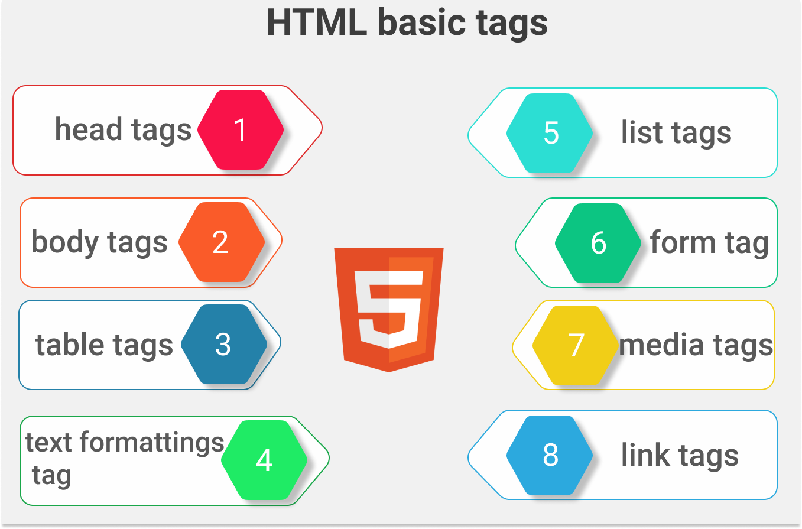

Slide 21
Name | Tag | Description
Head Tags | <h1></h1> | Heading 1
 | <h2></h2> | Heading 2
 | <h3></h3> | Heading 3
 | <h4></h4> | Heading 4
 | <h5></h5> | Heading 5
 | <h6></h6> | Heading 6
Text Tags | <p></p> | Paragraph
 | <b></b> | Bold
 | <i></i> | Italic
 | <u></u> | Underline a text
 | <mark></mark> | Highlight a text
 | <pre></pre> | Predefined Text

Slide 22
Name | Tag | Description
Text Tags | <br> | Leaves a line of Space.
 | <hr> | Leaves a Horizontal Line.
 | <sup></sup> | Super Script a text
 | <sub></sub> | Sub script a text
 | <del></del> | Strike through a text
 | <code></code> | To display text as a computer code.
 | <q></q> | Quote a text
 | <abbr></abbr> | Abbreviation
Table Tags | <table></table> | Defines a table
 | <tr></tr> | Defines table row
 | <th></th> | Defines column heading
 | <td></td> | Defines column data
 | <caption></caption> | Used to give caption for table
List Tags | <ol></ol> | Defines Ordered List
 | <ul></ul> | Defines Un-Ordered List
 | <li></li> | Defines List Items
 | <dl></dl> | Definition List / Description List.
 | <dt></dt> | Defines the term
 | <dd></dd> | Defines the term definition.

Slide 23
Name | Tag | Description
Link Tags | <link href=“”> | Used to link the files.
 | <a href =“url or path”></a> | Used to create the link.
Form Tags | <form></form> | Defines a From
 | <label></label> | Creates a Label
 | <input type=“”> | Creates input field.
 | <textarea></textarea> | Creates text area.
 | <select></select> | Defines select area
 | <option></option> | Defines select options.
Div | <div></div> | Defines a division of codes.
Media Tags | <img src=“image path with extension”> | Used to display images.
 | <audio controls src=“audio path”> </audio> | Used to input an audio
 | <video controls src=“video path”> </video> | Used to display videos.

Slide 24
Name | Tag | Description
Script Tag | <script type=“text/javascript”> </script> | Used to write scripts.
Comment Tag | <!-- --> | Both Comments

Slide 25
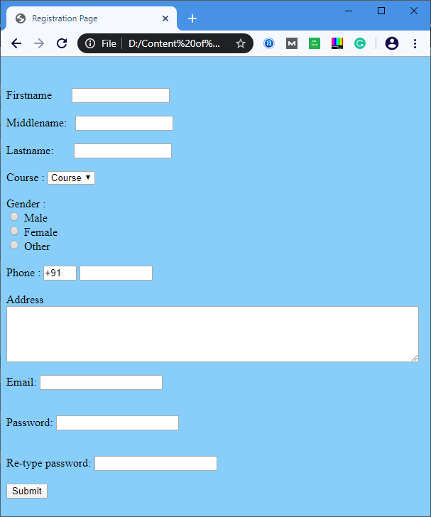

Slide 26
Css

Slide 27
CSS:
CSS – Cascading Style Sheets
CSS describes how HTML elements are to be displayed on a screen, paper or in other media.

Slide 28
Three ways to use css:
In a separate file (external)
At the top of a web page document (internal)
Right next to the text it decorates (inline)

Slide 29
Property | Value | Description
text-align | left, right, center | Sets the alignment of the text
padding-left | ex: 10px | Sets the left padding of an element
padding-right | ex:20px | sets the right padding of an element
padding-top, padding-bottom | ex: 20px | sets the top and bottom padding for the element
padding | ex: 10px | sets the overall padding property for the element
color | white | sets the text color as white
background-color | black | sets the background color for the element
border | 1px solid red; | creates a border with red color, with 1px size and solid style.
font-family | cursive, monospace, serif, sans-serif, fantasy | Sets the given style for the font.

Slide 30
Property | Value | Description
font-size | 10px | Sets the font size of an element
text-decoration | none, underline, overline, line-through | Used to give the underline of other properties for an element. If we give none, the underline or other properties will be removed.
border-radius | 2px | specifies the radius of the border. Used to design a curved borders.
cursor | pointer, progress, not allowed | Defines the cursor of an element
width | 50%, 400px | Defines the width of an element, Mostly used with div tag and img tag.
height | 30%, 800px | Defines the height of an element, mostly used with div and img tag
max-width, max-height | 100% | Used with img tag in-order to get responsive images
min-width, min-height | 100% | Used to specify the minimum height and width of an element.
box-sizing | border-box | used with div tag. The width of the division will be border+padding+width.

Slide 31
bootstrap

Slide 32
Bootstrap:
Bootstrap is a powerful front-end framework for faster and easier web development.
It includes HTML and CSS based design templates for common user interface components like, Forms, Buttons, Table, Navigation, Dropdown etc..

Slide 33
Downloading Bootstrap Files:
There are 2 versions available for download, compiled Bootstrap and Bootstrap source file.
You can download it from the below website.
https://getbootstrap.com/docs/3.3/getting-started/
Download the compiled version for better understanding.

Slide 34
Introduction to Django IDE & Structure.

Slide 35
Pycharm ide installation:
Open browser → Download community edition of Pycharm IDE.
Install the Pycharm in system.

Slide 36
create a django project:
Create an Virtual Environment for Django project.
Pycharm → File →New project →set Project Name
Untick the check box→ create a main.py welcome script.
select create → Now New Virtual Environment was created for Django.

Slide 37
1) Open Terminal in pycharm→Install Django package.
pip install django
2) To create Django Project:
django-admin startproject project name
3) To run project
cd project name → these command is used to change the Directory
4) To run project
python manage.py runserver → a link was created with port no 8000.
5)address bar → type admin → the default admin page of django will open.
6)To stop project → Enter clrl + c in Terminal.

Slide 38
The default Django project created location is c:user\admin\pycharm projects\ project name.
In the created project ,a below given python files are created,
1) manage.py → used to run entire Django file.
2) __init__ → used to intialize the project.
3) asgi.py → It contains the information about project of settings.
4) settings.py → It have all the settings for to run entire project.
5) urls.py →used to write patterns of url and given patterns are displays in address bar.

Slide 39
6)wsgj.py →This is Django web server.
7)db.sqlite.py → This file was created when we first time run server.
This is default database of django and we configure another database if we want.

Slide 40
create a django application:
Terminal → python manage.py startapp Application Name.
A new folder was created in django project.
(ex: name as Template)
settings.py → The created folder was register to this file as,
INSTALLED _APPS=[ ‘Application Name’]
TEMPLATES =[
‘DIR’ : [‘Template’]]

Slide 41
views.py → It has Two type of views.
1) Function based views: → The python statements are written in function.
2) Classy views: → The python statements are written in class.
Example:
def mainpage(request):
return render(request,’home,html’)
In the above example , the url come with request
render → use to share the response
In render pass 2 compulsary arguments(request,template name)

Slide 42
Template → To create a new HTML file in template directory.(home.html)
html file(home.html) →
Example:
<body>
<h1>Welcome to livewire </h1>
</body>
urls.py → path(pattern, function name,name=“”)
The two arguments are must in the urls.py, they are(pattern,function name)

Slide 43
Example:
from app1.views import mainpage
path(“home/”,mainpage, name=‘home’)
In the above example,
app1 is the Application Name and it was present in views file.
mainpage is the function name.
if we mention function name as * , then it represents all the function in the views file.
If we set the pattern as “ “ empty means, the home page was displayed default when we open the web page.

Slide 44
Django Views:
Django views take a HTTP request and return a HTTP response to the user.
Basically Django got 2 types of Views
Class Based Views
Function Based Views.

Slide 45
Function Based Views:
In the beginning there were only function based views, available in Django. Then in order to avoid the cracking and to provide some generic view of codes, they introduced class based views.
Now lets see how to get the current date and time and to display it in our page.

Slide 46
Django shortcut functions:
render(request, template_name, context = none, content_type = none, status = none, using=none)
It combines a given template with a given context dictionary and returns an HTTP response object with that rendered text.

Slide 47
Required Arguments:
request
Template_name
Optional Arguments:
context → A dictionary of values to add to template context.
content_type →Defaults to the value of the default_context_type in settings.
status →The status code for the response. Default is 200.
using →The name of a template engine to use for loading a template.

Slide 48
Templates:
Being a web framework, Django needs a convenient way to generate HTML dynamically.
The most common approach relies on templates.
A template contains the static parts of the desired HTML output as well as some special syntax describing how dynamic content will be inserted.

Slide 49
Jinja2:
Jinja2 is a modern and designer friendly Templating language for Python, modeled after Django’s Templates.
It is fast, widely used and secure with the optional sandboxed template execution environment.

Slide 50
Features:
Template Inheritance
Configurable Syntax

Slide 51
Jinja Delimiters:
{% …. %} → Statements
{{ ….. }} → Expressions to print to the template output.

Slide 52
Use of Delimeters:
{%block title%}….{%endblock%}
{%block content%}…{%endblock%}
{%extends ‘file.html’%}
{%include ‘file.html%}
{%if users%}…..{%endif%}
{%for users in user%}…{%endfor%}
{{name}}
Note:
Do not use the double bracket({{ }}),syntax within if or elif .
Make a indent between condition and variables (a == b).
use filter for module operator (ans|divisibleby:2)

Slide 53
Display current time at about page:
views.py :
from time import *
def mainpage(request):
return render(request,’home.html’)
def aboutpage(request):
return render(request,’base.html’,{‘now’:ctime})

Slide 54
Templates → Add new html file base.html
base.html →<h1> {{now}} </h1>
urls.py→
from app1.views import mainpage,aboutpage
path(“”,mainpage,name=‘home’),
path(“about/”,aboutpage,name=‘about’),

Slide 55
Filters:
You can modify variables for displaying using filters.
Filters looks like this {{name|lower}}. This displays the value of the {{name}} variable after being filtered through the lower filter, which converts the text to lowercase.
Filters can be chained. The output of one filter is applied to the next.

Slide 56
Some filters can take arguments
Length:
Returns the length of the value. This works for both strings and lists.
Ex: {{value|length}}

Slide 57
Using Filters in app:
views.py→
def mainpage(request):
return render(request,’home.html’)
def aboutpage(request):
return render(request,’base.html’)

Slide 58
urls.py →
from app1.views import *
urlpattern=[
path(“”,’home.html’,name=‘home’)
path(“about/”,’base.html’, name=“about”,{‘name’:’live’,’place’:’chennai’})
]

Slide 59
base.html →
<h3>
{{ name | upper}}
{{ place | lower}}
{{ name | length}}
{{ place | title }}
</h3>

Slide 60
Template Extending:
Then one of the awesome features of Django templates is like extending base templates. Which means whenever we are dealing with website development, it will be having an base template.
A template with a common header and footer and some other contents which should be followed in all other pages too.

Slide 61
Advantages:
We can avoid repeating the same code in all the pages.
Whenever some change needs to be done on the site we can simply modify a single page instead of doing it on all pages
A common design will provide a nice look and feel.

Slide 62
home.html →
<!DOCTYPE html> <html lang="en"> <head> <meta charset="UTF-8"> {% block title %} <title>Home Page</title> {% endblock %} <link rel="stylesheet" href="https://cdn.jsdelivr.net/npm/bootstrap@4.6.2/dist/css/bootstrap.min.css" integrity="sha384-xOolHFLEh07PJGoPkLv1IbcEPTNtaed2xpHsD9ESMhqIYd0nLMwNLD69Npy4HI+N" crossorigin="anonymous"> </head>

Slide 63
<body> <div class="container-fluid p-3 bg-dark text-white" > <h1>Welcome to livewire </h1> </div> <div class="container-fluid p-3"> <div class="row" > <div class="col-xl-3"> <a href="/" class="btn btn-success btn-block">Home</a> <a href="/about" class="btn btn-success btn-block">About</a> <a href="/course" class="btn btn-success btn-block">Courses</a> <a href="/" class="btn btn-success btn-block">Enquire</a> </div> <div class="bg-warning col-xl-9"> {% block content %} <h3>About Livewire</h3> <p> What is Livewire. Livewire is a package for Laravel created by Caleb Porzio that allows you to dynamic dynamic user interfaces without the hassle of writing JavaScript. Just keep writing PHP! </p> {%endblock%} </div> </div> </div> </body> </html>

Slide 64
about.html →
{% extends 'home.html' %} {% block title %} <title>AboutPage</title> {% endblock %} {% block content %} <div > <h3> {{now}} </h3> <h2>{{name | upper}}</h2> <h2>{{place | lower}}</h2> <h2>{{name | length}}</h2> <h2> {{place | title}}</h2> </div> {% endblock %}

Slide 65
course.html →(loop examples)
{% extends 'home.html' %} {% block title %} <title>CoursePage</title> {% endblock %} {% block content %} <h2>Courses on livewire:</h2> <ul> {% for a in cor %} <li>{{a}}</li> {% endfor %} </ul> {% endblock %}

Slide 66
views.py→
from django.shortcuts import * from time import * # Create your views here. def mainpage(request): return render(request,'home.html') def aboutpage(request): return render(request,'about.html',{'now':ctime,'name':'kalai','place':'chEnnai'}) def coursepage(request): course=["Python","Java","Django","Web Designing"] return render(request,'course.html',{'cor':course})

Slide 67
urls.py→
from django.urls import path from sample.views import * urlpatterns = [ #path('admin/', admin.site.urls), path('',mainpage,name='home'), path('about/',aboutpage,name='about'), path('course/',coursepage,name='course') ]

Slide 68
Models:
A model is the single, definitive source of information about your data. It contains the essential fields and behaviours of the data you’re storing.
Generally a model is a map to the single database table.
In models, each every classes consider as table and attributes consider as columns.

Slide 69
Database:
Django will provide you the default database called SQLite. You can also change the database as per your need.
In order to use the database, you have to download and install SQLite.
Download link →
https://sqlitebrowser.org/dl/

Slide 70
In sqlite database ,it have default tables in
dsqlite→browse data→table→auth_user.
If you want to see tables means, first you run the command at Terminal was,
python manage.py migrate
Refresh(f5) database and now default tables were showned.

Slide 71
Create table in database:
import model from library
create a class for database of table.
create a attributes for table of column.
To create a new table in database means,enter the following two commands.
python manage.py makemigrations
python manage.py migrate.

Slide 72
models.py:
from django.db import models
class Enquiry(models.Model):
name=models.Charfield(max_length)
email=models.Emailfield(unique=True)
phone=models.BigInteger Field()
Address=models.TextField()

Slide 73
Update data for database from shell:
Terminal:
python manage.py shell
from app1.models import
e=Enquiry(name=‘abcd’,email=‘abcd@gmail.com’,phone=9843439929,address=‘chennai’)
e.save()
ctrl+z ➔ to exit terminal.

Slide 74
common field types:
CharField → Is used to define short-to-mid of the sized fixed-length strings. You must specify the max_length of the data to be stored.
TextFiled → is used for large arbitary-length strings.
IntegerFiled → is a field for storing an integer.

Slide 75
DateField and DateTimeFiled → are used for storing/representing dates and date/time information. These fields can additionally declare the parameters, auto_now = true (to set the field to the current date every time the model is saved), auto_now_add = true (to only set the date when the model is first created), and default (to set a default date that can be overridden by the user).
EmailField → is used to store and validate email address.
FileField and ImageField → are used to upload files and images respectively. These fields can additionally declare the parameter ,upload_to=‘name’ (represents where will the image to be store).

Slide 76
Common Filed Arguments:
help_text → Provides a text label for HTML forms.
verbose_name → A human-readable name for the field used in field labels. If not specified, Django will infer the default verbose name from the field name.
default → The default value for the field. This can be value or a object, in which case the object will be called every time a new record is inserted.
max_length → Defines the maximum length of the field content.

Slide 77
Other arguments
unique→ It creates uniqueness for every field.
auto_now→ This argument used at DateTimeField. It saves time automatically when the user register the value.
choices→ This argument used at CharField as list format.
In the tuple the first value represents that the value store to database.
Second value represents that the value display into user interface.
Example:
(choices=[('Java','Java SE 8'), ('Python','Python3')]

Slide 78
ImageField/FileField:
settings.py
MEDIA_URL= '/media/' MEDIA_ROOT=os.path.join(BASE_DIR,'media/')
urls.py
from django.conf import settings from django.conf.urls.static import static
if settings.DEBUG: urlpatterns += static(settings.MEDIA_URL,document_root=settings.MEDIA_ROOT)

Slide 79
Migrations :
Migrations are Django’s way of propagating changes you make to your models (adding a field, deleting a model, etc.)
The commands:
makemigrations → Which is responsible for creating new migrations based on the changes you have made to your models.
migrate → Which is responsible for applying and removing migrations.

Slide 80
django form:
We know that whenever we are dealing with websites there will be values need to be taken from the user and also after some process we need to pass it back.
In order to do this kind of things, we need something called forms.

Slide 81
Advantages of Django Forms:
Django forms are having lots of advantages. Few as follows:
Rejecting faulty inputs (Input mismatch)
Automatically generate error messages and binding them to appropriate template objects.
Re-Populating other fields that contains good data.

Slide 82
GET and POST:
Along with all the forms we will be using GET and POST methods.
Django login form uses the POST method. In which it will take the form data from the user, encodes that for transmitting, then sends it to the server, the server will process it and sends back the result as a response.
GET will be binding all the data into a string and uses to compose it as a URL.
GET and POST are used for different purposes.

Slide 83
Where to use GET and POST?
Any request that could make changes in the system are Uses POST method. Example, a request that makes changes in our database should be written in POST.
GET should be used only for a requests that do not affect the state of the system.

Slide 84
CSRF middleware:
The CSRF middleware and templates tag provides easy-to-use protection against cross site request forgeries.
We will be using it in all Django Forms. Otherwise Django will raise some error messages.

Slide 85
FUNCTION BASED VIEWS:

Slide 86
creating a django form:
Create a new python file in your app with the name forms.py
forms.py→
from django import forms from app1.models import Enquiry class EnquiryForm(forms.ModelForm): class Meta: model = Enquiry fields = "__all__" # ('name','phone','email')

Slide 87
Now we can add these form into some HTML page. Then only we are able to show it to the user in the way we need.
enquiry.html→
{%extends 'home.html'%} {%block content%} <form method="post"> <h3>ENQUIRE NOW</h3> <table> {%csrf_token%} {{myform.as_table}} </table> <input type="submit" value="ENQUIRE NOW" class="btn btn-success"> </form> {%endblock%}

Slide 88
Now the form is ready with the fields. Now we need a view some view for storing the datas.
views.py→
from app1.forms import *
from app1.models import *
def enquiryPage(request): # POST fm = EnquiryForm(request.POST or None) if fm.is_valid(): # if form is valid fm.save() # saves the form into the database return HttpResponse("Saved Successfully") return render(request,'enquiry.html',{'myform':fm})

Slide 89
Already we have some urls to map hello and time pages respectively. Now we can add one more url which will map to the form file
urls.py→
from app1.views import *
path('enquiry/',enquiryPage ,name='enq'),
Whatever the data you’re entering in the form will be stored automatically in the database.
Home.html →
<a href="/enquiry" class="btn btn-success btn-block">Enquire Now</a>

Slide 90
Notes:
Along with Django form we can customize the things using css. We can include form in three ways,
{{form.as_p}} This will render them wrapped in the <p> tag.
{{form.as_table}} This will render them wrapped in the <tr> tag.
{{form.as_ul}} This will render them wrapped in the <ul> tag.

Slide 91
Read table:
view.py→Create a function for to get a data from database.
views.py→
def viewEnquiries(request): data = Enquiry.objects.all() return render(request,'enquiries.html',{'data':data})

Slide 92
add the anchor tag for create and read operation:
home.html →
<a href="/enquiries" class="btn btn-success btn-block">View Enquiries</a>
create html file in template for show data.
templates→create file enquiries.html

Slide 93
enquiries.html→
{%extends 'home.html'%} {%block content%} <h2>ENQUIRIES</h2> <table border="" width="100%"> <tr> <th>Name</th> <th>Email</th> <th>Phone Number</th> <th>Course</th> <th>Date of Enquiry</th> <th>Current Address</th> <th>Edit</th> <th>Delete</th> </tr>

Slide 94
{%for a in data%}
<tr> <td>{{a.name}}</td> <td>{{a.email}}</td> <td>{{a.phone}}</td> <td>{{a.courses}}</td> <td>{{a.date}}</td> <td>{{a.address}}</td> <td> <a href="/edit/{{a.id}}">Edit</a> </td> <td> <a href="/delete/{{a.id}}">Delete</a> </td> </tr> {%endfor%} </table> {%endblock%}

Slide 95
set path in urls.py.
url.py→path('enquiries/',viewEnquiries,name=‘enqs'),

Slide 96
Update operation:
enquiries.html→ Add the data for update and delete.
<td> <a href="/edit/{{a.id}}">Edit</a> </td> <td> <a href="/delete/{{a.id}}">Delete</a> </td>

Slide 97
urls.py →set a path for update.
path('edit/<id>/',editEnquiry,name='editenq'),
views.py→create function for update
def editEnquiry(request,id): data = get_object_or_404(Enquiry,pk=id)
# primarykey = id
# select * from enquiry where id = 2 myform = EnquiryForm(request.POST or None, instance=data)
# To seat data in specify column if myform.is_valid(): myform.save() return redirect('/enquiries/') return render(request,'edit.html',{'user':myform})

Slide 98
create a html file for update:
edit.html →
{%extends 'home.html'%} {%block content%} <form method="post"> {%csrf_token%} <table> {{user.as_table}} </table> <input type="submit" value="UPDATE" class="btn btn-success"> </form> {%endblock%}

Slide 99
Delete Operation:
enquiries.html →
<td> <a href="/delete/{{a.id}}">Delete</a> </td>
urls.py →
path('delete/<id>/',deleteEnquiry,name='delenq')

Slide 100
views.py→
def deleteEnquiry(request,id): data = get_object_or_404(Enquiry,pk=id) if request.method == "POST": data.delete() return redirect('/enquiries/') return render(request,'delete.html',{'data':data})

Slide 101
Create a new html for delete in templates.
delete.html →
{%extends 'home.html'%} {%block content%} <p>Are you sure want to delete the data of {{data.name}} ?</p> <form method="post"> {%csrf_token%} <input type="submit" value="YES" class="btn btn-success"> <a href="/enquiries/" class="btn btn-danger">No</a> </form> {%endblock%}

Slide 102
CLASS BASED VIEWS
(classy views)

Slide 103
Why classy views?
In the beginning stage of Django it was having only the function based views. Then after that when Django gets advanced, they came to know like function based views are easier to crack and also it’s not generic.
There was a time that function-based views were a thing. They were created to address the common use cases. But the problem was that they were quite simple, and was very hard to extend or customize them. To address those issues the Class Based Views were created.

Slide 104
We can create a function-based view for displaying all our data which we enter in our websites like, name, age, place etc,..
This is enough for the case of writing a function asked to view in order to display some contents into a page from the database. This view is very simple and easy, now we just need an html page along with a url specification

Slide 105
Advantages:
Class have Inheritance Method.
It have many Pre-defined Classes.
Re-usability.
Easy Modification.

Slide 106
Classy views for Crud
Django’s Class based generic views provide abstract classes implementing common web development tasks.
These are very powerful, and heavily-utilize Python’s object orientation and multiple inheritances in order to be extensible.

Slide 107
CreateView (Create Mode)
A view that displays a form for creating an object, redisplaying the form with validation errors (if any) and saving the object into the corresponding model fields.

Slide 108
CREATE operation:
step:1
Create a table and column in database using models.py.
models.py →
class student(models.Model): stdid=models.CharField(max_length=10,unique=True) name=models.CharField(max_length=20) phone=models.BigIntegerField() email=models.EmailField() course=models.CharField(max_length=20, choices=[('Java','Java'), ('Python','Python'), ('C','C')],default='python') fees=models.IntegerField()

Slide 109
step:2:
Run below command to Terminal for create a table in database.
python manage.py makemigrations
python manage.py migrate

Slide 110
step:3:
views.py→
import below defined modules for classy view.
from sample.models import * from django.urls import reverse_lazy from django.views.generic.edit import CreateView,UpdateView,DeleteView from django.views.generic.list import ListView
create a class for Create Operation in views.py:
The class inherit the library class of CreateView.
class Addstudent(CreateView): model = student template_name = 'addstudent.html' success_url = reverse_lazy('home') fields = '__all__'

Slide 111
step:4:
create a html file mentioned as in template_name.
Addstudent.html→
{% extends 'home.html' %} {% block content %} <h2>ADD STUDENT DATA</h2> <form method="post"> {% csrf_token %} {{ form.as_p}} <input type="submit" value="ADD DATA"> </form> {% endblock %}

Slide 112
step:5
Add the path in urls.py.
urls.py→
path('addstudent/',Addstudent.as_view(),name='add'),

Slide 113
read operation:
step:1:
create a class for Read Operation.
views.py→
class Viewstudent(ListView): model = student template_name = 'Viewstudent.html' context_object_name = 'data'

Slide 114
step:2:
create html file in templates mentioned in template_name of views.py.
Viewstudent.html→
{% extends 'home.html' %} {% block content %} <h2> STUDENT DATA</h2> <table border="" class="p-4"> <tr> <th>STUDENTID</th> <th>NAME</th> <th>EMAIL ID</th> <th>PHONE NO</th> <th>COURSE</th> <th>FEES</th> <!--update --> <th>UPDATE</th> <!--delete--> <th>DELETE</th> </tr>

Slide 115
{% for a in data %} <tr> <td>{{a.stdid}}</td> <td>{{a.name}}</td> <td>{{a.email}}</td> <td>{{a.phone}}</td> <td>{{a.course}}</td> <td>{{a.fees}}</td> <!--update --> <td><a href="/updatestu/{{a.id}}">update</a></td> <!--delete--> <td><a href="/deletestu/{{a.id}}">delete</a></td> </tr> {% endfor %} </table> {% endblock %}

Slide 116
step:3
Add a path for Read Operation.
urls.py→
path('view/',Viewstudent.as_view(),name='view'),

Slide 117
UPDATE OPERATION:
step:1
Add the headings(<th>),datas(<td>) for update in Viewstudent.html file.
Viewstudent.html→
<th>UPDATE</th>
<td><a href="/updatestu/{{a.id}}">update</a></td>

Slide 118
step:2
create a class for Update Operation.
views.py→
class updatestudents(UpdateView): model = student fields = '__all__' template_name = 'update.html' success_url = reverse_lazy('view') #→ These view represents the name of pattern in url. def get_object(self, queryset=None): obj=get_object_or_404(student,pk=self.kwargs['id']) return obj
Note:
The attribute of pk(primary key) should be anyone of the table of column.

Slide 119
step:3
create file for Update Operation in templates directory as update.html.
update.html→
{% extends 'home.html' %} {% block content %} <h3>EDIT STUDENT DATA</h3> <form method="post"> {% csrf_token %} {{form.as_p}} <input type="submit" value="EDIT"> </form> {% endblock %}

Slide 120
step:4
Add path for Update Operation
urls.py→
path('updatestu/<id>',updatestudents.as_view(),name='update'),

Slide 121
delete operation:
step:1
Add a class for Delete Operation in views.py
views.py→
class deletestudent(DeleteView): model = student fields ='__all__' template_name = 'deletestu.html' success_url = reverse_lazy('view') #→These ‘view’ represents the pattern name of url. def get_object(self, queryset=None): obj=get_object_or_404(student,pk=self.kwargs['id']) return obj

Slide 122
step:2
Create a html file for Delete Operation.
deletestu.html→
{% extends 'home.html' %} {% block content %} <p>Are you sure you want to Delete?</p> <form method="post"> {% csrf_token %} <input type="submit" value="YES" class="btn btn-success p-3"> <a href="/view/" class="btn btn-danger p-3">NO</a> </form> {% endblock %}

Slide 123
step:3
Add path for Delete Operation
urls.py→
path('deletestu/<id>',deletestudent.as_view(), name='delete'),

Slide 124
DJANGO AUTHENTICATION

Slide 125
Django Abstract Model for Authentication
We know that the application or website will be having some set of permission to view the set of task available in it. Consider the case of College website. In the case, it will be having different types of pages and functions.
Something for the students and some other things for the teachers or faculties. So if everyone is having the permission to access all of the pages and tasks, then it will be a waste site. Because the faculties will be having some options like updating marks, preparing question papers and all. In that case, if students also able to access this page then their no use of that particular site.

Slide 126
The necessary configuration was all done for us when we created the app using django-admin startproject command. The database tables for users and model permissions were created when we first called python manage.py migrate
The configuration is set up in the INSTALLED_APPS and MIDDLEWARE sections of the project file (settings.py)

Slide 127
That is the reason why every application is having an authentication system.
Which means, only the users having valid credentials will be taken into the system and also according to the user role, they will be seeing only some set of pages.
By using an authentication mechanism you will be able to restrict some set of users from accessing some set of pages.
Django provides almost everything you need to create authentication pages to handle login, logout and password managements.
This includes a URL mapper, views and forms, but it does not include the templates. We have to create out own!

Slide 128
Advantages:
The best advantage of using Django built-in authentication mechanism is that everything will be perfect and efficient.
The models and forms are built-in, so it will be mapped.
And also every form will be having validation mechanism also. So that in case of sign up and login better to use Django models and forms.

Slide 129
Django Sign-up and Login:
Whenever we need to allow some specified set of users into our application, first of all, we need to register each and every users who needs application access.
Then we can provide a login option so that unauthorized users will not be getting an option to use the application.
In order to create a sign-up and login form, Django is having a built-in-form called UserCreationForm.
And also it’s having the related set of Models also.
The user input data’s are stored in database in auth_user table.

Slide 130
sign-up:
step:1:
create a function for signup operation.
views.py→
from django.contrib.auth.forms import UserCreationForm
def signuppage(request): frm=UserCreationForm(request.POST or None) if frm.is_valid(): frm.save() return HttpResponse('User Added') return render(request,'singup.html',{'myform':frm})

Slide 131
step:2:
create a html file for signup operation.
signup.html→
{% extends 'home.html' %} {% block content %} <h2>SignUp Page</h2> <form method="post"> {% csrf_token %} {{myform.as_p}} <input type="submit" value="Create Account"> </form> {% endblock %}

Slide 132
step:3:
set a path for signup operation.
urls.py→
path('signup/',signuppage,name="signup"),
Note:
In Database,if the user/admin given data’s are stored into auth_user table.
The auth_user table contain the default columns are,
id,passsword,last_login,is_active,username,last_name,email,is_staff,is_superuser,date_joined, first_name.
when the user sign up the form ,the below specified details are automatically stored to database,
id, last_login,is_active,is_staff,is_superuser, date_joined

Slide 133
The Basic form details display by django is username,password,conform password, set of rules.
If we want to get other details from user means,
step:1:
create another new function for signup operation.
In these form, the signup form is created by manually.
views.py→
def signuppage(request): frm=signupform(request.POST or None) if frm.is_valid(): frm.save() return HttpResponse("User Added") return render(request,'singup.html',{'myform':frm})

Slide 134
step:2:
create a form in forms.py
forms.py→
from django.contrib.auth.forms import UserCreationForm from django.contrib.auth.models import User
class signupform(UserCreationForm): email=forms.EmailField() class Meta: model=User fields=('username','email','password1','password2')
Now the email input is added into the html page of form.
The path for signup process was already created at existing process .

Slide 135
login
In order to create a login page, there is no need of creating a views and all!
Django provides a function called authenticate and login.
One is for the form of login and the other is for the validating or checking the credentials provided by the user.
So, in this case, we need only an URL and and HTML page.

Slide 136
step:1:
create a path for login process.
urls.py→
from django.contrib.auth.views import LoginView,LogoutView
path('login/',LoginView.as_view(template_name="login.html"),name="login"),

Slide 137
step:2:
create html file for login process
login.html→
{% extends 'home.html' %} {% block content %} <h2>LOGIN FORM:</h2> <form method="post"> {% csrf_token %} {{form.as_p}} <input type="submit" value="LOGIN"> </form> {% endblock %}

Slide 138
step:3:
Then we need to add one line in out settings.py file in last.
Which means after login, to which function we need to redirect to!
settings.py→
LOGIN_REDIRECT_URL='/staff‘
LOGIN_URL='/login'
Note:
If the user click login button means,the request is redirect to urls.py.
Then we set the path for staffpage.

Slide 139
step:4:
create a path for staff page mentioned in settings.py
urls.py→
path('staff/',staffpage,name='staff'),
step:5:
Created the function for staffpage in views.py
views.py→
def staffpage(request): return render(request,'staff.html')

Slide 140
step:6:
create a html for staff page.
staff.html→
{% extends 'home.html' %} {% block content %} <h1>WELCOME ADMIN</h1> <a href="/logout">LOGOUT</a> <a href="/enquiry">ADD ENQUIRY</a> <a href="/enquiries">VIEW ENQUIRIES</a> <a href="/addstudent">ADD STUDENT</a> <a href="/view">VIEW STUDENT</a> {% endblock %}

Slide 141
logout:
In order to perform log out options, just give one more url in the urls.py file.
step:1:
create path for logout process.
urls.py→
path('logout/',LogoutView.as_view(next_page='home'),name='logout'),
Note:
next_page=‘home’ → Represents the pattern name of url.

Slide 142
mixins:
In object-oriented programming languages, a Mixin is a class that contains methods for use by other classes without having to be a parent class of those other classes.
In Django we are having two types of views, one is Function based views and the other is class based views.
So mixins are created and used along with class-based views. But django provides built-in mixin option which can be used along with the function based views.

Slide 143
Login Required Mixin:
In case of authentication, we have seen that we made sign up form and login in order to authenticate the users. But after doing that also, users will be able to access any of the pages by using the address bar. So there is no need for using this authentication mechanism
So we need to make our application in a way that, it should be redirecting to the login page whenever the user tries to access some pages using an address bar. For making this functionality available in Djnago we can use something called, LoginRequiredMixin.

Slide 144
mixin for funciton views:
step:1:
import the module for mixin
After importing this into the view you want, you can simply provide the decorator name using @ symbol at the beginning of each of the function which directs to some pages which needs authorization
views.py→
@login_required()
def welcome(request):
codings……..
@login_required()
def aboutPage(request):
codings……..

Slide 145
mixin for classy views:
step:1:
import the module for mixin.
After importing this into the urls you want, you can simply provide the keyword using at the beginning of each of the function mentioned in the urls.py which directs to some pages which needs authorization
urls.py→
path('addstudent/',login_required(Addstudent.as_view()),name='add'),

Slide 146
Django-Email

Slide 147
Django Email Service
Email has become a common task of all applications that live on web. Whether an application requires sending email for forgot-password purposes, notifications or confirming a purchase, it’s hard to imagine a web application that doesn’t require some kind of email functionality.

Slide 148
Django Email Service
Django supports connections to any email server and also offers various options to simulate email server connections.
The set up for an email server in Django is done in settings.py.
Depending on the mail server connection, you may need to set up several variables in settings.py.
Simple Mail Transfer Protocol (SMTP) is the mechanism used for sending emails through Django.

Slide 149
Sending Email
So for sending mail from a website needs some mail servers, we know a lot of web server’s like, Gmail, Yahoo and all. So all these are acting as a server in case of sending mail.
For Django if you want to use some real time mail services, then for sure you need to find some API for that. Something like yahoo and gmail will be suitable in the case of Django. This will be done during your production time of the site.
During development, we can simply use the backend as our console itself. In that case, we can specify EMAIL_BACKEND as our console in settings.py file.

Slide 150
Settings.py file
EMAIL_BACKEND = ‘django.core.mail.backends.console.EmailBackend’
Sends all email output to the console where Django is running. That is our Pycharm console. This is the only thing need to be added in settings.py. But if we are using some other mail server or API then you need to specify some more things like this,
EMAIL_BACKEND = 'django.core.mail.backends.smtp.EmailBackend' EMAIL_HOST = 'smtp.gmail.com' EMAIL_HOST_USER = 'pcs.tambaram004@gmail.com' EMAIL_HOST_PASSWORD = ‘app password' EMAIL_PORT = 587 EMAIL_USE_TLS = True

Slide 151
Password recovery via mail
So after signup, if someone feels like changing his password then we need to provide some option for that. Normally in the early days, we will simply change the password by providing old password. But in that case if someone forgets the password, there is no option to change the password.
That is the reason why everyone is using SMS and mail services for this kind of purpose. Now we are going to see how to change the password using a mail.

Slide 152
Here we are not going to use any API, we are going to get mail in our console. We are going to create URL and templates, because in the case of resetting the password, there is no need of writing a view.

Slide 153
urls.py →
from django.contrib.auth.views import PasswordResetView, PasswordResetDoneView, PasswordResetConfirmView, PasswordResetCompleteView
path('password_reset/',PasswordResetView.as_view(),name='password_reset'),
path('password_reset_done/',PasswordResetDoneView.as_view(),name='password_reset_done'),
path('password_reset_confirm/<uidb64>/<token>/',PasswordResetConfirmView.as_view(),name='password_reset_confirm'),
path('password_reset_complete/',PasswordResetCompleteView.as_view(),name='password_reset_complete'),

Slide 154
By using this code, We will be redirecting to the default Reset password page which is already there in ResetPassword views class.
We can customize the front end as our wish by using our own HTML templates.
Note:
The pattern and the pattern name must be in same.

Slide 155
reset.html →
{%extends 'home.html'%} {%block content%} <p>Please provide registered mail id to reset the password</p> <form method="post"> {%csrf_token%} {{form.as_p}} <input type="submit" value="SEND EMAIL" class="btn btn-primary"> </form> {%endblock%}

Slide 156
done.html →
{%extends 'home.html'%} {%block content%} <p>We have sent email to reset your password. kindly check in inbox or spam folder</p> {%endblock%}

Slide 157
cofirm.html→
{%extends 'home.html'%} {%block content%} <p>Provide good password</p> <form method="post"> {%csrf_token%} {{form.as_p}} <input type="submit" value="SEND EMAIL" class="btn btn-primary"> </form> {%endblock%}

Slide 158
complete.html →
{%extends 'home.html'%} {%block content%} <p>Your password changed successfully.</p> <a href="/login">Login Now</a> {%endblock%}

Slide 159
urls.py →
path('password_reset/',PasswordResetView.as_view(template_name='reset.html'),name='password_reset'), path('password_reset_done/',PasswordResetDoneView.as_view(template_name='done.html'),name='password_reset_done'), path('password_reset_confirm/<uidb64>/<token>/',PasswordResetConfirmView.as_view(template_name='confirm.html'),name='password_reset_confirm'), path('password_reset_complete/',PasswordResetCompleteView.as_view(template_name='complete.html'),name='password_reset_complete'),

Slide 160
When using the console to recover mail password means, after execute the PasswordDoneView ,the password will display with the link.
Then click the link means, the PasswordConfirmView page is open and now set the password and login.

Slide 161
DJANGO ADMIN

Slide 162
Django Admin:
We all know that admin is someone who is having all rights in a particular system. Which means he will be the person who will be controlling all the things in that system we call it as full control over the system.
Every applications or websites will be having an admin. Django also having an interface and its pretty much interesting and having a lot of built-in functions and tools.

Slide 163
This is a web based interface, limited to trusted site administrators, that enables the adding, editing and deletion of site content.
With django, building an admin interface is a solved problem.
In this chapter we will be exploring Django’s automatic admin interface – checking out how it provides a convenient interface to out models and some of the other useful things we can do with it.
We can call admin a superuser also, so in every django project, there will be a superuser.

Slide 164
Creating a superuser:
In order to create the admin, you will be having a command like,
python manage.py createsuperuser
After giving this command, Django is going to ask you some set of authentication details.
You have to enter username, mail id and password. After giving the valid details, you will get a success message.

Slide 165
Django admin site:
Run your project and open the web browser and type /admin after the address bar.
You will be redirecting to the Admin website.
By giving the Username and Password you’ve created earlier you can enter into the Admin page.
Initially the default admin page will be having without any contents.

Slide 166
admin.py
This is a built-in Django file available with all Django apps which we will create. So for each and every app in your project will be having different admin.py file.
The use of this file is to add all the customization for our admin page.
By default, it will be a normal page without having any contents. So if you want the contents to be available in your admin site, then you need to add the contents in this particular file.
All the codes will be in a class. And these class contents we can call inside admin.site.register()

Slide 167
Adding contents on Admin.py file
In our project we have already created a table or module called Enquiry. In my admin page, I need to add that model and should be having all CRUD operation there itself.
admin.py file:
from django.contrib import admin
from myapp.models import Enquiry
admin.site.register(Enquiry
)
After giving this, you can see the Enquiry added in your admin site. You can view the datas stored in Enquiry and you can make modifications on the data.

Slide 168
CRUD on admin console
We know about CRUD operation like, Creation, Read, Update, Delete.
So normally if we want to perform any of these, we do it along with the help of forms and views. But we have seen that the admin is someone who is having all permissions on the application.
So admin should be able to do all these kind of customizations in the admin site itself.
So whenever we need to do CRUD functions in any of the models in your project, just insert the model in admin.py file and call it using the function admin.site.register()

Slide 169
So it will be very much easy for handling databases from the admin site. Because of this feature in Django, no other user will be able to access the database and also in other end, the super user will be having all rights on the database!

Slide 170
How admin site works?
When Django loads at server startup, it runs the admin.autodiscover() function.
This function iterates over your INSTALLED_APPS in your settings, and looks for a file called admin.py in each installed apps. If an admin.py file exists in a given app, it executes the code in that file.
The django.admin.contrib.auth includes it’s own admin.py file, which is why Users and Groups showed up automatically.

Slide 171
ADVANCE FEATURES

Slide 172
HOW to handle static files:
when the program run into the server, the local files does not directly use in website.
The static directory is used to hold these type of external files.
A fully functional website will be always using these things like, CSS, Bootstrap and some external image files. In Django, we refer these files as “static files”. Django provides django.contrib.staticfiles to help you manage them.

Slide 173
Configuring static files:
Now create a directory for static files in app directory.
Copy the external files and paste into static directory.(ex-img, external css,js..)
Register a static directory into settings.py
settings.py→
import os
STATIC FILES_DIRS=(os.path.join(BASE_DIR,’static’))

Slide 174
Make a changes in Template files where the static file used as,
home.html →
{% load static %}
<img src=“{% static “logo1.png” %}”
{% load static %}
<link rel=‘stylesheet’ href={% static ‘style.css’ %}>

Slide 175
Migrate Database:
We can migrate the default database to another one.
This is the default database of sqlite3: 'ENGINE': 'django.db.backends.sqlite3', 'NAME': BASE_DIR / 'db.sqlite3',
step:1
settings.py→
DATABASES = {
‘default’:{
'ENGINE':'django.db.backends.mysql', 'USER':'root', 'PASSWORD':'hello123', 'HOST':' localhost', 'PORT':3306, 'NAME':‘kalai‘ ->represents database name } }

Slide 176
step:2
pip install mysqlclient
step:3
python manage.py make migrations
python manage.py migrate
Note:
Now check the Tables in mysql of database(kalai),The tables of sqlite are migrates to mysql.(Tables and columns only.Not a Entire data)

Slide 177
SETTINGS

Slide 178
Settings.py
In the case of Django, we have seen a lot of settings which we were changing during our website development. So during development phase, Django is providing some set of default settings. In order to see that just get inside the settings.py file.
The settings which we are given during development need to be changed during production. Because during production, we will be using some other server which will be loading our site contents. Now let’s see the Django settings one by one.

Slide 179
Allowed Hosts
Default : [] (Empty List)
A list of Strings representing the host/domain names that this django site can serve.
Values in this list can be fully qualified names (eg. ‘www.example.com’), in which case they will be matched against the request’s Host header exactly (case-insensitive, not including port). A value beginning with a period can be used as a subdomain wildcard: ‘example.com’ will match example.com, www.example.com, and any other subdomain of example.com. A value of ‘*’ will match anything; in this case, you are responsible to provid your own validation of the host header.

Slide 180
Installed Apps
Default : [] (Empty List)
But we will be having some default apps in Djnago
INSTALLED_APPS = [
‘django.contrib.admin’
‘django.contrib.auth’
‘django.contrib.contenttypes’
‘django.contrib.sessions’
‘django.contrib.messages’
‘django.contrib.staticfiles’
]
A list of strings designating all applications that are enabled in this Django installation. Each string should be a dotted Python path to an application configuration class(preferred), or a package containing an application. So whenever we create some apps we need to add it here, in order to inform Django that we added something new.

Slide 181
Middleware
Middleware is a framework of hooks into Django’s request/response processing.
Each middleware component is responsible for doing some specific function.
For example, Django includes a middleware component, Authentication middleware that associates users with requests using sessions.
A middleware is a callable that takes a request and returns a response just like a view.
A middleware can be written as a function that looks like this,

Slide 182
def simple_middleware(get_response):
#One-time configuration and Initialization
def middleware(request):
#code to be executed for each request before the view (and #later middleware) are called.
response = get_response(request)
# Code to be executed for each request/response after the #view is called
return response
return middleware
The get_response callable provided by Django might be the actual view (if this is the last listed middleware) or it might be the next middleware in the chain. The current middleware doesn’t need to know or care what exactly it is, just that it represents whatever comes next.

Slide 183
Templates
Default : [](Empty list)
A list containing the settings for all template engines to be used with django. Each item of the list is a dictionary containing the options for an individual engine.
Here’s a simple setup that tells the Django template engine to load templates from the templates subdirectory inside each installed applications.

Slide 184
TEMPLATES = [
{
‘BACKEND’ : ‘django.template.backends.django.DjangoTemplates’,
‘DIRS’ : [‘templates’]
‘APP_DIRS’ : True
‘OPTIONS’ : {
‘context_processors’: [
‘django.template.context_processors.debug’
‘django.template.context_processors.request’
‘django.contrib.auth.context_processors.auth’
‘django.contrib.messages.context_processors.messages’
],
},
},
]

Slide 185
BACKEND → The template backend to use. The default backends are,
‘django.template.backends.django.DjangoTemplates’
‘django.template.backends.jinja2.Jinja2’
DIRS → Directories where the engine should look for template source files, in search order.
OPTIONS → Extra parameters to pass to the template backend. Available parameters vary depending on the template backends.

Slide 186
Wsgi_Application
Default : None
The full python path of WSGI application object that Django’s built-in (ex. runserver) servers will use.
The Django admin startproject management command will create a simple wsgi.py file with an application callable in it and point this setting to that application. If not set, the return value of django.core.wsgi.get_wsgi_application() will be used.
WSGI_APPLICATION = ‘mysite.wsgi.application’
Where mysite is our project name

Slide 187
Databases
A dictionary containing the settings for all databases to be used with django. It is a nested dictionary whose contents map a database alias to a dictionary containing the options for an individual database.
The DATABASES setting must configure a default database. Any number of additional databases may also be specified.
The simplest possible settings file is for a single-database setup using SQLite. This can be configured using the following,

Slide 188
DATABASES = {
‘default’ : {
‘ENGINE’ : ‘django.db.backends.sqlite3’
‘NAME’ : os.path.join(BASE_DIR, ‘db.sqlite3’),
}
}
When connecting the other database backends such as MySQL, Oracle, PostgreSQL, additional connection parameters will be required. See the ENGINE setting below on how to specify other database types. This example is for PostgreSQL,

Slide 189
DATABASES = {
‘default’ : {
‘ENGINE’ : ‘django.db.backends.postgresql’
‘NAME’ : ‘mydatabase’,
‘USER’ : ‘mydatabaseuser’,
‘PASSWORD’ : ‘mypassword’
‘HOST’ : ‘127.0,0,1’,d
‘PORT’ : 5432,
}
}
The database we can choose according to our need. If it is a normal application then better to use Django default database SQLite.

Slide 190
Language code
Default : ‘en-us’
A string representing the language code for this installation. This should be in the standard language ID format.
For example, U.S English is “en-us”.

Slide 191
Time zone
Default : ‘UTC’
A String representing the time zone for this installation. Note that this isn’t necessarily the time zone of the server. For example, one server may serve multiple django-powered site, each with separate time zone setting. When USE_TZ is false, this is the time zone in which Django will store all datetimes. When USE_TZ is True, this is the default time zone that django will use to display datetimes in templates and to interpret datetimes entered in forms.

Slide 192
If we want to modify the time means, change the settings.py file in time zone as
TIME_ZONE = 'Asia/Kolkata'
This keyword set the time zone of India.
set the default time zone as False.
USE_TZ= False

Slide 193
Static url
Default : None
URL to use referring to static files located in STATIC_ROOT.
Example : “/static/” or http://static.example.com/
If not done, this will be used as the base path for asset definitions (the Media Class) and the Staticfiles app.
It must end in a slash if set to a non-empty value.
When dealing with templates, CSS and Bootstrap you will be knowing about this.

Slide 194
So these are all the core settings we need to be known when we are developing a Django site. But these are only very small in number. Actually there are more than hundreds of settings available. Whenever you find difficulty in setting up any of the Django configurations, then you can take a look into the django documentation.
https://docs.djangoproject.com/en/1.11/ref/settings/

Slide 195
GIThub

Slide 196
GIT
Git is the most commonly used version control system. Git tracks the changes you make to files, so you have a record of what has been done, and you can revert to specific versions should you ever need to.
Git also makes collaboration easier, allowing changes by multiple people to all be merged into one source.
Git is software that runs locally. Your files and their history are stored on your computer. You can also use online hosts (such as GitHub or Gitbucket) to store a copy of the files and their revision history.

Slide 197
Why Git?
According to the latest stack overflow developers survey, more than 70 percent of developers use Git Making it the most-used VCS in the world.
Git lets developers see the entire timeline of their changes, decisions and progression of any projects in one place. From the moment they access the history of a project, the developer has all the context they need to understand it and start contributing.

Slide 198
Basic Git commands
git init : Initializes a brand new Git repository and begins tracking an existing directory.
git add . : Stages a change. Git tracks changes to developer’s codebase, but it’s necessary to stage and take a snapshot of the changes to include them in the project’s history.
git config –global user.email ‘email.id’:
git config –global user.name ‘pw’: used to save project at specified user.
git commit -m ‘first_commit’: Saves the snapshot to the project history and completes the change-tracking process.

Slide 199
git status : Shows the status of changes as untracked, modified, or staged.
git branch : shows the branches being worked on locally.
git remote add origin ‘http/url’:Add the project specified repositary.
git push origin master: Updates the remote repository with any commits made locally to a branch.

Slide 200
Terminal
git init
git config --global user.password “your_pw”
git config --global user.email “your_mail_id”
git add .
git commit –m “any message”
git remote add origin ‘http/url’
git push –u origin master

Slide 201
END

