Slide 1
Homework 3
Hardware Implementation of Single Cycle MIPS
Digital System Design
Instructor: 吳安宇教授
Date: 2013/03/27

Slide 2
Introduction to Single-cycle MIPS Processor
pp. <number>

Slide 3
MIPS processor
Any instruction set can be implemented in many different ways.
  — In a basic single-cycle implementation all operations take the same amount of time—a single cycle.
  — A multicycle implementation allows faster operations to take less time than slower ones, so overall performance can be increased.
  — Finally, pipelining lets a processor overlap the execution of several instructions, potentially leading to big performance gains.
pp. <number>

Slide 4
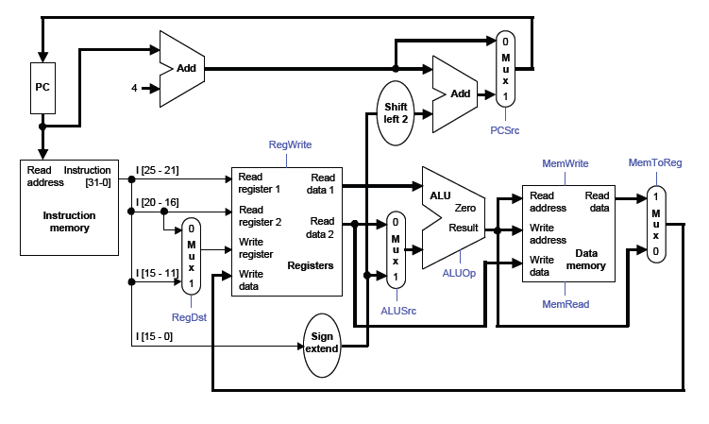
Datapath
pp. <number>

Slide 5
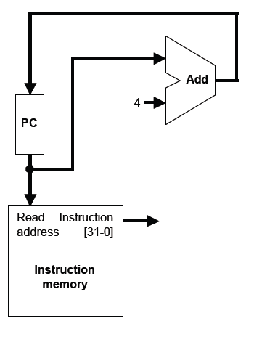
Instruction fetching
The CPU is always in an infinite loop,
fetching instructions from memory and
executing them.
The program counter or PC register holds
the address of the current instruction.
MIPS instructions are each four bytes
long, so the PC should be incremented by
four to read the next instruction in sequence.
pp. <number>

Slide 6
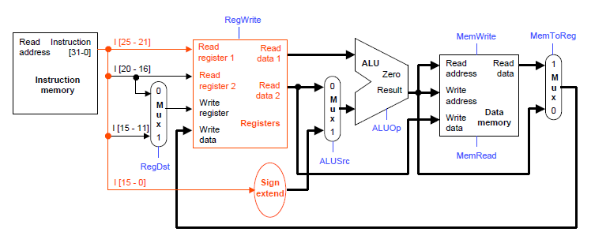
Instruction Decode
The Instruction Decode (ID) step reads the source register from the register file.
pp. <number>

Slide 7
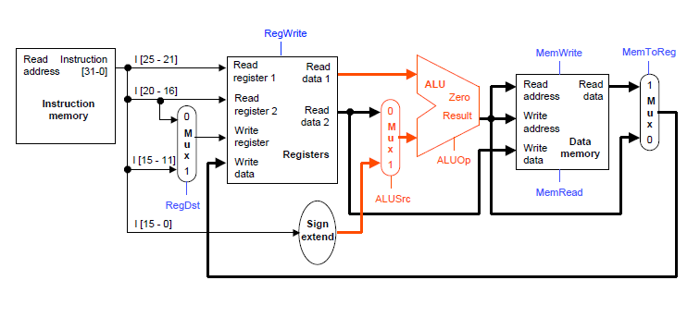
Execute
The third step, Execute (EX), computes the effective memory address from the source register and the instruction’s constant field.
pp. <number>

Slide 8
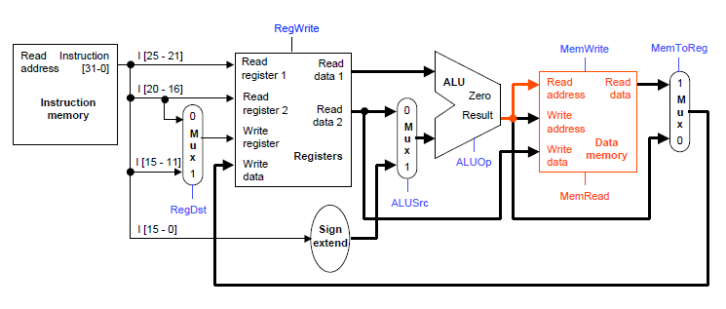
Memory
The Memory (MEM) step involves reading the data memory, from the address computed by the ALU.
pp. <number>

Slide 9
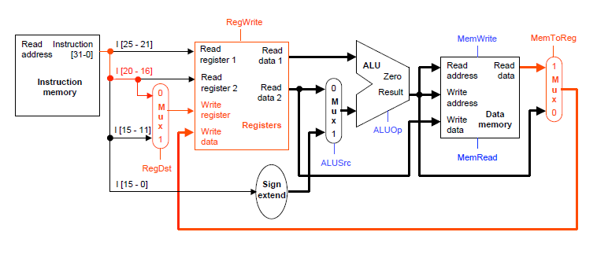
Write Back
Finally, in the Writeback (WB) step, the memory value is stored into the destination register
pp. <number>

Slide 10
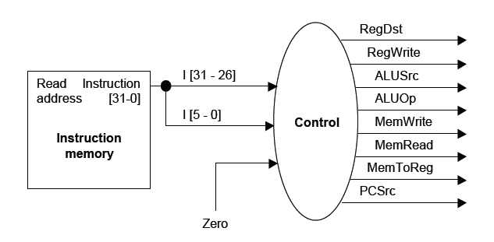
Control Unit
The control unit needs 13 bits of inputs.
  — Six bits make up the instruction’s opcode.
  — Six bits come from the instruction’s func field.
  — It also needs the Zero output of the ALU.
The control unit generates 10 bits of output, corresponding to the signals mentioned on the previous page.
pp. <number>

Slide 11
Homework 3
Single-cycle MIPS Processor
pp. <number>

Slide 12
Problem Statement
Using Verilog, implement the single-cycle MIPS processor:
  Supported instructions:
    add, sub, and, or, slt
    lw, sw
    beq
    j, jal, jr
Testbench/Memory model provided
pp. <number>

Slide 13
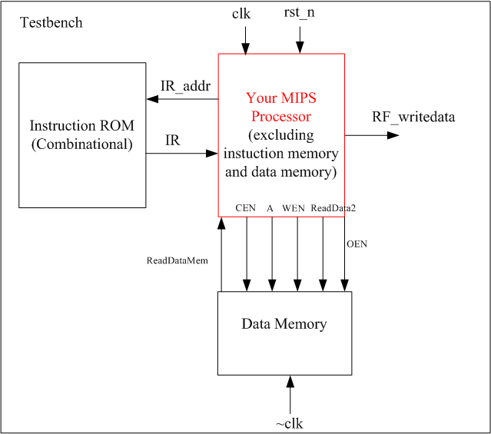
Block Diagram(1/2)
Instruction ROM
contains the testing instructions
RF_writedata:
the data to be written into the register file
  Used for testing your circuit
IR_addr:
instruction address
IR:
instruction
pp. <number>

Slide 14
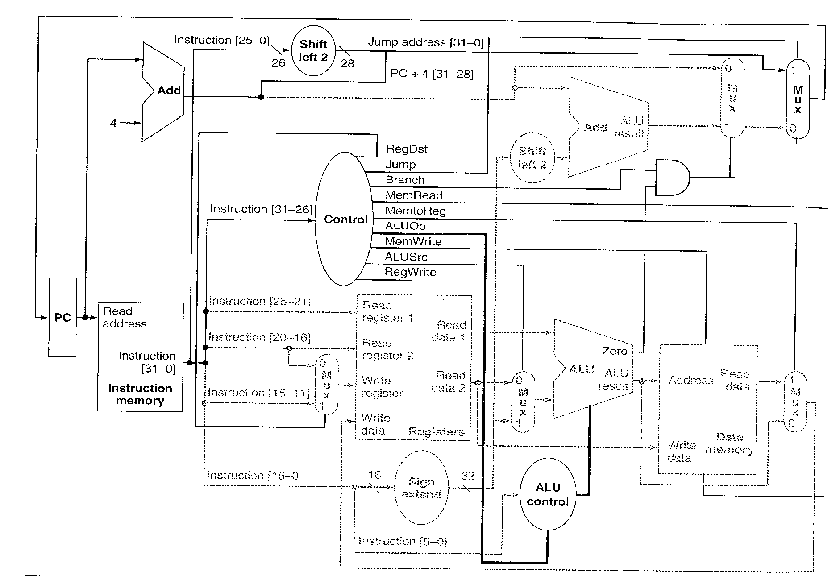
Block Diagram(2/2)
IR_addr
IR
RF_writedata
pp. <number>

Slide 15

Testbench
The testbench will
  Initialize the instruction memory and the data memory
  Reset your circuit
  Execute the instructions, and read the values of RF_writedata and IR_addr to see if your circuit is correct
  If your function is correct,
pp. <number>

Slide 16
Clock/Reset/Register File
Clock: positive edge triggered
Reset: active low asynchronous reset
Register file
  All registers are reset to 0 when reset occurs.
  Register $0 must be always 0
pp. <number>

Slide 17
Memory
Instruction memory and data memory are included in the testbench
For the data memory, a memory module is provided in HSs18n_128x32.v
  128 words x 32 bits
  Create an instance of HSs18n_128x32 as your data memory
  The spec of the memory is described in HSs18n_128x32.pdf
pp. <number>

Slide 18
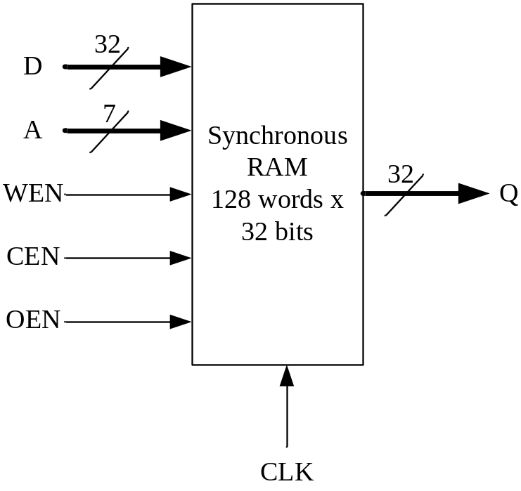
HSs18n_128x32
CLK: clock input
D: data inputs
A: address
CEN: chip_enable,
0 when you read/write data
WEN: write_enable,
0 when you write data into SRAM
OEN: read_enable,
0 when you read data from SRAM
  Should be inverse of WEN
Q: data outputs
pp. <number>

Slide 19
Memory Addressing
In MIPS, the memory address is byte address.
In HSs18n_128x32, the memory address is word address.
  We can just discard the least significant two bits of the address input
The address input of HSs18n_128x32 is 7-bit wide.
  More significant bits of address inputs are also discarded
pp. <number>

Slide 20
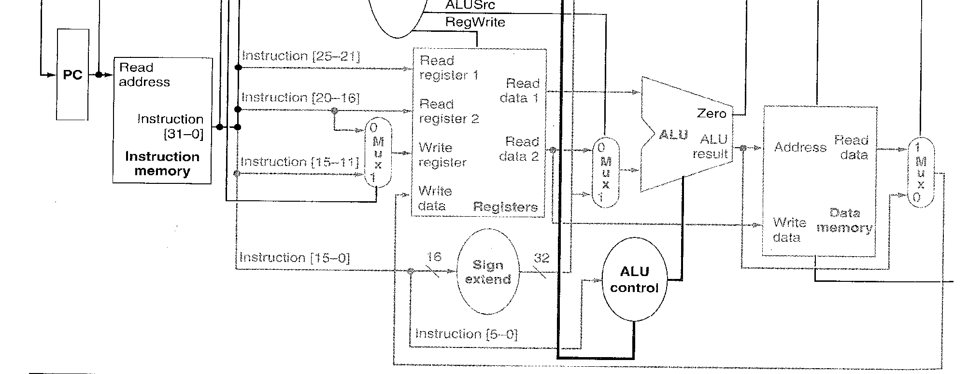
Memory Clock
To accomplish a load in a cycle, you need to connect the clock of the memory to the inverse of the main clock
clk
clk
~clk
pp. <number>

Slide 21
Simulation & Synthesis
Check “how_to_invoke_tools.txt”
3 Major Things
  RTL coding & simulation
  Logic Synthesis
  Gate-level simulation & debugging/refinement
Files needed for simulation
  RTL code: DSDHW3.v
  Gate-level code: DSDHW3.vg
  Timing information (SDF file): DSDHW3.sdf
  Design library (DDS file): DSDHW3.ddc
pp. <number>

Slide 22
Grading Policy
RTL (60%): function correctness
Synthesis (40%): correctness + area/timing
Provide information in report
  Area (um^2)
  Simulated timing (ns)
  (Not specified synthesis clock cycle)
TA: 任孝宜 電二 232實驗室
hsiaoi@access.ee.ntu.edu.tw
pp. <number>

Slide 23
Submission
Please submit 5 files (follow the name)
  RTL code: DSDHW3.v
  Synthesis: DSDHW3.vg, DSDHW3.sdf, DSDHW3.ddc
  Report: DSDHW3.pdf
Compress all the files into one ZIP or RAR file
  File name: DSD_HW3_學號_姓名.zip
Upload the file to FTP
  Address: 140.112.20.128 Port: 1232
  Account: DSD_STUDENT Password: DSD2013
Deadline: 2013/05/01 08:00am
  Late submission not allowed
pp. <number>

