Slide 1
IC Design HW3 Tutorial
Chun-Yuan Chu
Advisor：Tzi-Dar Chiueh
2012/11/20

Slide 2
Outline
Introduction to Verilog
Module
Value & number
Data type
Verilog-XL simulation & nWave tool

Slide 3
Introduction to Verilog
Module
Value & Number
Data Type

Slide 4
What is Verilog
Verilog is a Hardware Description Language (HDL)
Describe digital electronic system at multiple levels of abstraction
Model the timing
Express the concurrency of the system operation
Test the system

Slide 5
Verilog-Supported Levels of Abstraction
Behavioral level
Describe a system by the flow of data between its functional blocks. It is used when we don't worry about how the hardware looks-like. We use this to model any block if we just know how the input output should be.
Register Transfer Level (RTL)
Describe a system by the flow of data and control signals between and within its functional blocks
Gate level
Describe a system by connecting predefined components

Slide 6
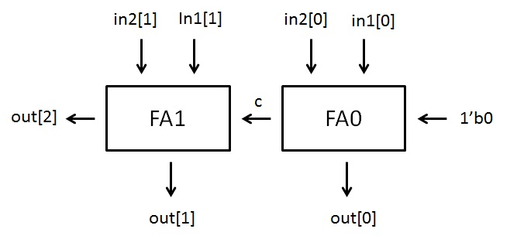
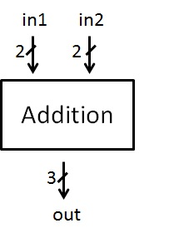
The Verilog Module
Basic building blocks .
Begin with module,
end with endmodule
module <module name>(<port lists>);
//module description
endmodule

Slide 7
Module Ports
Modules communicate through ports
input
output
inout (bidirectional)
module FD2 (Q, D, CLK, RESET);
output Q; input CLK, D, RESET;
//module description
endmodule
D
CLK
FD2
Q
RESET

Slide 8
4-Value Logic System
0
zero, false, low
1
one, true, high
Z
high impedance, floating
X
unknown, occurs at un-initialized storage elements or un-resolvable logic conflicts

Slide 9
Value and Number
[[<size>]’<radix>]<value>
Size
The size in bits
Default size is 32 bits
Radix
b (binary), o (octal), d (decimal), h (hexadecimal)
Default radix is decimal
Value
Any legal number in selected radix, including “x” and “z”
Radix and value are case-insensitive

Slide 10
Value and Number – Examples
underline usage
27_195_000
16’b0001_0101_0001_1111
32’h12ab_f001
X and Z is sign-extended
Ex. 12-bit a
a = ’h x; // yields xxx
a = ’h 3x; // yields 03x
a = ’h 0x; // yields 00x
659 //unsized decimal
’h87ff //unsized hexadecimal
4af // illegal syntax
4’b1001 // 4-bit binary
5’d3 // 5-bit decimal
3’b01x // 3-bit binary with unknown LSB
12’hx // 12-bit unknown
8’d -6 // illegal syntax
-8’d 6 // phrase as -(8’d6)

Slide 11
Data Type Classes
wire
wire [MSB:LSB] variables;
input, inout, output are default to be wire.
Used to describe combinational circuit!
reg
reg [MSB:LSB] variables;
Used to describe combinational or sequential circuit.

Slide 12
Assign a value to wire
wire
“assign “
wire a;
assign a = 1’b1;
Output port
wire a;
wire b;
assign b = 1’b0;
NOT n0(a, b);
Every wire can be only assigned once!!!
wire a;
wire b;
assign b = 1’b0;
NOT n0(a, b);
assign a = 1’b0; //Wrong!!!

Slide 13
Module Instances (1/2)
Create a higher-level system by connecting lower-level components
Reg2
module Reg2 (q, d, clk, rst);
output [1:0] q; input [1:0] d; input clk, rst;
FD2 f0(q[0], d[0], clk, rst); FD2 f1(.Q(q[1]), .D(d[1]), .CLK(clk), .RESET(rst));
endmodule
d[1]
FD2
q[1]
d[0]
clk
FD2
q[0]
rst

Slide 14
Module Instances (2/2)
module Reg2_2 (q, d, clk, rst);
output [1:0] q; input [1:0] d; input clk, rst;
wire [1:0] w;
Reg2 r0(w, d, clk, rst); Reg2 r1(q, w, clk, rst);
endmodule
Reg2_2
w
d
Reg2
Reg2
q
2
2
2
clk
rst

Slide 15
Net Concatenations
Representation | Meaning
{b[3:0],c[2:0]} | {b[3] ,b[2] ,b[1] ,b[0], c[2] ,c[1] ,c[0]}
{a,b[3:0],w,3’b101} | {a,b[3] ,b[2] ,b[1] ,b[0],w,1’b1,1’b0,1’b1}
{4{w}} | {w,w,w,w}
{b,{3{a,b}}} | {b,a,b,a,b,a,b}

Slide 16
Standard Cell Library (lib.v)
Choose what you need
Compose your circuit according to I/O connections
module AN3(Z,A,B,C);
output Z;
input A,B,C;
// netlist
and g1(Z,A,B,C);
// specify block, declare local
// timing constant
specify
// delay parameters
specparam Tp_A_Z = 0.275;
specparam Tp_B_Z = 0.275;
specparam Tp_C_Z = 0.275;
// path delay (full connection)
( A *> Z ) = ( Tp_A_Z );
( B *> Z ) = ( Tp_B_Z );
( C *> Z ) = ( Tp_C_Z );
endspecify
endmodule

Slide 17
Standard Cell Library (lib.v)
AN3
AN4
AN2
EN //xnor
EN3
EO // xor
EO3
FA1 // full adder
FD1 // DFF
FD2
HA1 // half adder
IV // not
MUX21H
// 2-to-1 MUX
ND2 // nand
ND3
ND4
NR2 //nor
NR3
OR2
OR3
OR4

Slide 18
Notification
In this HW, all the logic operation MUST consist of standard cell. You can NOT use logic operators.
wire a, b, c;
assign a = b & c;
wire a, b, c;
AN2 an(a, b, c);

Slide 19
Example
module ADDER (out, in1, in2);
output [2:0] out;
input [1:0] in1, in2;
wire c;
FA1 fa0(c, out[0], in1[0], in2[0], 1’b0);
FA1 fa1(out[2], out[1], in1[1], in2[1], c);
endmodule

Slide 20
Flow chart
tb_Comparator_51.v
lib.v
answer.dat
in0.dat
in1.dat
in2.dat
in3.dat
in4.dat
*.fsdb
Verilog
nWave
Your job
(Write Verilog file)
Comparator_51.v
All these files should be placed under the same folder

Slide 21
Your Job
module COMPARATOR_51(median, i0, i1, i2, i3, i4);
output [2:0] min; input [5:0] i0, i1,i2, i3, i4;
\\ Write your design here
wire [?:0] …;
My_module_0 M0(?, ?, … , ?);
…….. My_module_x Mx(?, ?, … , ?);
endmodule
i0
COMPARATOR_51
6
i1
6
min
i2
My_module_0
My_module_x
6
?
3
i3
6
i4
6

Slide 22
Verilog-XL Simulation & nWave Tool

Slide 23
Test and verification your circuit
By applying input patterns and observing output responses
Testbench
Device under test (*.v)
Device under test (*.v)
(tb_*.v)
(tb_*.v)
(*.fsdb)
(*.fsdb)
Test patterns
Output response

Slide 24
Compile and debug (1/2)
Source
source .cshrc_new
source /usr/cadence/cshrc
source /usr/spring_soft/CIC/verdi.cshrc
Include the testbench & lib.v files to run simulation
ncverilog +access+r tb_Comparator_51.v lib.v Comparator_51.v

Slide 25
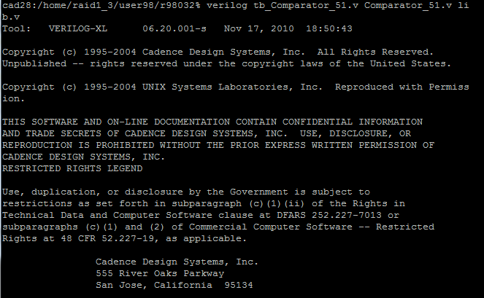
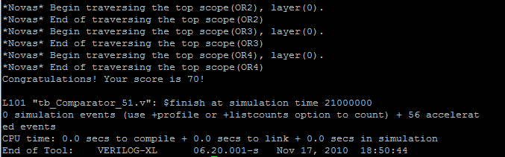
Compile and debug (2/2)

Slide 26
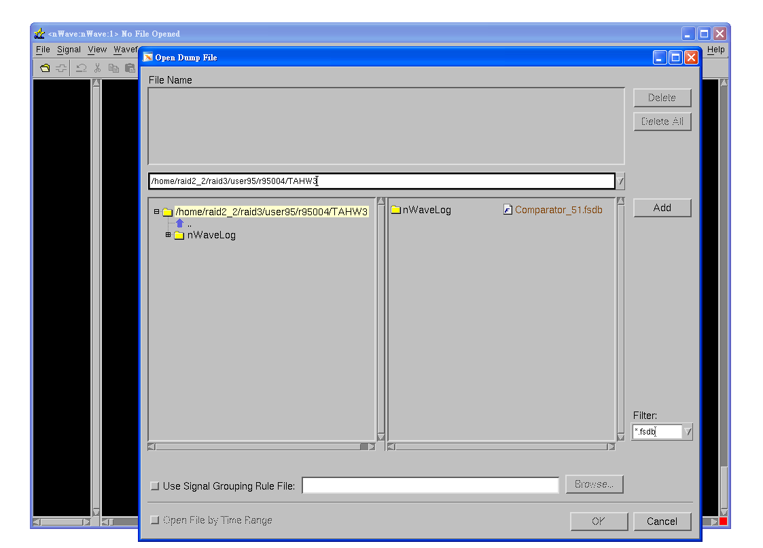
Execute nWave & Open *.fsdb
Execute : nWave &
Open waveform file:
File -> Open -> Comparator_51.fsdb

Slide 27
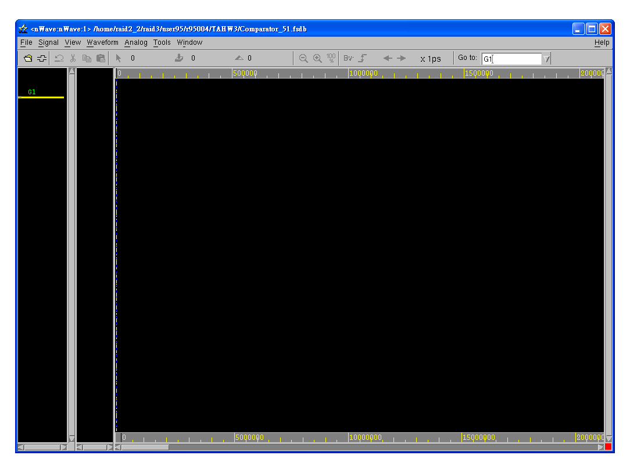
Get signals

Slide 28
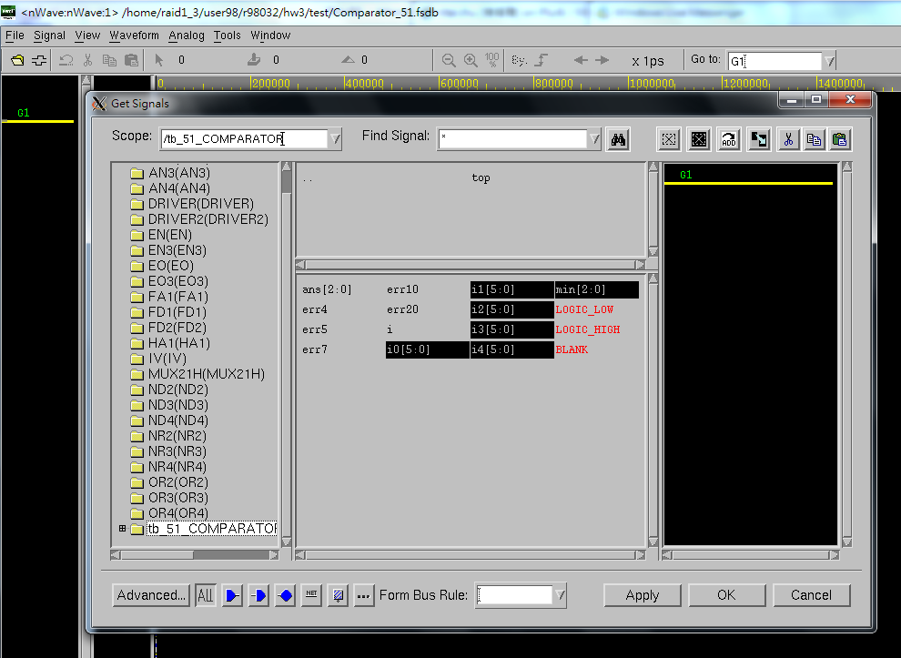
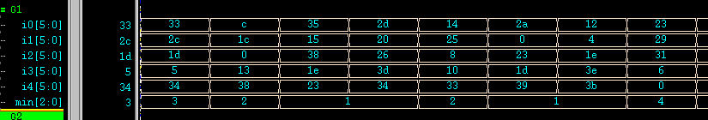
Find Top Module & Choose signals

Slide 29
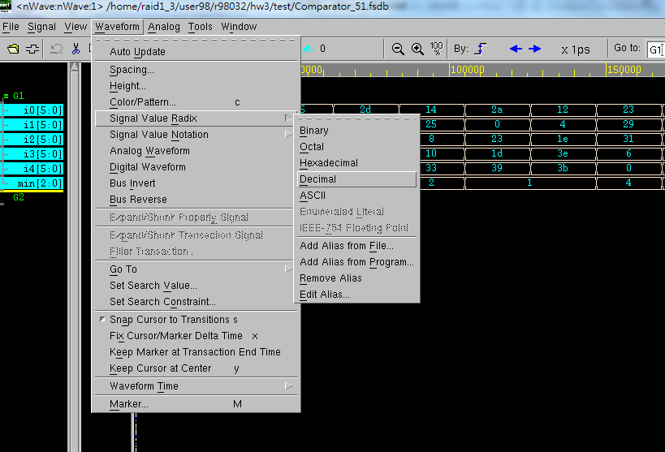
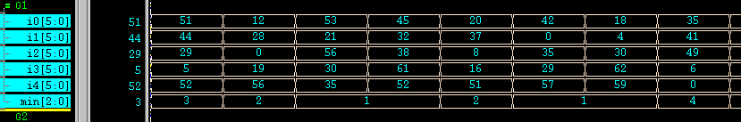
Change the radix to be decimal

Slide 30
Reminder
Due to 12/4 9:10AM in class!!
Please use cad 32~33 (for ncverilog & nWave)
Any further questions
b96901055@ntu.edu.tw
r00943118@ntu.edu.tw
To know more about Verilog, refer to
http://www.ece.umd.edu/courses/enee359a.S2008/verilog_tutorial.pdf

