Slide 1
Pet Adoption Analysis
Exploratory Data Analysis Report

Slide 2
Dataset Overview
Total Records: 14,993
Total Features: 24
Memory Usage: 2.75 MB
Missing Values: 1278
Duplicate Rows: 0

Slide 3
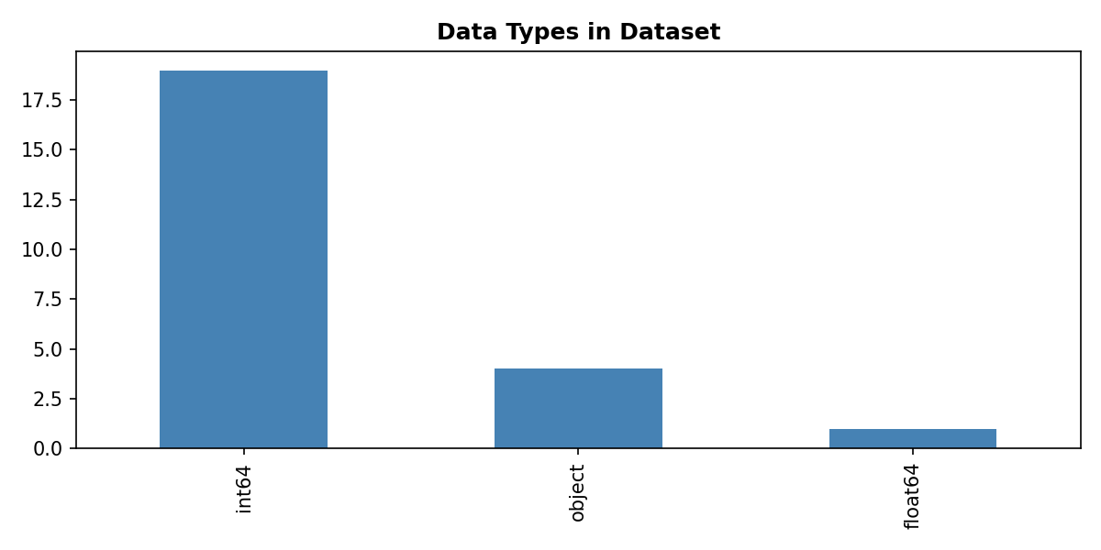
Data Types Distribution

Slide 4
Missing Values Analysis
Columns with Missing Values:
Name: 8.44%
Description: 0.09%

Slide 5
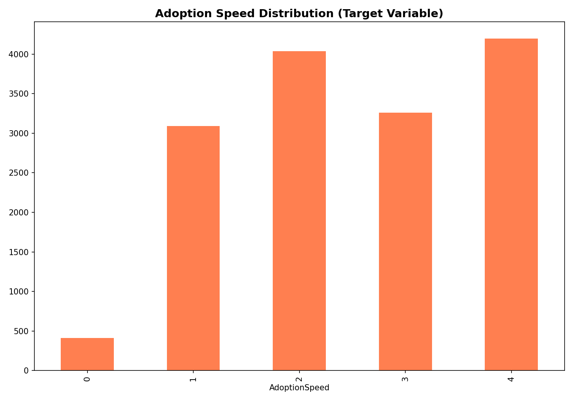

Slide 6
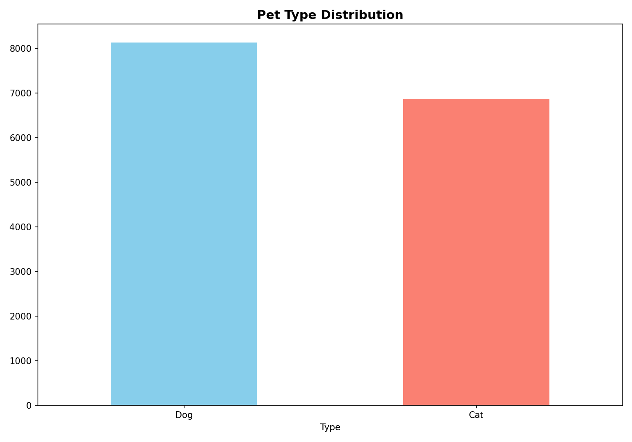

Slide 7
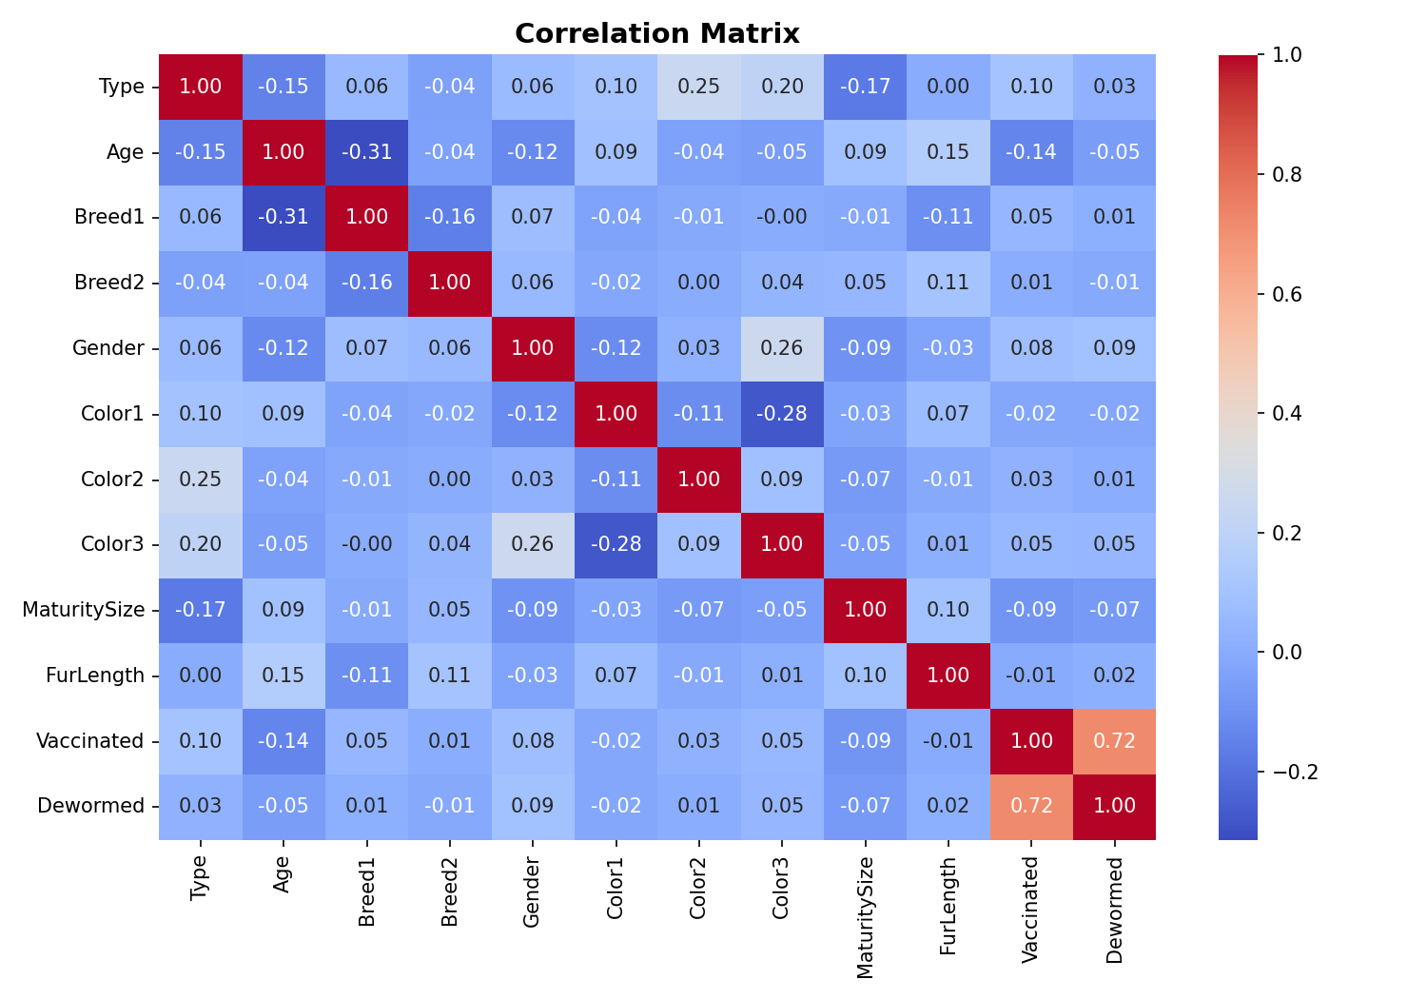

Slide 8
Key Statistics
Average Age: 10.45 months
Average Fee: $21.26
Pets with Photos: 14652 (97.7%)
Pets with Videos: 574 (3.8%)
Unique Breeds: 176
Unique States: 14

