Slide 1


Map of Cameras
Android app
Michal MED
Daniel DLUHOŠ
Martin LŽÍČAŘ
michal.med.jr@gmail.com

Slide 2
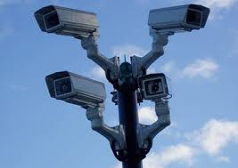
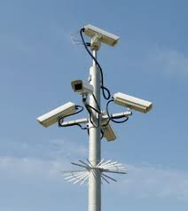
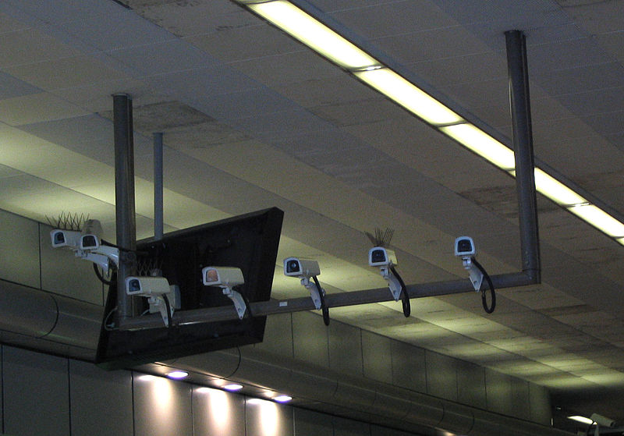
Motivation

Slide 3



Motivation

Slide 4


Targets
Cooperation with civic association
  Association deals with human rights
  www.mapakamer.cz/
  Big Brother Awards
  „The aim is to create a comprehensive overview of the eyes of Big Brother, that man knew where everywhere is he observed. At least keep an eye guard so that we will know about it!“

Slide 5
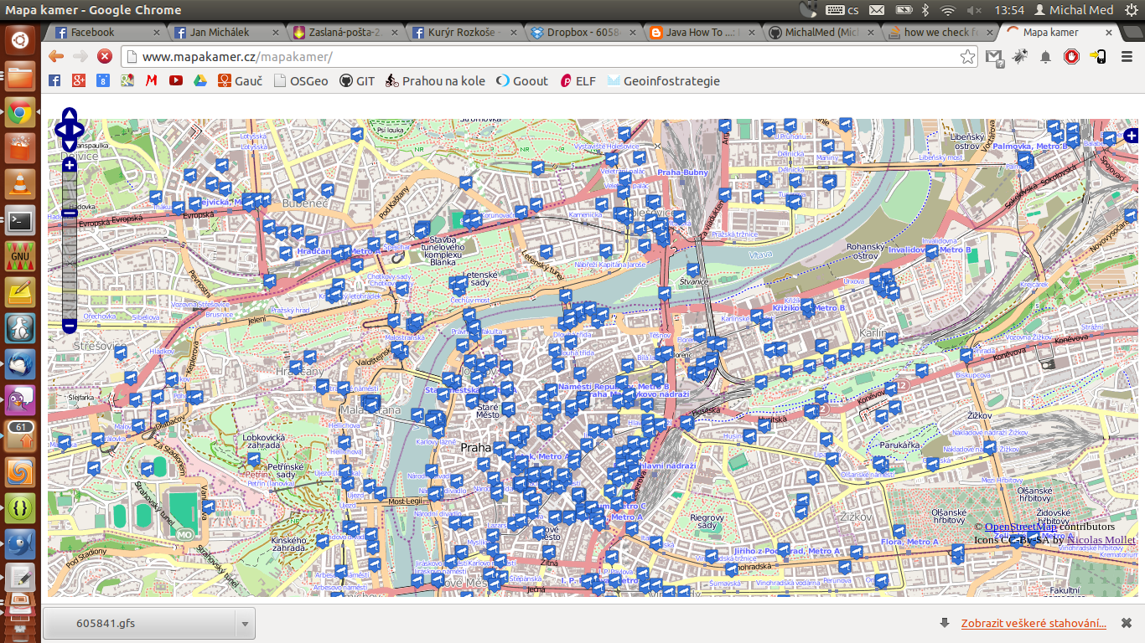

Slide 6





Technology

Slide 7
Project
Mobile application
Database
Server

Slide 8
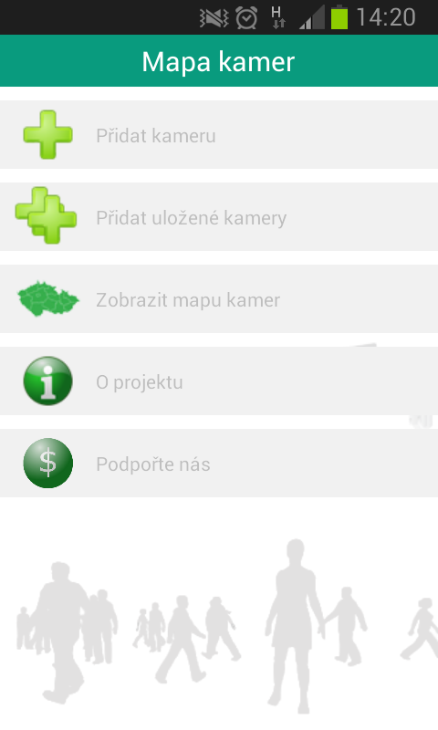
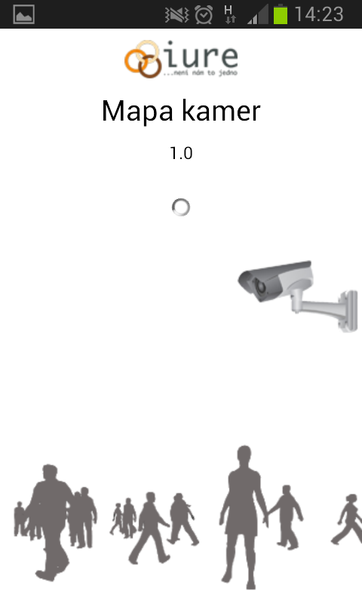
Application overview
Adding new cameras
View map
View CCTV details
About
Donate

Slide 9
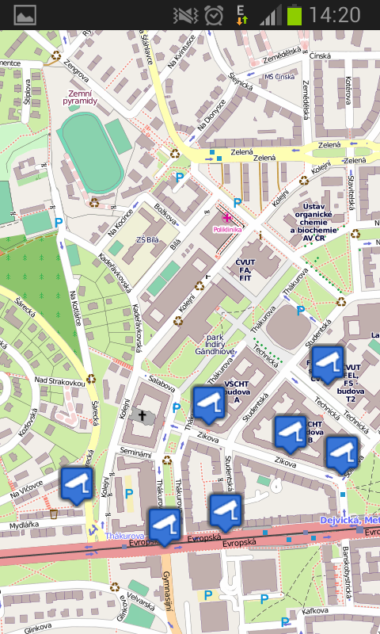
View map

Slide 10
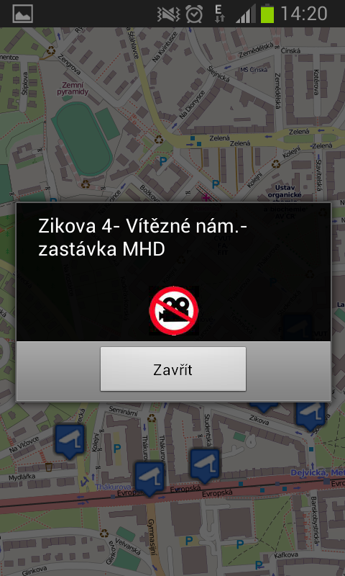
View CCTV Details

Slide 11
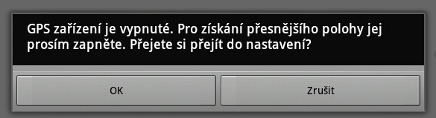

Add/Save Camera
Needs GPS reciever
What are we sending?
  CCTV location
  Camera description
  Picture of camera

Slide 12
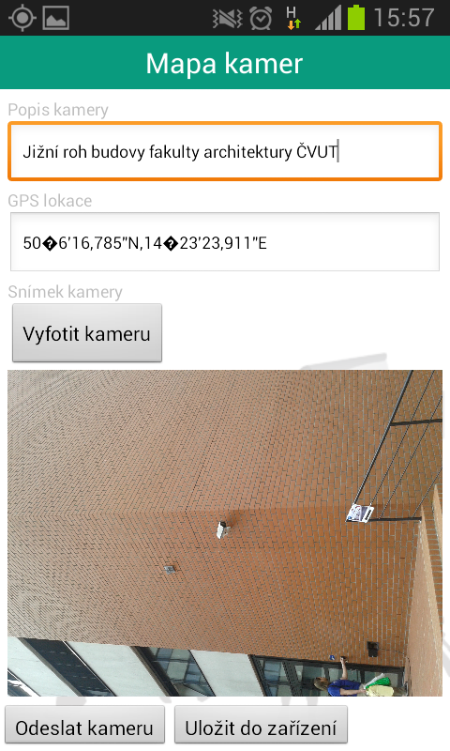
Add/Save Camera

Slide 13
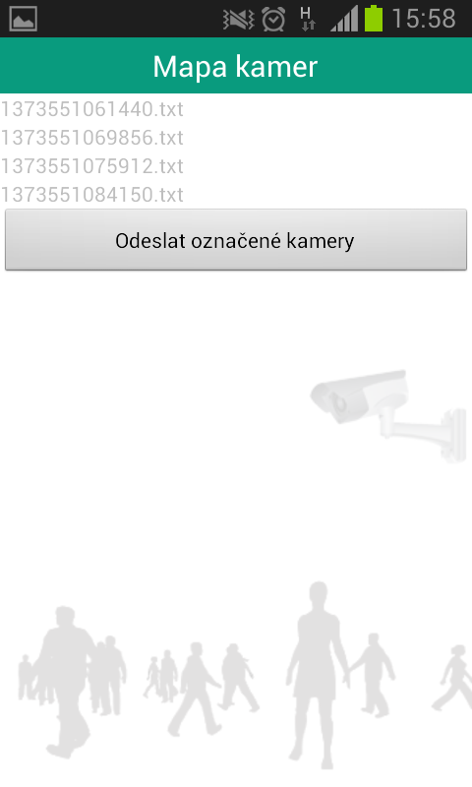
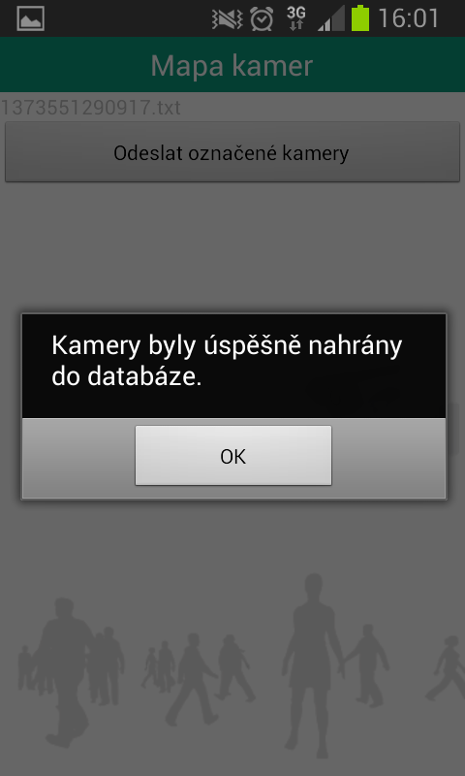
Queue adding of cameras

Slide 14
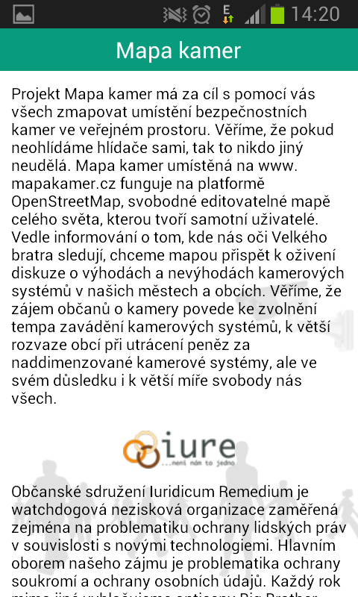
About/Donate

Slide 15


Application overview
App is optimized for Android v 4.2.2 JellyBean
Tested on Devices
  Samsung SIII mini – android 4.1.2
  HP TouchPad – android 4.0.4
  HTC Desire Z – android 2.3
Eclipse with Android Developer Tools

Slide 16
App Background
OpenStreetMap tiles
Library Osmdroid
  Opensource project
  Replaces native methods of Google Maps
  OSM layers in Android application
New classes written for display markers: ItemizedOverlay and ImageOverlayItem

Slide 17




Database
  OpenStreetMap uses also PostgreSQL
  In OSM there are lot CCTVs
  mapakamer.cz runs OSM via OpenLayers
  Problematic to get features from OSM via tag without OpenLayers
  Problems with queue adding of data
  OSM doesn't support images

Slide 18

Database
Solution
  Own DB, but basic data imported from OSM
  Need of rebuilding web app mapakamer.cz
  Need of actualization
create TABLE b_kamery as (SELECT osm_id,name,ST_X(ST_Transform(way::geometry,4326)) as lat,ST_Y(ST_Transform(way::geometry,4326)) as lon from osm.czech_point where man_made='surveillance');

Slide 19
Database
Simple table
  atributes
    osm_id, name, lat, lon, image
  Lack of data – owner of camera, hashed id of device, type (IN/OUT/PUBLIC)
  Easy to extend

Slide 20

Connection
Servlets:
  SaveToDB
    Adding cameras to DB
  LoadFromDB
    Data – all from BBOX
    Image – one by one

Slide 21
Connection
Class Java Servlet
  request
  response
Interface DataSource
  Predefined connections to DB
  Faster then direct connection

Slide 22



Future
Fasten recieving images from server
Think about securing application
Exchange data between our DB and OSM
Publish on Google Play
Wait for feedback

Slide 23
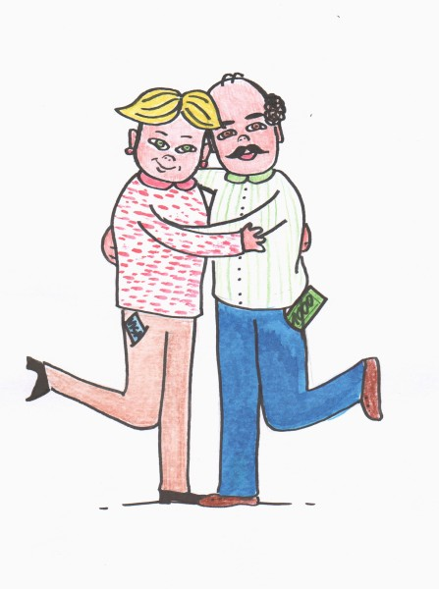

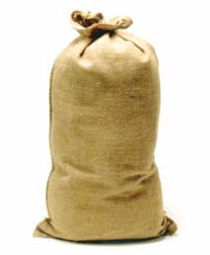

Thanks to...

Slide 24
Thank you
2013

