Slide 1
Social Networking Analysis
Brandon Byrne

Slide 2
Overview
Using metadata to find Paul Revere
Legality/ethics regarding data mining social media
Application

Slide 3
Using Metadata to find Paul Revere
Background/Context: 2013 was when Edward Snowden leaked a bunch of documents accusing the NSA of spying on US citizens
NSA asserted they were not listening to context of conversations, only using the “metadata” surrounding them
Publication in 2013 demonstrating how powerful metadata (that is, only knowing connections, not context) analysis can be
Dataset is a matrix of revolutionaries as rows, groups they belong to as columns
The idea is with no context, just knowing who was associated to what group, social network analysis could be done to discover that Paul Revere was a central figure in the Revolutionary War.
https://kieranhealy.org/blog/archives/2013/06/09/using-metadata-to-find-paul-revere/

Slide 4
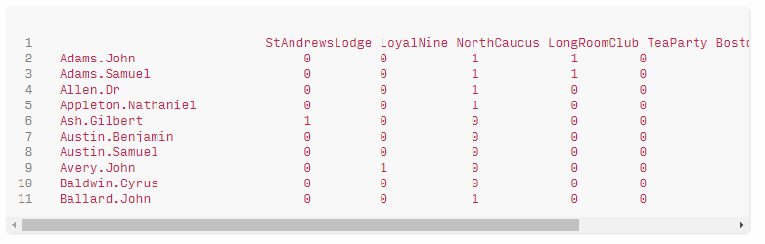
Paul Revere dataset

Slide 5
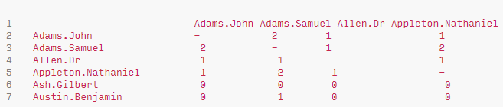
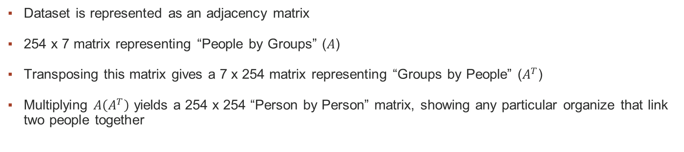
Matrix transforms & Network Analysis
Dataset is represented as an adjacency matrix
254 x 7 matrix representing “People by Groups” ($A$)
Transposing this matrix gives a 7 x 254 matrix representing “Groups by People” ($A^{T}$)
Multiplying $A\left(A^{T}\right)$ yields a 254 x 254 “Person by Person” matrix, showing any particular organize that link two people together

Slide 6
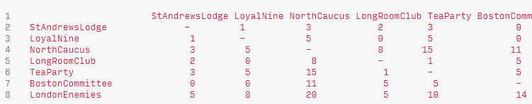
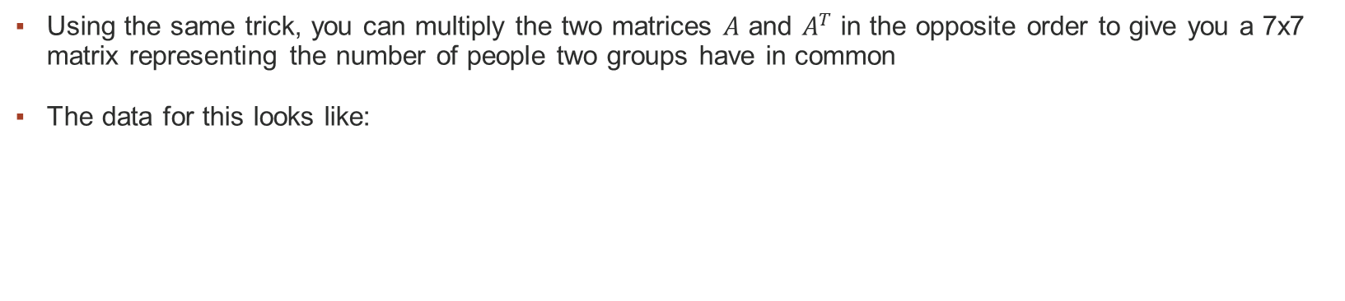
Matrix transforms & Network Analysis
Using the same trick, you can multiply the two matrices $A$ and $A^{T}$ in the opposite order to give you a 7x7 matrix representing the number of people two groups have in common
The data for this looks like:
..and yields..

Slide 7
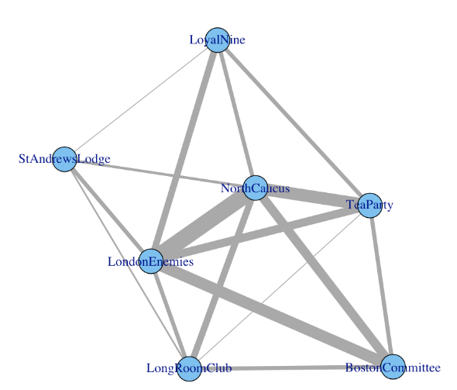
Matrix transforms & Network Analysis
..a graph showing groups with weights on connections for how many people are in common between them

Slide 8
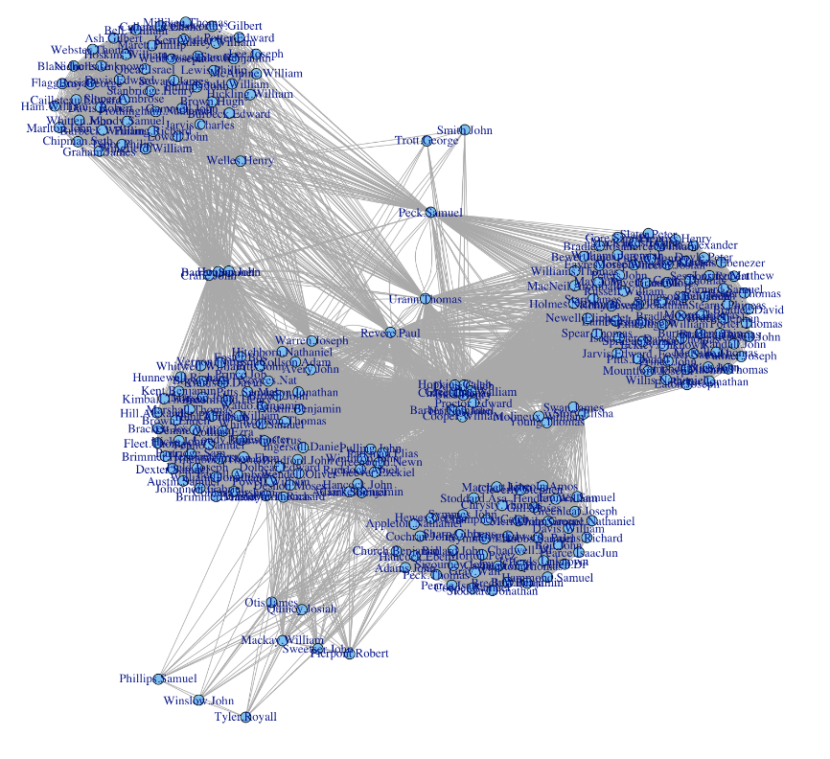
Matrix transforms & Network Analysis
Graphing the same way for the 254 person by person matrix, you get a graph relating how each person is connected. At the center of that group is…

Slide 9
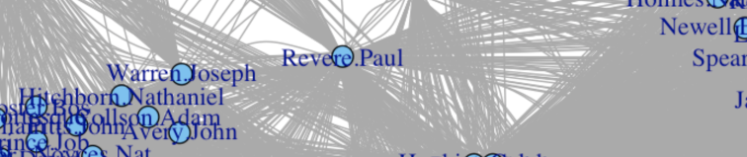
Matrix transforms & Network Analysis

Slide 10
Overview
Using metadata to find Paul Revere
Legality/ethics regarding data mining social media
Application

Slide 11
Legality/Ethics
“There are some risks associated with data scraping from Facebook. Facebook considers itself a private platform, so collecting any data from Facebook will come under the data breach or trespassing. ”
From Facebook TOS:
“You may not access or collect data from our Products using automated means (without our prior permission) or attempt to access data you do not have permission to access.”
“You may not sell, license, or purchase any data obtained from us or our services, except as provided in the Platform Terms.”

Slide 12
Less than benevolent intentions
Services/tools exist to scrape data from Facebook for you – potentially in violation of Facebook’s TOS
“Facebook is a huge database of user-generated content. If you know what you are doing, data from Facebook can be used to better understand your audience for business and political gains”
“Think about it: Facebook is enabling the subversion of our highly personal social networks for profit and undue political influence.”

Slide 13
Overview
Using metadata to find Paul Revere
Legality/ethics regarding data mining social media
Application

Slide 14
Goal
Use the same principles from the Finding Paul Revere demonstration to apply them to my own social network
Instead of finding who is a central person of interest, ie the 254 x 254 “Person by Person” matrix, identify different groups from my social connections
Do so in a way that does not violate Facebook TOS or ethics
Present the data in an intelligible fashion

Slide 15
Creating the dataset
Keeping in mind “You may not access or collect data from our Products using automated means (without our prior permission) or attempt to access data you do not have permission to access.”
As long as the means was not automated, I was not violating any TOS
I went to my own Facebook page and clicked my list of friends, copying all data into Excel, with one friend per row
Transpose the rows to columns, creating a matrix of “friends by friends”
0 out all cells in between them
Painstakingly click through each friend, noting which mutual friends we had in common, then replacing the 0 with a 1 in the Excel spreadsheet indicating a connection between people

Slide 16
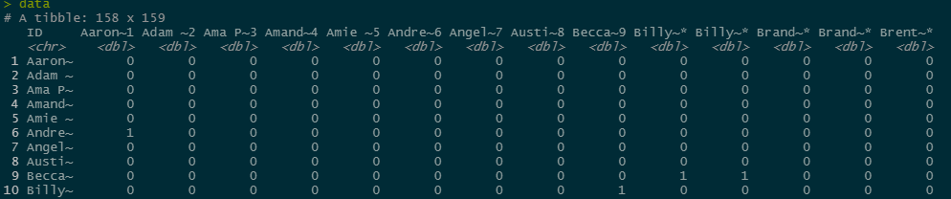
Creating the dataset
Data looks like this:

Slide 17
Analyzing the dataset
Created a script to turn the adjacency matrix into a graph and plot
Following pages show how the graph transforms as I added more information into the Excel document

Slide 18
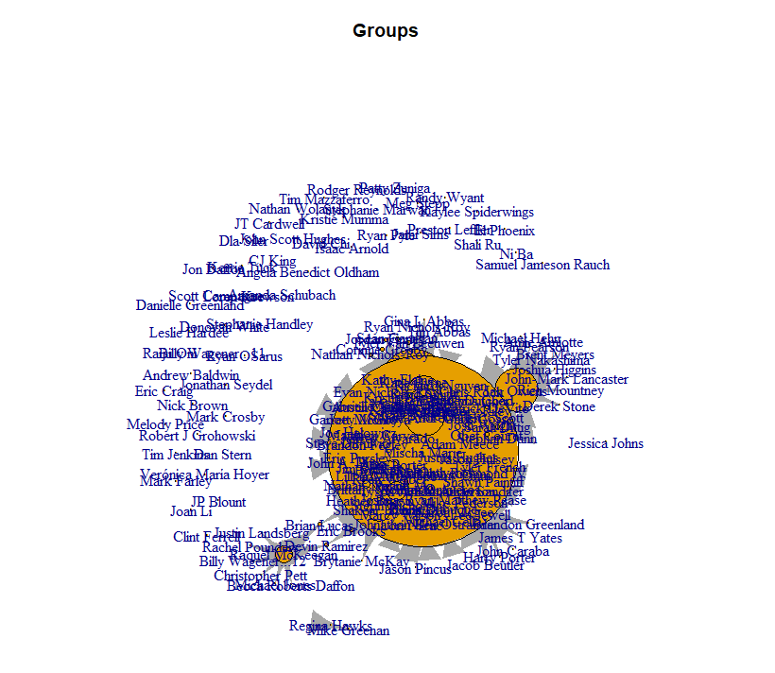
Initial work – small dataset

Slide 19
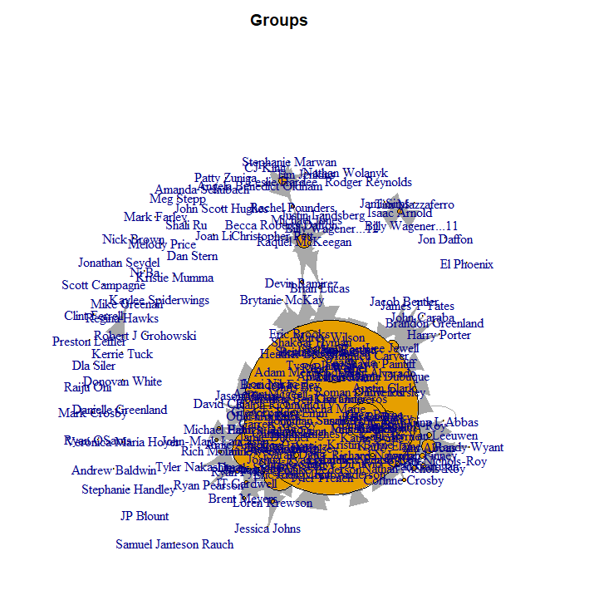
Dataset grows..

Slide 20
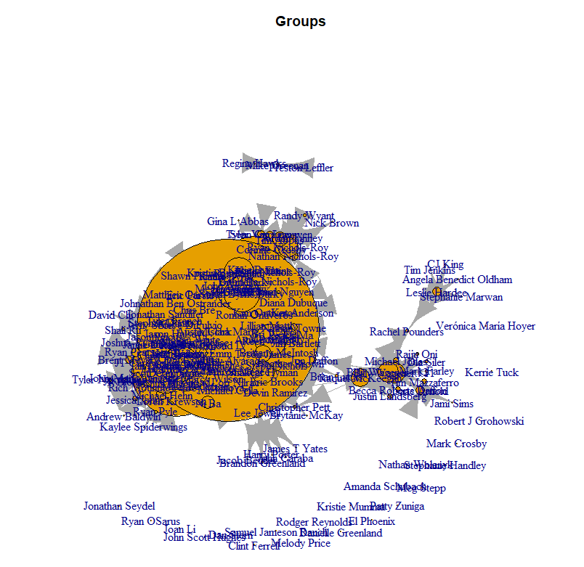
Dataset grows..

Slide 21
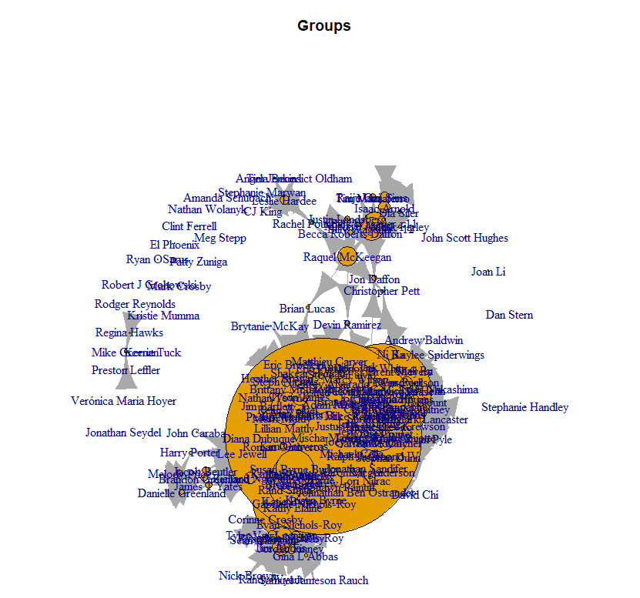
Dataset grows..

Slide 22
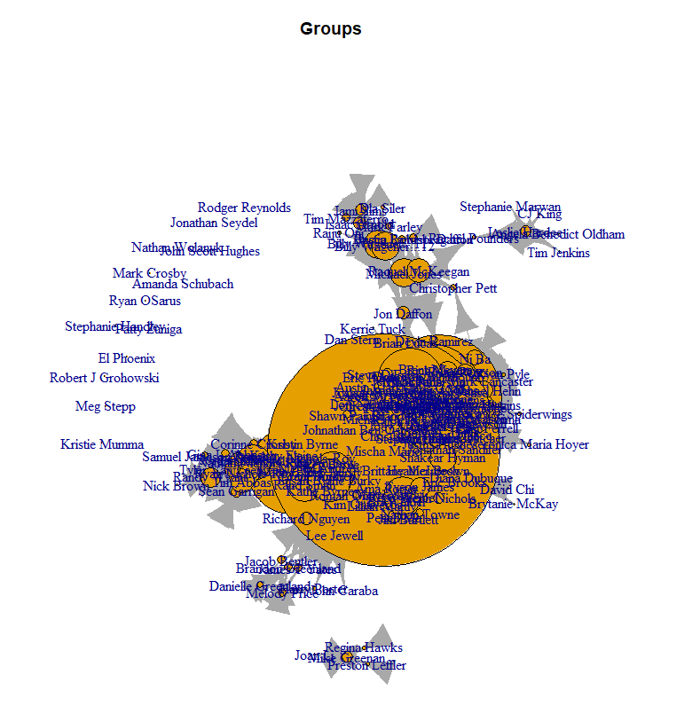
Dataset grows..

Slide 23
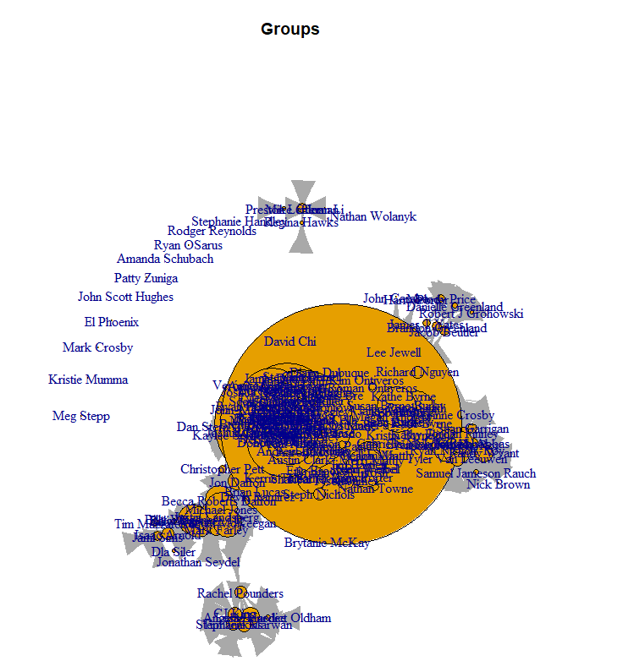
Dataset grows..

Slide 24
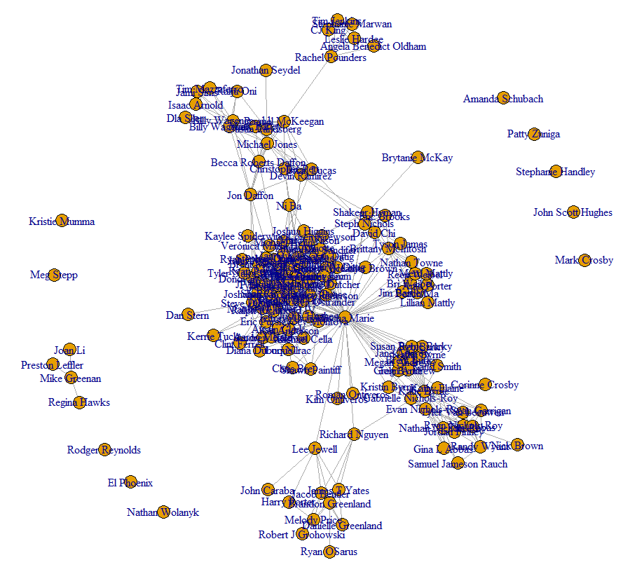
Changing plot parameters..
At this point, graphs overlapped too much so I changed parameters:

Slide 25
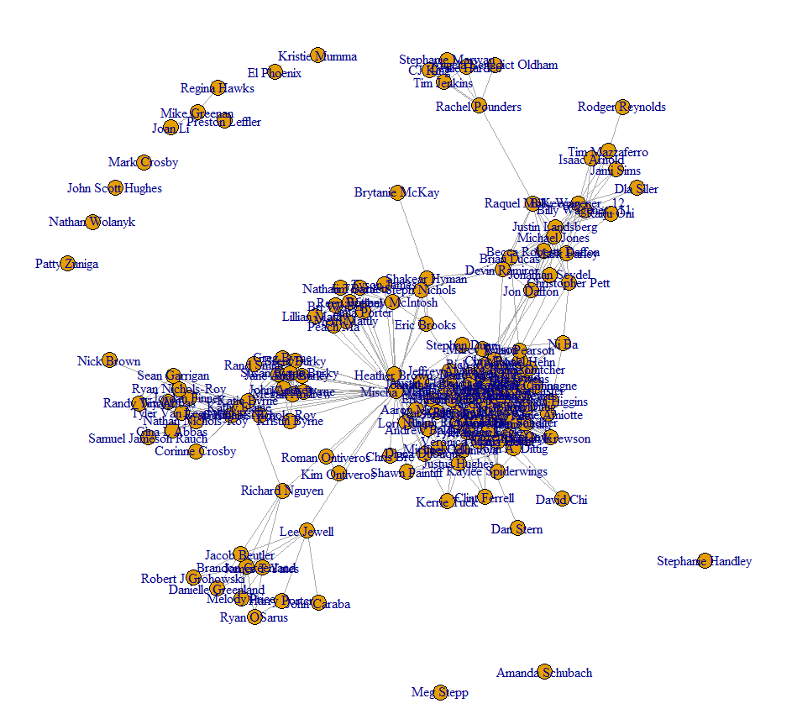
Final Graph

Slide 26
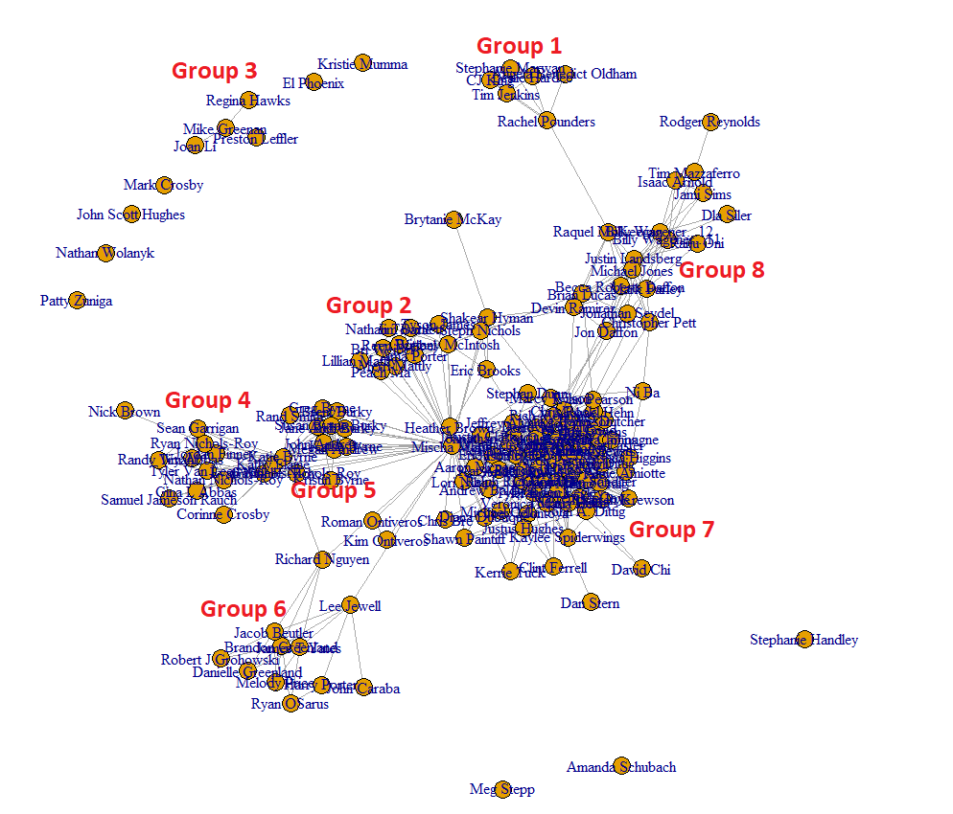
Final Graph

Slide 27
Final Graph
Group 1: People I met in training in Texas
Group 2: Wife’s family
Group 3: High school friends
Group 4: People from church
Group 5: My family
Group 6: People from my 1st job
Group 7: People from my 3rd job
Group 8: People from my 2nd job

Slide 28
Final Graph
Powerful implications from this graph
Remember, without context, these groups inherently don’t tell you anything except that the people in them are related in some way – the context from the previous slide was added by me
By “interviewing” people from the different groups in this graph, can determine what the context is
Law enforcement example: if I were a drug dealer, a similar graph/analysis could be done to understand and infiltrate my network

Slide 29
Wrapping up
Social Network Analysis increasingly growing field in law enforcement, intelligence, and ad product placement
Without knowing any context, just the metadata of how people are connected, you can discover links between them
Can be used to determine “if someone is real,” ie, if a Facebook profile is made up or not – very difficult to create these kinds of natural group connections from scratch

Slide 30
Sources
https://www.datamation.com/big-data/facebook-and-data-mining-is-anything-private/
https://kieranhealy.org/blog/archives/2013/06/09/using-metadata-to-find-paul-revere/
https://www.facebook.com/legal/terms

