Slide 1
Social Networking Analysis
Brandon Byrne
Notes:
Hello, I'm Brandon Byrne and my project is on Social Networking Analysis

Slide 2
What is Social Networking Analysis?
Social network analysis (SNA) is the process of investigating social structures through the use of networks and graph theory - Wikipedia
Notes:
First off, what is social networking analysis? Wikipedia defines it as the process of investigating social structures through the use of networks and graph theory. In simpler terms, it’s the study of social groups using people as nodes, and relationships as connections between nodes

Slide 3
Overview
Using metadata to find Paul Revere
Legality/ethics regarding data mining social media
Application
Notes:
My presentation will go over three things. It was actually inspired by a paper I read years ago called “Using metadata to find Paul Revere” I’ll give a quick summary of what that paper was about and its methods, then I’ll talk a little about what I found regarding the ethics and legality involved in scraping data from a site such as facebook. Finally I’ll show you how I applied some of the ideas from the Paul Revere paper into my own social network and formed graphs and connections between people

Slide 4
Using Metadata to find Paul Revere
Background/Context: 2013 was when Edward Snowden leaked a bunch of documents accusing the NSA of spying on US citizens
NSA asserted they were not listening to context of conversations, only using the “metadata” surrounding them
Publication in 2013 demonstrating how powerful metadata (that is, only knowing connections, not context) analysis can be
Dataset is a matrix of revolutionaries as rows, groups they belong to as columns
The idea is with no context, just knowing who was associated to what group, social network analysis could be done to discover that Paul Revere was a central figure in the Revolutionary War.
https://kieranhealy.org/blog/archives/2013/06/09/using-metadata-to-find-paul-revere/
Notes:
Real quick some context surrounding the Paul Revere paper – it was written in 2013 which was right after the Edward Snowden scandal where he leaked a bunch of classified documents about the NSA spying on US citizens. One of the NSA’s responses from this was that they were just collecting “metadata” – not listening to conversations or reading emails, only keeping track of who was talking to who, or who was emailing who. This paper was written as a kind of response to that, to highlight how hugely useful metadata can be, and how much you can find out about a person or social groups without knowing anything about what they are saying or doing.
The dataset used in this paper is a matrix with known revolutionaries as rows, and with revolutionary groups as columns. So the British knew about this people and groups, but not anything about their command structure or who was more important than anyone else

Slide 5
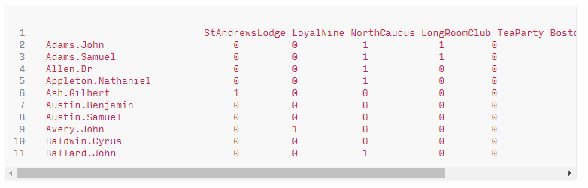
Paul Revere dataset
Notes:
This is what the dataset from the paper looks like – simple matrix, people on the rows, groups on the columns. If a person belonged to a group, there was a 1 at their intersection point, otherwise there was a 0.

Slide 6
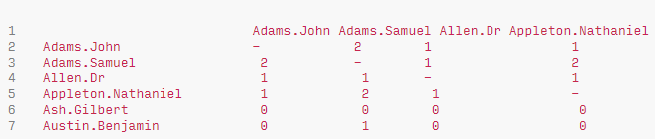
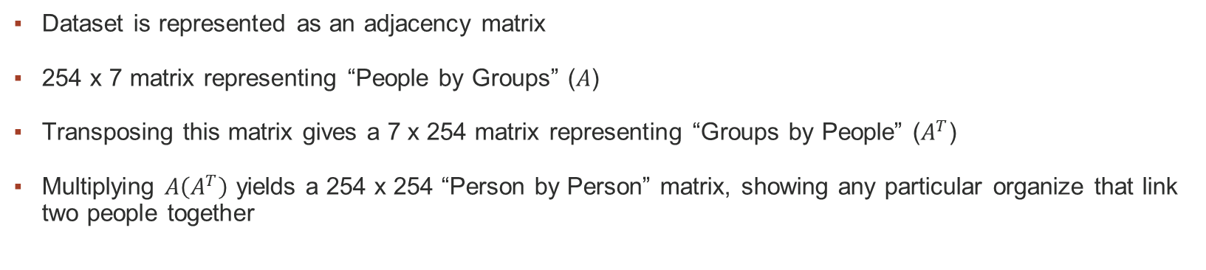
Matrix transforms & Network Analysis
Dataset is represented as an adjacency matrix
254 x 7 matrix representing “People by Groups” ($A$)
Transposing this matrix gives a 7 x 254 matrix representing “Groups by People” ($A^{T}$)
Multiplying $A\left(A^{T}\right)$ yields a 254 x 254 “Person by Person” matrix, showing any particular organize that link two people together
Notes:
The original dataset as represented is what is called an adjacency matrix, showing the connections between people and groups – that yields a 254 x 7 matrix. If you were to transpose this matrix, you would get a 7 x 254 matrix with groups as rows, and people as columns. You can then multiply the original matrix by its transpose which gives you a 254 x 254 person by person matrix showing who is connected to who through an organization

Slide 7
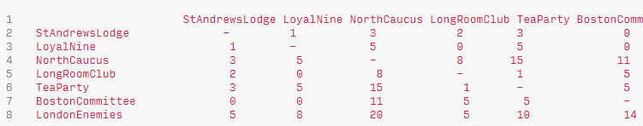
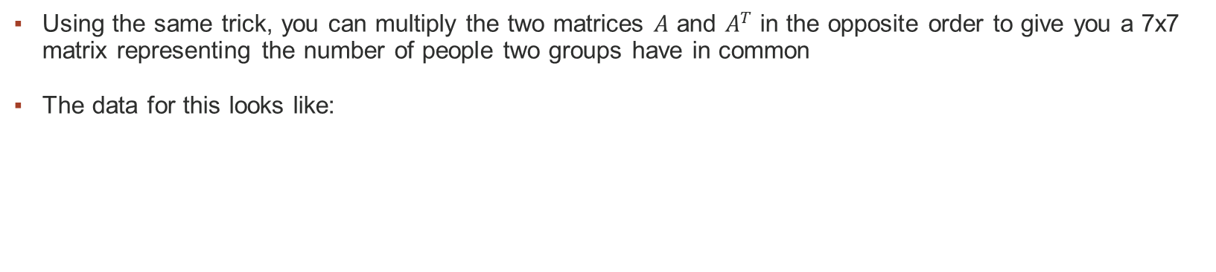
Matrix transforms & Network Analysis
Using the same trick, you can multiply the two matrices $A$ and $A^{T}$ in the opposite order to give you a 7x7 matrix representing the number of people two groups have in common
The data for this looks like:
..and yields..
Notes:
Matrix A multiplied by Matrix A transpose is not the same as A transpose multiplied by A – if you do it this way, you get a 7x7 matrix showing which groups are connected to each other and through how many people. Displayed as a graph, this looks like..

Slide 8
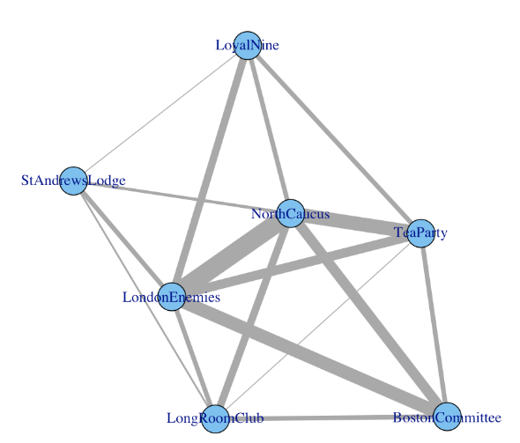
Matrix transforms & Network Analysis
..a graph showing groups with weights on connections for how many people are in common between them
Notes:
..this. The thicker lines denote more members in common between those two groups, so LondonEnemies and NorthCaucus have the most people who are part of both groups, with StAndrewsLodge and LoyalNine having the least amount of members in common.

Slide 9
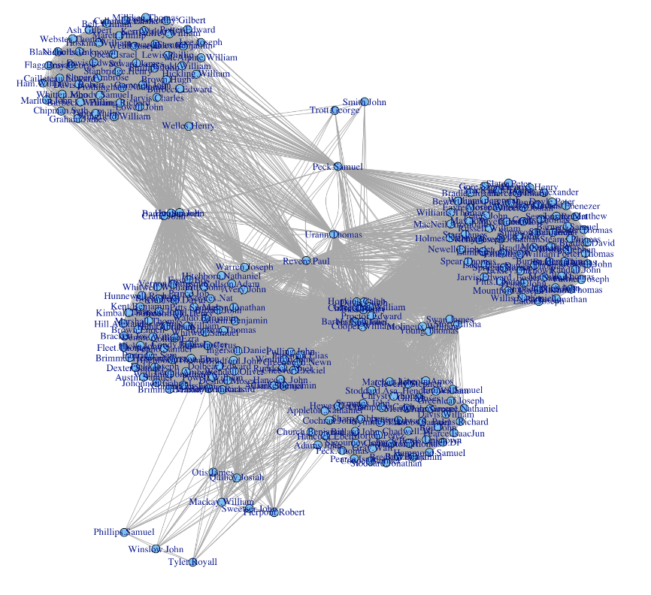
Matrix transforms & Network Analysis
Graphing the same way for the 254 person by person matrix, you get a graph relating how each person is connected. At the center of that group is…
Notes:
If you use the same logic for the 254 x 254 person by person matrix, what you can end up with is a graph of which people are connected to each other – remember, the original dataset only had which groups each member was a part of. This graph is showing a person by person connection, with some anamolies sticking out – at the center of this person by person graph is..

Slide 10
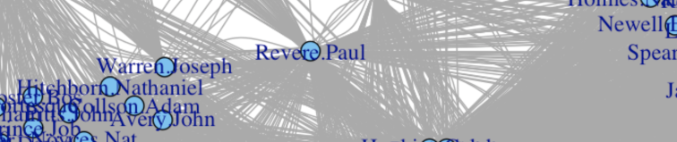
Matrix transforms & Network Analysis
Notes:
..Paul Revere. So given something as simple as the metadata of which people belonged to which groups, social network analysis lets us do some matrix math to reveal anomalies; in this case, without knowing any of the context of what was actually said at different group meetings, social network analysis can show us that Paul Revere was at the center of the Revolutionary War.

Slide 11
Overview
Using metadata to find Paul Revere
Legality/ethics regarding data mining social media
Application
Notes:
So far we’ve gone over what metadata is and how it could be used in powerful ways, the next topic I wanted to mention was the legality and ethics surrounding data mining social media. I found a couple interesting things regarding this, at least regarding facebook, there’s actually not an easy way to data mine it. Before I had started on this topic I had assumed that the built in Facebook APIs would let me quickly build the dataset that I needed, but what I found is that Facebook’s APIs can give you a lot of context around people, but there is no API call to get all the friends of a user, or to find what friends are mutually in common – even using your own account and personal access token – and I thought this was interesting because it’s basically just the data that you see when you go to facebook on the web. They have old API calls to get this information, but they have since removed it, so it’s really not easy for the “average” person to go mine data on facebook.
The other interesting thing that I found is that while there is no official API from facebook to get this data, there are tons of third party/external tools that you can pay for that will scrape this data for you. Most of these tools have what I thought was almost cheerfully sinister outlooks on data mining from facebook – I’ll show you some of the quotes in another slide.

Slide 12
Legality/Ethics
“There are some risks associated with data scraping from Facebook. Facebook considers itself a private platform, so collecting any data from Facebook will come under the data breach or trespassing. ”
From Facebook TOS:
“You may not access or collect data from our Products using automated means (without our prior permission) or attempt to access data you do not have permission to access.”
“You may not sell, license, or purchase any data obtained from us or our services, except as provided in the Platform Terms.”
Notes:
So a couple interesting legal/ethical things regarding Facebook and data mining – Facebook is considered a private entity, and the data that you input as a user is actually owned by Facebook, meaning that using automated ways to try to exfiltrate that data is actually considered a data breach or trespassing. So the tools that I found that will let you do this are technically in a gray area as the tool themselves is not illegal, but if you used it to scrape data from Facebook they could open a legal suit and sue you. The other thing is that it’s in violation of Facebook’s terms of service – if you do it through automated means. So what I did was build my dataset manually by clicking through my friends list and filling out an adjacency matrix myself.

Slide 13
Less than benevolent intentions
Services/tools exist to scrape data from Facebook for you – potentially in violation of Facebook’s TOS
“Facebook is a huge database of user-generated content. If you know what you are doing, data from Facebook can be used to better understand your audience for business and political gains”
“Think about it: Facebook is enabling the subversion of our highly personal social networks for profit and undue political influence.”
Notes:
Here’s some of the descriptions from software you can buy to scrape data from Facebook, none of them really mention reasons that would generally be regarded as good, such as research, they all basically talk about how you can use data mined from facebook for nefarious or less than altruistic reasons

Slide 14
Overview
Using metadata to find Paul Revere
Legality/ethics regarding data mining social media
Application
Notes:
So again to recap, Facebook doesn’t really condone an automated means of mining data from it. It’s prohibited in their TOS, and technically you can get in legal trouble if they want to come after you for it. Anyway, next I’m going to talk about how I was able to build my dataset and do some social analysis within the confines of Facebook’s TOS

Slide 15
Goal
Use the same principles from the Finding Paul Revere demonstration to apply them to my own social network
Instead of finding who is a central person of interest, ie the 254 x 254 “Person by Person” matrix, identify different groups from my social connections
Do so in a way that does not violate Facebook TOS or ethics
Present the data in an intelligible fashion
Notes:
The goals for my actual project were to apply some of the ideas from the finding paul revere paper, but on myself. Since I’m not really part of a revolutionary group or anyone that interesting, I decided to try to do the inverse of what the paul revere demonstration did; rather than find out information on persons of interest by group association, I wanted to see if I could use my friends list, as well as mutual friends, to reverse engineer “what groups I was part of”

Slide 16
Creating the dataset
Keeping in mind “You may not access or collect data from our Products using automated means (without our prior permission) or attempt to access data you do not have permission to access.”
As long as the means was not automated, I was not violating any TOS
I went to my own Facebook page and clicked my list of friends, copying all data into Excel, with one friend per row
Transpose the rows to columns, creating a matrix of “friends by friends”
0 out all cells in between them
Painstakingly click through each friend, noting which mutual friends we had in common, then replacing the 0 with a 1 in the Excel spreadsheet indicating a connection between people
Notes:
So keeping in mind that Facebook does not allow for automated collection of data from its platform, I had to manually build it – this was really time consuming. I basically copy and pasted my friends list into excel as rows, and then flipped it to have the names as columns as well. Then in the actual datacells, there is a 1 if two people are mutual friends, or a 0 if they are not. It was really tedious to build the dataset this way, but I was determined to see what I could do with the data.

Slide 17
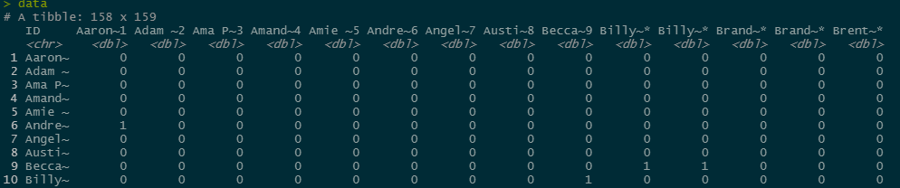
Creating the dataset
Data looks like this:
Notes:
Here’s what my dataset looked like in R – with persons as both rows and columns, and a 1 denoting which friend was mutual friends with another friend

Slide 18
Analyzing the dataset
Created a script to turn the adjacency matrix into a graph and plot
Following pages show how the graph transforms as I added more information into the Excel document
Notes:
After I got some data into R, I started writing a script to display the graphs, just to make sure it would work how I wanted it to before wasting a bunch of time manually adding the connections into the excel doc. The next few slides show what those graphs looked like as I filled out more and more data..

Slide 19
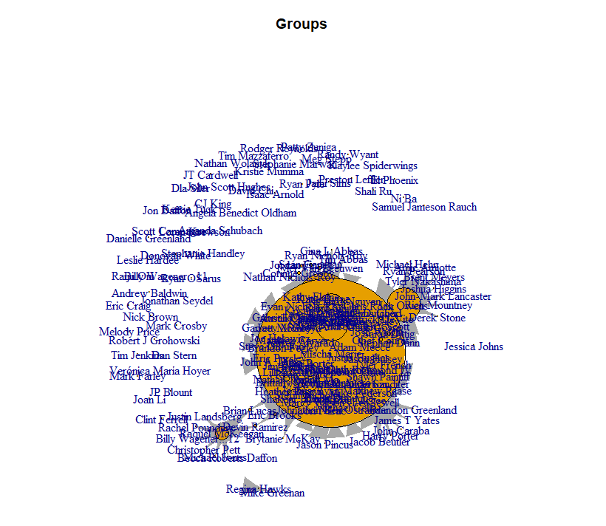
Initial work – small dataset
Notes:
So initial dataset, lots of unconnected names, and the ones that were input kind of blobbed together in the middle

Slide 20
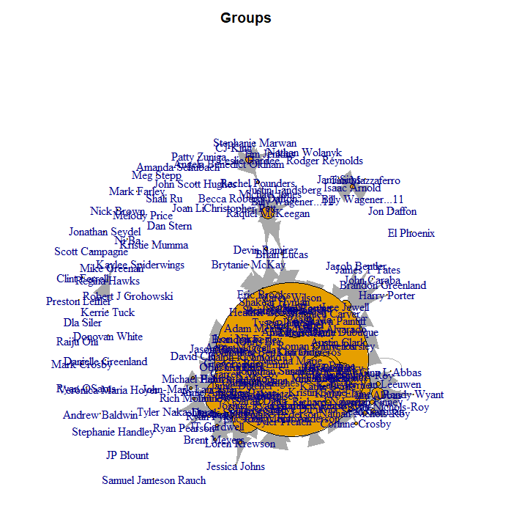
Dataset grows..
Notes:
As I started adding more info you can see that little pockets of groups start forming

Slide 21
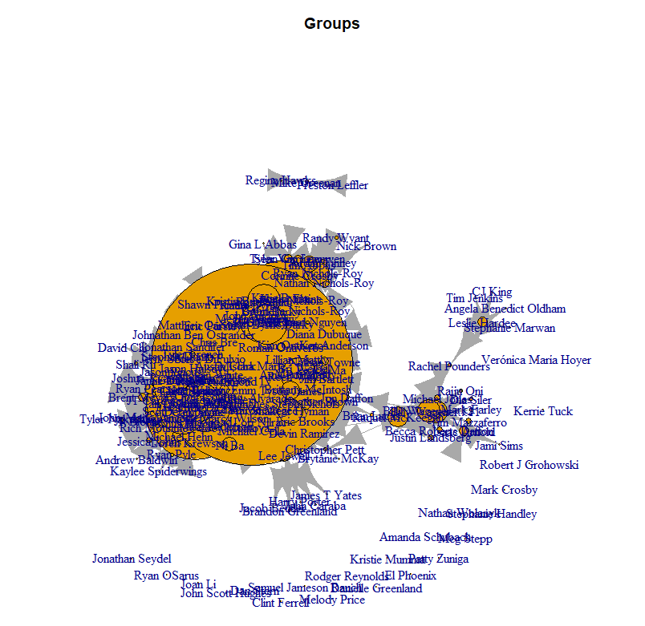
Dataset grows..
Notes:
More data added, more groups start forming

Slide 22
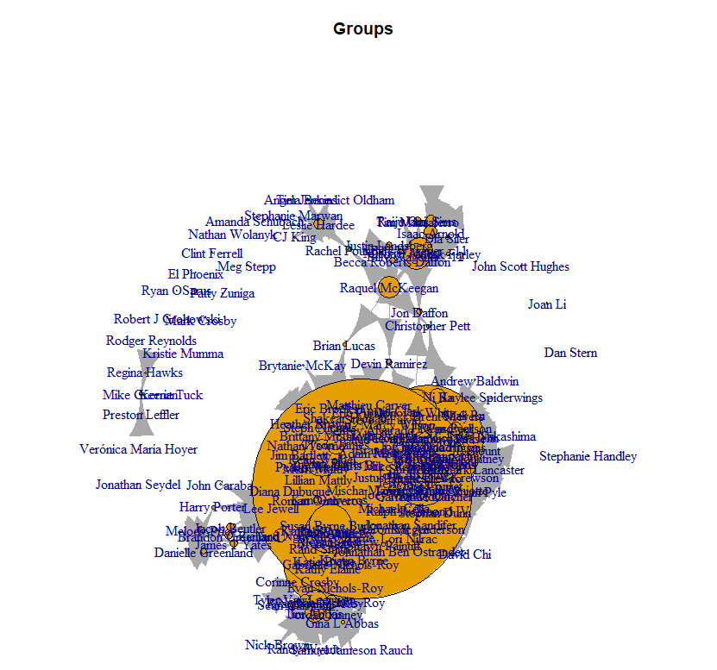
Dataset grows..

Slide 23
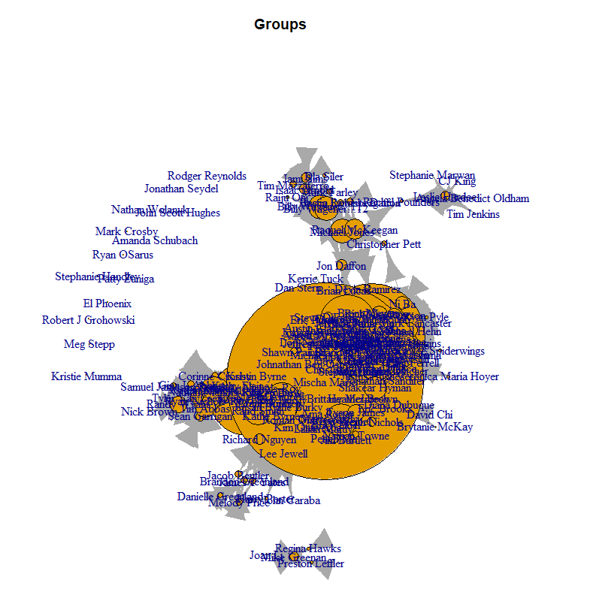
Dataset grows..
Notes:
At this point I started wondering how I was going to make sense of the data because as I added more connections, it all started to blob together a bit – making it kind of difficult to see additional groups forming

Slide 24
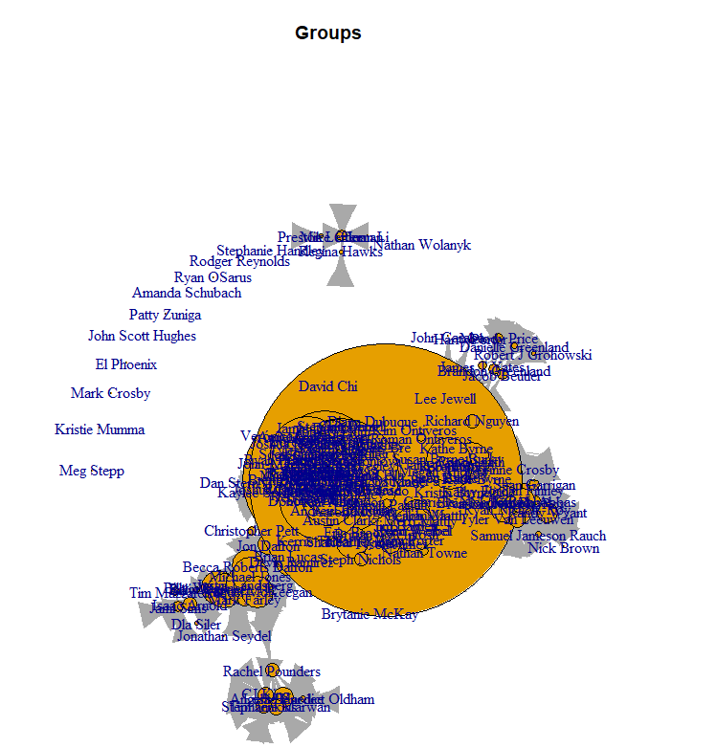
Dataset grows..
Notes:
At this point I had added enough connections that I really needed a new way to visualize it – so I started looking at some of the graphs functions and see what other ways could relate the data, and ended up going with one that does not try to do overlapping groups – simple connect names to other names. What I got was…

Slide 25
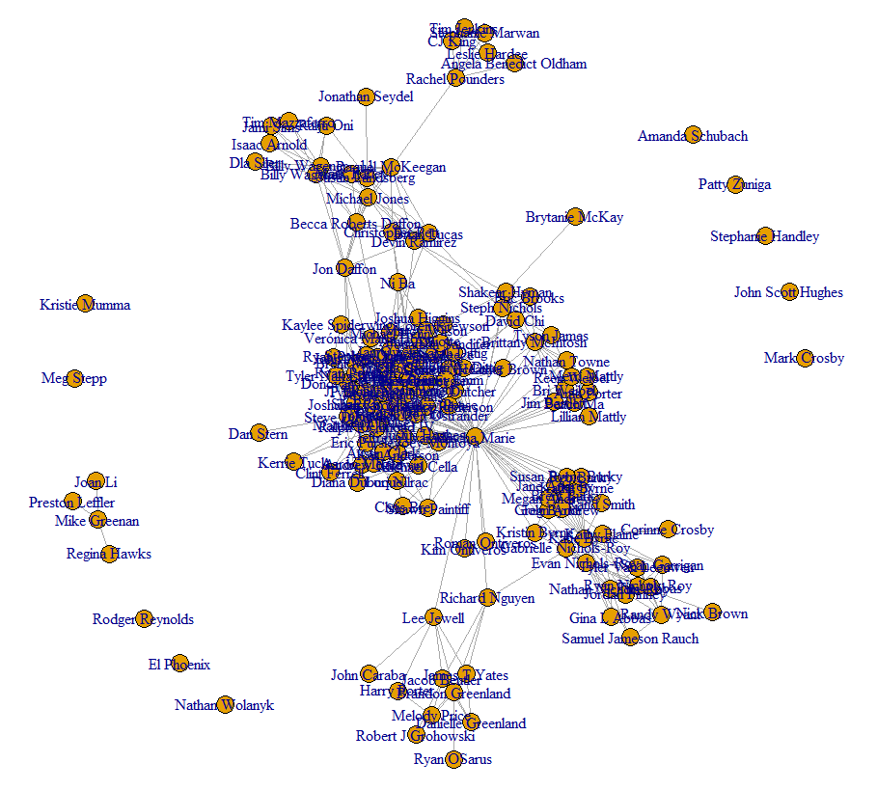
Changing plot parameters..
At this point, graphs overlapped too much so I changed parameters:
Notes:
This guy. It’s a bit hard to see in the powerpoint presentation, but there are clear groups forming here, so I continued adding more data

Slide 26
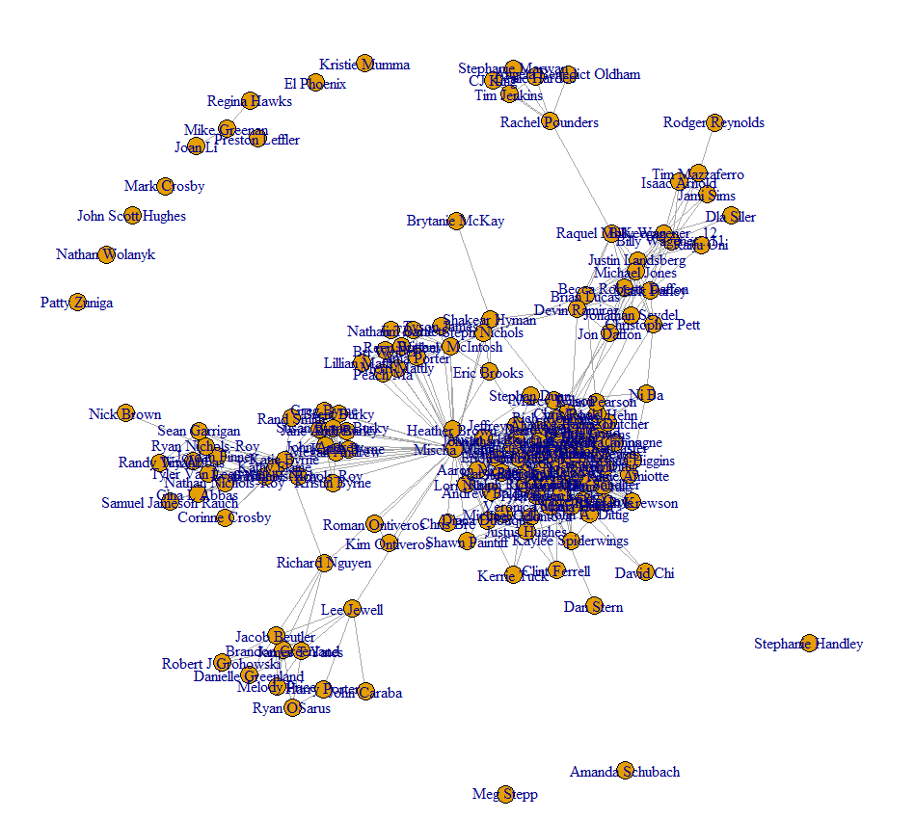
Final Graph
Notes:
This is the final graph that I landed on – some of the outliers you see are friends that I have that have no mutual friends in common with me. The other interesting thing from this view is that you can see certain people who bridge groups together – this is basically what the finding paul revere paper was doing. It’s a bit hard to see from this very busy image but my wife is actually in the center of it – which makes sense, because as I have friends and connections from multiple groups she’s also making similar connections, bridging different groups together. My name is not actually a node on here since it was the original source of the data – if it were you would just see my name with a line to every person on there, and that wouldn’t do much except to clutter the analysis.

Slide 27
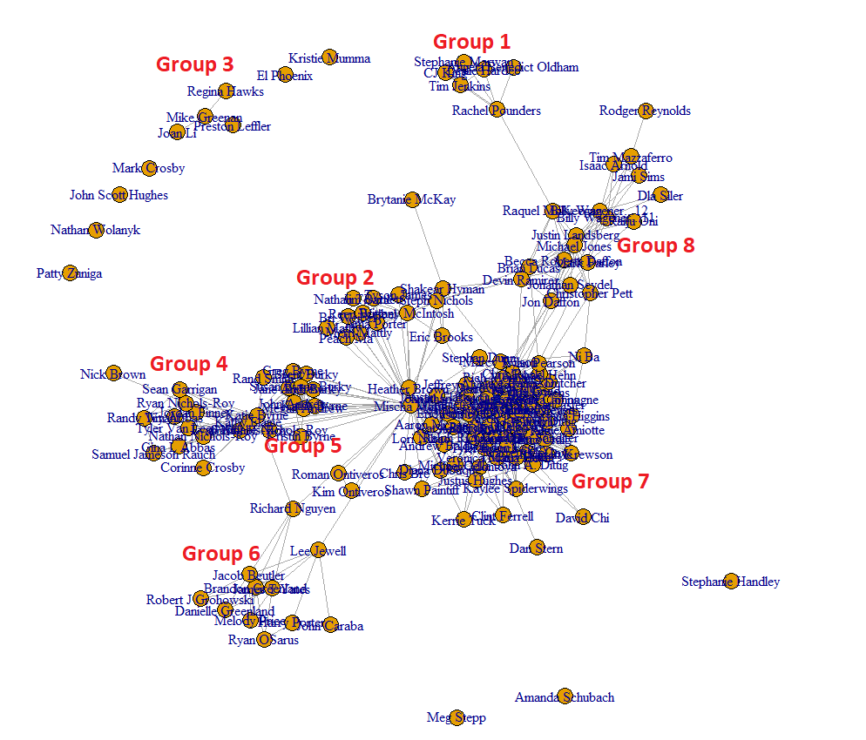
Final Graph
Notes:
I went in and just added some labels to the different groups I was able to see. Remember, using “just metadata” and this type of analysis, you can’t get any context from what each group is without knowing something about it. So from a high level view, you just know that these groups of people are related in some way.

Slide 28
Final Graph
Group 1: People I met in training in Texas
Group 2: Wife’s family
Group 3: High school friends
Group 4: People from church
Group 5: My family
Group 6: People from my 1st job
Group 7: People from my 3rd job
Group 8: People from my 2nd job
Notes:
And just to show how powerful it is when you add context, each of those groups basically consist of different people I know from different parts of life. Not everyone in each of those groups know each other, but they have enough connections to other people in the group that you can get a really see the distinct groups popping out

Slide 29
Final Graph
Powerful implications from this graph
Remember, without context, these groups inherently don’t tell you anything except that the people in them are related in some way – the context from the previous slide was added by me
By “interviewing” people from the different groups in this graph, can determine what the context is
Law enforcement example: if I were a drug dealer, a similar graph/analysis could be done to understand and infiltrate my network
Notes:
So again, through just the metadata of friends and mutual friends and plotting them in a matrix, social network analysis let me identify 8 major groups; within these groups consist of smaller sub-groups, but at a higher level view it gives you a real good idea of relations. If you were to talk to a person or two from each group and ask them “how do you know Brandon?” you could get a pretty good idea of the group labels I listed a few slides back.

Slide 30
Wrapping up
Law enforcement example: if I were a drug dealer, a similar graph/analysis could be done to understand and infiltrate my network
Social Network Analysis increasingly growing field in law enforcement, intelligence, and ad product placement
Without knowing any context, just the metadata of how people are connected, you can discover links between them
Can be used to determine “if someone is real,” ie, if a Facebook profile is made up or not – very difficult to create these kinds of natural group connections from scratch
Notes:
The applications of this can be used all over, and remember, facebook has all of this data on their servers. It’s not as easy to get from their API as it might seem, and it might violate their terms of service, but there are all kinds of tools that people can use to get this data – you don’t even need to ever post anything on facebook, this data is just who you have made friends with and how they relate to each other. It’s a method commonly employed by law enforcement and intelligence agencies, if you have access to peoples metadata you can basically build a graph like this for any person you want, find outliers within that graph, and then go build a graph on the outlier. Another interesting application of social network analysis is actually part of how facebook can determine if a profile is a real person or not – it’s really hard to fake social connections like this, they just happen naturally. Profiles that don’t have clear groups of people and just seem to have random friends are much more likely to not actually be real accounts. Anyway, hop you enjoyed my presentation, thanks for watching.

Slide 31
Sources
https://www.datamation.com/big-data/facebook-and-data-mining-is-anything-private/
https://kieranhealy.org/blog/archives/2013/06/09/using-metadata-to-find-paul-revere/
https://www.facebook.com/legal/terms

