Slide 1
Database

Slide 2
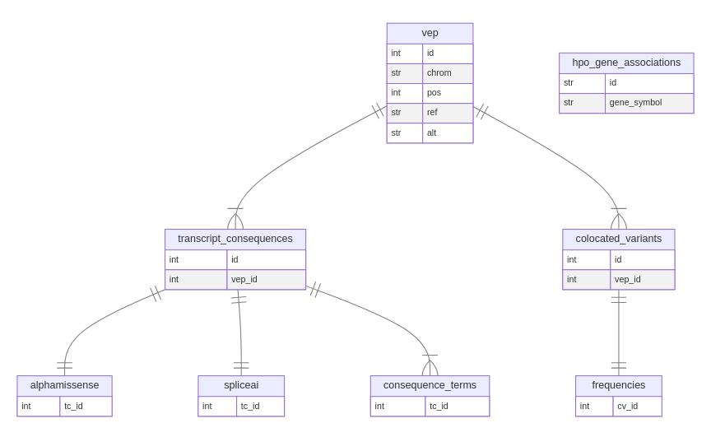
Database - General Scheme

Slide 3
Database - Functions
VEP (vepcontroller)
  insert_vep(vep)
  dict → int
  get_vep(c, p, r, a)
  str,int,str,str → dict
HPO (hpocontroller)
  insert_hpo(datasets)
    list →
  fetch_hpo(gene_symbol)
    str → list
  fetch_genes(id)
    str → list
utility
  clean
  create
  init

