Slide 1
Annotation Service: REST API
Microservice: process building a REST API with shrinked complexity
Microservice Framework: FastAPI: Based on asynchronous programming → process many requests simultaneously (advantage for API calls to Ensembl VEP)

Slide 2
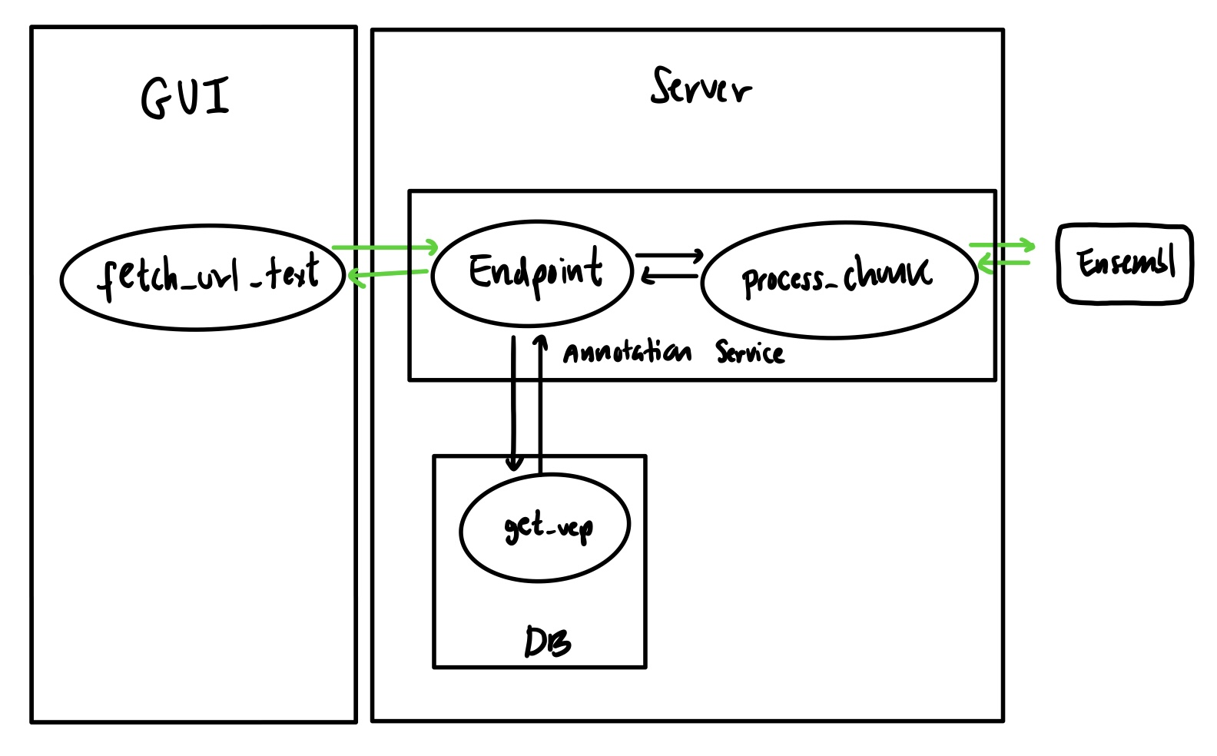
Annotation Service: REST API

Slide 3
Annotation Service: REST API
Function “convert_to_hgvs()” which handles subs, del + ins
Processing in chunks asynchronus: to avoid API overload and handling multiple API requests simultaneously
  Function “process_chunk()” interacts with Ensembl VEP API (values of variables directly set in function body)
Endpoint (/vep)
  Takes a request in form of JSON and looks if it is in the DB
  Yes? Returns annotation
  No? Converts to hgvs + does request to Ensembl VEP API, parses + stores + returns it

