Slide 1
Highly Opinionated ASP.NET MVC
Jeremy Miller
Chad Myers

Slide 2
Core Principles
Reversibility
DRY
SOLID and other “OO-y” stuff

Slide 3
Opinions Page 1 - General
Rails inspired, but stick with C# idioms/STR
Conventions, Conventions, Conventions
Testing (reduce friction)
Views light, Controllers medium, Model heavy
ASP.NET doesn’t exist (shh – wrap where necessary)
NO MAGIC STRINGS!

Slide 4
Opinions Page 2 - Model
Conventions, Domain Layer Supertype
Model is King, everything flows from the model
DB generation, including null/non-null, string len
Validation
Localization

Slide 5
Opinions Page 3 - Controllers
Conventions
Testable, DI, IoC
No direct contact with ASP.NET
Invocation Interception for pre- and post-action processing
And…. (wait for it)….

Slide 6
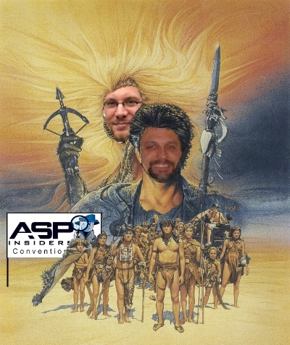
The Thunderdome Principle

Slide 7
The Thunderdome Principle
One model enters, one model leaves
Incoming model represents Form, QueryString, Context, and Cookies
Controller processes, produces output model with everything the view will need
Controllers *may* override ActionResult if necessary, generally shouldn’t
Invocation Interception handles the populating of input model and handling of output model

Slide 8
Opinions Page 4 – Controllers
No mystery meat data passed to views – No hashtables, dictionaries, magic strings, etc
ActionContext<IN, OUT, CONTROLLER>

Slide 9
Opinions Page 5 - Views
Strongly typed views, no mystery meat and no magic strings
Form element names predictable/consistent – Conventions!
NO Code Behind
NO logic in view
NO if’s or foreach’s
Method Chaining/Fluent API for HTML Expressions

Slide 10
Misc Other Stuff
jQuery, QUnit, Testing, CI Integration
Partials
StoryTeller
Entity Query Infrastructure

