Slide 1

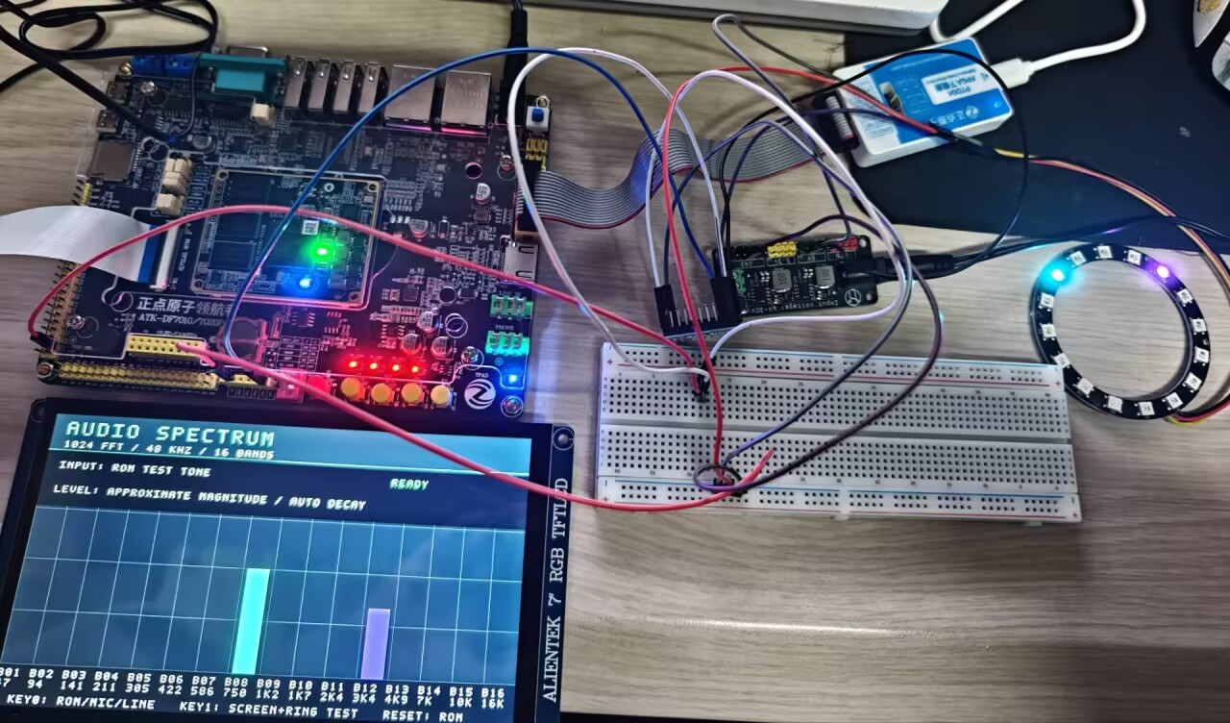
项目概览
基于 Zynq 的音频可视化
与本地听歌识曲系统
淮安大学
HUAI'AN UNIVERSITY
队员：刘浩然 毛凯鑫 施航 指导老师：魏丹丹
系统设计
测试与性能
板载 MIC 或 LINE IN
表2 实现后资源占用
资源 | 使用 | 可用 | 占比
LUT | 7,232 | 17,600 | 41.09%
FF | 10,560 | 35,200 | 30.00%
BRAM | 23 | 60 | 38.33%
DSP | 7 | 80 | 8.75%
ES8388，48 kHz PCM
1024点 FFT
16段幅度聚合
127抽头 FIR
4倍抽取至12 kHz
PCM16
500 kbaud
BRAM 按36 Kb块计，统计包含 ILA 调试核。
主时钟50 MHz，WNS +0.379 ns
LCD 实时频谱
WS2812B 音乐灯效
USB UART
PC 本地音频指纹匹配
WHS +0.025 ns，已约束路径时序通过。
图1 开发板、LCD 与16灯灯环
板载 MIC 与 LINE IN 采集音频，FPGA 完成实时频谱与灯效。电脑匹配本地曲库，并将歌名和演唱者回显到板端 LCD。
表3 验证摘要
LCD 歌名与演唱者
RTL 仿真 | 21项通过
PC 回归 | 33项通过
LINE IN 已知片段 | 5首×3片段，15/15
库外歌曲 | 3首均拒识
实物功能 | MIC采集、灯环联动 与LCD歌名回显
图2 并行频谱与识曲数据通路
表1 硬件与工具
FPGA | XC7Z010CLG400-1
采音 | ES8388，48 kHz
屏幕 | 7英寸 RGB LCD，1024×600
灯环 | 16灯 WS2812B
工具 | Vivado 2022.2
算法与显示保护
频谱：1024点 FFT，频点间隔46.875 Hz。
识曲：Hann窗提取局部峰值并配对，
按时间偏移一致性投票确认歌曲。
本地曲库16首、11位歌手。仅识别已录入的原版录音，以上结果对应已测样本。
回显：连续证据确认，CRC16 校验与双缓冲保护文字更新。
后续：扩充曲库，验证复杂噪声场景。
Notes:
Project: D:/hyit/programs/zdyz/navigator7010/music_rgb_lcd_recognizer
Architecture and fingerprint settings: docs/听歌识曲设计与验收.md
Resources and timing: reports/utilization_impl.txt, reports/timing_impl.txt (routed, includes ILA)
Software verification: reports/python_selftest.log and RTL simulation logs (21 cases)
LINE IN known / unknown physical samples: reports/recognition_hardware_status.json
Later user-confirmed MIC capture, LCD response, RGB self-test and music response: current project conversation and supplied demonstration video
Library: song_library/README.md (16 tracks, 11 artists)
Photo and university emblem: supplied by the user. The school name follows the user's explicit wording.
The poster makes no claim of general music recognition accuracy or 30-minute integrated stability.

Slide 2
SYSTEM OVERVIEW
Audio Visualization and Local
Song Recognition on Zynq
HUAI'AN
UNIVERSITY
Team: Haoran Liu, Kaixin Mao, Hang Shi Supervisor: Dandan Wei
SYSTEM DESIGN
TESTS AND PERFORMANCE
On-board MIC or LINE IN
Table 2 Post-route resource utilization
Resource | Used | Available | Usage
LUT | 7,232 | 17,600 | 41.09%
FF | 10,560 | 35,200 | 30.00%
BRAM | 23 | 60 | 38.33%
DSP | 7 | 80 | 8.75%
ES8388, 48 kHz PCM
1024-point FFT
16-band magnitude
127-tap FIR
4:1 decimation, 12 kHz
PCM16
500 kbaud
BRAM counts 36 Kb tiles. Figures include the ILA.
Main clock: 50 MHz. WNS: +0.379 ns.
LCD spectrum
WS2812B music lighting
USB UART
PC fingerprint matching
WHS: +0.025 ns. Constrained paths meet timing.
Fig. 1 Prototype with LCD and 16-LED ring
The on-board MIC or LINE IN feeds audio to the FPGA for spectrum and RGB lighting. A PC matches a local song library and sends the title and artist back to the LCD.
Table 3 Validation summary
Title and artist on LCD
RTL simulation | 21 cases passed
PC regression | 33 tests passed
LINE IN samples | 5 tracks × 3 excerpts, 15/15
Unknown tracks | 3 tracks rejected
Hardware | MIC capture, RGB response and LCD song title feedback
Fig. 2 Parallel spectrum and recognition paths
Table 1 Hardware and tools
FPGA | XC7Z010CLG400-1
Audio | ES8388, 48 kHz
Display | 7-inch RGB LCD, 1024×600
RGB ring | 16 WS2812B LEDs
Tools | Vivado 2022.2
Algorithms and display integrity
Spectrum: 48 kHz / 1024 = 46.875 Hz per FFT bin.
Matching: Hann-window spectral peaks form paired fingerprints. Votes align in time.
Local library: 16 tracks by 11 artists. Recognition targets enrolled recordings. Results refer to tested samples.
Display: consistent evidence, CRC16 checks and double buffering protect text updates.
Next: broader library and noise testing.
Notes:
Project: D:/hyit/programs/zdyz/navigator7010/music_rgb_lcd_recognizer
Architecture and fingerprint settings: docs/听歌识曲设计与验收.md
Resources and timing: reports/utilization_impl.txt, reports/timing_impl.txt (routed, includes ILA)
Software verification: reports/python_selftest.log and RTL simulation logs (21 cases)
LINE IN known / unknown physical samples: reports/recognition_hardware_status.json
Later user-confirmed MIC capture, LCD response, RGB self-test and music response: current project conversation and supplied demonstration video
Library: song_library/README.md (16 tracks, 11 artists)
Photo and university emblem: supplied by the user. The school name follows the user's explicit wording.
The poster makes no claim of general music recognition accuracy or 30-minute integrated stability.

