Slide 1


AGENTIC AI BOOTCAMP HACKATHON • PROJECT 2
Recruitment Agent
AI-Powered Recruitment System Chatbot
TEAM
M.S.Y.K.G. Franzonia
23881A05DM • CSE - G
Charaka Ananya
23881A05L3 • CSE - D
01

Slide 2
INTRODUCTION
What is Recruitment Agent?
Recruitment Agent is an Agentic AI-powered HR assistant that streamlines recruitment through a conversational, terminal-based chatbot. It helps recruiters screen resumes, rewrite job descriptions, generate interview questions, retrieve top candidates using Retrieval-Augmented Generation (RAG), and fetch live salary insights via web search.
PROJECT SNAPSHOT
100%
Terminal-based Agentic AI chatbot
4
Specialised task nodes (screen, rewrite, interview, salary)
Built end-to-end with:
RAG
Powered candidate retrieval via ChromaDB
LangGraph — agent orchestration & routing
ChromaDB — vector store for resume retrieval
OpenAI GPT — language generation
Tavily Search API — live web / salary data
Live
Web-sourced salary benchmarking via Tavily
RECRUITMENT AGENT
02

Slide 3






PROBLEM STATEMENT
Recruitment is slow and repetitive
Recruiters spend significant time manually screening resumes, comparing candidates, rewriting job descriptions, preparing interview questions, and researching salary trends — tasks that are repetitive but still demand attention for every open role.
Manual Resume Screening
Time-Consuming Process
Repetitive JD Rewrites
Every resume read and compared by hand against a role.
Hours spent per role before a shortlist even exists.
Job descriptions reworded manually for every audience.
Interview Prep Overhead
Manual Salary Research
High Manual Effort
Interview questions drafted fresh for each candidate.
Market pay ranges looked up role by role, city by city.
Little of this repetitive work is actually automated today.
RECRUITMENT AGENT
03

Slide 4



OBJECTIVES
What we set out to build
Automate resume screening
Reduce manual recruitment effort
Use RAG for intelligent candidate retrieval
Generate interview questions automatically
Rewrite job descriptions
Fetch live salary expectations
Demonstrate an Agentic AI workflow
RECRUITMENT AGENT
04

Slide 5

OUR SOLUTION
One agent, five focused capabilities
Recruitment Agent is a single conversational agent, built with LangGraph, that routes each recruiter query to the right specialised node — instead of one generic model trying to do everything. Every capability maps directly to one pain point from the previous slide.
Resume Screening via RAG
Job Description Rewriting
Interview Question Generation
Live Salary Lookup
Human-in-the-loop Shortlisting
Resumes embedded and stored in ChromaDB; queries retrieve the closest-matching candidates with similarity scores.
OpenAI GPT rewrites a JD for a given audience (e.g. startup tone) on request.
Role- and candidate-specific interview questions generated automatically.
Tavily Search fetches current market salary data for a role and location.
Final shortlist requires explicit recruiter confirmation before it is closed.
RECRUITMENT AGENT
05

Slide 6








TECHNOLOGY STACK
What Recruitment Agent is built on
Python
LangGraph / LangChain
OpenAI GPT
Programming language
Agentic orchestration framework
Core language model
ChromaDB
Sentence Transformers
Tavily Search API
Vector database
Text embeddings
Live web search tool
Pydantic
python-dotenv
Rich
Data validation
Environment management
Terminal UI
RECRUITMENT AGENT
06

Slide 7




SYSTEM ARCHITECTURE
How a query moves through the system
→
→
→
→
User
Router
Conditional Routing
Specialised Agent
Response
Recruiter types a natural-language query
Detects intent from the query
Sends intent to the matching node
Python / ChromaDB / OpenAI / Tavily
Answer returned to the recruiter
The Router intelligently selects the right tool for each request instead of calling the LLM for every single query — keeping the system fast and cost-efficient.
RECRUITMENT AGENT
07

Slide 8

WORKFLOW
From query to the right tool
Query Intake
RAG Pipeline
Recruiter enters a recruitment query
Router identifies the intent
Resume Text Files
↓
Sentence Embeddings
Applicant count
→
Python
↓
ChromaDB Storage
Resume screening
→
ChromaDB Retrieval
↓
Similarity Search
JD rewrite
→
OpenAI
Interview questions
→
OpenAI
↓
Top Matching Candidates
Salary lookup
→
Tavily
↓
AI Explanation
Shortlist
→
Human Confirmation
RECRUITMENT AGENT
08

Slide 9


KEY FEATURES
What Recruitment Agent can do
Resume Screening (RAG)
Candidate Ranking
Similarity Scores
Job Description Parsing
JD Rewriting
AI Interview Question Generation
Salary Benchmark Search
Intelligent Routing
Human-in-the-loop Confirmation
Terminal Chatbot
RECRUITMENT AGENT
09

Slide 10
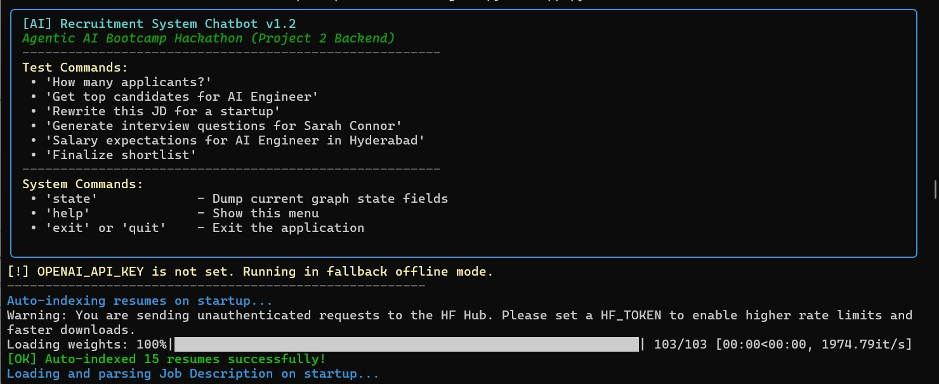
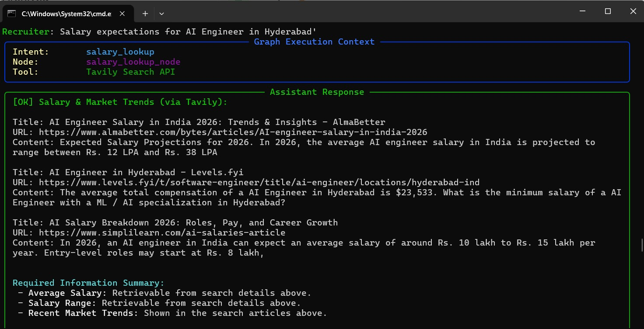
PROTOTYPE IN ACTION
Chatbot startup & live salary lookup
Startup — intent menu & auto-indexed resumes
Salary lookup — Tavily Search API results
RECRUITMENT AGENT
10

Slide 11
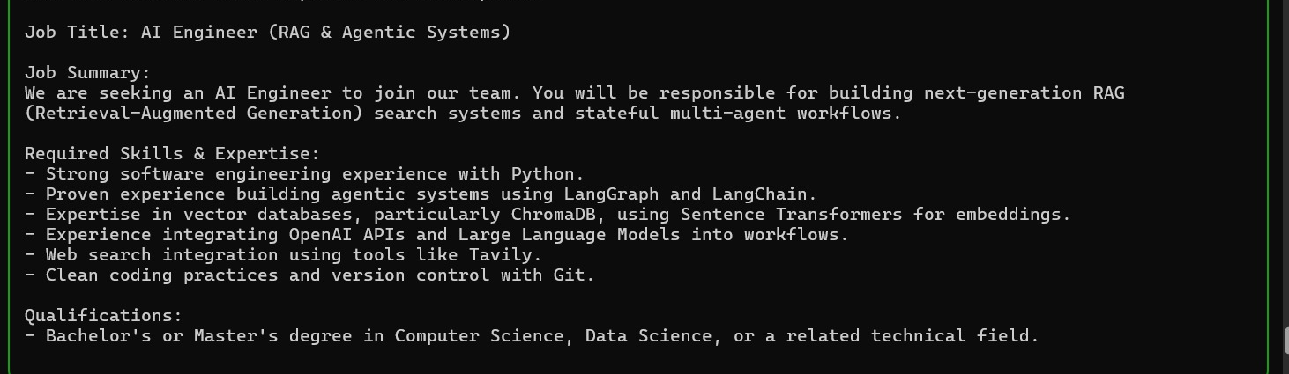
PROTOTYPE IN ACTION
Job description rewriting
Why this matters
Graph Execution Context shows the exact intent, node, and tool used per query.
The rewritten JD is saved directly to disk, ready to reuse.
Same terminal handles screening, rewriting, interviews, and salary lookup end to end.
JD rewrite — routed to OpenAI GPT-4o-mini for a startup tone
RECRUITMENT AGENT
11

Slide 12


CONCLUSION
Agentic AI, applied to hiring
Recruitment Agent shows how Agentic AI, RAG, and external tools can automate the end-to-end recruitment workflow. By intelligently routing tasks to Python, ChromaDB, OpenAI, or Tavily, the system avoids unnecessary LLM calls while giving recruiters accurate, context-aware assistance — from screening to salary research.
Thank You
Questions?
A FEW WAYS FORWARD
github.com/franzonia137/Recruitment-agent
PDF resume parsing & ATS integration
Gmail integration & calendar scheduling
Web dashboard & candidate comparison view
Multi-agent collaboration & red-flag detection
M.S.Y.K.G. Franzonia (23881A05DM, CSE-G) • Charaka Ananya (23881A05L3, CSE-D)
12

