Slide 1
GeoGuard
Satellite Air Quality Intelligence
Dated atmospheric measurements and AI-assisted
methane screening for environmental investigation
Team GeoGuard · Theme: Air Quality Intelligence · UAE pilot
Notes:
Source: GeoGuard report, sections 1–4, 7 October 2026. https://docs.google.com/document/d/1m8BmXCIb25mvpgSxf2ykUxtepey_wdF7z4WF1vljtgs/edit
Research PoC. No source attribution, safety verdict or validated UAE forecast is claimed.

Slide 2
Environmental investigation
User
Decision
Environmental monitoring
and enforcement teams
Where should we review
satellite evidence and
request field measurements?
The problem
Separate products, mixed units and missing observations complicate comparisons.
Satellite coverage provides regional context; dated evidence supports closer review.
02
Notes:
Source: GeoGuard report, sections 1–4, 7 October 2026. https://docs.google.com/document/d/1m8BmXCIb25mvpgSxf2ykUxtepey_wdF7z4WF1vljtgs/edit

Slide 3
Measurements in the PoC
Quantity | Sentinel-5P measurement | Display
NO₂ | Tropospheric column | µmol/m²
CO | Total atmospheric column | mmol/m²
SO₂ | Vertical column; assumed ground profile | µmol/m²
Regional CH₄ | Bias-corrected dry-air column mixing ratio | ppb
Sentinel-2 imagery + MARS-S2L: candidate / no candidate / not assessable
PM, VOC and H₂S instruments are not connected. Columns are not surface exposure.
03
Notes:
Source: GeoGuard report, sections 1–4, 7 October 2026. https://docs.google.com/document/d/1m8BmXCIb25mvpgSxf2ykUxtepey_wdF7z4WF1vljtgs/edit
Report section 1.5 and section 2. Four separate quantities; no combined pollution score. Sentinel-5P catalogs: https://developers.google.com/earth-engine/datasets/catalog/COPERNICUS_S5P_NRTI_L3_NO2 ; corresponding CO, SO2 and OFFL CH4 catalogs.

Slide 4
Satellite evidence workflow
Atmospheric measurements
Sentinel-5P
quality masks
Daily area
values
Monthly / period
summaries
Dated JSON / CSV
and display
→
→
→
Methane screening
Observation +
reference imagery
Cloud / valid mask
alignment + wind
Pretrained
MARS-S2L
Candidate flag +
evidence history
→
→
→
Different quantities and footprints remain separate. Missing observations stay unknown.
04
Notes:
Source: GeoGuard report, sections 1–4, 7 October 2026. https://docs.google.com/document/d/1m8BmXCIb25mvpgSxf2ykUxtepey_wdF7z4WF1vljtgs/edit
Report sections 2.2–2.4 and 3.1–3.3. Methane screening uses an approximately 2 × 2 km crop, up to three reference candidates and acquisition-time modeled wind.

Slide 5
UAE atmospheric comparison
Dubai and Jebel Ali · 5 km radius comparison circles
Quantity / window | Dubai mean · usable days | Jebel Ali mean · usable days
NO₂ · Jan–Aug 2026 | 207.85 µmol/m² · 226/243 | 206.67 µmol/m² · 224/243
CO · Aug–Sep 2026 | 36.33 mmol/m² · 52/61 | 37.70 mmol/m² · 60/61
SO₂ · Aug–Sep 2026 | 145.83 µmol/m² · 60/61 | 143.96 µmol/m² · 60/61
Regional CH₄ · Aug–Sep 2026 | 1966.93 ppb · 33/61 | 1969.56 ppb · 37/61
Different valid days and retrieval uncertainty limit comparisons.
These means alone do not establish significance or identify an emission source.
05
Notes:
Source: GeoGuard report, sections 1–4, 7 October 2026. https://docs.google.com/document/d/1m8BmXCIb25mvpgSxf2ykUxtepey_wdF7z4WF1vljtgs/edit
Report sections 2.3 and 4.2. Actual Earth Engine exports: NO₂ 4 October; CO/SO₂/CH₄ 7 October 2026. Equal weighting of usable daily area means. Raw source exports and exact precision available in repository.

Slide 6
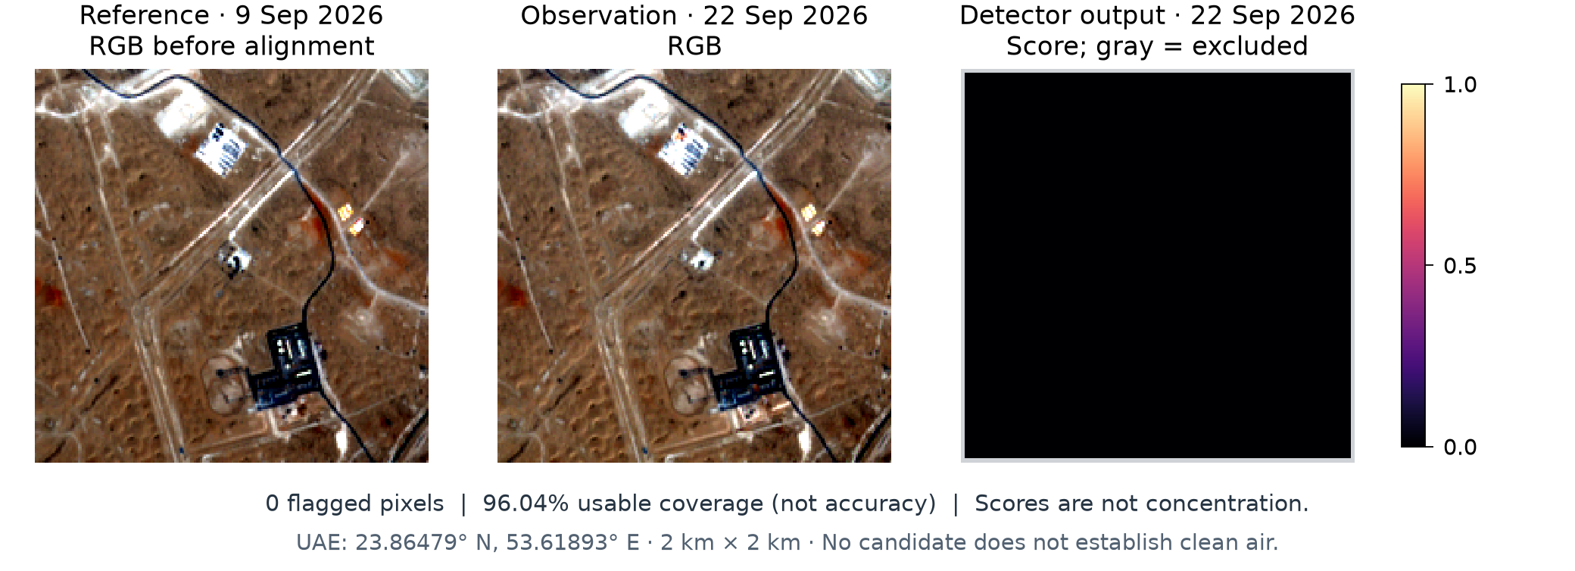
Dated methane screening
22 September 2026 observation · 9 September reference
23.86479° N, 53.61893° E
0
candidate pixels
96.04%
usable coverage
No candidate is not proof of zero methane. Coverage is not model accuracy.
06
Notes:
Source: GeoGuard report, sections 1–4, 7 October 2026. https://docs.google.com/document/d/1m8BmXCIb25mvpgSxf2ykUxtepey_wdF7z4WF1vljtgs/edit
Report sections 3.1–3.3 and 4.2. Image: GeoGuard derived output, Copernicus Sentinel-2 data (2026), pretrained UNEP IMEO MARS-S2L. https://huggingface.co/datasets/UNEP-IMEO/MARS-S2L ; https://github.com/UNEP-IMEO-MARS/marss2l .

Slide 7
Review an area in GeoGuard
1
Choose an area
Select a UAE location and quantity.
2
Read the evidence
Review units, observation dates, coverage and history.
3
Inspect methane candidates
Review dated images and quality information.
4
Export and follow up
Share evidence and request gas-specific field checks.
Bundled NO₂ has area/history results; CO, SO₂ and regional CH₄ include archived map layers.
07
Notes:
Source: GeoGuard report, sections 1–4, 7 October 2026. https://docs.google.com/document/d/1m8BmXCIb25mvpgSxf2ykUxtepey_wdF7z4WF1vljtgs/edit
Report sections 2.4, 3.5 and 4.4. Public demo: https://losth6wz.github.io/Geoguard/ ; fresh queries use the interactive notebook.

Slide 8
Reproducibility and validation
30 software tests passed
The PoC runs end to end with pinned dependencies and bundled real inputs.
Daily, monthly and period summaries match the archived Earth Engine exports.
Executed notebook, raw inputs, numerical outputs and evidence are available
for review. Website checks cover quantity switching, imports and location matching.
Software verification does not establish independent UAE detection accuracy.
08
Notes:
Source: GeoGuard report, sections 1–4, 7 October 2026. https://docs.google.com/document/d/1m8BmXCIb25mvpgSxf2ykUxtepey_wdF7z4WF1vljtgs/edit
Report section 4.3 and repository VALIDATION.md. All 30 full-environment local tests passed; lightweight CI may skip optional widget tests. Fresh authenticated Python queries and independent UAE accuracy are not established by these checks.

Slide 9
Interpretation and development priorities
Current limits
Next evidence needed
Columns do not give ground-level exposure,
AQI, emission rates or a safety verdict.
Candidates need analyst review. Clouds,
wind and reference uncertainty matter.
UAE forecasting is not validated.
Pair satellite observations with
calibrated, gas-specific field inputs.
Build reviewed plume/no-plume history
and test on held-out dates and locations.
Use persistent hosting for unattended checks.
The PoC supports environmental investigation; it does not confirm emissions.
09
Notes:
Source: GeoGuard report, sections 1–4, 7 October 2026. https://docs.google.com/document/d/1m8BmXCIb25mvpgSxf2ykUxtepey_wdF7z4WF1vljtgs/edit
Report sections 3.4, 4.5 and conclusion. Regional XCH₄ differs from model scores; 10 m processing does not improve native 20 m SWIR information. Field validation must pair gas-specific observations and held-out dates/locations.

Slide 10
Team and demonstration
Zainab
Raseel
Abdulaziz
Pollutants, sources
and sensing methods
Earth Engine mapping
and comparison areas
AI methane screening
and project integration
Website
losth6wz.github.io/Geoguard/
Repository and reproducible PoC
github.com/losth6wz/Geoguard
10
Notes:
Source: GeoGuard report, sections 1–4, 7 October 2026. https://docs.google.com/document/d/1m8BmXCIb25mvpgSxf2ykUxtepey_wdF7z4WF1vljtgs/edit
Report contribution headings and references. Zainab: supplied Geoguard.pdf; Raseel: Earth Engine mapping; Abdulaziz: AI screening and integration. Model terms: MARS-S2L CC BY-NC-SA 4.0; CloudSEN12 weights CC BY-NC 4.0; packages LGPLv3. Team-authored material has no blanket licence asserted.

Slide 11
Data and model attribution
Copernicus Sentinel-5P / Sentinel-2
2026 satellite observations; Earth Engine and public imagery archives
UNEP IMEO MARS-S2L + CloudSEN12
Pretrained models; MARS-S2L CC BY-NC-SA 4.0, CloudSEN12 weights CC BY-NC 4.0
NASA GEOS-FP / recorded GFS fallback
Modeled wind matched to acquisition time; source and fallback recorded
Full references and applicable terms: THIRD_PARTY_NOTICES.md in the repository
11
Notes:
Source: GeoGuard report, sections 1–4, 7 October 2026. https://docs.google.com/document/d/1m8BmXCIb25mvpgSxf2ykUxtepey_wdF7z4WF1vljtgs/edit
Principal source: GeoGuard team report. Full terms and provider links: https://github.com/losth6wz/Geoguard/blob/main/THIRD_PARTY_NOTICES.md . Sentinel catalogs: https://developers.google.com/earth-engine/datasets/catalog/ . MARS-S2L: https://huggingface.co/datasets/UNEP-IMEO/MARS-S2L . CloudSEN12: https://huggingface.co/isp-uv-es/cloudsen12_models . Wind: https://gmao.gsfc.nasa.gov/gmao-products/ ; https://open-meteo.com/en/terms .

