Slide 1
BPM- OptumId Integration with OpenID Connect
Srikar Pradeep M

Slide 2
Topics
SSO & Types
Overview of OAuth2
Roles in OAuth2
OAuth2 Flows
Problems with OAuth2
JSON Web Tokens
OpenID Connect Flows
OpenID Connect Implementation
References

Slide 3
SSO & Common Standards
SAML
Open ID Connect
OAuth2
SSO
Security Assertion Markup Language
SAML is the oldest identity standard with latest revision in 2005.
SAML has three main components. Assertion, the protocol & the binding.
The SAML assertion is an XML-based package of information that contains user, group, or any other information that might be useful to an application.
SAML was designed before mobile use was even a use case. It assumes its clients will be web browsers, which poses a problem for mobile apps

Slide 4
Overview of OAuth2
Framework for delegated Authorization
Provides limited access to user accounts
Http/json friendly to send/receive tokens
Supports different flows

Slide 5





Roles in OAuth2
is registered
Client
authorizes
Authorization Server
uses
accesses
trusts
owns a resource
User API
Feed API
Graph API
Resource Owner
Resource Server

Slide 6
Authorization Flows in OAuth2
Authorization Code Flow
Resource Owner Password Credentials
Implicit Flow
OAuth2
Web Application Clients
Native/Local Applications
Client Credentials
Trusted Clients
Client Server Communication

Slide 7
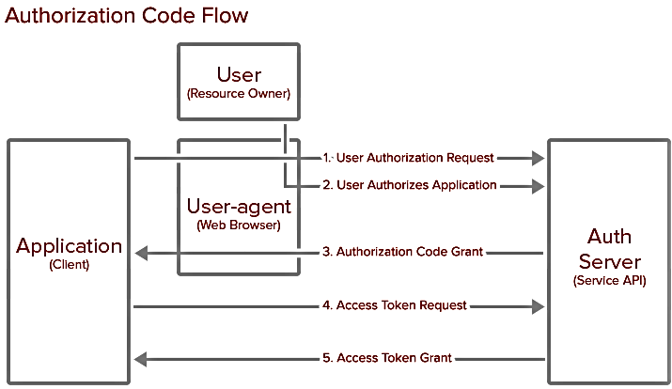
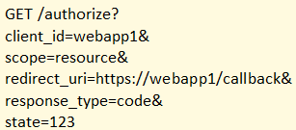

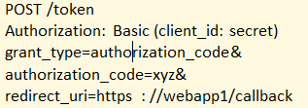
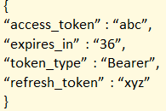
Authorization Code Flow – OAuth2

Slide 8

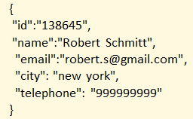
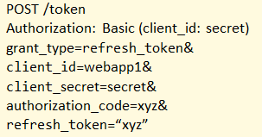
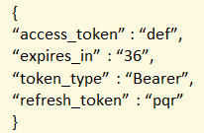
Refresh Tokens – OAuth2
User
(Resource Owner)
User-Agent
(web browser)
Application
(client)
6. Request User Info
Auth
Server
(service API)
7. User Info Response
8. Refresh Token Request
9. Refresh Token Grant

Slide 9
Drawbacks of OAuth2
Delegated Authorization standard, and not a Authentication standard
Doesn’t have enough features to securely authenticate
Home grown Authentication by providers needed support for each of them seperately.
Doesn’t specify to which resource owner the access tokens are generated

Slide 10
Web SSO with siteminder
Siteminder
Authenticated
Sessions
User Directory
Application1 with SM agent
Policy Server
Application2 with SM agent
Application3 with SM agent
Policy Store
Points
SM Agent - policy enforcement point for access control and creates SMSESSION.
SM Policy Server - communicates with SM agent and accesses the relevant policy information.
SM Policy Store - A repository for holding the access control policies defined in SiteMinder.
User Directory - holds all the user account information and group definitions
Protected Application - application covered by siteminder.

Slide 11
Overview OpenID Connect
OpenID Connect
is a simple identity layer on top of the OAuth 2.0 protocol, which allows computing clients to verify the identity of an end-user based on the authentication performed by an authorization server, as well as to obtain basic profile information about the end-user in an interoperable and REST-like manner.
allows clients of all types, including Web-based, mobile, and JavaScript clients, to request and receive information about authenticated sessions and end-users.
is extensible, allowing participants to use features such as encryption of identity data, discovery of OpenID Providers, and session management.

Slide 12
Roles in OpenID Connect
Authorization
End Point
Relying Party
A component of OpenID Connect enabled Identity Provider system which receives the OpenID Connect/OAuth requests from client application and works together with Identity Provider authentication components to authenticate resource owner
Auth
EndPoint
Relying
Party
A relying party application providing business services to end user thru a graphical interface
User
Info
User Info
End Point
Token
End Point
provides basic identity information for the user as managed/available within Identity Provider
Token
End Point
A component of OpenID Connect enabled identity provider that plays following key roles:
•Trades authorization code to actual identity and access tokens in authorization code grant back-channel call after authenticating client application
•Generates (refreshes) new access tokens using “Refresh token”
•Allows APIs (or if a proxy like Layer 7 or Datapower in front of actual API implementation) to validate access tokens presented to it by client
Identity
Provider UI
IDP
UI
Identity Management platform exposed thru an end-user accessible UI where end user performs one or more of following functions Login, Registration, Forgot username and Forgot password

Slide 13
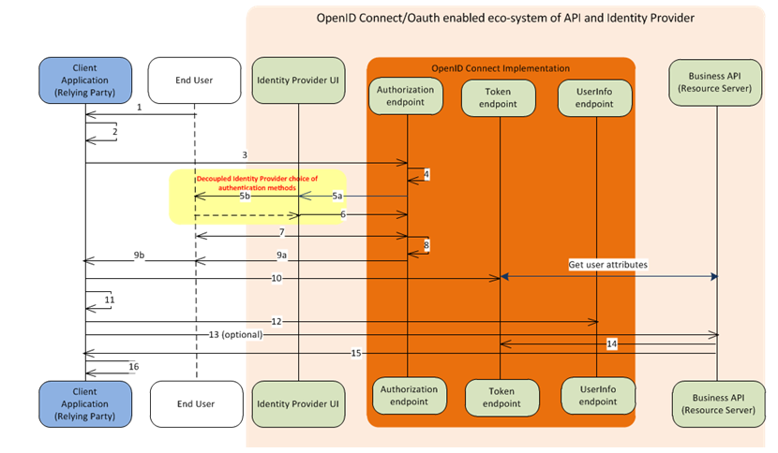
SSO with OpenID Connect

Slide 14
Authentication Flows in OpenID Connect
Authorization Code Flow
Hybrid Code Flow
Implicit Code Flow
OpenID Connect
Web & Mobile Applications
SPA App, javascript applications

Slide 15
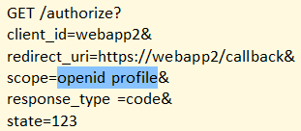


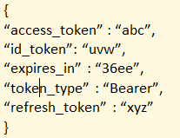
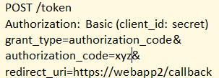
Roles in OpenID Connect
Authorization
End Point
User Info
End Point
A component of OpenID Connect enabled Identity Provider system which receives the OpenID Connect/OAuth requests from client application and works together with Identity Provider authentication components to authenticate resource owner
Auth
EndPoint
User
Info
Token
End Point
Token
End Point

Slide 16
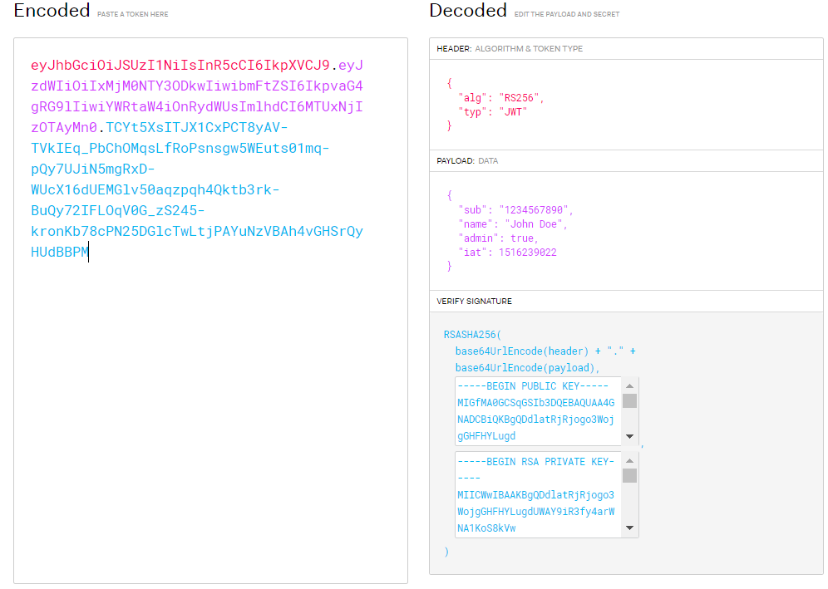
Json Web Tokens

Slide 17
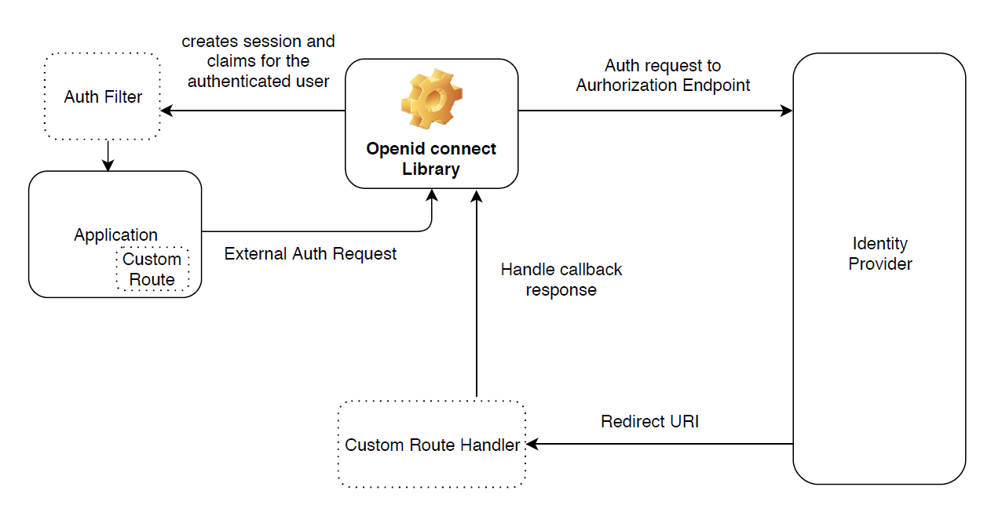
Implementation of OpenID Connect

Slide 18
References
OpenID Connect
http://openid.net/connect/
https://developers.google.com/identity/protocols/OpenIDConnect
https://accounts.google.com/.well-known/openid-configuration
https://jwt.io/
Java
https://github.com/mitreid-connect/OpenID-Connect-Java-Spring-Server
OAuth2 Security:
https://leastprivilege.com/2013/03/15/oauth2-security/

Slide 19


Confidential property of Optum. Do not distribute or reproduce without express permission from Optum.

