Slide 1
Dependency-based unknown words prediction
Xiaonan Jing

Slide 2
Agenda
Motivation of the project
Data preparation
Dataset
Tokenization
Dependency parsing
Pre-trained word embedding
Training data and labels
Model
Model structure
Training the model
Results
Best model
Evaluation method
Result evaluation
Thoughts and future work

Slide 3
Motivation
Goal

Slide 4
Motivation
Text cleaning can be difficult for data scientists
Especially for texts data taken from online communities
There are many slangs or unknown words in these textual data
Goal
Map the unknown word in a sentence to a known word
Example - a sentence taken from the dataset used in this project
Naturally, it’s easier to get a job when you are good in foreign languagers or computers.
languagers → languages

Slide 5
Data Preparation
Dataset description
Tokenization
Dependency parsing
Pre-trained word embeddings
Training data and labels

Slide 6
Dataset
Treebank of Learner English (Berzak et al., 2016)
The dataset contains 5,124 sentences with 97,691 tokens
The dataset include two corpus
original texts with errors labeled
corrected text (with errors corrected)

Slide 7
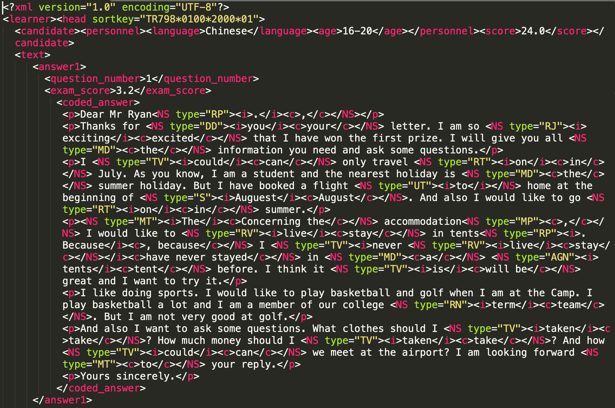
Example essay taken from the dataset
<NS> tags contain the correct, incorrect, error type information
<c> tags contain correct text
<i> tags contain incorrect text
<type=” ”> is the label for error type
In this project, the training stage used all corrected texts with all errors tags
The testing stage only used spelling errors (errors tagged with “S”)
The testing takes a very long time, the reason for this will be explained later

Slide 8
Tokenization
All essays were separated into sentences, three corpus were created
A corpus with all corrected sentences
A corpus with all original sentences
A separate corpus with the original sentences containing spelling errors
The sentences were tokenized with Stanford coreNLP (ver. 3.9.2 10-5-2018)
Tokenizer separate all the words apart, as well as separate the words from the punctuations
Example of tokenized sentence
[‘Naturally’, ‘,’, ‘it’, ‘'s’, ‘easier’, ‘to’, ‘get’, ‘a’, ‘job’, when, ‘you’, are, ‘good’, ‘in’, ‘foreign’, languages, ‘or’, ‘computers’, ‘.’]

Slide 9
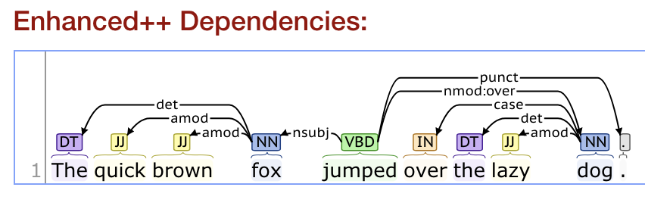
Dependency parsing
Dependency parsing is a process to find structural syntactic relations between pairs of words in a sentence
Stanford coreNLP (ver. 3.9.2 10-5-2018) dependency parsing API is used to parse all sentences (“enhance++” dependencies was used)
The following is an example of the visualized dependency relations in the sentence
The lines on top of the word pairs are dependency relations
i.e. amod(quick, fox) means “quick” and “fox” has adjectival modifier relations

Slide 10
Pre-trained word embeddings
Glove 27B pre-trained word embeddings (100 dimensions) was used
The model contains about 1.2M pre-trained embeddings trained on twitter data
The raw embedding file is just a text file with each row being a vector
5 methods were implemented for getting the relations between embeddings
get_vector(“word”) -- get the pre-trained embedding for an input word
similarity(“word1”, “word2”) -- get the cosine similarity between two input words
most_similar(“word1”, topn=10) -- get the top 10 most similar words with the input word
similarity_embedding(embed1, embed2) -- get the cosine similarity between two vectors
most_similar_token(embed, topn=10) -- get the top 10 most similar words with the input word vector

Slide 11
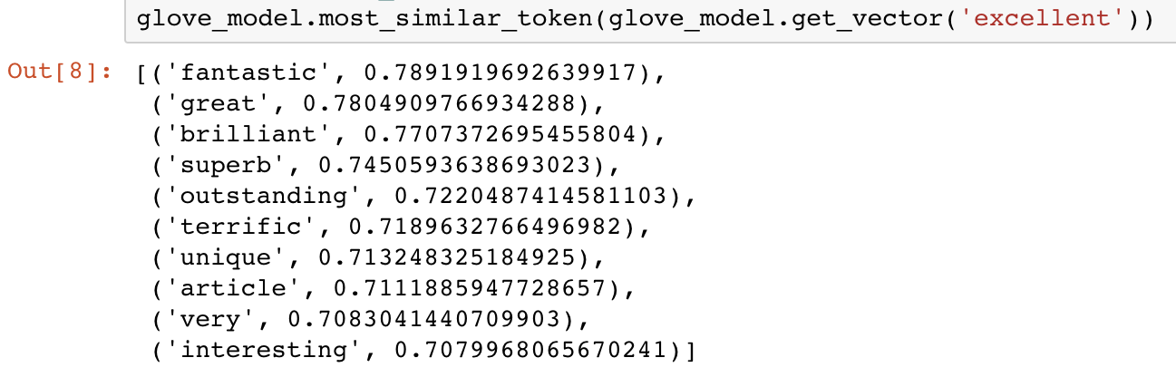
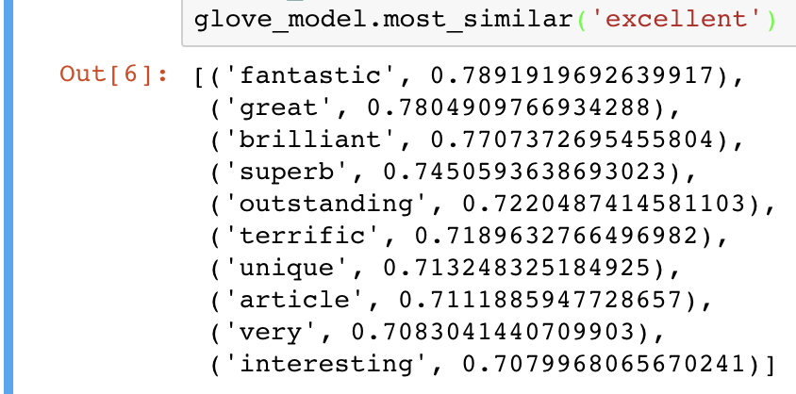
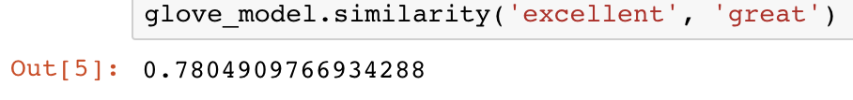
Example of pre-trained Glove word embedding
The examples show the functionality of 3 out of 5 methods I implemented using the raw Glove embedding vectors

Slide 12
Training data and labels
Each dependency pairs in the sentence were mapped to its pre-trained embeddings
The input is the combination of all dependency pairs a target word has
Maximum number of dependency pairs is set to 15
It is unusual for a word to have too many dependencies
31 out of 130,287 target words (having more than 15) were filtered out
Since 100d pre-trained embedding is used, here the input is 1500d
The embedding for each dependency word is obtained
When a pre-trained embedding does exist, replace it with all 0s
When a target has less than 15 dependency pairs, pad with 0s
The label is the word embedding of the target word
The label is 100 dimension
When a label word not in the pre-trained embedding model, replace with 0s to represent unknown word

Slide 13
Model
Model structure
Training the model

Slide 14
Model structure
Trained 3 models with slightly different structure (based on research in what might be good for word embeddings)
Mimicing word2vec (Mikolov et al, 2014) CBOW structure
Input layer - 15 * 100d
Hidden layer - 512d
Output layer - 100d
Model 1 - ReLU activation for hidden, Softmax smoothing for output layer
Model 2 - Tanh activation for hidden, Softmax smoothing for output layer
Model 3 - ReLU activation for hidden, no smoothing for output layer
Hyperparameters for all models stayed the same

Slide 15
Training the Model
Hyperparameters
Epoch - 50
Learning rate - 0.01
Optimization - adam
Loss function - cosine embedding loss
Cosine embedding loss is good for measuring the loss between two embeddings
As both label and prediction are embeddings (instead of 1 hot vector)
Loss = 1 - cosine similarity (ranging from 0 to 1)
Cosine similarity: higher → more similar, lower → less similar

Slide 16
Results
Best Model
Evaluation Method
Result Evaluation
Tougthts and Future Work

Slide 17
Best Model
Three models
Model 1 - ReLU activation for hidden, Softmax smoothing for output layer
Model 2 - Tanh activation for hidden, Softmax smoothing for output layer
Model 3 - ReLU activation for hidden, no smoothing for output layer
Best model loss
Model 1 - 0.32822805643081665
Model 2 - 0.35057276487350464
Model 3 - 0.2146233171224594
It turned out ReLU with no softmax smoothing model did the best
Note: Cosine similarity loss likely will not go as low as other loss functions unless two vectors are exactly the same
Note: the model is predicting pre-trained 100 vectors, it is more difficult than predicting 1-hot like embeddings

Slide 18
Evaluation Method
Different method was used compared to generic prediction task
The goal is to given a context (dependencies in this case) of a unknown target word, predict the embedding of the target word, then find the most similar known word
Need to feed the prediction back to pre-trained Glove model and find the most similar known word to the predicted embedding
Recall: there are about 1.2M Glove pre-trained embeddings (it took a very long time to compute the most similar words for prediction!)
Evaluated with only 200 sentences containing spelling errors (model3)
Input - still up to 15 dependencies of the target misspelled word
Output - predicted 100d embedding
Evaluate the output by human
Feed the output back to Glove pre-trained embeddings and find 5 top similar words

Slide 19
Result Evaluation - part 1
Most of the top 5 most similar words of the predicted embedding are not very sensible
Most of the top 5 are common words in dependencies
i.e. words like “there”, “where”, “when”, “it”, …., ect. appeared a lot
Top 5 similar words of “caracterize” are
“How”, “there”, “know”, “n’t”, “when”

Slide 20
Result Evaluation - part 2
The words that do not have strong dependencies with common words obtained really good predictions
Top 5 similar words of “well-organized”, in most similar order
“organized”, “established”, “encouraged”, “celebrated”, “accompanied”
Top 5 similar words of “sathurday”, in most similar order
“sunday”, “friday”, “monday”, “thursday”, “tomorrow”
Top 5 similar words of “languagers”
“cultures”, “languages”, “cities”, “nations”, “companies”
Top 5 similar words of “fesival”
“expo”, “fest”, “showcase”, “event”, “tour”
Top 5 similar words of “contries”
“cities”, “states”, “europe”, “nations”, “americans”

Slide 21
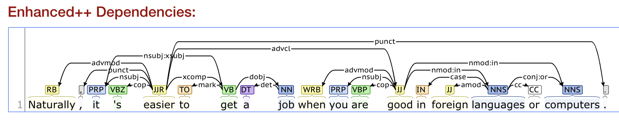
Thoughts and Future Work
Based on the results, use dependencies as contexts of an unknown word will work when it is not strongly related to any common words
The future work for this part should include filtering the dependency relations by categories - instead of taking all dependencies of a word, filter out some pure structurial dependency categories
i.e. “or”, a conjunction word, in the following example has “cc” dependency with “languages”. “cc” relation is the relation between conjunction and a preceding
Example like “cc” relation is not very helpful in prediction as context word

Slide 22
END

