Slide 1
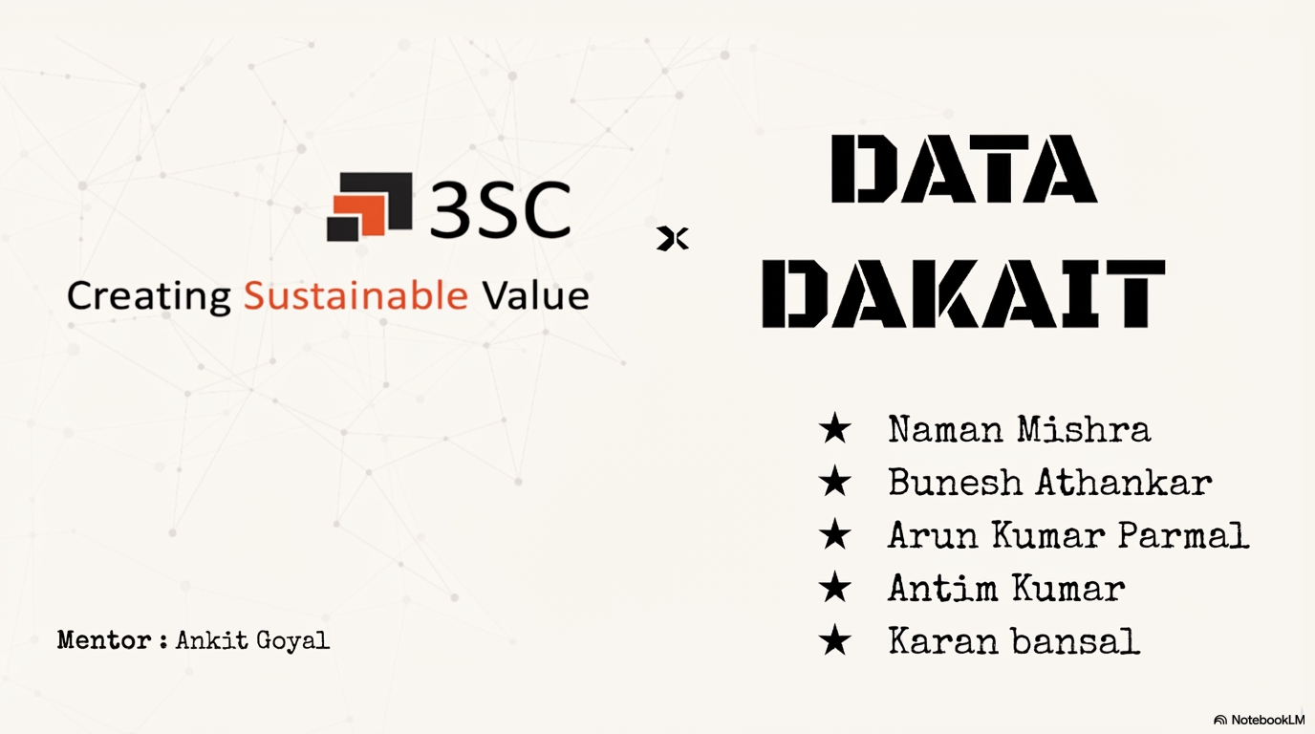


Slide 2







THE PROBLEM
Where Finance Stops Being Manual
Finance teams at growing enterprises waste
Manual bill processing
Approvals in WhatsApp
60–70%
40+ hrs/week lost to email → forward → re-type into ERP
No audit trail; bills stuck 2–3 weeks on average
of their time on repetitive, error-prone manual work —
processing vendor bills, chasing approvals, matching payments, and answering the same data questions over and over.
Budget overruns found late
Compliance deadlines missed
15–20% overspend undetected until quarter-end*
GST, TDS, MSME 45-day rule tracked by hand
Vendor bank-change fraud
Duplicate & inflated bills
No cooling period; no verification call
Spot-checks only; no anomaly detection
* 3SC internal finance operations estimate, FRD v2.0 (Apr 2026). Percentages reflect 3SC's own baseline, not a published benchmark.
Creating Sustainable Value · 3SC × Data Dakait

Slide 3




PROPOSED SOLUTION
An AI Layer That Sits on Top of Your ERP
FinanceAI turns 40-hour manual workflows into 40-minute self-service ones — with built-in fraud detection, compliance enforcement, and a CFO copilot that answers questions in plain English.
01
02
AI-first Ingestion
Smart Workflows
Vendors self-submit bills. Claude Sonnet 4 Vision extracts every field automatically. Zero re-typing.
Generic 6-step approval engine with real-time budget checks, anomaly detection, and hard-coded Segregation of Duties.
03
04
Always-on Compliance
CFO Copilot
MSME 45-day rule, GST prep, TDS, and Section 43B exposure monitored automatically. Human CAs still file.
Plain-English queries, 90-day Prophet forecast, and an AI-narrated monthly summary. 2 days of Excel → 2 minutes.
11 MODULES
Expense · Sales Invoice · Budget · Vendor · Accounts Receivable · Accounts Payable · Cash Flow · Reporting · Compliance · Audit · Shared Capabilities
Creating Sustainable Value · 3SC × Data Dakait

Slide 4






HOW WE BUILD IT
The FinanceAI Tech Stack
Frontend
API
Async
Data
AI
Integration
React 18 · Vite
TypeScript
Tailwind + shadcn/ui
TanStack Query
Django 5 · DRF
JWT Auth
drf-spectacular
(OpenAPI)
Celery + Redis
Celery Beat
OCR jobs
SLA timers
PostgreSQL 16
Redis cache
MinIO blob store
(S3-compatible)
Claude Sonnet 4
(Vision + NL)
Isolation Forest
Prophet forecast
Mock D365 BC
OData v4 schema
Adapter pattern
Zero-rewrite swap
Why This Stack
Hackathon → Production
Django over FastAPI — auth, ORM, admin, migrations built-in. 3× productivity in 4 weeks.
Claude Sonnet 4 over GPT/Gemini — best-in-class vision OCR + structured output.
Postgres over Mongo — financial data is relational. Need ACID, FK constraints.
Mock D365 adapter — forces clean interface from day 1. Production swap is free.
Hosting
Docker Compose
→ Kubernetes + HPA
Database
Single Postgres
→ PG HA + replicas
Auth
Email + JWT
→ Azure AD + MFA
D365
Mock adapter
→ Real BC OData v4
Secrets
.env files
→ HashiCorp Vault
Every component is swappable. Scaling is a configuration problem, not a rewrite problem.
Creating Sustainable Value · 3SC × Data Dakait

Slide 5




ARCHITECTURE & FLOW
From Vendor Bill to Ledger, in One Flow
1. INGEST
2. EXTRACT
3. VALIDATE
4. APPROVE
5. BOOK
6. PAY & REPORT
Vendor
self-serve portal
Claude Vision
(~6 seconds)
Rules +
Isolation Forest
6-step chain
SoD enforced
D365 adapter
OData v4
Bank API +
CFO dashboard
PDF upload
Magic-link auth
Line items
GSTIN · HSN · amounts
Duplicate check
Anomaly scoring
L1 → L2 → HoD
→ Fin1 → Fin2 → Head
Purchase invoice
Webhook confirm
UTR to vendor
Cash forecast
BACKEND
Django 5 REST · Generic Approval Engine · State Machine · Celery workers · Audit Log (hash-chained)
DATA & STORAGE
PostgreSQL 16 (ACID, JSONB) · Redis (broker + cache) · MinIO / S3 (PDFs)
EXTERNAL & AI
Claude Sonnet 4 (via Masking Middleware) · Mock D365 → Real BC OData v4 · Bank API · Email
Single PII chokepoint
1 generic approval engine
Immutable audit log
Adapter-swap D365
Masking Middleware
reused by 8 workflows
4 defense layers
zero-rewrite to production
Creating Sustainable Value · 3SC × Data Dakait

Slide 6
FEASIBILITY & VIABILITY
Buildable in 4 Weeks. Scalable to 100k Bills/Day.
4-WEEK MVP PLAN
KEY RISKS & MITIGATIONS
Foundation
MED
OCR accuracy on Indian invoices
W1
Django skeleton · auth · vendor module · mock D365 adapter · file upload
Confidence scores + human fallback < 85%
HIGH
PII leakage via Claude API
Core pipeline
Single masking chokepoint; bank stripped, names tokenized
W2
Claude Vision OCR pipeline · Expense module · 6-step approval engine
HIGH
Audit log tampering
4 layers: app → ORM → DB trigger → SHA256 hash chain
Intelligence
HIGH
Approval SoD edge cases
W3
Hard-coded SoD + hourly continuous scanner
Anomaly detection · audit log · real-time budget check · notifications
D365 integration complexity
MED
Mock BC with adapter pattern; zero-rewrite swap
W4
CFO layer
Vendor adoption
NL query · AI monthly summary · CFO dashboard · demo polish & dry run
MED
Magic-link auth, 3-click submit, mobile-first
SCALABILITY PATH
Day 1
Month 3
Month 9
Year 2
100/day
1k/day
10k/day
100k/day
Docker Compose
K8s + HPA
Read replicas + CDN
Multi-region + Kafka
Creating Sustainable Value · 3SC × Data Dakait

Slide 7
IMPACT & BENEFITS
What Changes on Day One
Metric
Before
With FinanceAI
Δ
SOCIAL IMPACT
Bill processing time
2–3 weeks
2–3 days
~85% faster
MSME support Enforces Section 43B(h) on-time payment to small vendors. Digital India Moves SMEs off Excel + email into real automation. Higher-value jobs Shifts finance work from data entry to analysis. Tax compliance Reduces GST / TDS leakage at national level.
Finance team time on ops
70%
25%
45% freed for analysis
Undetected budget overruns
15–20%
< 2%
~90% reduction
MSME 45-day breaches
5–10% of bills
0% (enforced)
100% compliant
CFO report generation
2–3 days
2 minutes
~1000× faster
Duplicate bill detection
< 10%
> 95%
~10× better
WHO BENEFITS
Finance Teams
CFOs
Vendors
Employees
Auditors
Stop ticketing.
Start strategy.
Real-time cash
before 9 am.
30-sec submit.
Paid faster.
Mobile approvals.
Full audit trail.
Hash-chained log.
Signed PDF export.
All Before/After values are 3SC internal baselines from FRD v2.0 (Apr 2026). Targets reflect 4-week MVP scope against current manual baseline.
Creating Sustainable Value · 3SC × Data Dakait

Slide 8



BUILT ON SOLID GROUND
Research & References
Regulatory & Standards
Technical Foundations
Market & Differentiation
Section 43B(h), Income Tax Act (India)
Microsoft Dynamics 365 Business Central
FRD v2.0 — 3SC Solutions (Apr 2026)
MSME 45-day rule — non-payment disallows deduction
OData v4 API — standard enterprise BC integration
Primary source: real company, real pain points
GST Council e-invoice framework
Anthropic Claude API documentation
SAP Concur / Coupa
IRN generation for B2B turnover > ₹5 Cr
Vision API for OCR + structured outputs
Expensive, weak on Indian compliance
MSME Udyam registration portal
Prophet — Taylor & Letham, Meta (2017)
Zoho Books / Tally Prime
Source for vendor MSME status verification
Open-source time-series forecasting
Bookkeeping-first, limited workflow automation
ISO 27001 / SOC 2 control frameworks
Isolation Forest — Liu, Ting, Zhou (2008)
Razorpay X
Basis for masking middleware & audit log design
ICDM paper, academic basis for anomaly detection
Payments-only, not workflow-driven
Our unique contribution: first AI-native Indian finance automation layer to combine OCR + anomaly + approvals + compliance + forecasting + NL query in one integrated product.
Creating Sustainable Value · 3SC × Data Dakait

