Slide 1
Aadhaar Address Formatting Issue
Team Name: Beyond Infinity
Shreya Sridhar
Riya Patricia
Vignesh K
Venkatesh K
Srinivasan

Slide 2

Problem Statement:
To Develop the API which will undertake Address Formatting
Accepts the Address in Raw Form (English and Local Language Address)
Formats the Address and Presents as an Output

Slide 3
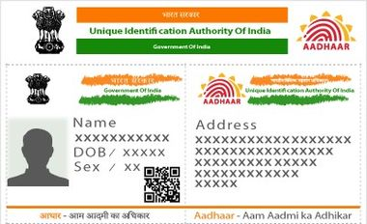
UIDAI Address Object Consists of Common Fields Like
House/Building/Apartment,
Street/Road/Lane,
Area/Locality/Sector,
Landmark,
Village/Town/City,
Pincode,
Sub District,
District,
State

Slide 4
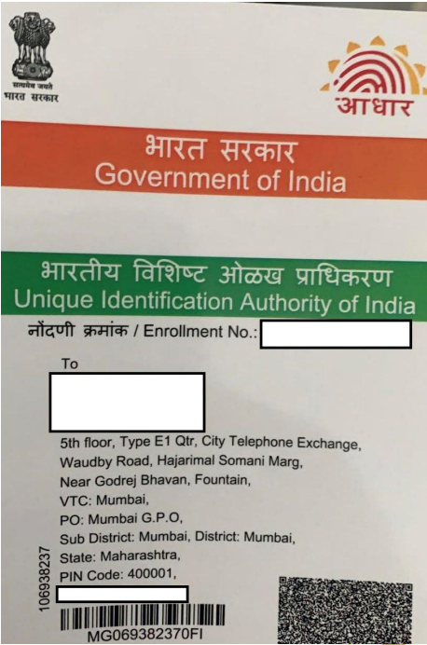
DESCRIPTION:
Repetition of texts in the aadhaar address is now a common issue around.
For example: In the give picture the word Mumbai is repeated atleast four times

Slide 5
So we propose a solution to solve the problem of Repetitive text.
In our solution ,we De-Clutter the Address by
Identify Repetitive Constituents
Merge and Format the Address

Slide 6
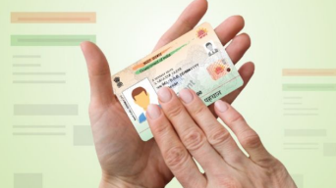
We also included the input address to be in the regional language

Slide 7
Thank You

