Slide 1
Finding the most suitable area in Mumbai to open a restaurant

Slide 2
INTRODUCTION
Mumbai is the financial and cultural capital of India. It is home to Indians of all states and is also a tourist attraction.
What is more intriguing than its coastal location is the plethora of cuisines it hosts.
Be it vegetarian or non-vegetarian, the dishes in Mumbai boast of rich taste, fieriness and impressive flavors. The cuisine of Mumbai covers a large assortment of interesting, authentic dishes and zesty seafood dishes.
The staple foods consumed by the residents of Mumbai include rice, aromatic fish curries, Indian bread (chapatis and rotis), vegetable curries, pulses and desserts. Coconuts, cashew nuts, peanuts and peanut oil are some of the major ingredients used in many of Mumbai's traditional dishes.

Slide 3
BUSINESS MODEL
To monopolise on the hunger pangs of its residents, Mumbai is a rather great location for someone looking to enter the restaurant business.
But being so populated, the high competition is obvious.
So it is sensible to analyse and settle for a location which would be most economically profitable.
This project looks forward to help people make a data driven decision

Slide 4
DATA COLLECTION
The following data was collected for this project:
Neighborhood data of Mumbai was scraped from: https://en.wikipedia.org/wiki/List_of_neighborhoods_in_Mumbai
Venue data for all neighbourhoods in Mumbai using Foursquare API.
The geographical coordinates and longitude and latitude were found using the built in python functions.

Slide 5
METHODOLOGY
The neighbourhood data was first cleaned and processed to make it usable.
Then the dataframe with neighbourhoods with respective latitudes and longitudes was created.
The area with maximum number of neighbourhoods was determined to be south Mumbai
The venue recommendations were collected using Foursquare API.
The dataframe with the top 5 common venues was created.
Clusters were formed using KMean clustering method.

Slide 6
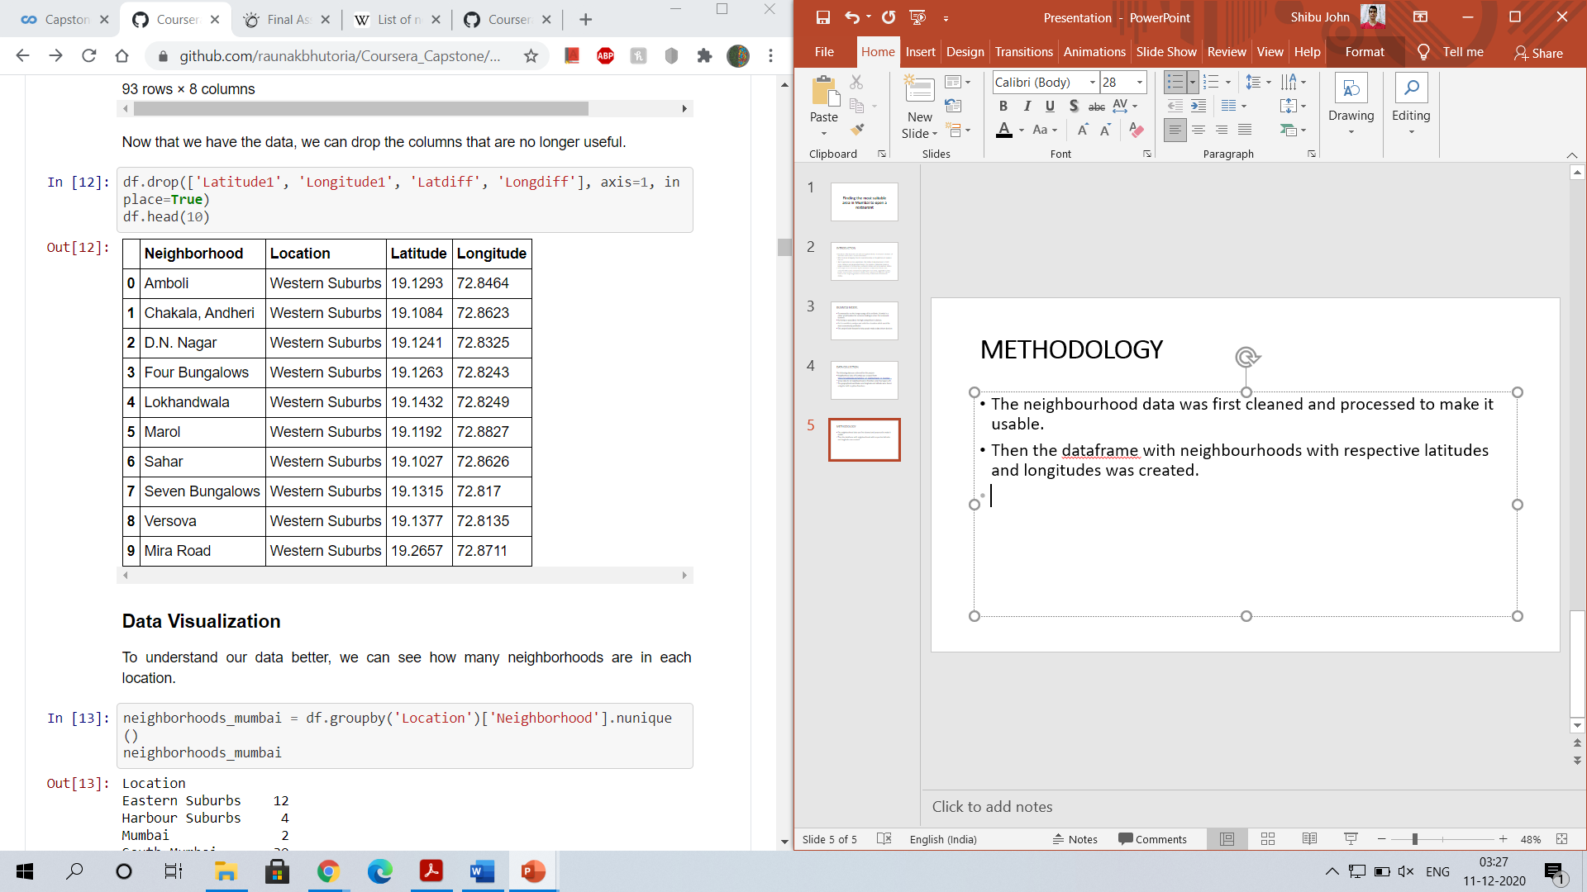
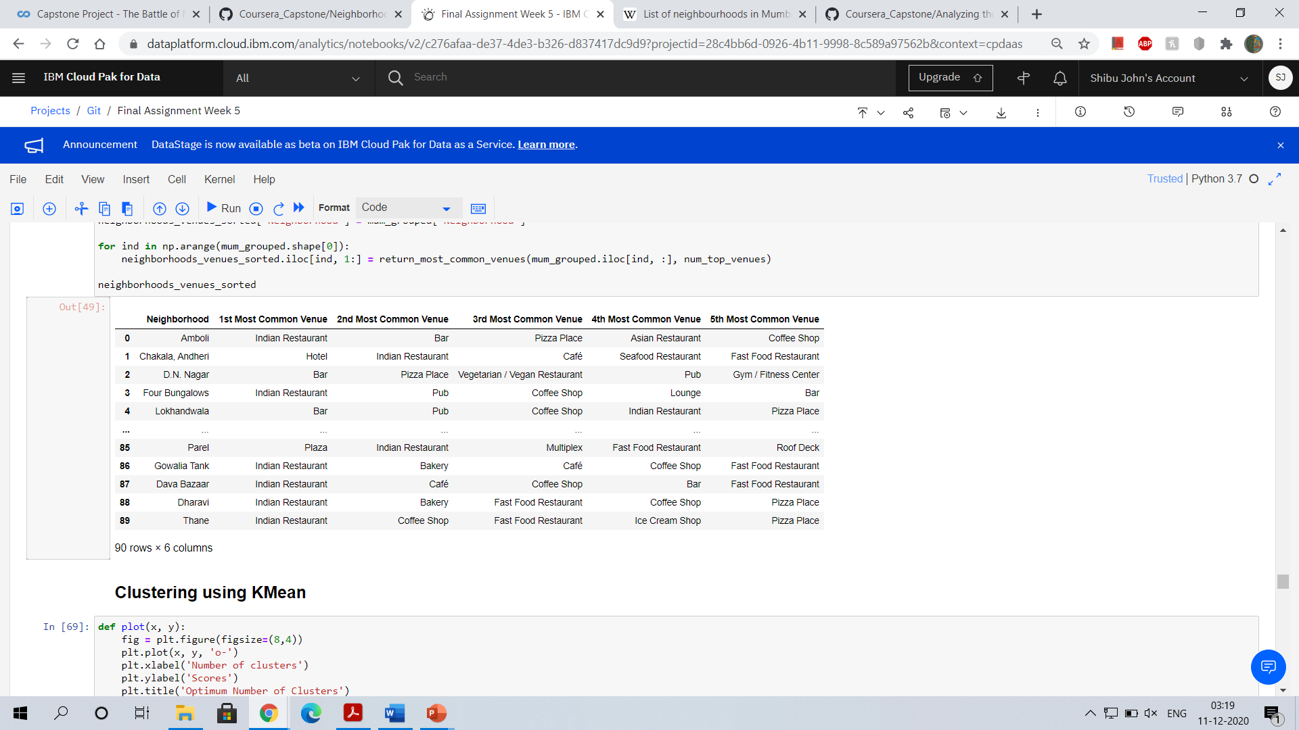

Slide 7
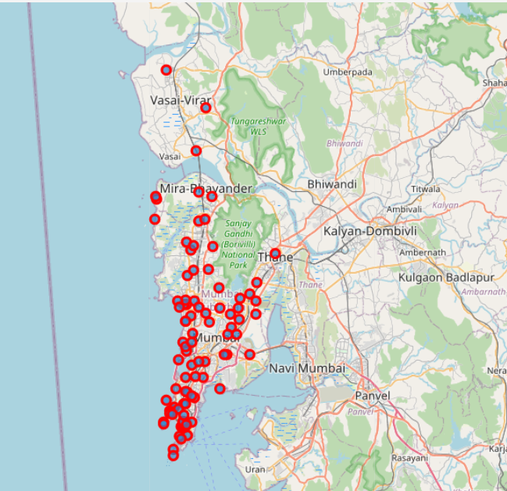
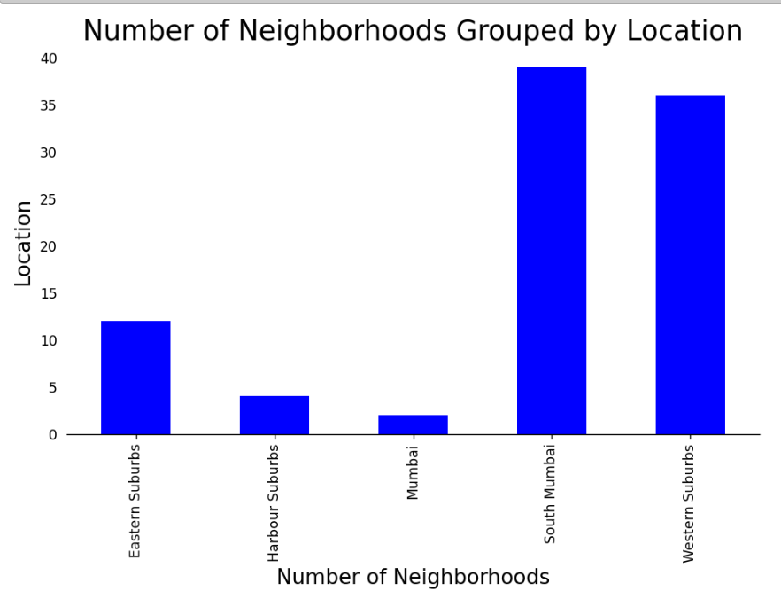

Slide 8
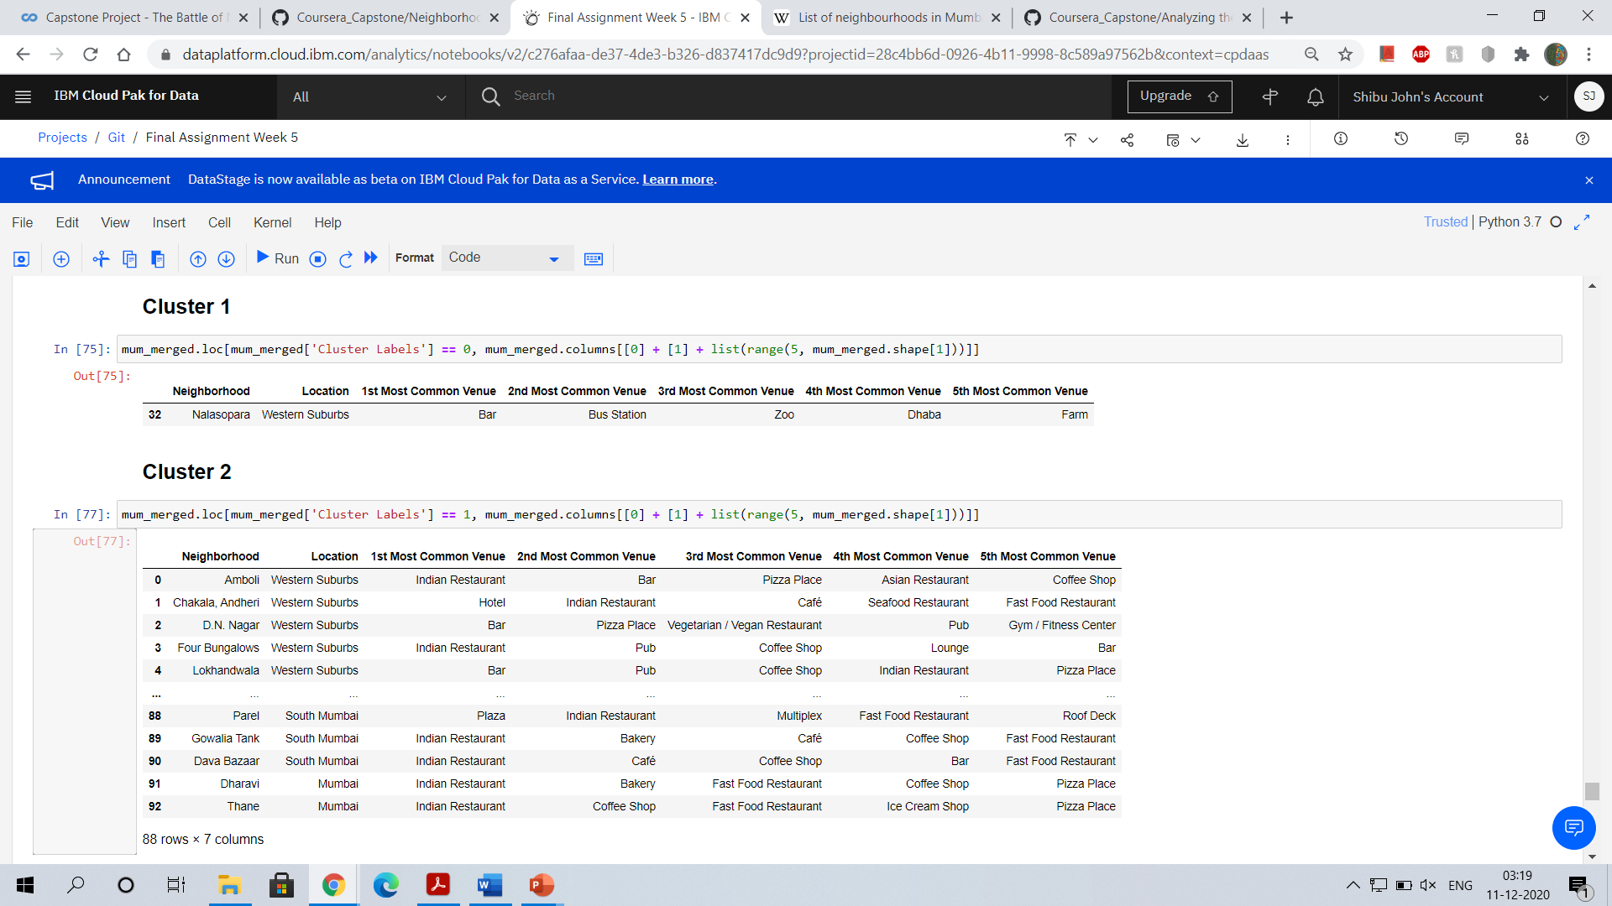
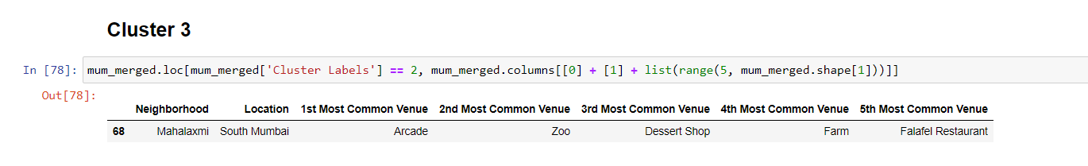

Slide 9
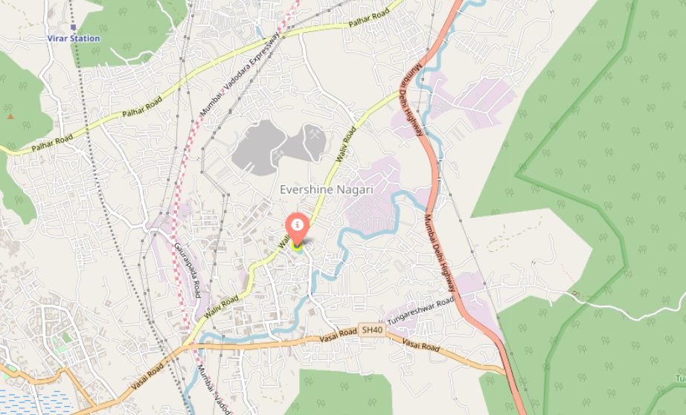
RESULT
The most recommended region was out of cluster 1

Slide 10
CONCLUSION
The data for the neighbourhoods of Mumbai were successfully analysed.
We could find the most suitable region in Mumbai where it would be feasible to open a restaurant.
Cluster 1 shows the most promising result.

