Slide 1
End-to-End MLOps
on Azure
Azure Machine Learning + Azure DevOps
BFSI Loan Approval Classification | SDK v2 | scikit-learn | MLflow
Production-Grade Lab Guide

Slide 2



What is MLOps?
Definition: MLOps (Machine Learning Operations) is a set of practices that combines Machine Learning, DevOps, and Data Engineering to deploy and maintain ML models in production reliably and efficiently.
DevOps
ML Engineering
Data Engineering
CI/CD pipelines,
version control,
automated testing
Model training,
evaluation, feature
engineering
Data pipelines,
storage, quality
monitoring

Slide 3
MLOps vs Traditional ML
Aspect | Traditional ML | MLOps
Deployment | Manual, ad-hoc | Automated CI/CD pipelines
Monitoring | None or manual checks | Automated drift detection
Reproducibility | "It works on my machine" | Versioned data, code, models
Retraining | Manual when accuracy drops | Auto-triggered on drift
Collaboration | Data scientist silos | Cross-team DevOps workflow
Scalability | Single model, single server | Managed endpoints, auto-scale

Slide 4
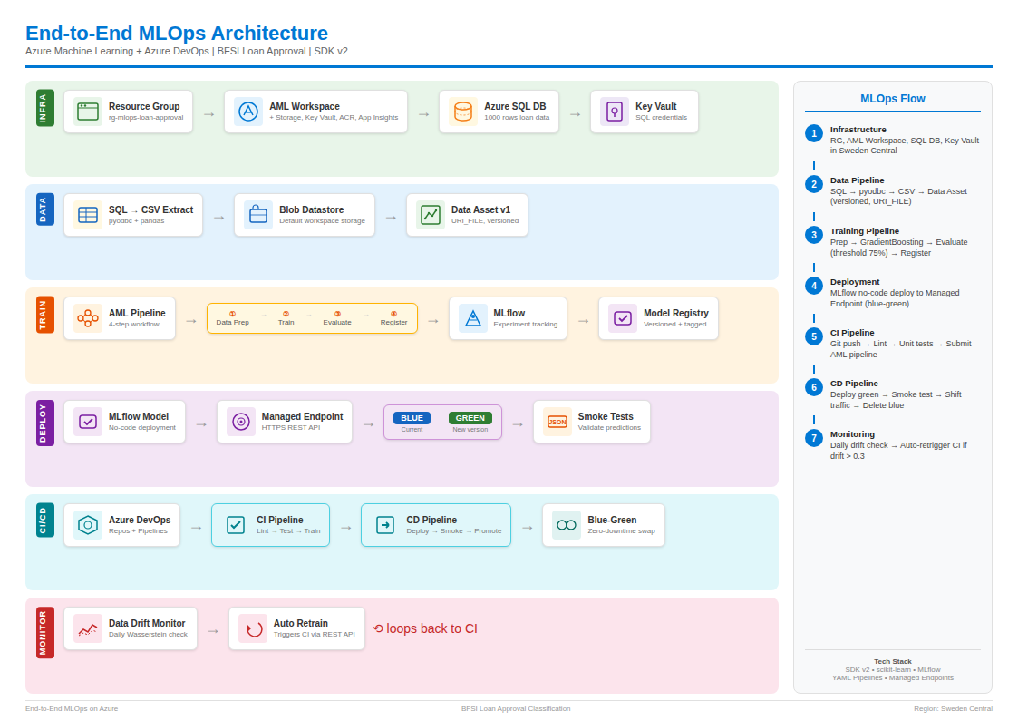
Architecture Overview

Slide 5



Phase 1: Infrastructure Setup
Resource Group
A logical container that holds related Azure resources. All resources in this lab live in rg-mlops-loan-approval for easy management and cleanup.
AML Workspace
The central hub for Azure Machine Learning. It auto-creates a Storage Account (for data), Key Vault (for secrets), Container Registry (for Docker images), and Application Insights (for monitoring).
Azure SQL Database
A managed relational database storing our 1,000-row loan application dataset. We use SQL Admin authentication and firewall rules to control access.
Azure Key Vault
A secure store for secrets, keys, and certificates. We store the SQL password here so it never appears in code. Requires RBAC role assignment (Key Vault Secrets Officer).

Slide 6
Phase 2: Data Pipeline
Azure SQL DB
→
pyodbc + pandas
→
Blob Datastore
→
Data Asset v1
1000 rows
SQL → CSV
Default storage
Versioned URI_FILE
Datastore
A connection pointer to where your data lives (Blob Storage, Files, ADLS). SDK v2 does NOT support Azure SQL as a datastore — so we extract to CSV first.
Data Asset
A versioned reference to a specific dataset. Think of it as a Git tag for data. Version 1 = the original 1000 rows. If data changes, you create Version 2.
URI_FILE
The asset type for a single file (our CSV). Other types include URI_FOLDER (directory of files) and MLTABLE (schema-defined tabular data).

Slide 7
Understanding the Loan Data
Factor | Points | ML Impact
Credit Score > 700 | +2 | Strongest positive predictor
Credit Score 600-700 | +1 | Moderate positive signal
Income > 75K | +2 | Strong income signal
Debt-to-Income < 0.35 | +1 | Financial health indicator
Employment > 3 years | +1 | Stability signal (~90% get this)
Loan/Income ratio < 3 | +1 | Affordability check
Previous Default = Yes | -2 | Biggest negative predictor
Threshold: 4+ points = Approved
This creates a ~58% approval rate with realistic feature correlations. The model should learn that CreditScore + Income + PreviousDefault are the top predictors.
Why balanced data matters
A 58/42 split (approved/denied) ensures the model learns meaningful patterns instead of just predicting the majority class. If 99% were approved, the model could achieve 99% accuracy by always saying "yes" — useless in production.

Slide 8
Phase 3: Training Pipeline
1
2
3
4
→
→
→
Data Prep
Train
Evaluate
Register
Label encoding, stratified
train/test split (80/20)
GradientBoosting
Classifier (scikit-learn)
Accuracy, F1, AUC-ROC
Threshold gate: 75%
Model Registry
Versioned + tagged
Gradient Boosting Classifier
An ensemble ML algorithm that builds many decision trees sequentially, each correcting errors of the previous one. Handles mixed features without scaling, provides feature importance, and is robust to outliers.
MLflow
Open-source platform for tracking experiments. Logs hyperparameters (n_estimators, learning_rate), metrics (accuracy, AUC), and saves model artifacts. mlflow.autolog() captures everything with one line.
Model Registry
Version-controlled storage for trained models. Each registration creates v1, v2, v3... with tags (accuracy, framework). Enables traceability, rollback, and audit — critical for BFSI regulatory compliance.

Slide 9
Evaluation Metrics — What Each One Tells You
~85%
Accuracy
Overall correct predictions / total. Easy to understand but misleading if data is imbalanced.
~82%
Precision
Of loans predicted 'Approved', how many were truly approved? High precision = fewer false approvals (controls risk).
~88%
Recall
Of all actually approved loans, how many did the model find? High recall = fewer missed good customers (revenue).
~85%
F1 Score
Harmonic mean of Precision and Recall. Balances both. In BFSI, this is often the primary metric.
~0.92
AUC-ROC
Model's ability to distinguish approved vs denied across all thresholds. 0.5 = random, 1.0 = perfect. >0.85 is good for lending.

Slide 10



Phase 4: Model Deployment
Managed Online Endpoint
An HTTPS URL that accepts JSON and returns real-time predictions. Azure handles compute, scaling, and networking. You only define the model and instance type.
MLflow No-Code Deployment
Since our model is MLFLOW_MODEL type, Azure auto-handles inference. No score.py needed, no custom environment. The MLflow serving layer loads scikit-learn models automatically.
Blue-Green Deployment
Two model versions run simultaneously. 'Blue' is production, 'Green' is the new version. Traffic shifts to Green only after smoke tests pass. Enables zero-downtime and instant rollback.
Smoke Tests
Automated validation after deployment. Sends a sample loan application to the Green endpoint and asserts the response format is correct (prediction must be 0 or 1). Prevents broken models from reaching production.

Slide 11
Phase 5: CI/CD with Azure DevOps
CI — Continuous Integration
CD — Continuous Deployment
1. Git push triggers pipeline
1. CI completes → triggers CD
2. Lint code with flake8
2. Deploy new model as 'Green'
3. Run unit tests with pytest
3. Run smoke tests on Green
4. Submit AML training pipeline
4. Shift 100% traffic to Green
5. Validate model accuracy > 75%
5. Delete old Blue deployment
6. Register model if passed
6. Zero-downtime achieved

Slide 12
Phase 6: Monitoring & Drift Detection
Feature Drift
Input distributions change. Example: Average credit scores in applications drop from 700 to 620 due to economic downturn. Model hasn't seen this pattern.
Target Drift
The approval rate itself changes. Example: Bank tightens lending policy from 60% to 30% approval. The model's training data no longer reflects reality.
Concept Drift
The relationship between features and outcome changes. Example: Income used to be a strong predictor, but a new regulation makes employment history more important.
Wasserstein Distance
A statistical measure of how different two data distributions are. We set threshold at 0.3 — if drift exceeds this, the monitoring alert fires and triggers retraining automatically.

Slide 13
The Self-Healing MLOps Loop
1
Model serves predictions in production
2
AML Monitor compares incoming data vs training data (daily)
3
If drift > 0.3 threshold → alert fires
4
retrain_trigger.py calls Azure DevOps REST API
5
CI pipeline retrains model on fresh data
6
CD pipeline deploys via blue-green (zero downtime)
7
New model serves predictions → loop continues
This creates an automated, self-healing ML system

Slide 14
Tech Stack
ML Framework
scikit-learn (GradientBoostingClassifier)
Experiment Tracking
MLflow + Azure ML integration
SDK
azure-ai-ml v2 (Python)
Data Storage
Azure SQL DB → Blob Storage (CSV)
Model Serving
Managed Online Endpoints (no-code MLflow)
CI/CD
Azure DevOps YAML Pipelines
Monitoring
AML Data Drift Monitor (Wasserstein)
Security
Key Vault (RBAC), Service Principal
Region
Sweden Central

