Slide 1
Module: Introduction to Agentic AI Business Solution Architecture
module # • 60 min

Slide 2
Unit: Introduction

Slide 3
Overview
• AI transformation is a strategic shift impacting business processes, people, and culture
• Architects ensure AI solutions deliver business value with compliance, scalability, and security
• Architects align AI initiatives with organizational objectives and integrate AI into existing systems
• Responsible AI governance frameworks and scalable solutions are essential
• AI transformation follows a structured framework from goals to monitoring and optimization
• Best practices include measurable outcomes, modular design, responsible AI, collaboration, and leveraging Microsoft Azure AI services
Notes:
This unit introduces the concept of Agentic AI Business Solution Architecture, emphasizing the strategic nature of AI transformation beyond technology upgrades. It highlights the critical role of architects in bridging business strategy and technical implementation, ensuring responsible AI governance, and scaling AI solutions effectively using Microsoft Azure AI services.

Slide 4
Key responsibilities of an AI architect
• Define AI adoption vision and roadmap
• Ensure data readiness and governance
• Integrate AI services with enterprise workflows
• Implement responsible AI principles such as fairness and transparency
• Monitor performance through clear KPIs
• Align AI solutions with business priorities
Notes:
AI architects have a multifaceted role that includes strategic planning, data governance, integration, ethical AI implementation, and performance monitoring to ensure AI solutions are effective and aligned with organizational goals.

Slide 5
AI transformation process framework
• Define business goals
• Develop AI strategy
• Design architecture
• Implement solutions
• Monitor and optimize performance
Notes:
The AI transformation process is systematic and outcome-driven, ensuring long-term business success by progressing through defined phases from goal setting to continuous optimization.

Slide 6
Best practices for scaling AI across the enterprise
• Start with measurable business outcomes
• Adopt modular and flexible design principles
• Prioritize responsible AI
• Foster collaboration among stakeholders
• Leverage Microsoft Azure AI services for speed and reliability
Notes:
Following these best practices helps organizations maximize AI investment value while maintaining trust and compliance.

Slide 7
Unit: Role of the Architect in AI Transformation for Businesses

Slide 8
Learning objectives
• Explain the architect’s role in driving AI adoption and transformation.
• Identify key responsibilities of an AI architect in business contexts.
• Understand how architects align AI solutions with organizational goals.
• Apply best practices for scaling AI across enterprise environments.

Slide 9
Overview
• AI transformation is a strategic shift impacting processes, people, and culture.
• Architects ensure AI solutions deliver measurable business value.
• Focus on compliance, scalability, and security in AI implementations.
Notes:
AI transformation goes beyond technology upgrades to affect organizational culture and processes. Architects play a key role in aligning AI initiatives with business goals while ensuring compliance and scalability.

Slide 10
Architect’s Role in AI Transformation
• Bridge gap between business strategy and technical implementation.
• Ensure AI initiatives support organizational objectives (Strategic Alignment).
• Design architectures integrating AI into existing systems (Solution Design).
• Establish frameworks for responsible AI use (Governance and Compliance).
• Design scalable solutions to grow with business needs.
Notes:
Architects play a pivotal role in connecting business goals with technical AI solutions, ensuring responsible governance and scalability.

Slide 11
AI Architect Responsibilities
Responsibility | Description
Vision & Roadmap | Define AI adoption strategy aligned with priorities
Data Architecture | Ensure data readiness and governance
Integration | Connect AI services with enterprise workflows
Security & Ethics | Implement responsible AI principles
Performance Monitoring | Establish KPIs and monitor effectiveness
Notes:
Key responsibilities of AI architects include strategic vision, data governance, integration, ethical AI implementation, and performance monitoring.

Slide 12
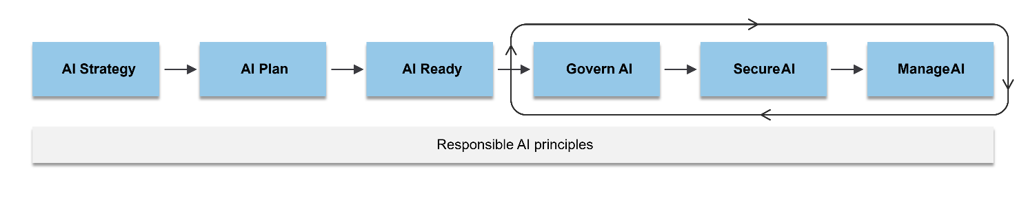
AI Transformation Framework
Notes:
The AI transformation process flows from defining business goals through strategy, design, implementation, and ongoing monitoring and optimization.
https://learn.microsoft.com/en-us/azure/cloud-adoption-framework/scenarios/ai/

Slide 13
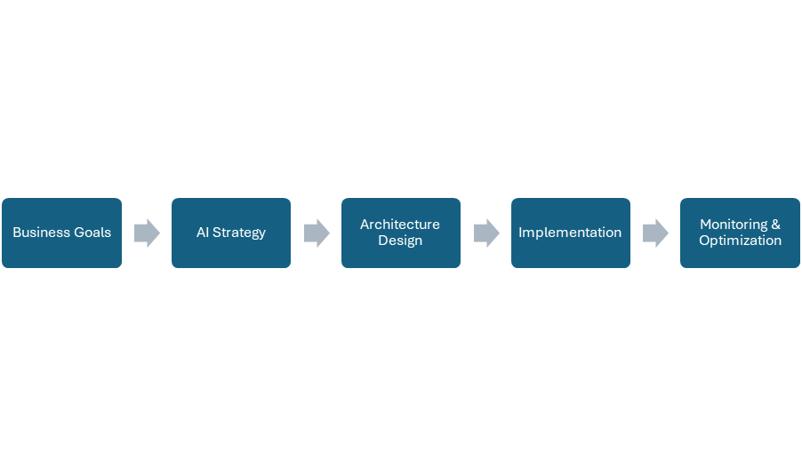
AI Transformation Framework
Notes:
The AI transformation process flows from defining business goals through strategy, design, implementation, and ongoing monitoring and optimization.
https://learn.microsoft.com/en-us/azure/cloud-adoption-framework/scenarios/ai/

Slide 14
Best Practices for AI Architects
• Start with business outcomes focusing on measurable impact.
• Adopt modular design for flexibility and scalability.
• Prioritize Responsible AI principles: fairness, transparency, accountability.
• Collaborate across teams: data scientists, developers, business leaders.
• Leverage Azure AI services for speed and reliability.
Notes:
Effective AI architecture involves outcome-driven design, modularity, responsible AI, cross-team collaboration, and use of Azure AI services.

Slide 15
Scaling AI Across the Enterprise
• Automation to streamline deployment and monitoring.
• Standardization using common frameworks and tools.
• Continuous learning enabling models to evolve with new data.
• User training to foster a culture of continuous learning.
Notes:
Scaling AI requires automation, standardization, continuous model learning, and user training to embed AI capabilities enterprise-wide.

Slide 16
References
• https://info.microsoft.com/ww-landing-Azure-Data-and-Architect-Handbook.html
• https://www.microsoft.com/en-us/ai?msockid=1e655f68c35d65753a8c49b1c22864c2
• https://learn.microsoft.com/en-us/training/modules/scale-ai/2-unlock-ai-value
Notes:
Additional resources for AI architecture and scaling AI in enterprises.

Slide 17
Knowledge check
Question 1
Which responsibility ensures AI initiatives align with business priorities?
a) Integration
b) Vision & Roadmap
c) Performance Monitoring
d) Data Architecture
Notes:
Discussion Question: How can architects ensure Responsible AI principles are embedded in enterprise solutions?
Answer: b) Vision & Roadmap

Slide 18
Unit: Overview of Microsoft AI Technologies

Slide 19
Learning objectives
• Identify core Microsoft AI services and tools
• Understand SDKs and development environments for Azure AI
• Explore Microsoft Copilot solutions and their business value
• Identify core Microsoft AI technologies and their role in business solutions
• Explain how AI technologies create business value
• Understand how generative AI unlocks productivity in enterprise environments
Notes:
These objectives cover understanding Microsoft AI services, tools, SDKs, Copilot solutions, and their impact on business productivity and value.

Slide 20
Overview
• Microsoft AI technologies empower organizations to build intelligent solutions
• Enhance productivity, improve decision-making, and deliver measurable business value
• Introduces key Azure AI services, development tools, and Copilot solutions
• Tools help businesses innovate, automate, and scale processes
• Support measurable outcomes and enhanced collaboration
Notes:
This unit covers the foundational concepts and components of Microsoft AI technologies and their role in business solutions.

Slide 21
Core Components of Microsoft AI Technologies
• Azure AI Services: Cognitive Services, Azure Machine Learning, Azure OpenAI Service, Azure Foundry
• Tools and SDKs: Azure Machine Learning Studio, SDKs, APIs, CLI, REST APIs
• Microsoft Copilot Solutions: Embedded AI in Microsoft 365 and Dynamics 365
• Copilot automates tasks, generates content, and provides actionable insights
• Enhances productivity across business processes
Notes:
Key components include Azure AI services for AI model development and deployment, tools for integration, and Copilot solutions for productivity enhancement.

Slide 22
Phase-by-phase guidance
Phase | Goals | Key activities | Outputs
Azure AI Services | Provide AI capabilities via APIs and platforms | Develop, train, deploy AI models; access generative AI | Prebuilt APIs, ML models, generative AI services
Tools and SDKs | Enable AI integration and automation | Use SDKs, APIs, CLI, REST APIs for development and workflows | Visual interfaces, multi-language SDKs, automation tools
Copilot Solutions | Embed AI to enhance productivity | Automate tasks, generate content, provide insights | Improved business process efficiency and insights
Notes:
This table summarizes the phases of Microsoft AI technologies, their goals, key activities, and expected outputs.

Slide 23
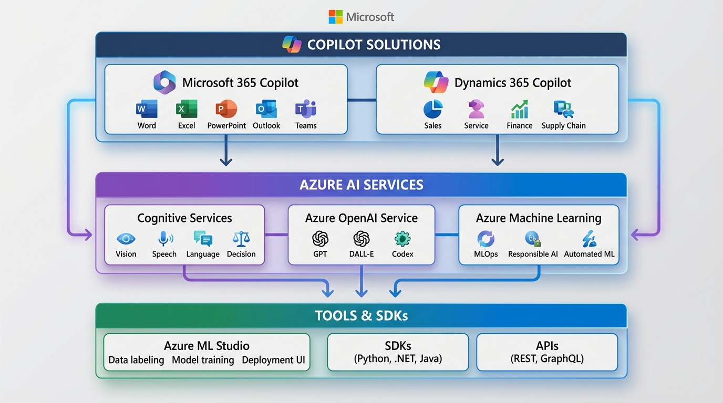
Microsoft AI Ecosystem
Notes:
Visual representation of the Microsoft AI Ecosystem layers to illustrate the integration of Copilot solutions, Azure AI services, and development tools.
Prompt: Layered diagram of Microsoft AI Ecosystem with Microsoft brand colors showing Top Layer: Copilot Solutions (Microsoft 365, Dynamics 365), Middle Layer: Azure AI Services (Cognitive Services…

Slide 24
Best Practices for Business Value
• Start with measurable business outcomes
• Implement AI responsibly: fairness, reliability, safety, privacy, security, inclusiveness, transparency, accountability
• Leverage cloud scalability for enterprise-wide adoption
Notes:
Adopting AI technologies requires focus on measurable outcomes and responsible implementation to maximize business value.

Slide 25
References
• https://learn.microsoft.com/en-us/training/modules/prepare-azure-ai-development/3-azure-ai-services
• https://learn.microsoft.com/en-us/training/modules/prepare-azure-ai-development/5-tools-and-sdks
• https://learn.microsoft.com/en-us/training/modules/business-value-microsoft-copilot-solutions/2-explore-copilot-solutions
• https://www.microsoft.com/en-us/ai?msockid=1e655f68c35d65753a8c49b1c22864c2
• https://learn.microsoft.com/en-us/training/modules/generative-ai-productivity/
• https://learn.microsoft.com/en-us/training/modules/create-business-value/
Notes:
Useful URLs for further learning and reference on Microsoft AI technologies and business value.

Slide 26
Knowledge check
Question 1
Which service provides prebuilt APIs for vision and speech?
a) Azure Machine Learning
b) Cognitive Services
c) Microsoft Copilot
d) Power BI
Notes:
Knowledge check questions to assess understanding of Microsoft AI services and Copilot solutions' impact on productivity. --- Answer: b) Cognitive Services

Slide 27
Knowledge check
Discussion
How can Copilot solutions improve productivity in business processes? Provide two examples.
Notes:
Knowledge check questions to assess understanding of Microsoft AI services and Copilot solutions' impact on productivity.

Slide 28
Unit: Identify Out-of-the-Box (OOB) Microsoft AI Agent Resources

Slide 29
Learning objectives
• Identify OOB Microsoft AI agent resources available for business solutions.
• Understand how these resources accelerate AI adoption and integration.
• Explore tools and practices for leveraging AI agents effectively.

Slide 30
Overview
• Microsoft offers out-of-the-box AI agent resources to accelerate AI implementation.
• Resources include prebuilt agents, templates, and tools integrated with Azure AI and Copilot Studio.
• These agents reduce development time, ensure compliance, and enable enterprise scalability.
Notes:
Microsoft provides a range of out-of-the-box AI agent resources designed to help organizations quickly implement AI capabilities without starting from scratch. These resources include prebuilt agents, templates, and tools that integrate seamlessly with Microsoft platforms like Azure AI and Copilot Studio. Out-of-the-box AI agents reduce development time, ensure compliance with best practices, and enable scalability across enterprise environments.

Slide 31
Key Components of OOB AI Agent Resources
• Prebuilt AI Agents available via Copilot Studio, Dynamics 365, and Microsoft 365.
• AI Tools and Practices including Azure AI Services, Azure Machine Learning, and OpenAI Service.
• Templates and Scenario Libraries for custom agents and business process automation.
Notes:
1. Prebuilt AI Agents: Available through Microsoft Copilot Studio and integrated into Dynamics 365 and Microsoft 365. Designed for common business scenarios such as customer service, sales automation, and workflow optimization. 2. AI Tools and Practices: Azure AI Services (Vision, Speech, Language, Decision APIs), Azure Machine Learning (build, train, deploy models), OpenAI Service (generative AI for natural language tasks). 3. Templates and Scenario Libraries: Ready-to-use templates for creating custom agents and scenario libraries for business process automation and adoption strategies.

Slide 32
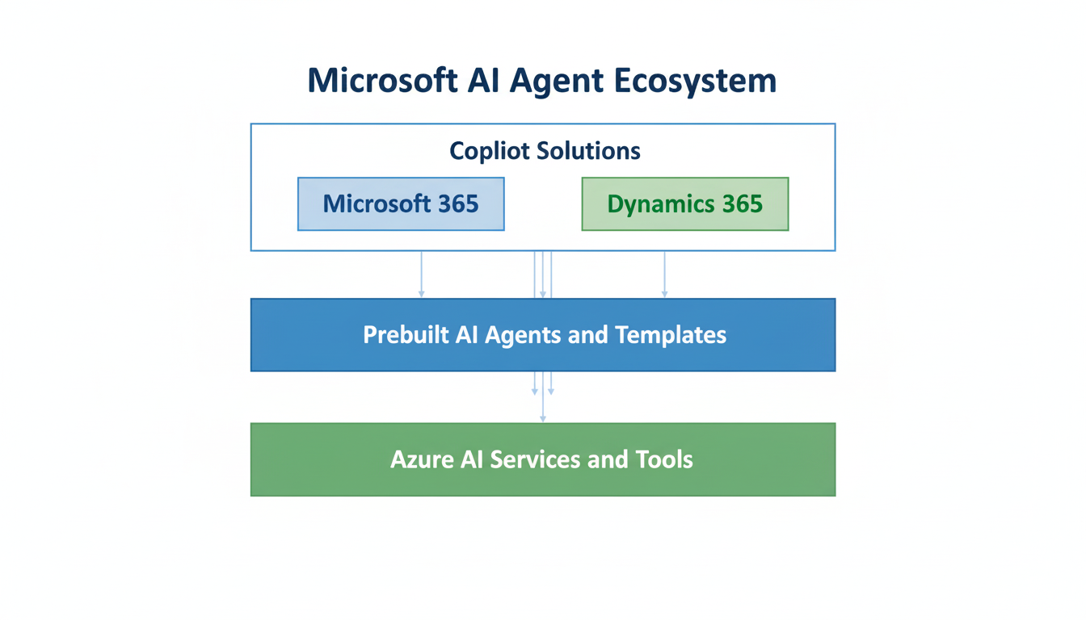
Microsoft AI Agent Ecosystem
Notes:
Visual diagram illustrating the Microsoft AI Agent Ecosystem with three layers: Top Layer - Copilot Solutions (Microsoft 365, Dynamics 365), Middle Layer - Prebuilt AI Agents and Templates, Bottom Layer - Azure AI Services and Tools.
Prompt: Layered diagram showing Microsoft AI Agent Ecosystem with top layer as Copilot Solutions (Microsoft 365, Dynamics 365), middle layer as Prebuilt AI Agents and Templates, bottom layer as Azu…

Slide 33
Best Practices
• Start with business outcomes before selecting tools.
• Use prebuilt agents for quick deployment.
• Ensure responsible AI principles: Fairness, Reliability and Safety, Privacy and Security, Inclusiveness, Transparency, Accountability.
• Leverage Azure AI for scalability and compliance.
Notes:
Best practices emphasize starting with business outcomes, using prebuilt agents for speed, adhering to responsible AI principles, and leveraging Azure AI for scalability and compliance.

Slide 34
Knowledge check
Question 1
Which Microsoft resource provides prebuilt AI agents for business workflows?
A) Azure Machine Learning
B) Copilot Studio
C) Power BI
D) GitHub Copilot
Notes:
Question 1 is multiple choice with correct answer B) Copilot Studio.

Slide 35
Knowledge check
Discussion
How can prebuilt AI agents accelerate AI adoption in your organization? Provide two examples.
Notes:
Question 2 is a discussion prompt to explore examples of how prebuilt AI agents accelerate AI adoption.

Slide 36
References
• https://www.microsoft.com/en-us/ai/tools-practices
• https://learn.microsoft.com/en-us/training/azure-ai
Notes:
References for further reading on Microsoft AI tools and practices.

Slide 37
Unit: Identify Out-of-the-Box (OOB) Microsoft AI Agents

Slide 38
Learning objectives
• Explain what OOB Microsoft AI Agents are and their role in business process automation
• Identify pre-built AI agents available in Microsoft Copilot Studio
• Understand how templates and scenario libraries accelerate AI adoption
• Explore best practices for leveraging AI agents responsibly and effectively

Slide 39
Overview
• Microsoft provides Out-of-the-Box (OOB) AI Agents to integrate AI quickly into workflows
• Agents automate common business processes, improve efficiency, and ensure compliance
• Designed to help organizations avoid starting AI projects from scratch

Slide 40
Core Concepts
• OOB AI Agents are pre-built agents and templates in Microsoft Copilot Studio and Microsoft 365
• Designed for scenarios like customer service automation, workflow optimization, and data-driven decision-making
• Benefits include faster deployment, scalability with Microsoft 365 and Dynamics 365, and compliance with Responsible AI standards

Slide 41
Key Resources
• Copilot Studio: Explore and customize pre-built AI agents
• Templates: Use fundamentals to create tailored AI solutions
• Scenario Library: Access adoption guides and best practices for enterprise AI

Slide 42
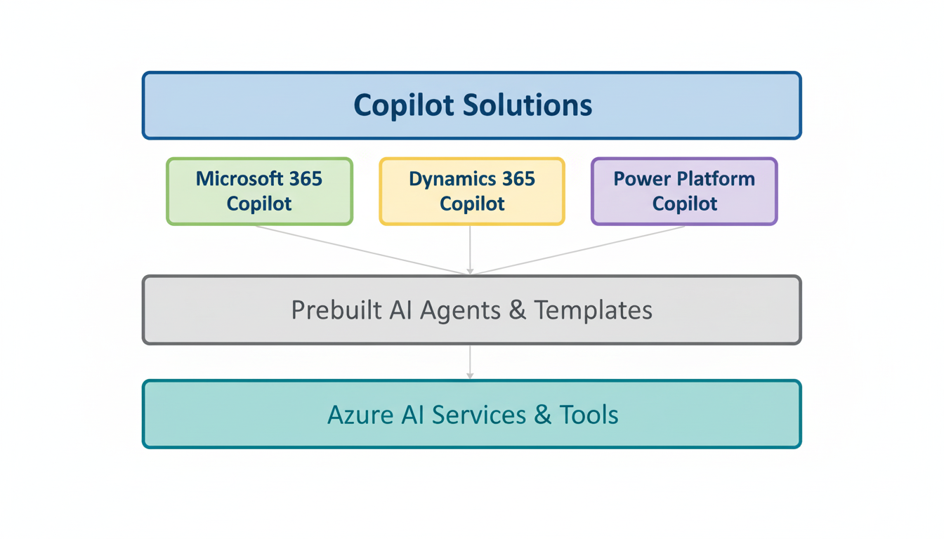
Microsoft AI Agent Ecosystem
Notes:
Use this layered diagram in PowerPoint for classroom delivery to illustrate the ecosystem structure.
Prompt: Layered diagram showing Microsoft AI Agent Ecosystem with top layer: Copilot Solutions (Microsoft 365, Dynamics 365, Power Platform), middle layer: Prebuilt AI Agents & Templates, bottom la…

Slide 43
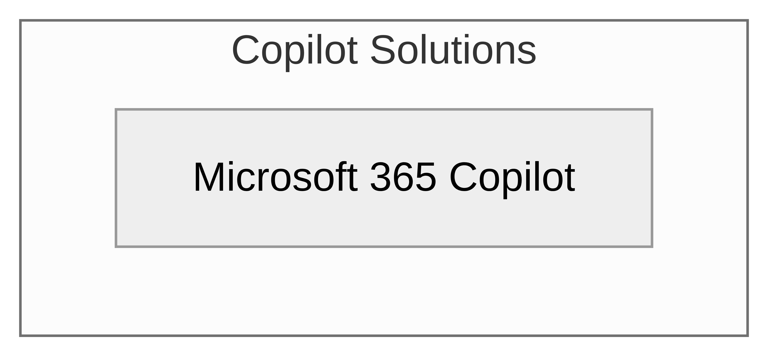
Microsoft AI Agent Ecosystem (Mermaid)
Notes:
Prompt: Layered diagram showing Microsoft AI Agent Ecosystem with top layer: Copilot Solutions (Microsoft 365, Dynamics 365, Power Platform), middle layer: Prebuilt AI Agents & Templates, bottom la…

Slide 44
OOB AI Agent Resources
• Prebuilt Agents: Automate common business workflows
• Copilot Studio: Customize and deploy AI agents
• Azure AI Services: Vision, Speech, Language, Decision-making capabilities
• Scenario Library: Best practices and adoption guides

Slide 45
Best Practices
• Start with business outcomes before selecting tools
• Use prebuilt agents for quick deployment
• Ensure Responsible AI principles: Fairness, Reliability and Safety, Privacy and Security, Inclusiveness, Transparency, Accountability
• Leverage Azure AI for scalability and compliance

Slide 46
References
• https://www.microsoft.com/en-us/microsoft-copilot/blog/copilot-studio/explore-agents-pre-built-for-you-in-microsoft-copilot-studio/?msockid=1e655f68c35d65753a8c49b1c22864c2
• https://www.microsoft.com/en-us/dynamics-365/blog/business-leader/2024/10/21/transform-work-with-autonomous-agents-across-your-business-processes/
• https://learn.microsoft.com/en-us/microsoft-copilot-studio/template-fundamentals
• https://adoption.microsoft.com/en-us/scenario-library/
• https://adoption.microsoft.com/en-us/ai-agents/agents-in-microsoft-365/
• https://learn.microsoft.com/en-us/power-apps/maker/canvas-apps/ai-overview

Slide 47
Knowledge check
Question 1
Which Microsoft resource provides prebuilt AI agents for business workflows?
a) Azure Machine Learning
b) Copilot Studio
c) Power BI
d) GitHub Copilot
Notes:
Answer: b) Copilot Studio --- Discussion Question: How can prebuilt AI agents accelerate AI adoption in an organization? Provide two examples.

Slide 48
Unit: Knowledge Checks

Slide 49
Knowledge check
Question 1
Which of the following best describes the primary role of an architect in AI transformation for businesses?
a) Developing machine learning models
b) Bridging business strategy and technical implementation
c) Managing IT support tickets
d) Designing user interfaces
Notes:
Answer: b) Bridging business strategy and technical implementation --- What is a key responsibility of an AI architect to ensure AI solutions are effective and aligned with business priorities?

Slide 50
Knowledge check
Question 1
What is a key responsibility of an AI architect to ensure AI solutions are effective and aligned with business priorities?
a) Defining the AI adoption vision and roadmap
b) Writing code for AI models
c) Building physical servers
d) Conducting end-user training only
Notes:
Answer: a) Defining the AI adoption vision and roadmap --- Which best practice should architects follow to scale AI across the enterprise?

Slide 51
Knowledge check
Question 1
Which best practice should architects follow to scale AI across the enterprise?
a) Focus solely on technology upgrades
b) Adopt modular and flexible design principles
c) Avoid collaboration with business leaders
d) Implement AI without considering responsible AI principles
Notes:
Answer: b) Adopt modular and flexible design principles

