Slide 1


Gennoor Tech
train. innovate. build.

Slide 2


We empower enterprises to
harness AI at scale.
From strategy to deployment — Gennoor Tech delivers
AI training, consulting, and production-grade solutions
for multinational companies worldwide.

Slide 3



What We Do
AI Training
AI Consulting
AI Solutions
Custom programs for
enterprise teams across
Azure AI, Copilot Studio
& Power Platform
Strategy, architecture
and roadmap for
AI transformation
in BFSI & Government
Production agentic AI,
MCP servers, RAG
pipelines & intelligent
automation

Slide 4
Core Expertise
AI & Generative AI
Certifications
Azure OpenAI · GPT-4o · Claude (Anthropic) · Google Gemini · Llama · Mistral · Ollama · Hugging Face
AB-100 Agentic AI
AI-102
Agentic AI Frameworks
AZ-400
AZ-204
LangChain · LangGraph · CrewAI · AutoGen · Semantic Kernel · MS Agent Framework · MCP Servers
AZ-305
DP-100
Cloud AI — Azure
Azure AI Foundry · Azure AI Search · Azure ML · Azure OpenAI · Cognitive Services · Document Intelligence
PL-300
PL-400
Cloud AI — AWS & GCP
PL-200
GH-900
Amazon Bedrock · SageMaker · Lex · Comprehend · Google Vertex AI · Gemini API · Cloud AutoML
GH-300
AI-900
Copilot & Productivity AI
Applied Skills
M365 Copilot · Copilot Studio · GitHub Copilot · Claude Code · Claude Cowork · Cursor · Power Platform
AI Agents (Azure)
Custom Copilots
MLOps & DevOps
Semantic Kernel
Doc Intelligence
Azure ML Pipelines · MLflow · Docker · GitHub Actions · Azure DevOps · CI/CD · Weights & Biases
NLP & Vision
Generative AI
Automation & Integration
N8N · Power Automate · Logic Apps · Dataverse · FastAPI · Zapier · Make · Adaptive Cards

Slide 5
Microsoft AI & Cloud Stack
Azure AI & ML
Copilot Ecosystem
Power Platform & DevOps
Azure OpenAI Service
Microsoft 365 Copilot
Power Apps
Azure AI Foundry
Microsoft Copilot Studio
Power Automate
Azure AI Search (RAG)
GitHub Copilot
Power BI
Azure ML Pipelines
Copilot Agent Builder
Dataverse
Azure Cognitive Services
Semantic Kernel
Power Pages
Document Intelligence
MS Agent Framework
Azure DevOps
Azure Bot Service
Adaptive Cards
GitHub Actions
Content Safety
Azure AI Agent Service
CI/CD Pipelines
Speech & Vision APIs
Copilot for Sales/Service
ALM & Managed Envs
MLflow on Azure
Teams AI Library
Logic Apps

Slide 6
Amazon Web Services
Google Cloud Platform
Generative AI
Generative AI
Amazon Bedrock · Titan Models · PartyRock
Vertex AI · Gemini API · Imagen · PaLM
ML & Training
ML & Training
SageMaker · SageMaker Studio · Autopilot
AutoML · Vertex AI Pipelines · TensorFlow on GCP
NLP & Conversation
NLP & Conversation
Amazon Lex · Comprehend · Transcribe · Translate
Dialogflow CX · Natural Language API · Translation
Vision & Media
Vision & Data
Rekognition · Textract · Personalize
Vision AI · Document AI · BigQuery ML
Infrastructure
Infrastructure
Lambda · S3 · EC2 (GPU) · Step Functions
Cloud Functions · Cloud Run · GKE (GPU) · Pub/Sub

Slide 7
Open Source & ML Ecosystem
Community-driven AI tools we train, build, and deploy with
Machine Learning
Generative AI & LLMs
Agentic AI & RAG
Dev Tools & Infra
Scikit-learn
Hugging Face
LangChain
FastAPI
TensorFlow
Ollama
LangGraph
Streamlit
PyTorch
LM Studio
CrewAI
Gradio
XGBoost
vLLM
AutoGen
Docker
Keras
Llama 3
LlamaIndex
MLflow
ONNX
Mistral
Chroma
Weights & Biases
Pandas
Qwen
FAISS
Jupyter
NumPy
Phi
Pinecone
Git
Matplotlib
GPT4All
Weaviate
N8N

Slide 8
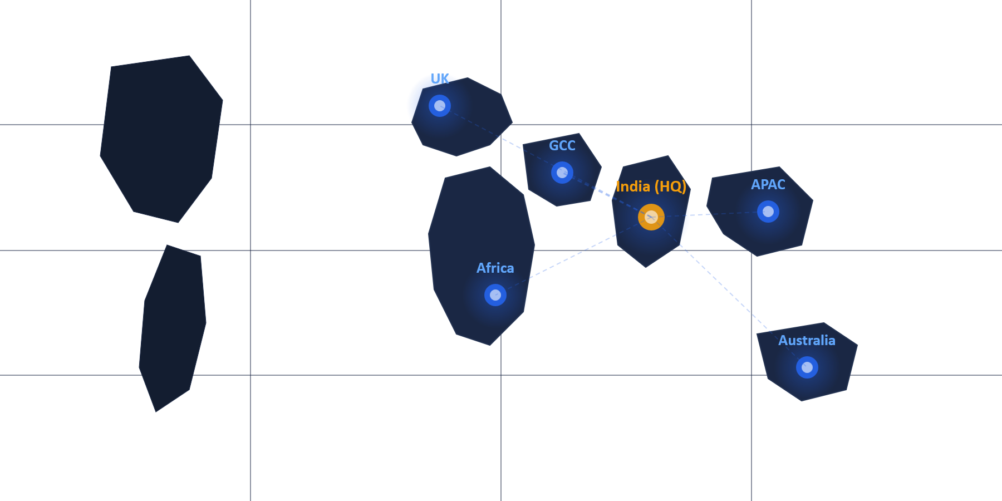







Global Delivery
Saudi Arabia
UAE
Bahrain
Tanzania
India
Australia
UK

Slide 9
Trained & Consulted For
Programs delivered to multinational companies across industries
Microsoft
EY
IBM
Boeing
MCT Partner
BFSI Programs
AI Training
Enterprise AI
Saudi Aramco
HDFC Bank
MCIT Saudi
PepsiCo
Energy & AI
Banking AI
National AI
Corp. Training
Key Engagements
→ MCIT Saudi Arabia — National AI Capacity Building
→ Bank of Tanzania — Digital Banking Transformation
→ EY BFSI — 40-Hour Agentic AI in Power Platform
→ Govt of Bahrain — Enterprise Cloud & AI Readiness

Slide 10

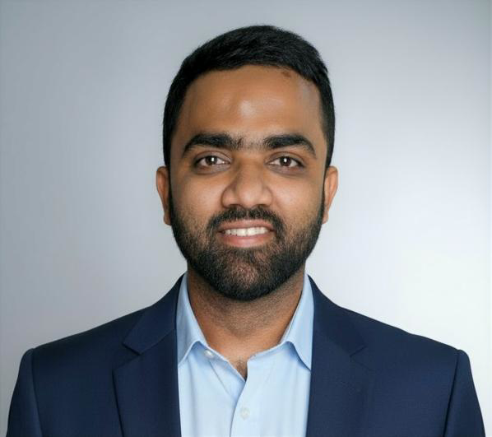
Jalal Khan
Founder & Director · Project Manager · Digital Transformation · Microsoft Certified Trainer
M.E. Mechanical Engg. (Mumbai University) · 14+ Years Experience
CEO Photo
2011
Engineering Professor — Mumbai University
(Replace with image)
2021
Senior Corporate Trainer — Koenig Solutions
2022
Microsoft Certified Trainer (MCT)
2023
Asst. Technical Manager AI — Koenig Solutions
2025
PM & AI Solution Architect — Tech Mahindra
2025
Founded Gennoor Tech Private Limited
2026
Agentic AI Business Solutions Architect
6+ Countries · 80+ Organizations · 5000+ Professionals Trained · GCC · Africa · APAC

Slide 11

From CEO’s Desk
Transforming how enterprises adopt, implement, and scale AI
60%
40%
95%
50+
Faster RFP Response
via Azure OpenAI PoC
Accelerated AI
Adoption Rate
Client Satisfaction
Across Programs
C-Suite Leaders
Trained (MCIT & SADAI Saudi)
5000+
80+
8
14+
Professionals Upskilled
Programs Delivered
Open-Source AI Tools
Active Certifications

Slide 12
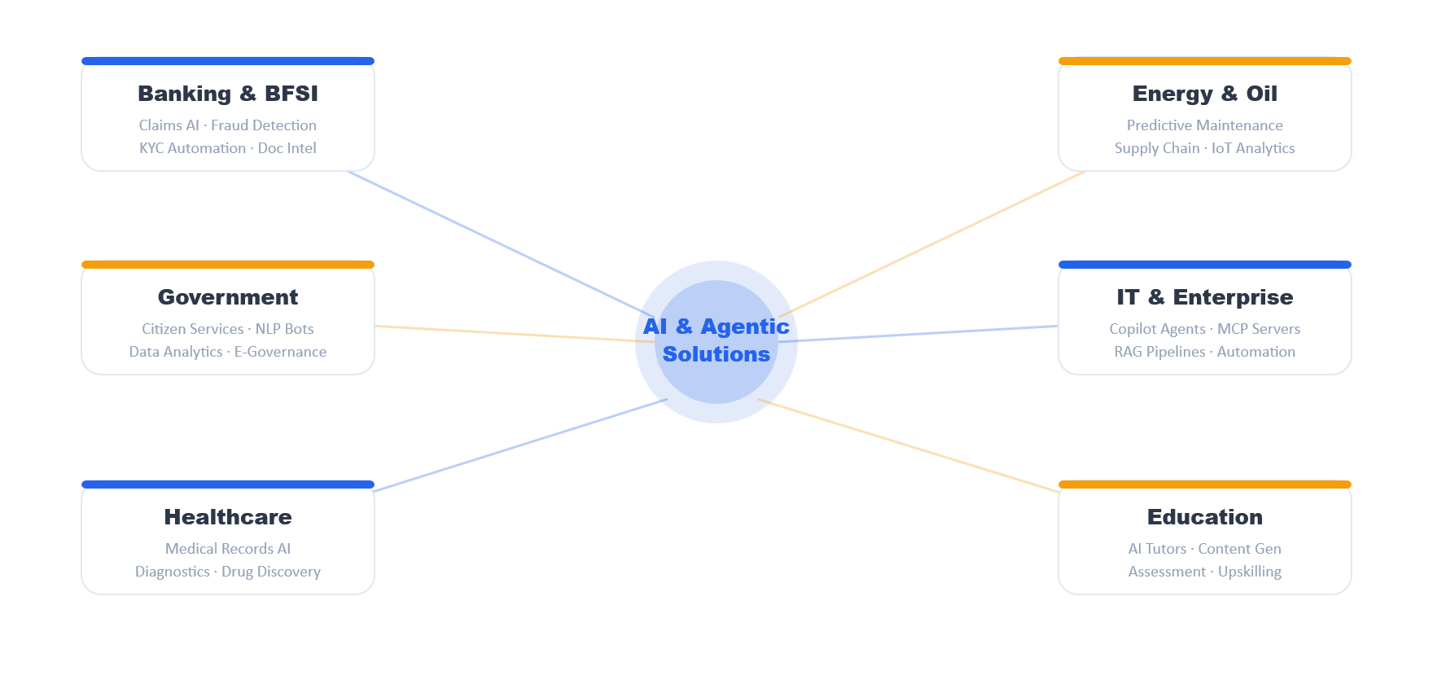
Where We Can Help
AI & Agentic AI Solutions Across Industries

Slide 13

Gennoor Tech
Let's Build the Future Together
🌐 www.gennoor.com
✉ enquiry@gennoor.com
📱 +91 9326 352 241
🔗 linkedin.com/company/gennoor-tech-private-limited
▶ YouTube — @GennoorTech

