Slide 1
DEEP LEARNING · CHAPTER 5
How transformers turn
context into the next token
context
weights
A visual briefing on the machinery behind modern language models
next token
SOURCE · 00:23
Notes:
[Sources]
- https://www.youtube.com/watch?v=wjZofJX0v4M&t=23s
- Evidence: ev-001
- Transcript: tr-00007, tr-00008, tr-00009, tr-00010
[/Sources]

Slide 2
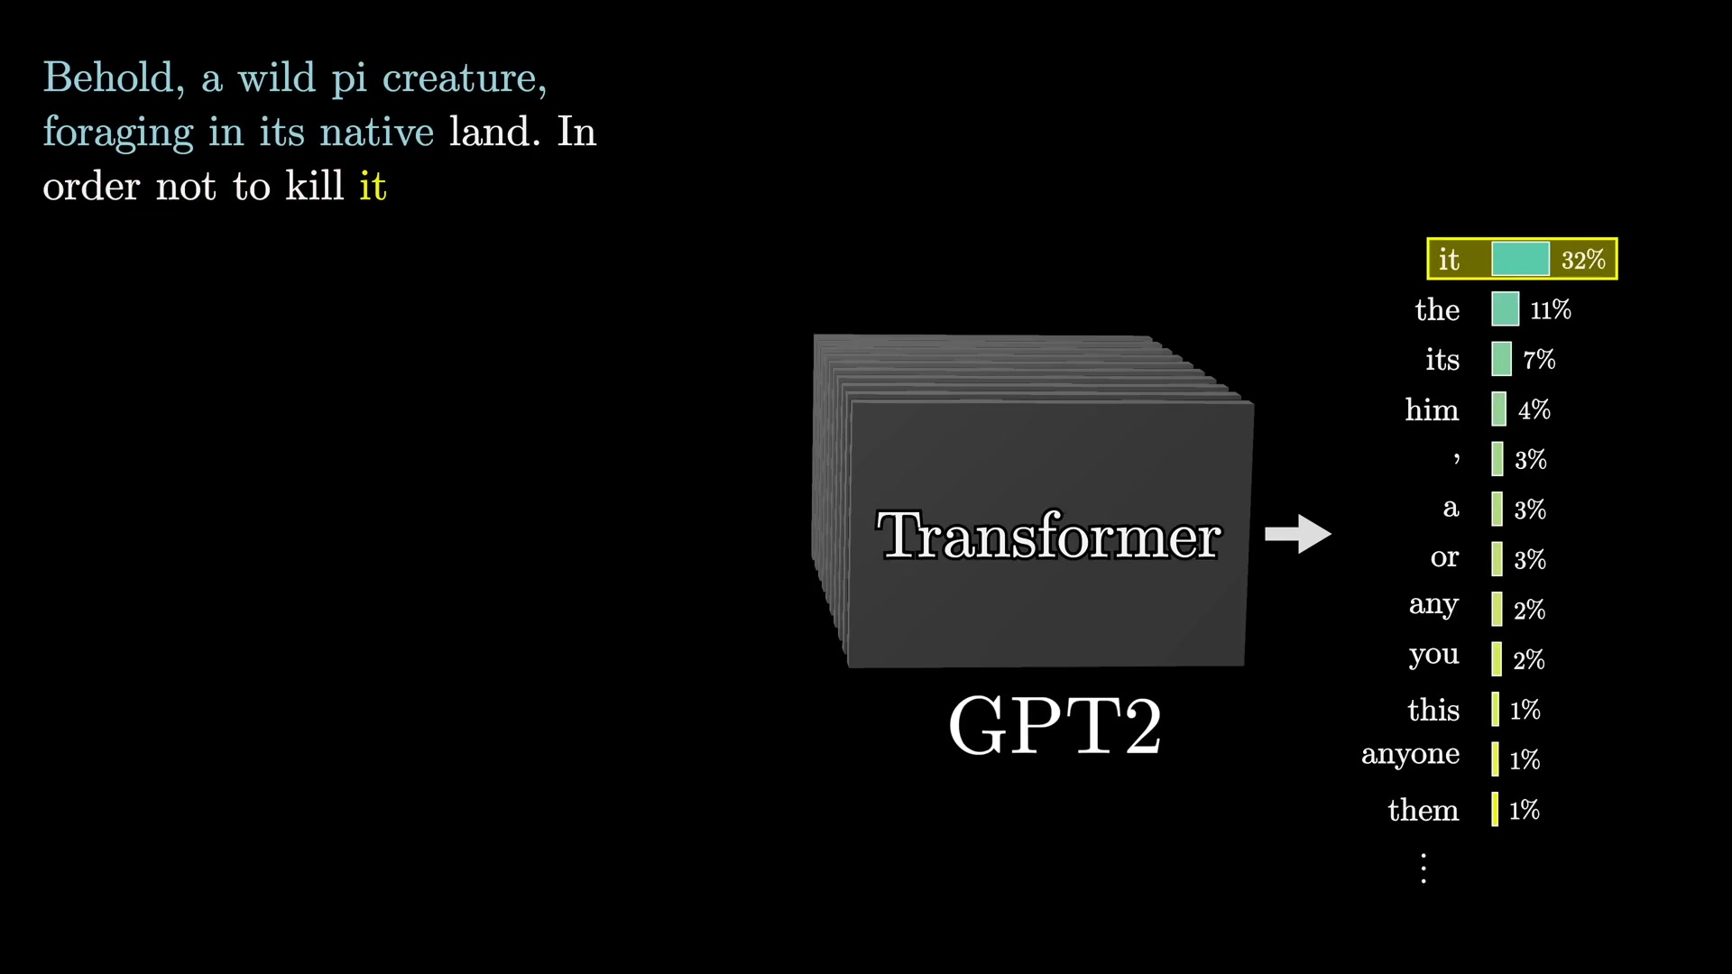
THE BEHAVIOR
02
Generation is a loop: predict, sample, append, repeat
A next-token predictor becomes a text generator by feeding its own sampled output back into the prompt.
01
Predict a distribution
02
Sample one token
03
Append it
04
Run the model again
SOURCE FRAME • 02:20
ONE TOKEN AT A TIME
3BLUE1BROWN · TRANSFORMERS
2 / 13
Notes:
[Sources]
- https://www.youtube.com/watch?v=wjZofJX0v4M&t=98s
- Evidence: ev-002
- Transcript: tr-00026, tr-00027, tr-00030, tr-00033, tr-00034, tr-00035, tr-00044, tr-00045, tr-00046, tr-00047
- Frame: fr-00012
[/Sources]

Slide 3
INSIDE THE MODEL
03
A transformer is a four-stage data pipeline
Text enters as discrete tokens and leaves as a probability distribution over what comes next.
02
01
03
04
Attention
Embedding
Unembed
Softmax
→
⇄
→
tokens exchange context
tokens → vectors
vector → logits
logits → probability
repeated with MLP blocks
Attention and MLP blocks repeat; normalization steps are omitted in this high-level view.
3BLUE1BROWN · TRANSFORMERS
3 / 13
Notes:
[Sources]
- https://www.youtube.com/watch?v=wjZofJX0v4M&t=183s
- Evidence: ev-003
- Transcript: tr-00055, tr-00056, tr-00060, tr-00065, tr-00066, tr-00075, tr-00077, tr-00089, tr-00090, tr-00093, tr-00094, tr-00095
[/Sources]

Slide 4
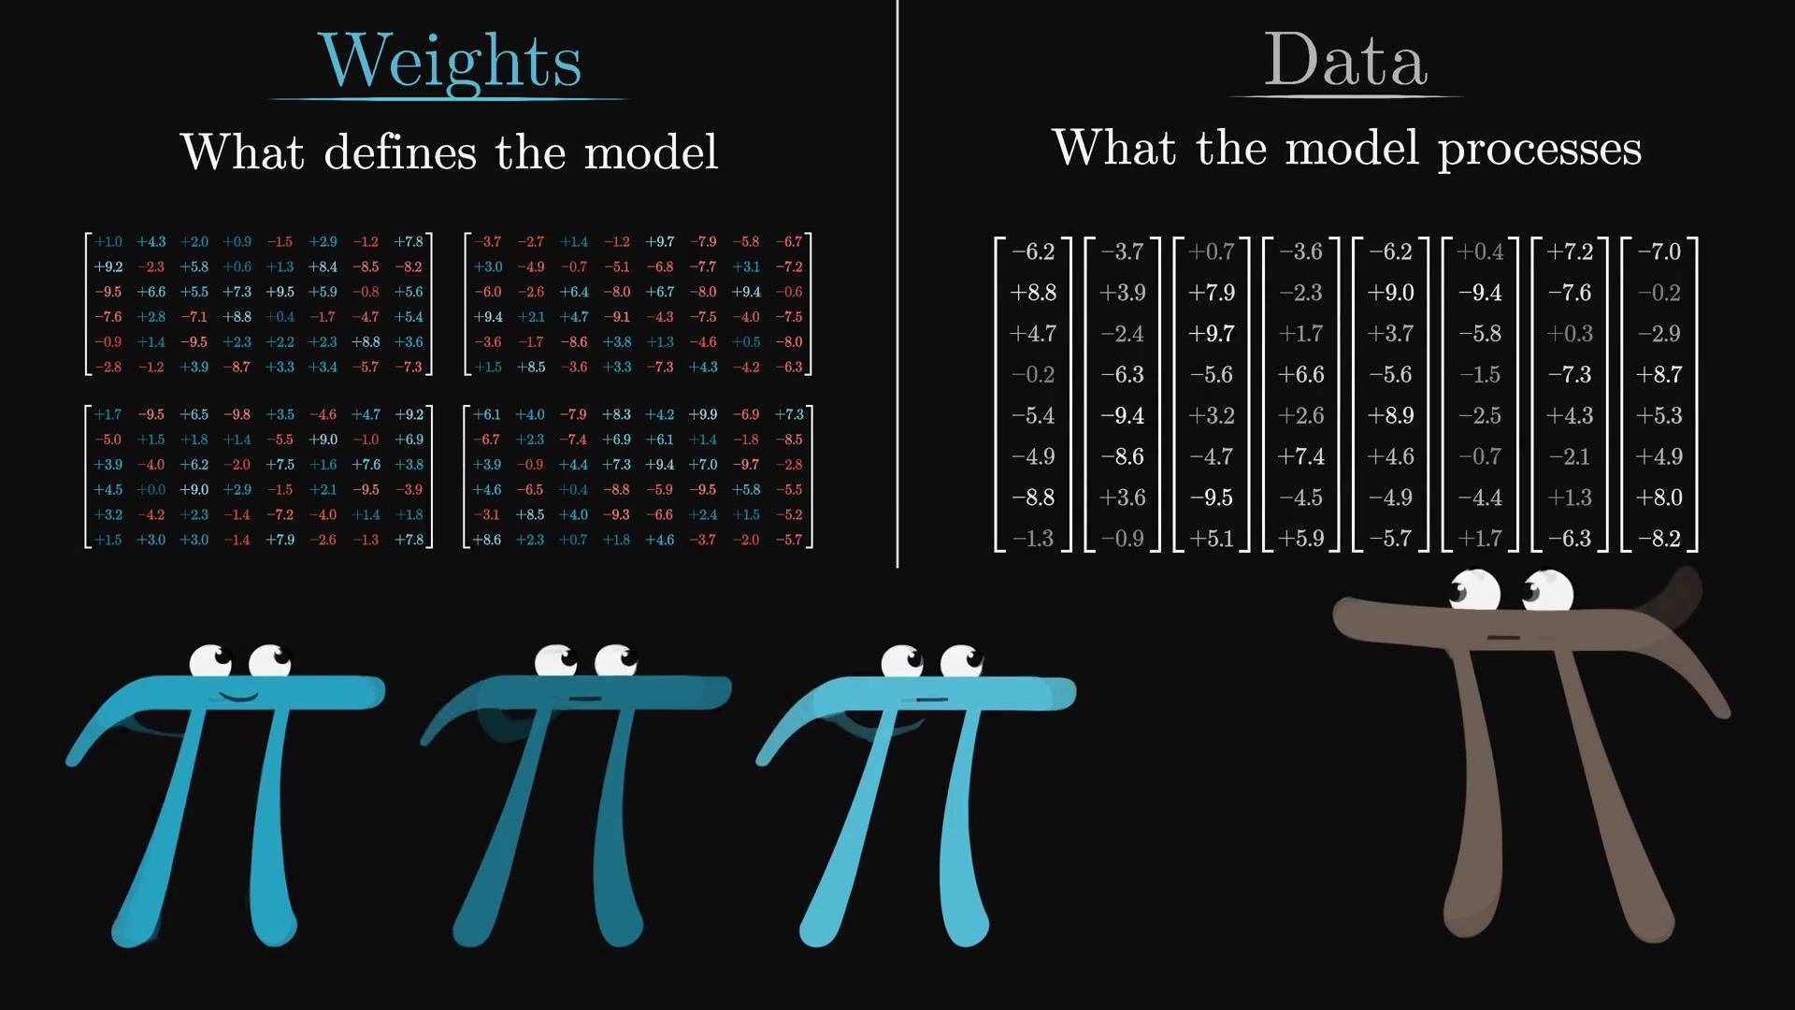
THE FOUNDATION
04
Deep learning turns data into trainable matrix operations
TWO THINGS TO KEEP SEPARATE
WEIGHTS
Learned during training.
They determine behavior.
DATA
The current input.
It changes on every run.
SOURCE FRAME • 12:27
Almost all computation looks like matrix × vector multiplication.
3BLUE1BROWN · TRANSFORMERS
4 / 13
Notes:
[Sources]
- https://www.youtube.com/watch?v=wjZofJX0v4M&t=449s
- Evidence: ev-004
- Transcript: tr-00136, tr-00139, tr-00141, tr-00142, tr-00165, tr-00166, tr-00169, tr-00175, tr-00177, tr-00182, tr-00183, tr-00202, tr-00204, tr-00207, tr-00209
- Frame: fr-00048
[/Sources]

Slide 5
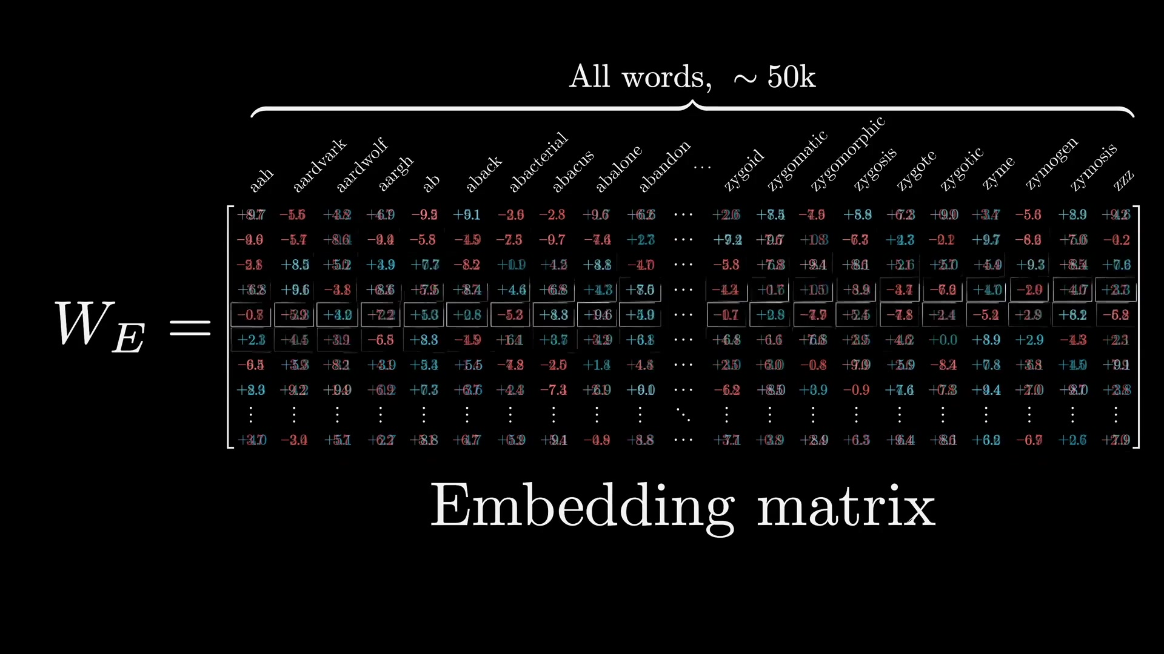
EMBEDDINGS
05
Tokenization becomes a learned vector lookup
A token selects one column from the embedding matrix.
That column is the token’s starting representation inside the model.
12,288
dimensions per GPT-3 embedding
≈ 617M
weights in the embedding matrix
SOURCE FRAME • 13:20
3BLUE1BROWN · TRANSFORMERS
5 / 13
Notes:
[Sources]
- https://www.youtube.com/watch?v=wjZofJX0v4M&t=747s
- Evidence: ev-005
- Transcript: tr-00211, tr-00212, tr-00214, tr-00215, tr-00220, tr-00221, tr-00222, tr-00223, tr-00224, tr-00225, tr-00230, tr-00234, tr-00235, tr-00298, tr-00299, tr-00301, tr-00303, tr-00304
- Frame: fr-00051
[/Sources]

Slide 6
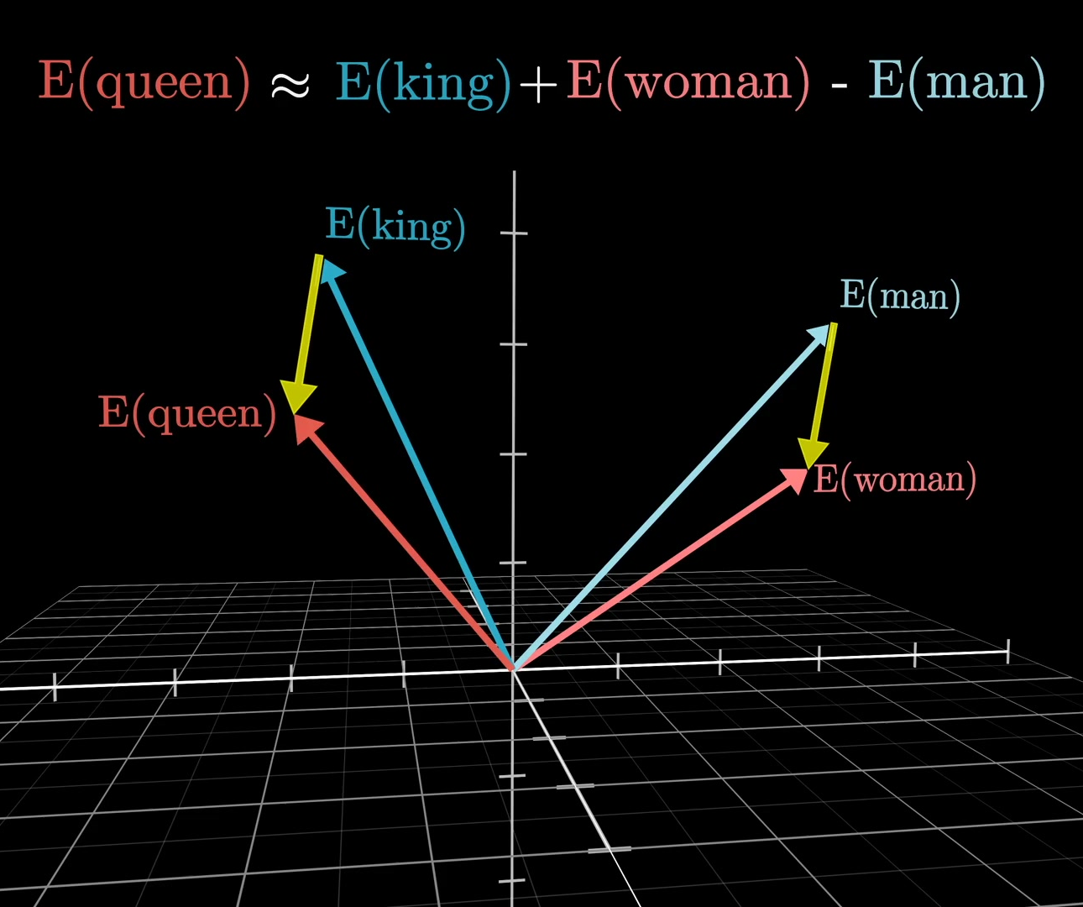
Meaning becomes
geometry
Embeddings place words in a high-dimensional space. Directions can encode relationships—but only approximately.
Analogy is intuition, not an
exact semantic law.
SOURCE · 15:32
Notes:
[Sources]
- https://www.youtube.com/watch?v=wjZofJX0v4M&t=861s
- https://www.youtube.com/watch?v=wjZofJX0v4M&t=927s
- Evidence: ev-006, ev-007
- Transcript: tr-00241, tr-00242, tr-00243, tr-00244, tr-00246, tr-00247, tr-00250, tr-00251, tr-00252, tr-00253, tr-00254, tr-00255, tr-00256, tr-00257, tr-00258, tr-00259, tr-00260, tr-00261, tr-00262, tr-00263, tr-00264
- Frame: fr-00059
[/Sources]

Slide 7
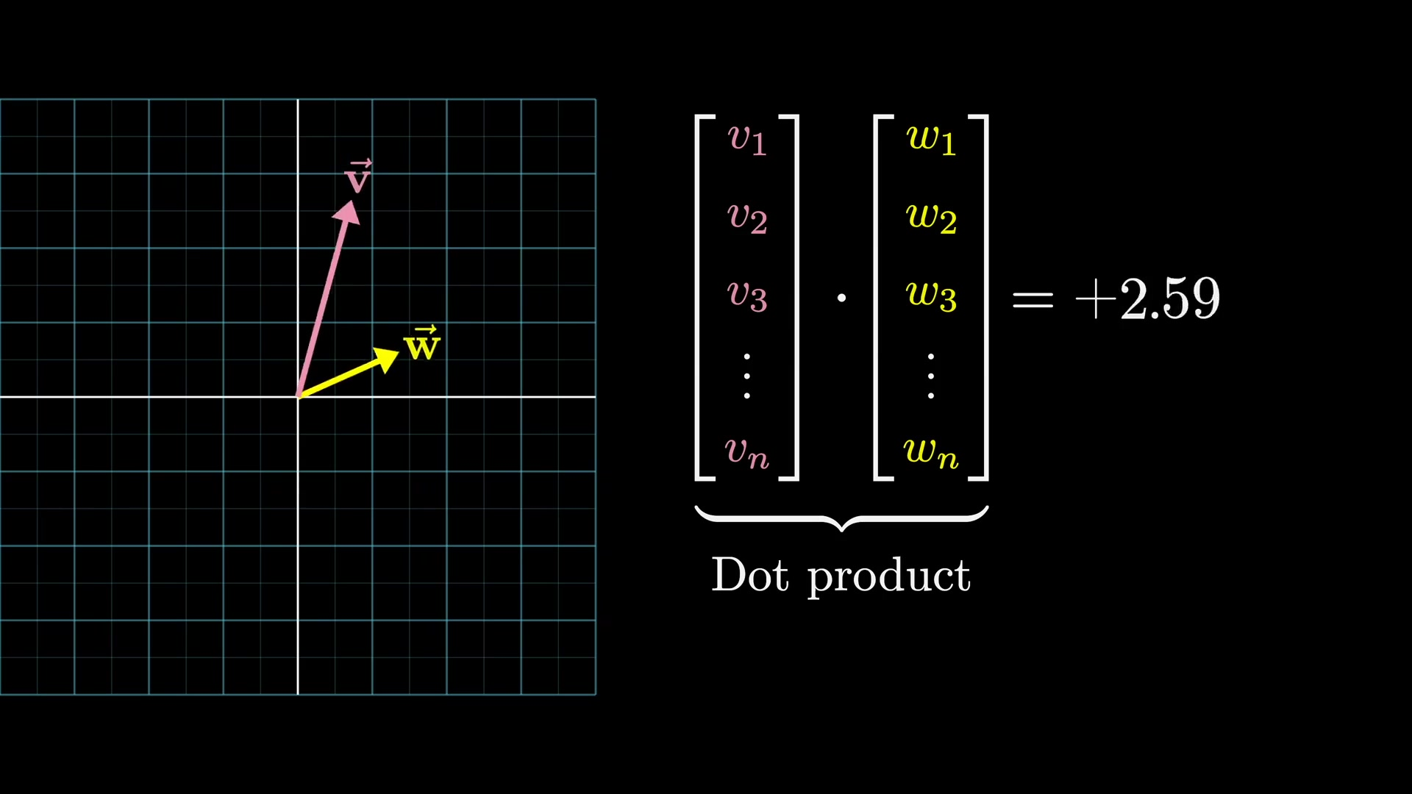
VECTOR MATH
07
Dot products turn alignment into a computable signal
v · w
Multiply corresponding components, then add the results.
+
similar direction
0
perpendicular
−
opposing direction
SOURCE FRAME • 16:40
3BLUE1BROWN · TRANSFORMERS
7 / 13
Notes:
[Sources]
- https://www.youtube.com/watch?v=wjZofJX0v4M&t=994s
- Evidence: ev-008
- Transcript: tr-00277, tr-00278, tr-00279, tr-00280, tr-00281, tr-00282, tr-00283, tr-00284, tr-00285, tr-00287, tr-00288, tr-00289, tr-00290, tr-00291, tr-00292, tr-00293, tr-00294, tr-00295, tr-00296, tr-00297
- Frame: fr-00063
[/Sources]

Slide 8
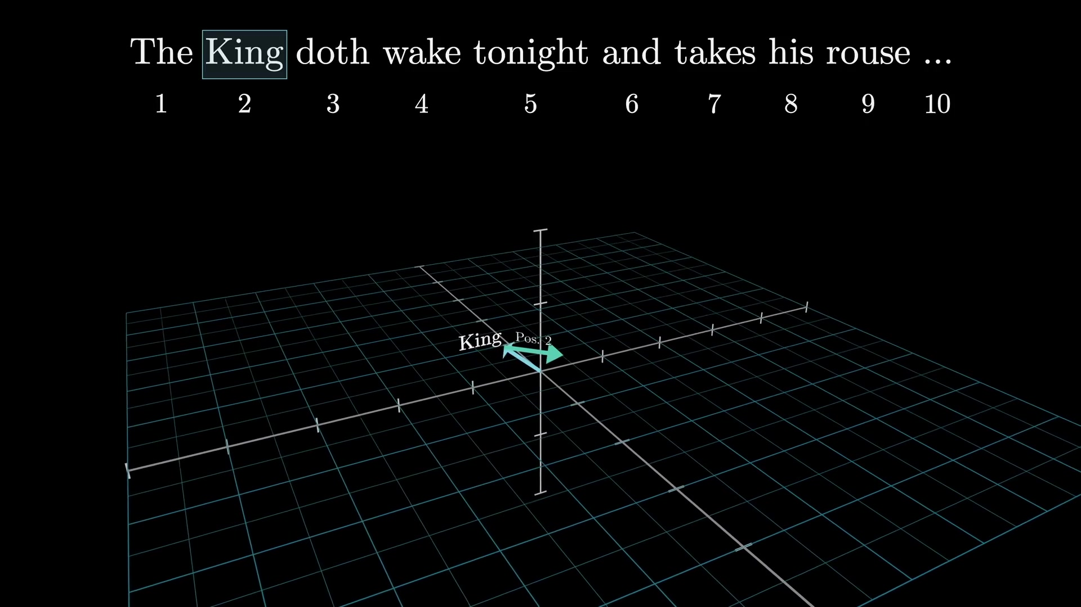
CONTEXT
08
Layers turn generic token vectors into contextual meaning
START
king
A context-free lookup from the embedding matrix.
AFTER MANY LAYERS
a Scottish king, in a specific passage
The vector absorbs information from its surroundings.
SOURCE FRAME • 18:40
3BLUE1BROWN · TRANSFORMERS
8 / 13
Notes:
[Sources]
- https://www.youtube.com/watch?v=wjZofJX0v4M&t=1105s
- Evidence: ev-009
- Transcript: tr-00307, tr-00308, tr-00311, tr-00312, tr-00313, tr-00314, tr-00315, tr-00316, tr-00317, tr-00319, tr-00320, tr-00321, tr-00322, tr-00323, tr-00324, tr-00325, tr-00326, tr-00327, tr-00328, tr-00329
- Frame: fr-00069
[/Sources]

Slide 9
CONTEXT
09
Context windows cap what the model can consider
2,048
INSIDE THE CONTEXT WINDOW
tokens in GPT-3’s training context
The
model
reads
2,048
tokens
…
Only text inside this window can shape the next prediction.
BOUNDARY
Earlier text falls outside the active window
unavailable
Outside the window → unavailable
3BLUE1BROWN · TRANSFORMERS
9 / 13
Notes:
[Sources]
- https://www.youtube.com/watch?v=wjZofJX0v4M&t=1189s
- Evidence: ev-010
- Transcript: tr-00330, tr-00331, tr-00332, tr-00333, tr-00334, tr-00335, tr-00336, tr-00337, tr-00338, tr-00339
[/Sources]

Slide 10
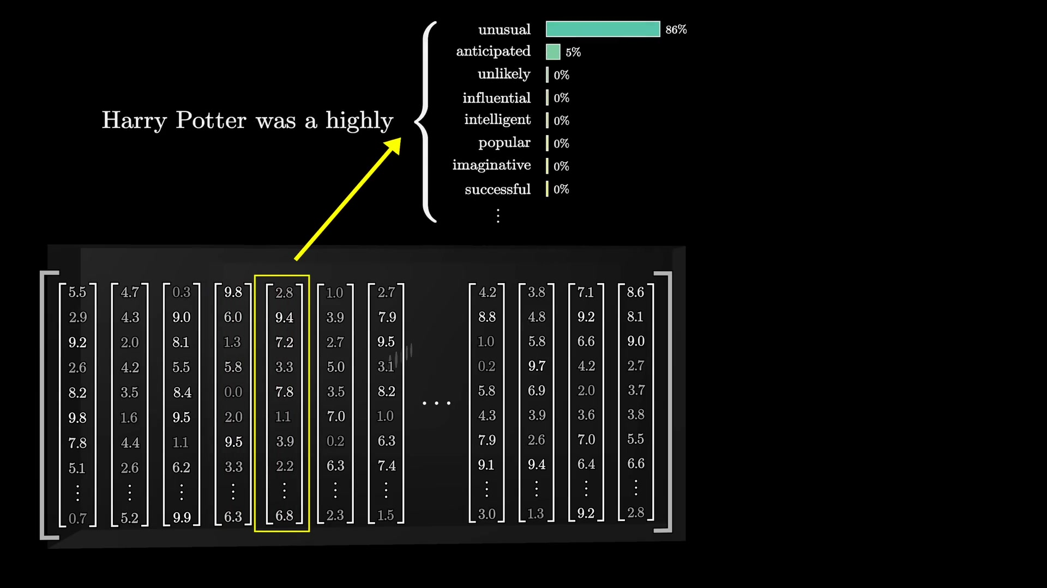
THE OUTPUT
10
Unembedding converts context into vocabulary-wide logits
THE LAST TRANSFORMATION
01
Last contextual vector
02
Multiply by Wᵤ
03
One raw score per token
04
Pass logits to softmax
SOURCE FRAME • 21:40
3BLUE1BROWN · TRANSFORMERS
10 / 13
Notes:
[Sources]
- https://www.youtube.com/watch?v=wjZofJX0v4M&t=1229s
- Evidence: ev-011
- Transcript: tr-00342, tr-00343, tr-00344, tr-00345, tr-00346, tr-00348, tr-00349, tr-00350, tr-00351, tr-00352, tr-00353, tr-00354, tr-00358, tr-00359, tr-00360, tr-00363, tr-00364, tr-00365, tr-00366, tr-00367, tr-00368, tr-00369, tr-00370
- Frame: fr-00079
[/Sources]

Slide 11
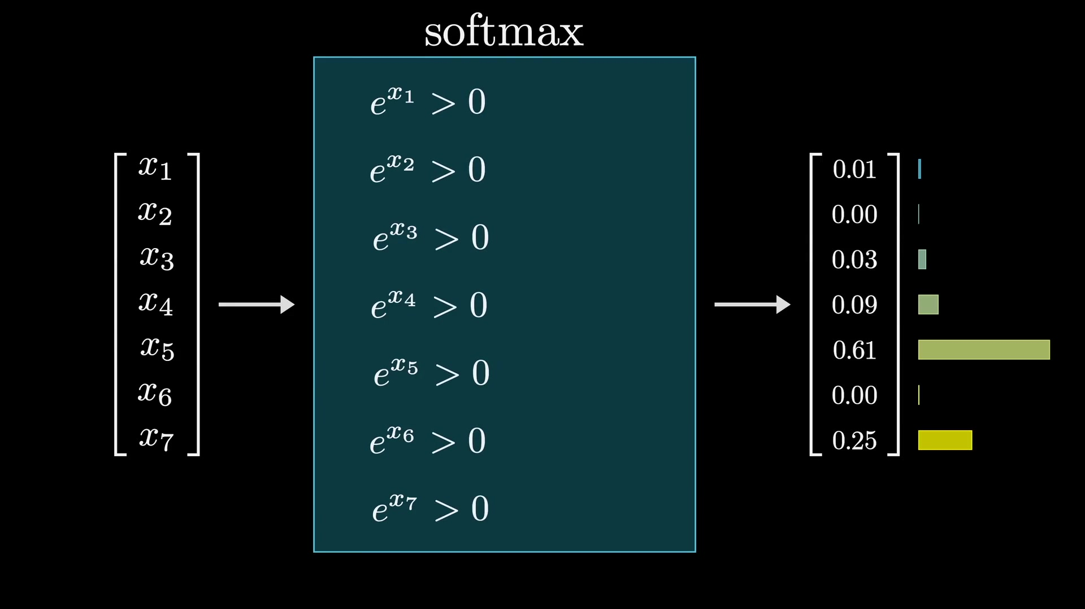
THE OUTPUT
11
Softmax turns arbitrary logits into probabilities
01
Exponentiate
All values become positive.
02
Add
Compute the total mass.
03
Normalize
Divide each value by the total.
The probabilities now sum to 1.
SOURCE FRAME • 23:20
3BLUE1BROWN · TRANSFORMERS
11 / 13
Notes:
[Sources]
- https://www.youtube.com/watch?v=wjZofJX0v4M&t=1342s
- Evidence: ev-012
- Transcript: tr-00377, tr-00378, tr-00379, tr-00380, tr-00381, tr-00382, tr-00383, tr-00384, tr-00385, tr-00386, tr-00388, tr-00389, tr-00390, tr-00391, tr-00392, tr-00393, tr-00394, tr-00395, tr-00396, tr-00397, tr-00398
- Frame: fr-00084
[/Sources]

Slide 12
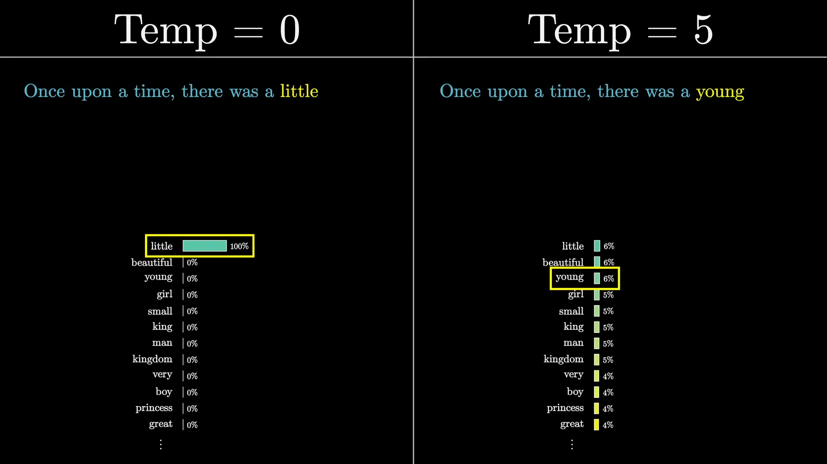
SAMPLING
12
Temperature trades predictability for diversity
LOW T
Predictable
Probability concentrates on the most likely choices.
HIGH T
Diverse—and risky
Less likely choices gain weight; novelty rises, then coherence can collapse.
SOURCE FRAME • 24:40
3BLUE1BROWN · TRANSFORMERS
12 / 13
Notes:
[Sources]
- https://www.youtube.com/watch?v=wjZofJX0v4M&t=1435s
- Evidence: ev-013
- Transcript: tr-00399, tr-00400, tr-00401, tr-00402, tr-00403, tr-00404, tr-00405, tr-00406, tr-00407, tr-00408, tr-00409, tr-00410, tr-00411, tr-00412, tr-00413, tr-00414, tr-00415
- Frame: fr-00087
[/Sources]

Slide 13
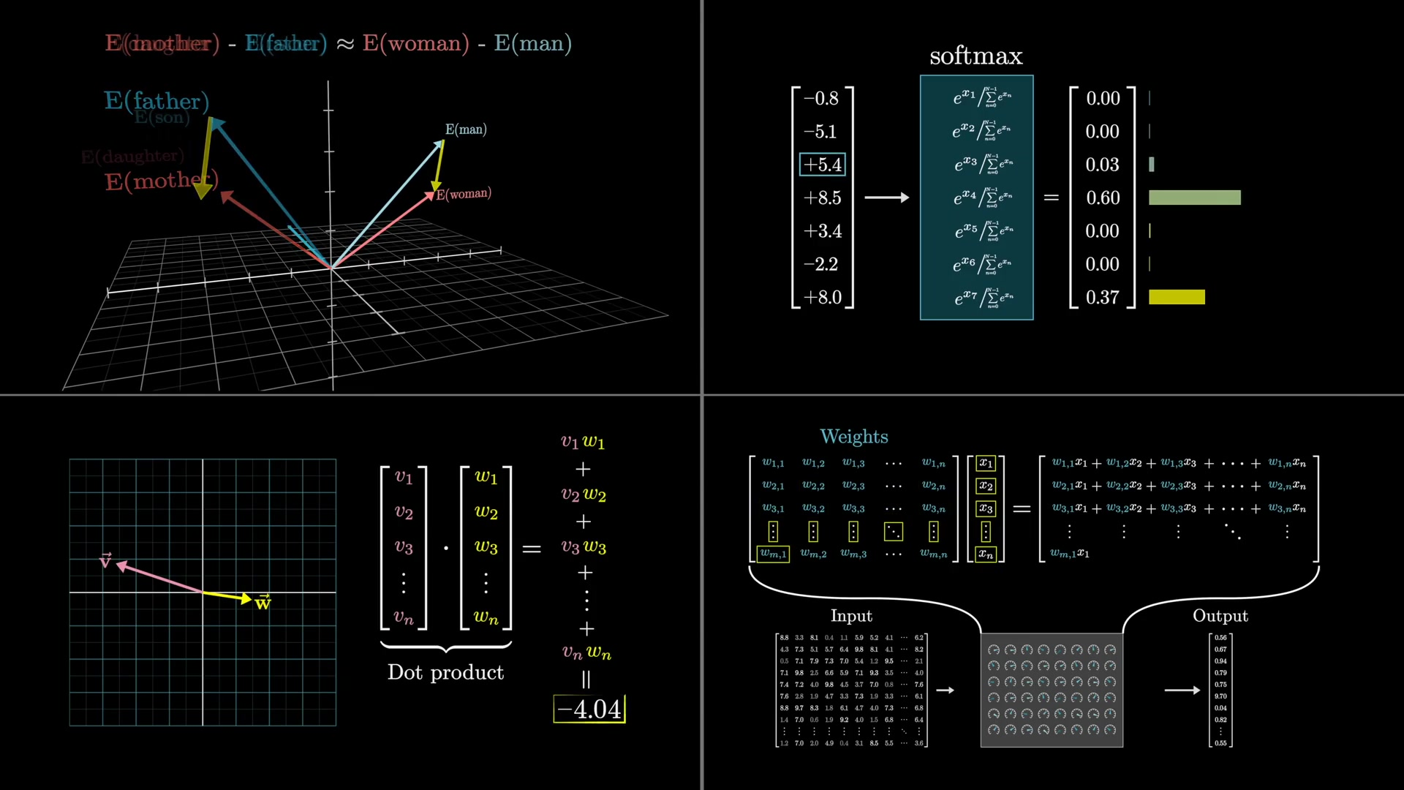
Four operations do most of the work
ONE REUSABLE
TOOLKIT
Embeddings · dot products · matrix transforms · softmax
NEXT · ATTENTION
Notes:
[Sources]
- https://www.youtube.com/watch?v=wjZofJX0v4M&t=1563s
- Evidence: ev-014
- Transcript: tr-00430, tr-00431, tr-00432, tr-00433, tr-00434, tr-00435, tr-00436
- Frame: fr-00092
[/Sources]

