Slide 1
Speed Limit Enforcement using Artificial Neural Networks
Leo Osvald
Supervisor: Prof. Sven Lončarić

Slide 2
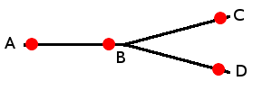
Principle of operation
2 checkpoints
  Pass detection sensor
  Camera (approx. same angle & distance)
Vehicle image matching
Average speed calculation
Generalization – N checkpoints
  Tracking system

Slide 3
Naive matching algorithm
Tries to match 1 vehicle image from second checkpoint with L from the first
Greedy algorithm
How to determine threshold?
What if a mismatch occurs?

Slide 4
Maximum probability matching
Tries to match L images from first checkpoint with R images from second
How to maximize total matching probability?
How to do it efficiently?
p | r₁ | r₂ | r₃ | x₁ | x₂
l₁ | 0.53 | 0.92 | 0.16 | 0.37 | 0.37
l₂ | 0.21 | 0.84 | 0.62 | 0.67 | 0.67

Slide 5
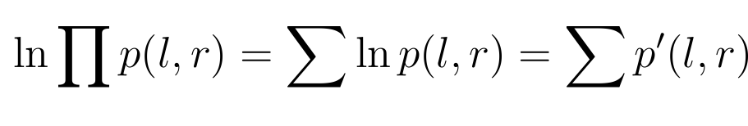
Maximum probability matching
ln p | r₁ | r₂ | r₃ | x₁ | x₂
l₁ | -0.63 | -0.08 | -1.83 | -0.99 | -0.99
l₂ | -1.56 | -0.17 | -0.48 | -0.40 | -0.40
Minimum cost assignment problem
Hungarian algorithm, time complexity O(n³)

Slide 6
Matching probability computation
Feature extraction
  Shape discriminators
  Color discriminators
  Licence plate discriminators
Artificial Neural Networks
  Input = shape/color/plate discriminators
  Output = matching probability

Slide 7
Software implementation
C++ programming language
Multiple libraries
  OpenCV
  Boost
  Fast Artificial Neural Network Library
  Google C++ Testing Framework
  libhungarian
> 400 hours of work
> 10 000 source lines of codes

Slide 8
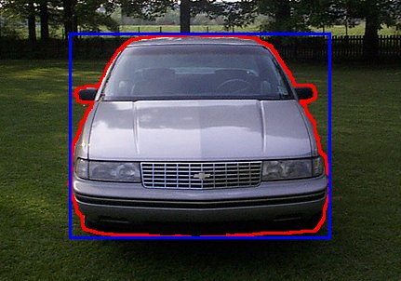
Shape discrimination

Slide 9
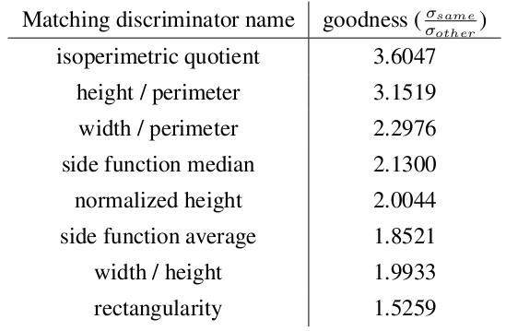
Experimental results –
Shape discriminators evaluation

Slide 10
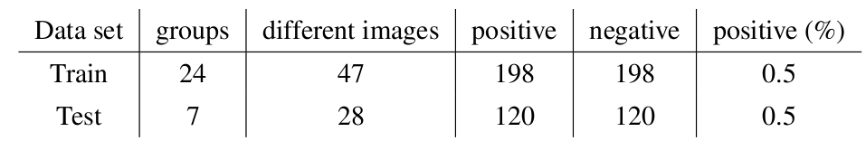
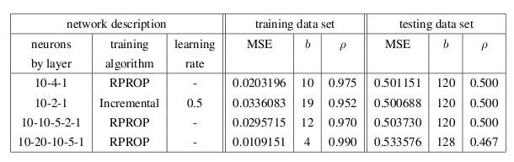
Experimental results –
Shape matching probability computation using ANN

Slide 11

Color discrimination
Average color computation
Hue/intensity dominance

Slide 12
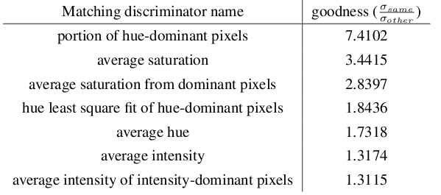
Experimental results –
Color discriminators evaluation

Slide 13
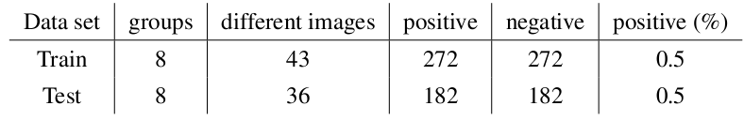
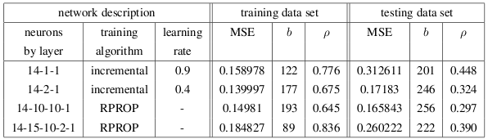
Experimental results –
Color matching probability computation using ANN

Slide 14
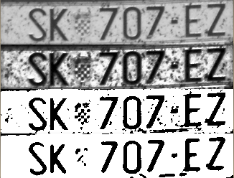
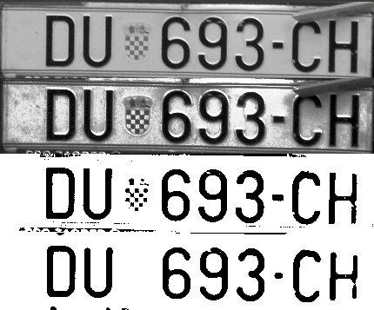
Plate image filtering
Highly robust

Slide 15
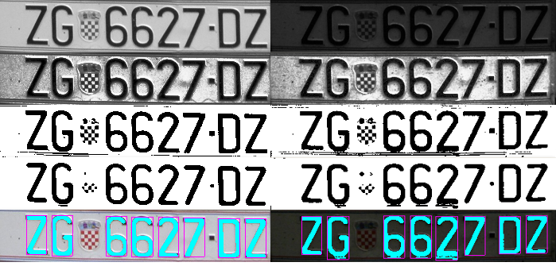
Plate image filtering

Slide 16
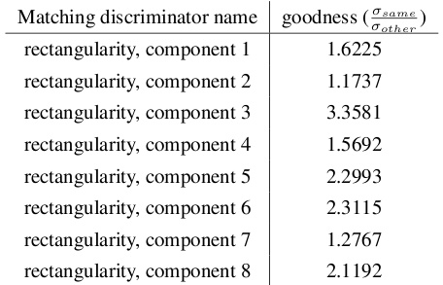
Experimental results –
Plate discriminators evaluation

Slide 17
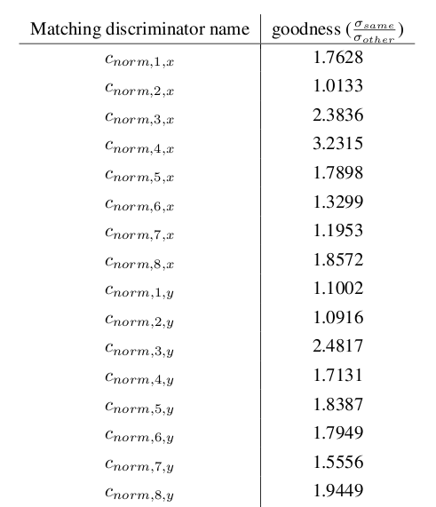
Experimental results –
Plate discriminators evaluation

Slide 18
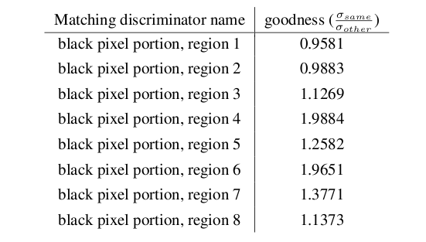
Experimental results –
Plate discriminators evaluation

Slide 19
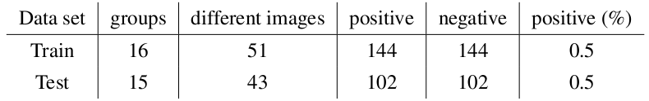
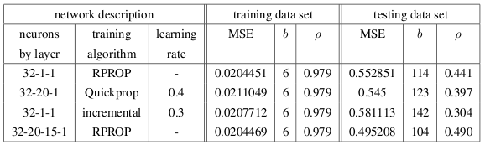
Experimental results –
Plate matching probability computation using ANN

Slide 20
Conclusion
Too small data set?
Imprecise test data?

Slide 21
Thank you

