Slide 1
Classification
Omnia Hosny

Slide 2

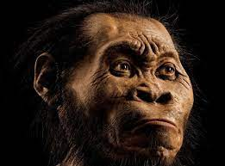
Classification

Slide 3
Agenda
Definition of Classification
Application of Classification
Concept of Classification
Cost Function
Underfitting and Overfitting
Coding

Slide 4
Classification
There are two basic types of classification that a machine can perform.
1) Supervised Classification
2) Unsupervised Classification

Slide 5
Classification
There are two basic types of classification that a machine can perform.
1) Supervised Classification
2) Unsupervised Classification
Let’s look at supervised classification.

Slide 6
Classification
1) Supervised Classification
Here, a machine can learn using large number of data and use that experience to make prediction for a given data point.

Slide 7
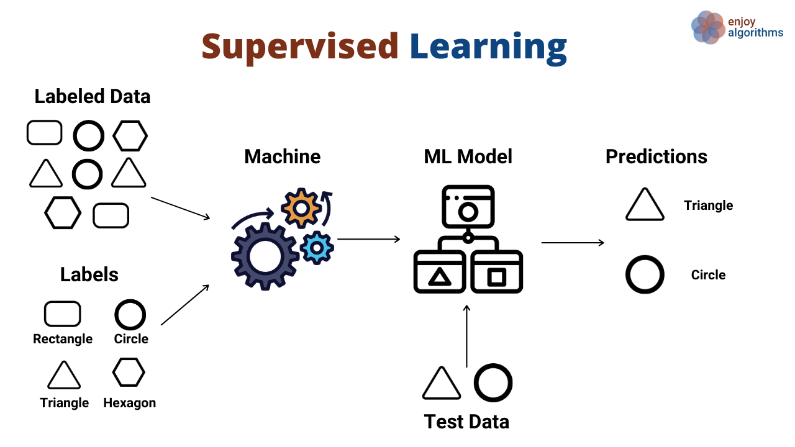
Classification

Slide 8
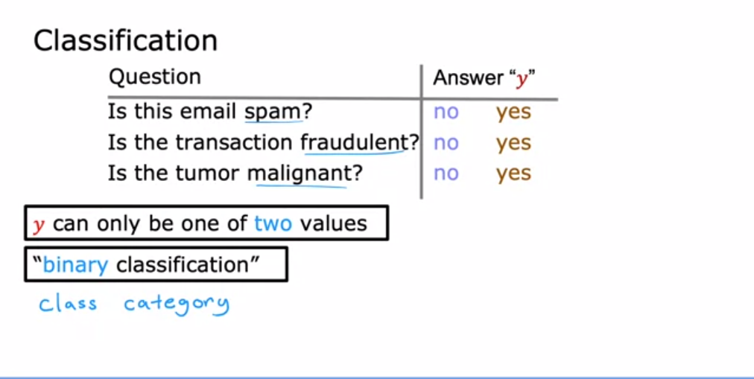
APP. Of Classification

Slide 9
Classification
Supervised Classification
•Logistic Regression
•Decision Tree
•Random Forest
• AdaBoost, XGBoost

Slide 10
Classification
Logistic regression
The classification problem is just like the regression problem, except that the values we now want to predict take on only a small number of discrete values. For now, we will focus on the binary classification problem in which y can take on only two values, 0 and 1. (Most of what we say here will also generalize to the multiple-class case.) For instance, if we are trying to build a spam classifier for email.

Slide 11
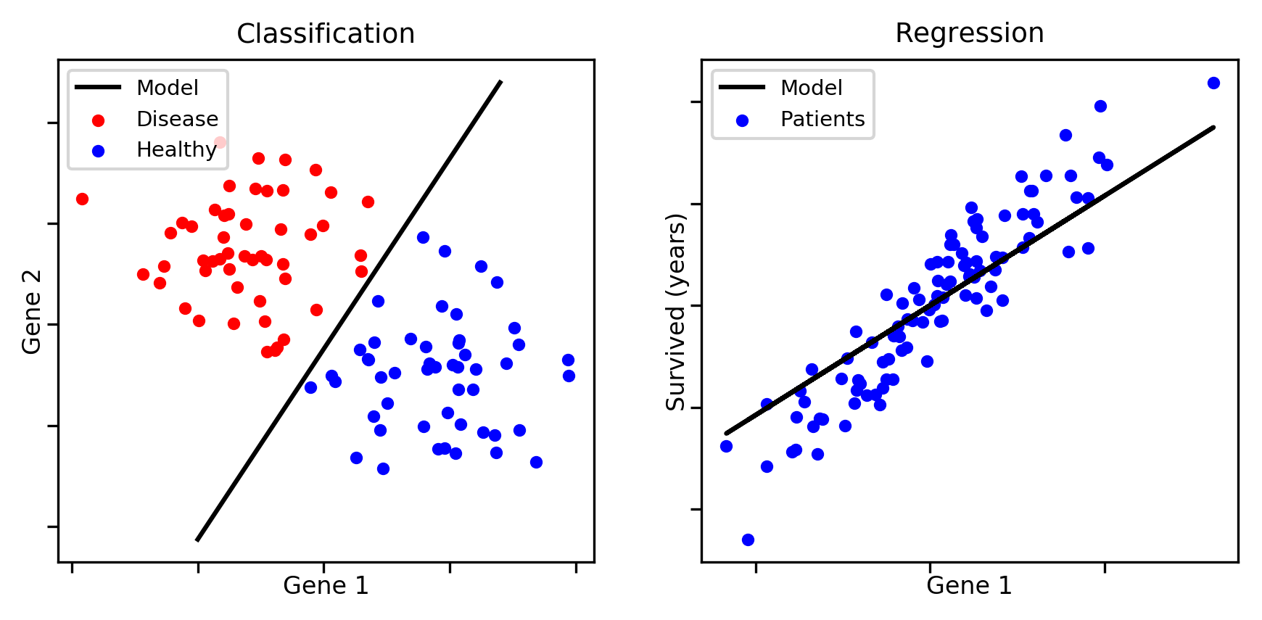
Classification
Logistic regression

Slide 12
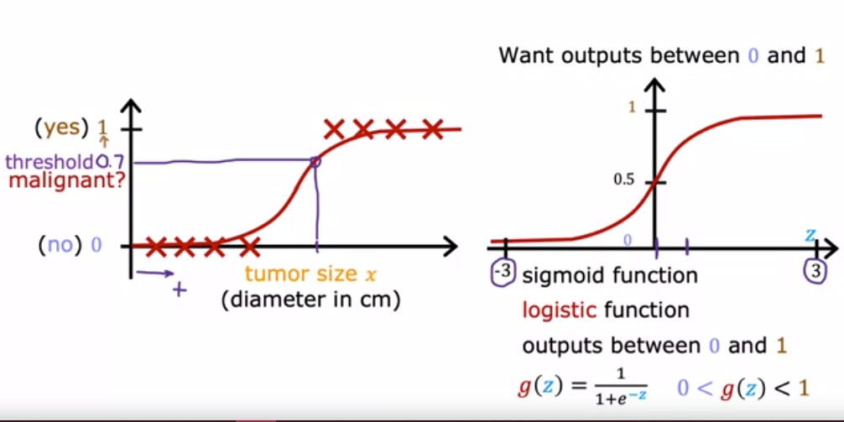
Classification
Logistic regression

Slide 13
Classification
Logistic regression
What is a Hypothesis that helps Us?

Slide 14
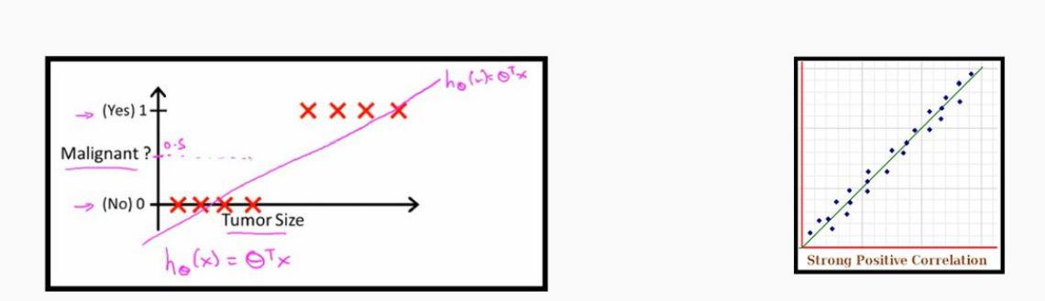
Classification
Logistic regression

Slide 15
Classification
Background
Logarithms:
1) It is a count of Zeros after one of base 10
Log 10 = 1
Log 100 = 2
Log 1000 = 3
2) It is a count of Zeros after any number of base 10
log 50 = 1.69
log 7000 = 3.84

Slide 16
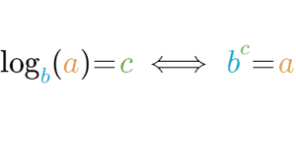
Classification
Background
If base not 10

Slide 17
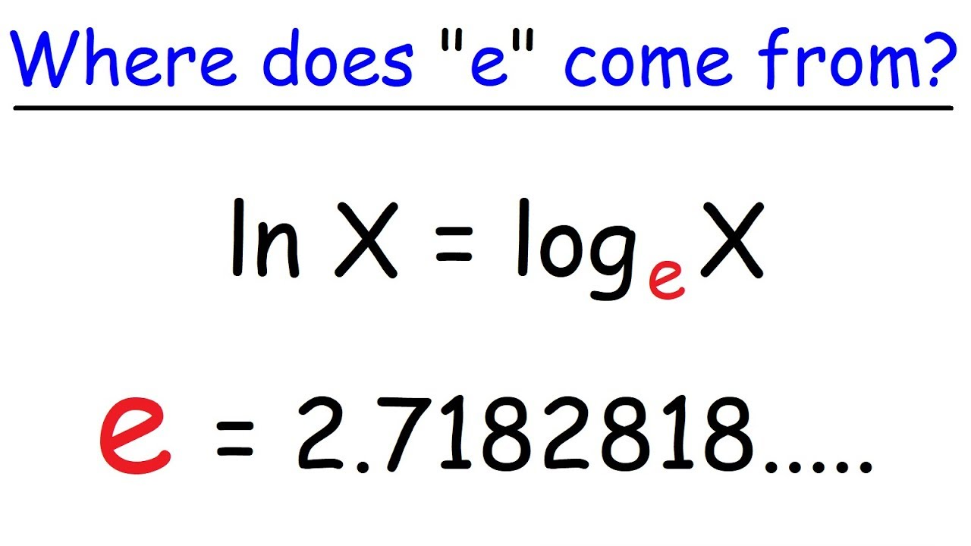
Classification
Background

Slide 18
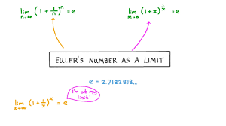
Classification
Background

Slide 19

Classification
Logistic regression
What is a Hypothesis that helps Us?
let’s change the form for our hypotheses to satisfy:

Slide 20
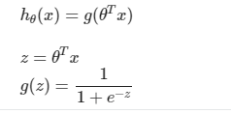
Classification
Logistic regression

Slide 21
Classification
Logistic regression
When z is negative, the power of e is be positive then h(θ) will be very small. approximately equal Zero
When z is positive, the power of e is be negative then h(θ) will be very large. approximately equal one
When z equal zero the power of exp is be zero then exp of power zero equal one then h(θ) = 1/2

Slide 22
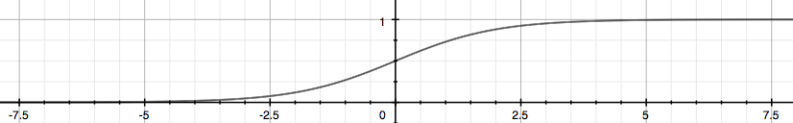
Classification
Logistic regression

Slide 23
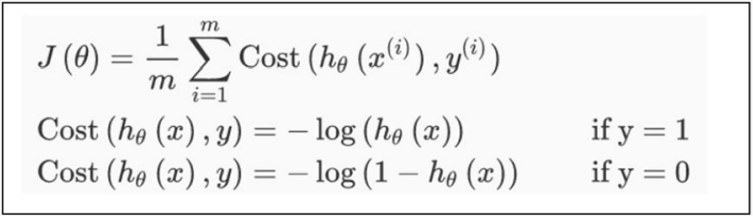
Logistic Regression
Cost Functions

Slide 24
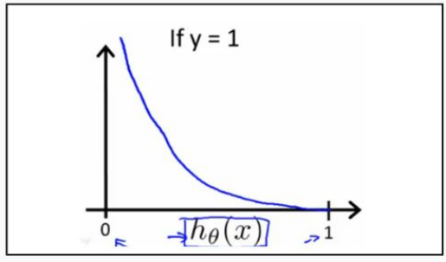
Logistic Regression
Cost Functions
When y=1

Slide 25
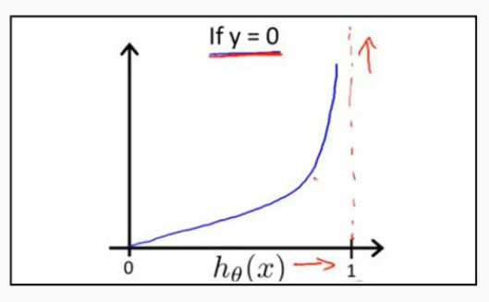
Logistic Regression
Cost Functions
When y=0

Slide 26
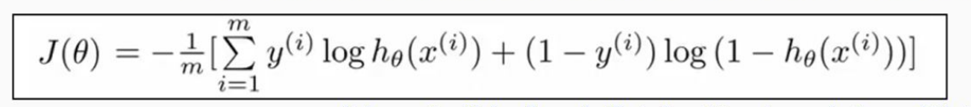
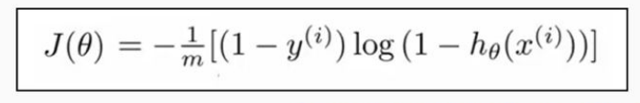
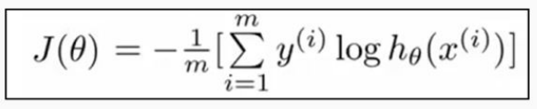
Logistic Regression
Cost Functions

Slide 27
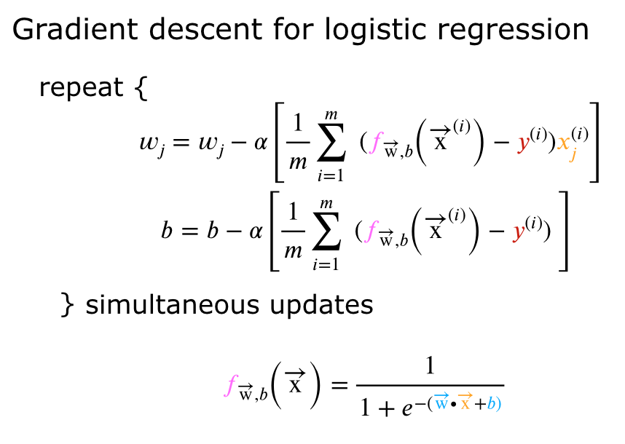
Logistic Regression

Slide 28
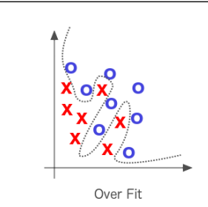
Overfitting & Underfitting
What is Overfitting?
When a model performs very well for training data but has poor performance with test data (new data),the machine learning model learns the details and noise in the training data such that it negatively affects the performance of the model on test data

Slide 29
Overfitting & Underfitting
Reasons for Overfitting
Data used for training is not cleaned and contains noise (garbage values) in it
The size of the training dataset used is not enough
The model is too complex

Slide 30
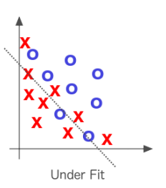
Overfitting & Underfitting
What is Underfitting?
When a model has not learned the patterns in the training data well and is unable to generalize well on the new data, An underfit model has poor performance on the training data and will result in unreliable predictions

Slide 31
Overfitting & Underfitting
Reasons for Underfitting
Data used for training is not cleaned and contains noise (garbage values) in it
The size of the training dataset used is not enough
The model is too simple

Slide 32
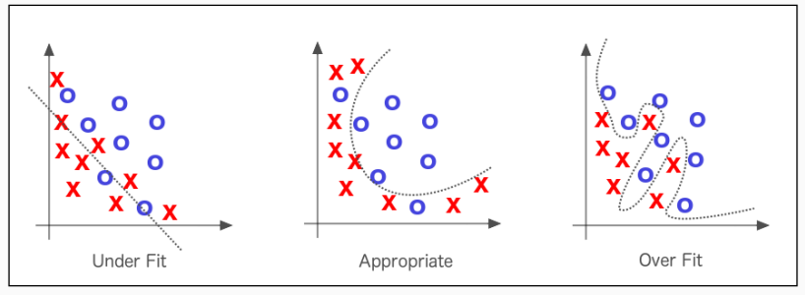
Overfitting & Underfitting

Slide 33
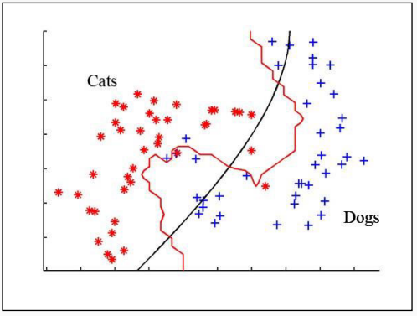
Overfitting & Underfitting

Slide 34
Thank you

