Slide 1
Algorithms and Machine Learning

Slide 2
Supervised Learning
Supervised learning is a type of machine learning where an algorithm learns from a labeled dataset to predict outcomes or classify data. Essentially, the algorithm is "trained" on data that includes both inputs and the correct outputs, allowing it to learn the relationship between them.

Slide 3
Unsupervised Learning
Unsupervised learning is a type of machine learning that analyzes unlabeled data to discover hidden patterns, structures, and relationships within the data without any prior knowledge or labeled examples.
Unlike supervised learning, where the model learns from labeled data to predict or classify, unsupervised learning algorithms explore the data to identify inherent groupings, anomalies, or data representations.

Slide 4
What is Decision Tree
“Decision tree algorithm belongs to the family of supervised learning algorithms.
Unlike other supervised learning algorithms decision tree can be used to solve regression and classification problems.
The goal of decision tree is to create training model that can predict class(single or multi) or value by learning simple decision rules from training data.
Decision tree form a flow chart like structure that's why they are very easy to interpret and understand. It is one of the few ML algorithm where its very easy to visualize and analyze the internal working of algorithm.”
“Just like flowchart, decision tree contains different types of nodes and branches.
Every decision node represent the test on feature and based on the test result it will either form another branch or the leaf node. Every branch represents the decision rule and leaf node represent the final outcome.

Slide 5
What is Random Forest
“A random forest is a supervised machine learning algorithm that is constructed from decision tree algorithms. This algorithm is applied in various industries such as banking and e-commerce to predict behavior and outcomes.”
“A random forest is a machine learning technique that’s used to solve regression and classification problems. It utilizes ensemble learning, which is a technique that combines many classifiers to provide solutions to complex problems.”
“A random forest algorithm consists of many decision trees. The ‘forest’ generated by the random forest algorithm is trained through bagging or bootstrap aggregating. Bagging is an ensemble meta-algorithm that improves the accuracy of machine learning algorithms.”

Slide 6
What is Logistic Regression
”A basic machine learning approach that is frequently used for binary classification tasks is called logistic regression.
Though its name suggests otherwise, it uses the sigmoid function to simulate the likelihood of an instance falling into a specific class, producing values between 0 and 1.
Logistic regression, with its emphasis on interpretability, simplicity, and efficient computation, is widely applied in a variety of fields, such as marketing, finance, and healthcare, and it offers insightful forecasts and useful information for decision-making.”

Slide 7
What is Ensemble Learning
”Ensemble methods combine several trees base algorithms to construct better predictive performance than a single tree base algorithm.
The main principle behind the ensemble model is that a group of weak learners come together to form a strong learner, thus increasing the accuracy of the model.
When we try to predict the target variable using any machine learning technique, the main causes of difference in actual and predicted values are noise, variance, and bias. Ensemble helps to reduce these factors (except noise, which is irreducible error).”

Slide 8
Preprocessing
In machine learning, preprocessing refers to the initial steps of preparing raw data into a usable format for training models. It involves cleaning, transforming, and structuring data to make it suitable for algorithms to learn from effectively. This is a crucial step because real-world data is often messy and needs to be refined before it can be used for building accurate and reliable machine learning models.

Slide 9
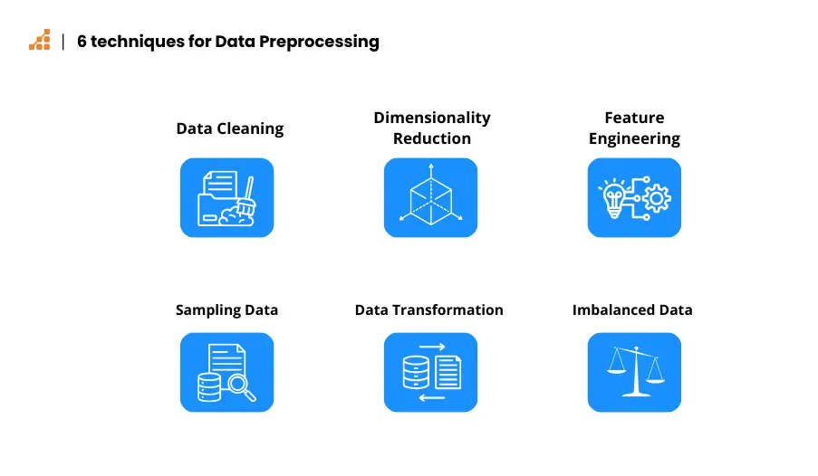
Preprocessing
https://www.scalablepath.com/data-science/data-preprocessing-phase

Slide 10
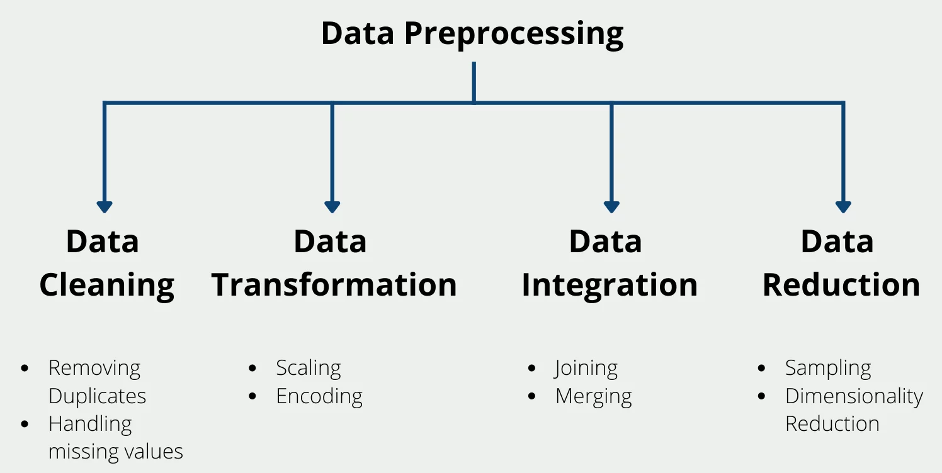
Data preprocessing steps
https://www.scalablepath.com/data-science/data-preprocessing-phase

Slide 11
Feature Engineering
Feature engineering involves creating new features from raw data or transforming existing ones to improve model performance. Feature processing, on the other hand, focuses on cleaning, transforming, and scaling the data to make it suitable for machine learning algorithms. Essentially, feature engineering aims to create more informative and useful features, while feature processing ensures the data is in a usable format for those features.

Slide 12
Feature Engineering
Feature Creation: Generating new variables from existing ones (e.g., creating a "total_price" feature from "quantity" and "price_per_unit").
Feature Transformation: Modifying existing features (e.g., scaling numerical features using standardization or normalization).
Feature Extraction: Reducing the dimensionality of the data by creating new, more informative features (e.g., using Principal Component Analysis (PCA) or Singular Value Decomposition (SVD).
Feature Selection: Choosing the most relevant features for the model, discarding irrelevant or redundant ones to prevent overfitting and improve performance.

Slide 13
What is Feature Selection
“Feature selection is a important step in machine learning which involves selecting a subset of relevant features from the original feature set to reduce the feature space while improving the model’s performance by reducing computational power.
It’s a critical step in the machine learning especially when dealing with high-dimensional data.”
Improved Model Performance:
By removing irrelevant or noisy features, you can improve the model's ability to generalize to new, unseen data.

Slide 14
Feature Processing
Handling Missing Values: Addressing missing data through imputation or removal.
Encoding Categorical Variables: Converting non-numerical data into numerical format (e.g., one-hot encoding).
Outlier Handling: Addressing extreme values that can negatively impact model performance.
Scaling Numerical Features: Ensuring all numerical features have a similar scale (e.g., using standardization or normalization).

Slide 15
Read Supervised Vs Unsupervised Algorithms
https://www.datacamp.com/blog/supervised-machine-learning

Slide 16
Confusion Matrix
A confusion matrix is a table that summarizes the performance of a classification model by comparing predicted labels to actual labels.

Slide 17
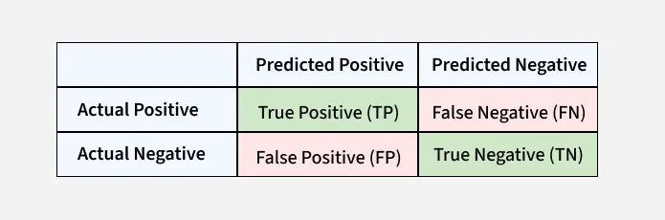
Confusion Matrix
https://www.geeksforgeeks.org/confusion-matrix-machine-learning/

Slide 18
Confusion Matrix
Read more
https://www.geeksforgeeks.org/confusion-matrix-machine-learning/

Slide 19
Hyperparameter Tuning
Hyperparameters are configuration variables that control the learning process of a machine learning model.
Unlike model parameters (like coefficients in a linear model) which are learned from the data, hyperparameters are set by the user before training.
Examples of hyperparameters include:
Learning rate in neural networks.
Number of hidden layers and nodes in a neural network.
Regularization parameters (e.g., L1, L2).
Batch size in training.
Number of trees in a random forest.
Why is Hyperparameter Tuning Important?
Hyperparameters directly influence how a model learns, its complexity, and its ability to generalize to new data.
Finding the right hyperparameter values can significantly improve a model's accuracy, efficiency, and overall performance.
Poorly tuned hyperparameters can lead to underfitting (model is too simple) or overfitting (model is too complex).

Slide 20
Hyperparameter Tuning
Hyperparameters are configuration variables that control the learning process of a machine learning model
Hyperparameters are set by the user before training
Examples of hyperparameters
Batch size in training
Number of trees in a random forest
Hyperparameters directly influence how a model learns, its complexity, and its ability to generate new data
Finding the right hyperparameter values can significantly improve a model’s accuracy, efficiency, and overall performance.
Models that are not hyper tuned well can lead to underfitting (model that is too simple) or overfitting (model that is too complex)

Slide 21


