Slide 1
Heather Sweeney Designs

Slide 2
Heather Sweeney,
Interior Design
Specializes in home kitchen design
Offers a variety of free seminars
  Home shows
  Kitchen and appliance stores
  Other public locations.

Slide 3
Heather’s Business
Sells books and videos that instruct people on kitchen design
Offers custom-designed consulting services
Uses seminars to expand customer base

Slide 4
Description
Heather wants to keep track of the following:
  Customers
  The seminars they have attended
  The contacts she made with them
  Their purchases

Slide 5
Description
Heather wants to use the database to:
  Continue to contact customers
  Offer them products and services

Slide 6
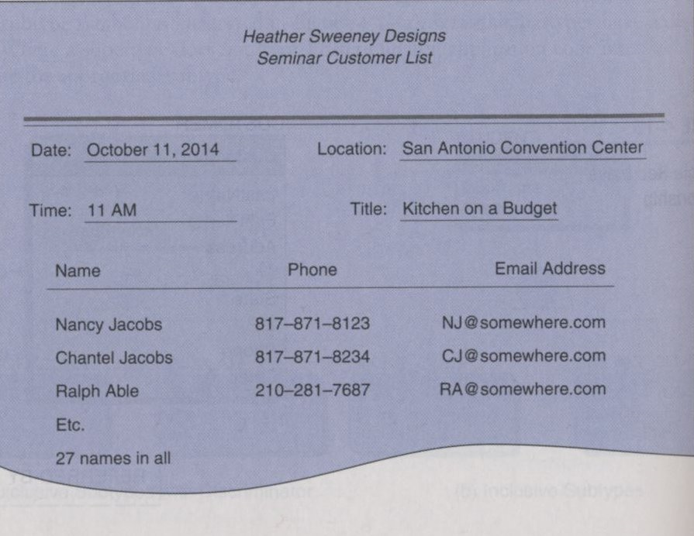
What she has

Slide 7
Additional information
Customers may attend as many seminars as they like
She would like to record customers even if they haven’t attended a seminar
A seminar is never offered with fewer than 10 attendees
  should this constrain the database?

Slide 8
Customer contact
Heather wants to be able to send a letter to customers after they attend a seminar.
  She wants to refer to both them and the specific seminar by name
  She wants to send the message as an email and a letter

Slide 9
Sales Invoice
Heather has invoices that she wants to store in the database as well
  She doesn’t want to store the CC# due to security concerns
Example on the next slide

Slide 10
