Slide 1




Transactions

Slide 2
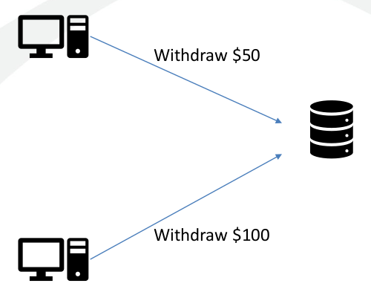
Concurrency
Two users manipulate a database simultaneously
What happens?
YouTube: ACID Compliant

Slide 3
ACID
Atomicity
  All or Nothing Transactions
Consistent
  Rules are not violated (Business rules, etc)
Isolated
  Transactions are Independent
Durable
  Committed Data is Never Lost

Slide 4
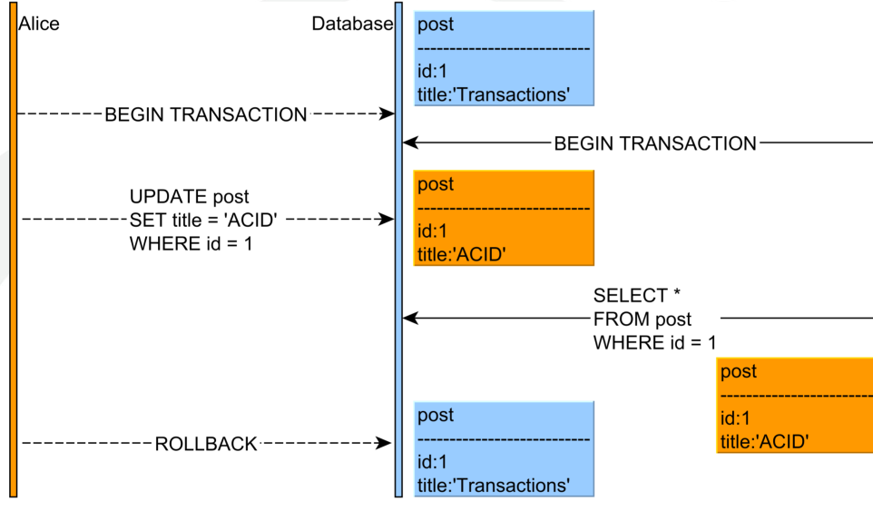
Dirty Read

Slide 5
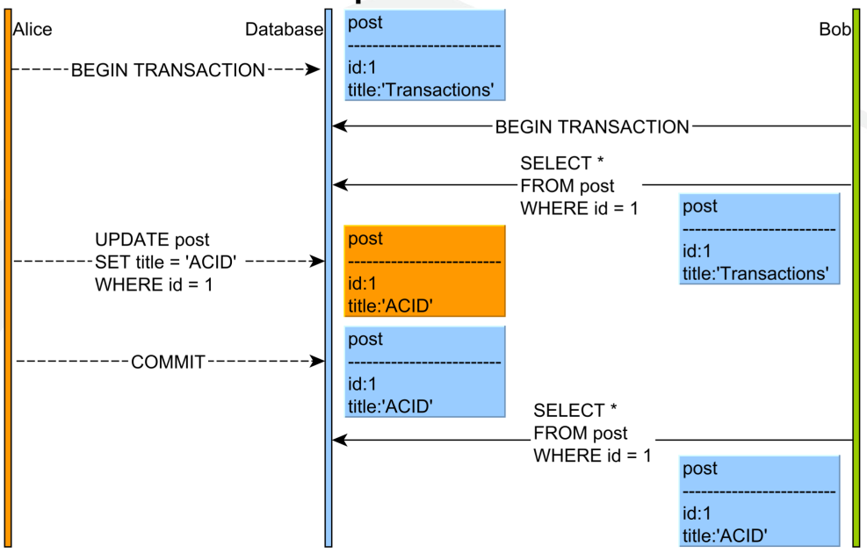
Non-Repeatable Read

Slide 6
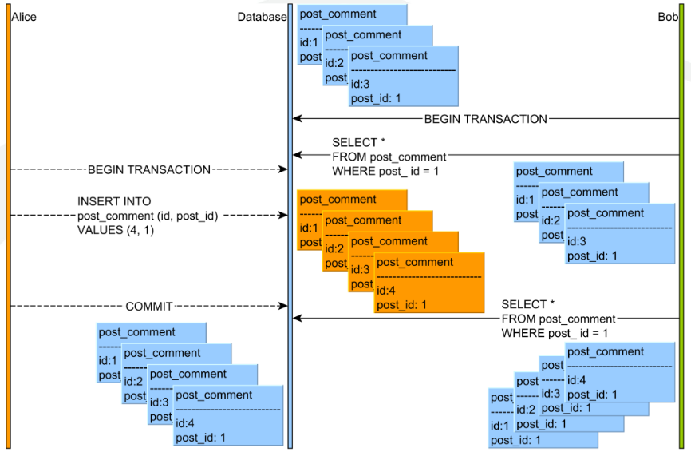
Phantom Read

Slide 7

Schedules
Sequential order of operations for multiple transactions
Operations can be interleaved in some instances
  What instances cause no conflict?
Equivalent schedules
  Will give same result
Conflicting schedules
  Can cause differing results

Slide 8
The gold standard
Serial Schedule
  Transactions are executed one at a time.
Serializable Schedule
  Equivalent to a serial schedule

Slide 9
Isolation Levels
SERIALIZABLE
  Transactions are run in a serializable schedule with concurrent transactions
  Isolation is guaranteed.
REPEATABLE READ
  Transactions read only committed data
  After the transaction reads data, other transactions cannot update the data
  Prevents most types of isolation violations but allows phantom reads.
READ COMMITTED
  Transactions read only committed data
  After the transaction reads data, other transactions can update the data
  Allows nonrepeatable and phantom reads.
READ UNCOMMITTED
  Transactions read uncommitted data
  Processes concurrent transactions efficiently but allows a broad range of isolation violations, including dirty, nonrepeatable, and phantom reads.

Slide 10
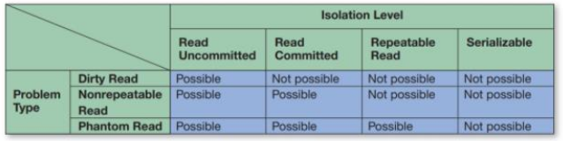

Isolation Levels

Slide 11
Schedules and recovery
Nonrecoverable schedule
  One or more transactions cannot be rolled back
Cascading schedule
  Rollback of one transaction forces rollback of other transactions
Strict schedule
  Rollback of one transaction never forces the rollback of other transactions

Slide 12
Locking
Shared Lock
  Allows for a transaction to read, but not write data
  There can be multiple shared locks
Exclusive Lock
  Allows for the transaction to read and write
  If there is an exclusive lock, there can be no other locks

Slide 13
Two-phase locking
Expand phase and contract phases
Basic two-phase locking
  The transaction can grow or shrink its scope as needed
Strict two-phase locking
  Exclusive locks are held until commit/rollback
  Scope can be expanded as necessary
Rigorous two-phase locking
  Both shared and exclusive locks are held until commit/rollback
  In effect, it has no contract phase

Slide 14
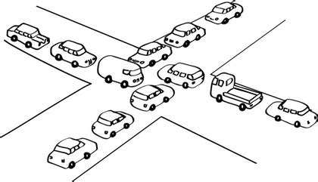
Problems with locking
Dependent transaction
  Waiting for data locked by another transaction
A cycle of dependent transactions indicates a deadlock
A deadlock is a state in which a group of transactions cannot be resolved

Slide 15
Avoiding Deadlock
Aggressive Locking
  Transactions request locks when the transaction starts
Data ordering
  For example, rearrange locks so that locks on X occur before locks on Y
Timeout
  If a transaction takes too long, it rolls back
Cycle detection
  When a cycle is detected, the ‘cheapest’ transaction is rolled back

Slide 16
Other options for concurrency
Snapshot isolation
  A snapshot is taken when the transaction starts
  Updates are applied to the snapshot
  Prior to commit, check for conflicts
  If no conflict is detected, write the snapshot
  If a conflict is detected, roll back

Slide 17

Transactions in SQL
SET [ GLOBAL | SESSION ] TRANSACTION
ISOLATION LEVEL [ SERIALIZABLE | REPEATABLE READ | READ COMMITTED | READ UNCOMMITTED ];
SESSION
  Until the user or program disconnects
GLOBAL
  All transactions during this and later sessions. Can only be used by the administrator
If neither is specified, defaults to only the next transaction in the session

Slide 18
Defining a transaction
Start
  START TRANSACTION
End
  COMMIT
  ROLLBACK
Autocommit can be set with: SET autocommmit = [ OFF | ON ];
Optional keywords for COMMIT and ROLLBACK
  AND CHAIN – override autocommit setting
  RELEASE – end current session

Slide 19
Savepoints
Savepoint – partial transaction results are saved temporarily
SAVEPOINT identifier;
ROLLBACK TO identifier;
RELEASE SAVEPOINT identifier;

