Slide 1
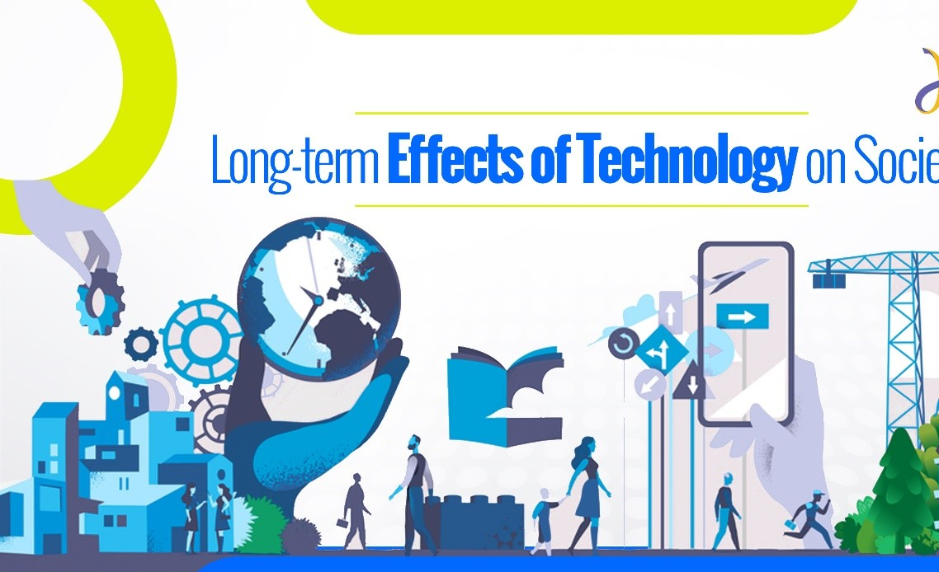
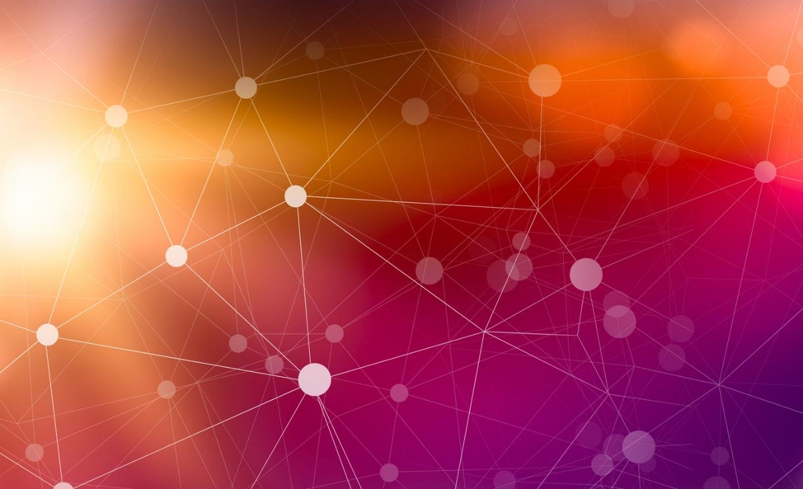
The Impact of Technology on Society
By: Zuber Lotif

Slide 2
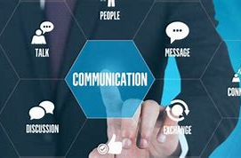
Positive Impact of Technology on Society
Improved communication:
Technology has made it easier for people to communicate with each other, regardless of distance. This has enabled people to stay connected with family and friends, collaborate with colleagues, and access information from anywhere in the world.

Slide 3
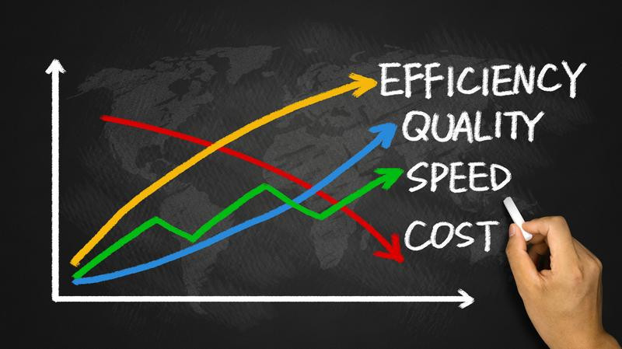
Increased Efficiency: Many Technology have improved the efficiency of various industries, making it easier to produce goods and services at a faster pace. This has helped to increase productivity and reduce costs, making products more affordable for consumers.

Slide 4
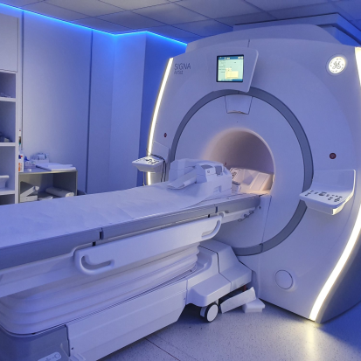
Improved Healthcare:
Technology has improved the equality of healthcare service, making it easier for doctors and healthcare providers to diagnose and treat patients. Medical technologies such as MRI machines, CT scanners, and robotic surgery have revolutionized the way we treat diseases and illnesses.

Slide 5
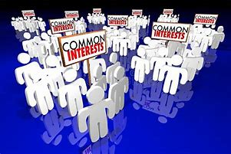
Access to information:
The internet has made it easier for people to access information from anywhere in the world. This has enabled people to learn new things, stay informed about current events. And engage with other people who share similar interest.

Slide 6

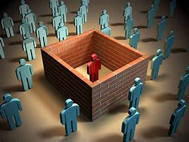
Negative Impact of Technology on Society
Social Isolation:
While technology has enabled people to communicate with each other more easily, it has also led to social isolation for some individuals.
Spending too much time online can lead to lack of face-to-face interaction and reduced social skills.

Slide 7

Job loss:
Many technological advancements, such as automation and artificial intelligence, have the potential to replace human workers in certain industries. This can lead to job loss and increased economic inequality.

Slide 8
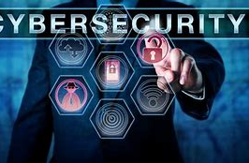
Cybersecurity Threats:
As technology becomes more integrated into our lives, the risk of cyber-attacks and data breaches increases. This can lead to the loss of sensitive information and loss of trust in technology.

Slide 9
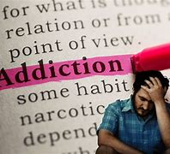
Addiction:
Technology addiction, or excessive use of technology, can have negative impacts on mental health and wellbeing. It can lead to feelings of anxiety, depression, and sleep deprivation.

Slide 10
Impact of Technology on Society | A Brighter Side | key Impacts of Technology on Society (youtube.com)
Impact of technology on society

Slide 11
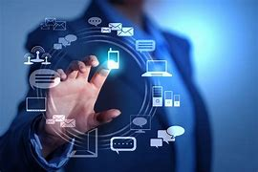
Overall,, technology has had a significant impact on society, both positive and negative.
On the positive side, technology has improved communication, increased efficiency, improved healthcare, and improved greater access to information.
However, on the negative side, technology has led to social isolation, job loss, cybersecurity threat, and addiction.

Slide 12
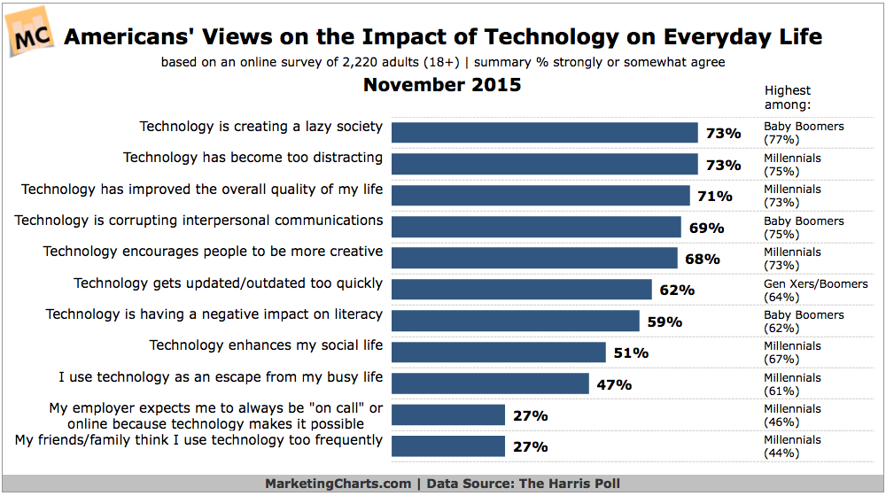
Impact of technology on society

Slide 13
References
Major Disadvantages of Technology [2022 Technology Disadvantages] - Wise Healthy n Wealthy
Potential Negative Effects of Technology | Digital Detox
The Impact of Digital Technologies | United Nations

Slide 14
Thank you!

