Slide 1
R Workshops Day 1
Dr. Lotte Meteyard

Slide 2
Getting started
https://github.com/lottemeteyard/RWorkshop2017
Download the zip file: Reading Workshops 2017.zip
Save it somewhere simple and accessible

Slide 3
R Studio
A friendlier way to use R
Install from University app store – it runs from a cloud
This means it might stall and you need restart sometimes
Doing R is “intelligent copy paste”
HUGE online resources
Amazing open source community
If you have data analysis issue, most likely somebody somewhere has already built a package for it

Slide 4
Foundations of Linear Mixed Effects Models
Dr. Lotte Meteyard (Dr Rob Davies)

Slide 5
Mixed models
Analysis technique that includes both fixed and random effects.
Related terms.. Linear/generalised mixed models Multilevel models/analysis Heirarchical models

Slide 6
What is a LMM?
Used for any data where there is a hierarchical or multi-level structure. That is, groups & sub-groups.
All particiapnts
Males
Stimuli set 1
Stimuli set 2
Females
Stimuli set 1
Stimuli set 2
All particiapnts
Time 1
Stimuli set 1
Stimuli set 2
Time 2
Stimuli set 3
Stimuli set 4

Slide 7
Multilevel structures
When to use..
Pre and post tests
Multiple stimuli, multiple grouped samples
Repeated testing
For example - data collected from the same people at different times (correlated) - data collected from the same place/location (correlated) - data collected with different groups of items/stimuli (confound of different items)

Slide 8
What is a LMM?
Hierarchical structures are a problem because (1) Most analyses assume data is independent – standard errors smaller if data assumed to be independent when it isn’t (2) Averaging or aggregating across groups/sub-groups can ‘hide’ the true pattern in the data - we assume taking the average is OK, but this is usually a convenient oversimplification

Slide 9
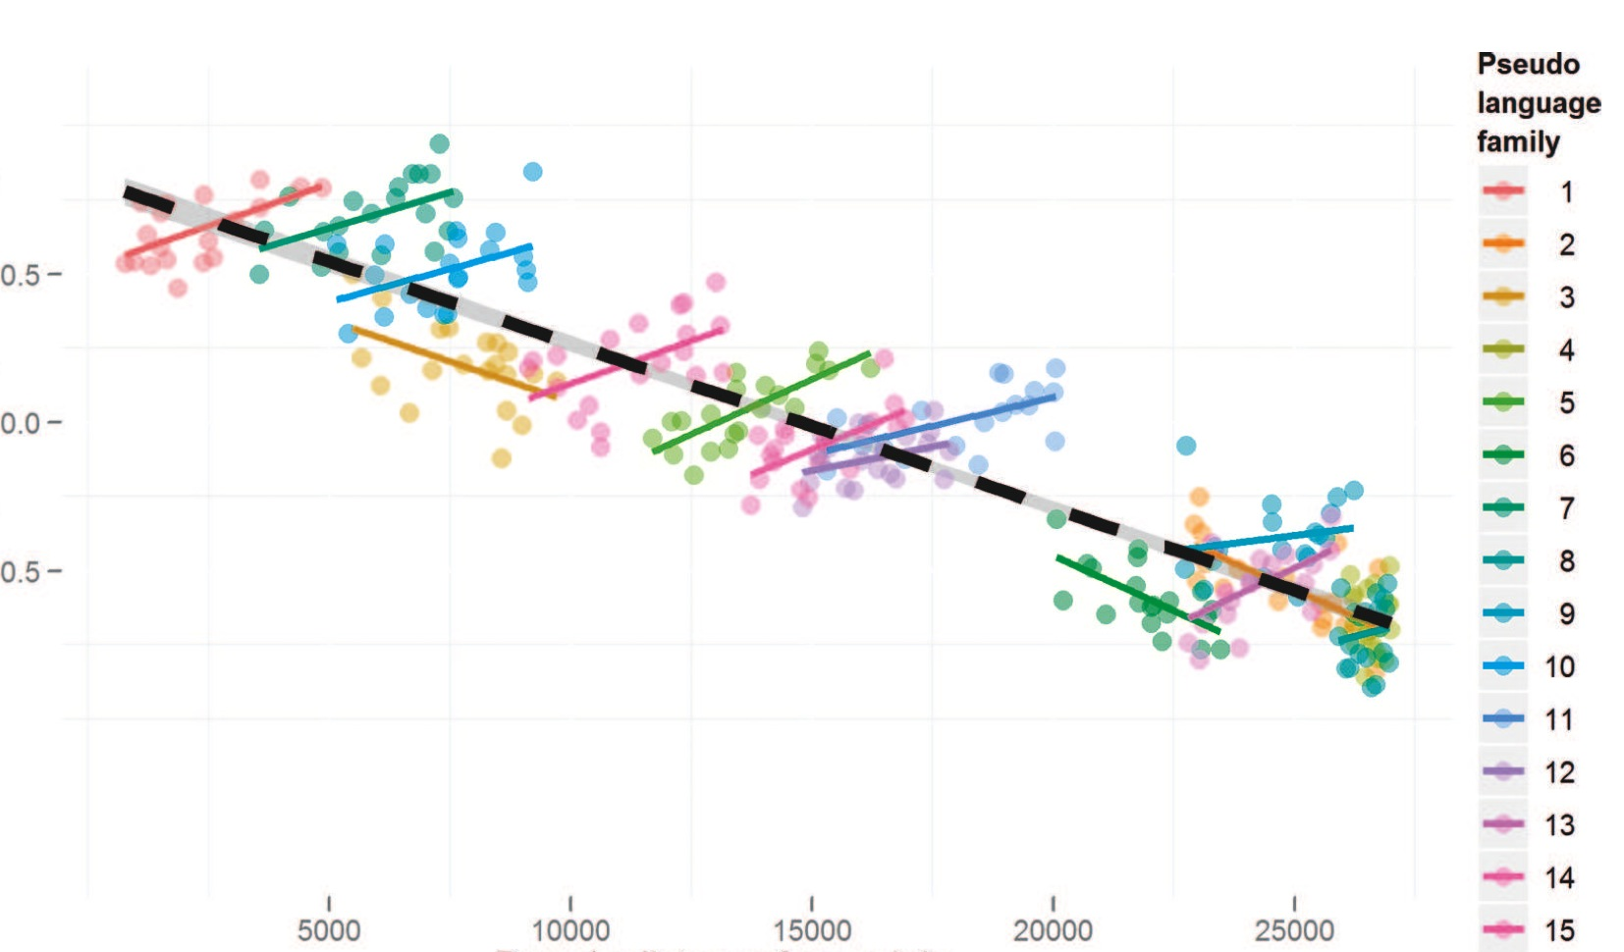
Jaeger et al (2011)
Jaeger, T. F., Graff, P., Croft, W., & Pontillo, D. (2011). Mixed effect models for genetic and areal dependencies in linguistic typology. Linguistic Typology, 15(2), 281-320.

Slide 10
When to use LMMs
Whenever you want to manage these problems… (1) Model subject & item variance (e.g. F1 vs F2) - may replace your usual ANOVA analysis (2) Model groupings in your data (e.g. over time, hierarchical designs) (3) Individual differences and effects within specific groups

Slide 11
What should my data look like?
LMMs should be seen as a form of REGRESSION So.. (1) Lots of data points to power the analysis (2) Good/sufficient variance in your data (2) Data meets assumptions of regression NB: linear mixed effects models
If you are planning on using LMMs, then design your experiment to fit LMM analysis.

Slide 12
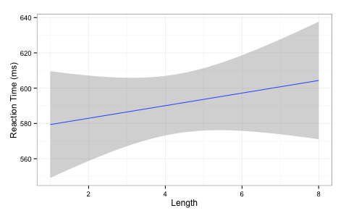
What do LMMs do?
Standard regression
slope of line
intercept
RT ~ intercept + slope(Length)

Slide 13
Regression
Experiment with RT by Length of Word (IV)
RT ~ intercept + slope(Length)
y ~ a + b(x)

Slide 14
LMM & regression
For LMMs we can model how the intercept and slope will vary across different groups
Because we are modeling variation these are called random effects (i.e. the group has some random variation associated with it). Measured in standard deviations Fixed effects are your normal predictors/IVs. Fixed because we want to know on average what they do. Measured in means.

Slide 15
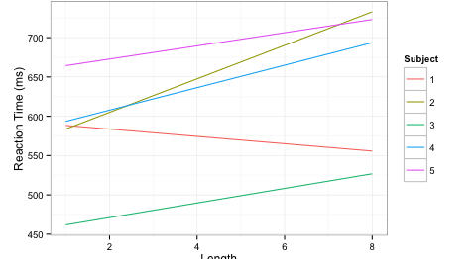
What do LMMs do?
slope is allowed to vary across groups e.g. subjects
intercepts are allowed to vary

Slide 16
What do LMMs do
For LMMs we can model how the intercept and slope will vary across different groups
For example, model the difference (i.e. the variance/deviation) for each subject from the average slope and the average intercept for all subjects. Similarly, model the difference for each item from the average slope and the average intercept for all items.

Slide 17
What do LMMs do?
That is basically it!
Gets complicated because you can end up with very large random effect structures e.g. intercepts +/- slopes for subjects, items, and more slopes varying for different predictors for different groupings slopes of interactions between fixed effects across different groups

Slide 18
Intercepts and slopes
Experiment with Subjects, Items and Length of Word (IV)
Random intercepts only
RT ~ Length + (1|Subjects) + (1|Items)
Random intercepts and slopes (nb: 1 = correlated)
RT ~ Length + (1 + Length|Subjects) + (1 + Length|Items)
Intercept varies by Subjects
Intercept varies by Items
Length varies by Subject (correlated)

Slide 19
LMMs in R
Models estimate values for fixed and random effects NB: you are modeling your data i.e. fitted values estimated from the data
Order of entry doesn’t matter (simultaneous)
Tries to find the solution that makes the observed data most likely (maximum likelihood) ML – assumes fixed effects are precise REML – averages fixed effects and then calculates random effects
Sometimes this modeling fails (convergence)

Slide 20
There is no recipe book
Each statistical analysis has “boundary conditions” (Baayen)
Identify boundary conditions and check them
Mixed models:
Variance / number data points
(2) Normality / distribution of data (e.g. residuals, outliers)
(3) Rationale & selection of random & fixed effects
(4) ‘Final’ model – Does it look sensible? Can you interpret it?

Slide 21
Random effects
Sampling groups: subjects, items, school, etc.
You expect or predict some variation e.g. interaction of subject ability with item
LMM will tell you how much variance associated with a grouping - if very small, consider removing it. - include random effect because it is part of experiment design - include random effect because it is something you are interested in - can test models with and without (Baayen et al 2008) LRTs comparing models with same FE, differing in RE.

Slide 22
There is no recipe book
Model checking and model selection
Say what model checking was done (e.g. residuals, optimization, re)
Say what approach and why (e.g. maximal to minimal; control/null model up; inclusion or not of higher order interactions)
Report model selection / testing / comparison process

Slide 23
A mixed-model workflow
Collect data
Model data
Large sample of items / trials
Check parameters / boundary conditions – outliers, scaling etc.
Maximise variance
Iterate
REPORT iterations
Most issues can be addressed by transparency..

Slide 24
Reporting models (thank you Rob Davies)
Report model comparisons and Likelihood Ration Tests (LRC) / AIC/ BIC for different models
Explain the model selection choice, based on aims of study and information criteria comparisons
Summary of fixed effects: like linear models, with CIs
Summary of random effects: variance and covariance (if applicable)

Slide 25
Convergence
This is not just a problem with the ‘mathematical engine’
“determine whether the problem lies in a failure of the…optimization stage, as opposed to a case of model misspecification or unidentifiability or a problem with the underlying PLS algorithm. To date we have only observerd PLS failures..” Bates et al (page 24; http://cran.r-project.org/web/packages/lme4/vignettes/lmer.pdf)
Optimiziation
Model misspecification
Variance or covariance in random effects (0/1)
Unidentifiability / PLS failures
Cf: Bates et al (2015) – parsimonious models (arXiv)

Slide 26
Building and choosing models
“There is no such thing as an all purpose statistical method” Nagin & Odgers, 2010, pg 132
Give rationale for the analysis & model choice
Be explicit about technical choices (e.g. random and fixed effects structures, model selection process, model checking)
Make programming script available
Report your basic data that are going into the model (e.g. central tendency, variance, distribution for the DV/response variable)

Slide 27
Building models: many methods
Simple model upwards: intercept only + random effects + fixed effects
Models with control variables + fixed effects
Models with main effects + interactions
Simple regression/ordinary least squares models for sub-groups/per subject/per item, to inform LMM (Gelman & Hill, 2006)
intercept = overall mean intercept assumed in lmer/R

Slide 28
Building models
Add in fixed effect predictors: should see random effect variance reduce if the predictors are doing any work
Compare successive models – does adding in a predictor make the model better?
Change either RE or FE for comparisons
Model comparison with AIC or LRT
Likelihood – of data given the model
Information criterion – trade off between likelihood of data and number of parameters
Notes:
Anderson & Burnham (early 200os) information criteria paper. (ecologists?)
Information theoretic criteria = distance between a model and observed outcomes will loose information. The real world to the simplification in your model - you have to drop complexity and loose information to make that leap.
Information Criteria are based around estimates of information lost in this move... Model selection aims to minimise information lost - the more negative the better.. Trade off between likelihood of data and number of parameters. Trade off between simplicity and complexity. Best OLS model will have minimum residuals and maximum R squared.
CF: Rob Davies stats slides (random effect structures revised pdf).
LRT = 2log likelihood-complex/likelihood-simple Usually LRT, AIC, BIC tend to move in same direction consistently – but AIC and BIC can diverge, especially with complex models – BIC can say ‘this added complexity does not add’ whereas AIC says it does Pinheiro & Bates (2000) says LRT is anti-conservative for comparing fixed effects, but OK for random effects. All parts of this computation are worked out well and model comparisons are well motivated. The LRT statistics give a distribution that is approximately X2 distributed.
For example: Kliegl, R., Hohenstein, S., Yan, M., & McDonald, S. A. (2013). How preview space/time translates into preview cost/benefit for fixation durations during reading. QJEP.
“Comparisons between models with different fixed effects are based on maximum likelihood (ML) statistics; comparisons between models with different random effects are based on restricted maximum likelihood statistics (REML); comparisons involve only strictly nested models (Pinheiro & Bates, 2000)”

Slide 29
Building models
Too many parameters = false positives
Complex to explain and understand
Too few…. Have you included all the important parameters? (hypotheses, motivation, previous evidence..)
Model that will replicate across samples?
What complexity do you want for your research questions?

Slide 30
Building models
Once have a reliable model, see if you can ‘break’ the effects you have e.g. change logRT to reciprocal (1/RT)? higher order interactions that modulate effects? other variables you expect to matter?

Slide 31
R interpretation / GLMMs

Slide 32
Significance and fitting
Calculation of p values is non-trivial, due to issues with identifying degress of freedom
Report confidence intervals for estimates
can simulate p values – mcmc / pval.fnc
lmerTest package in R
MuMIn (R² values for LMMs)

Slide 33
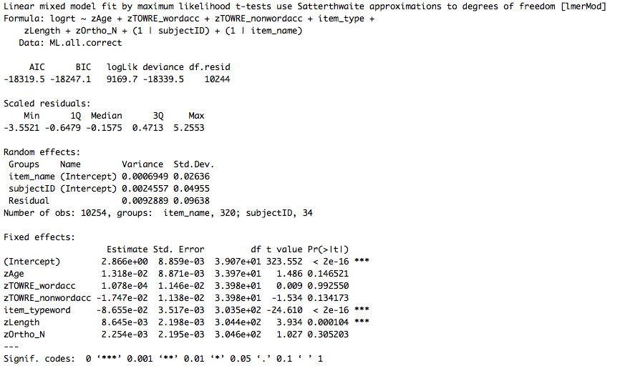
Random effects - varaince/SD associated with subject/item etc.
(e.g. difference between each subject and mean)
Fixed effects
Typically same coefficients estimates as OLS regression
Standard errors will be different
Get p values from lmerTest

Slide 34
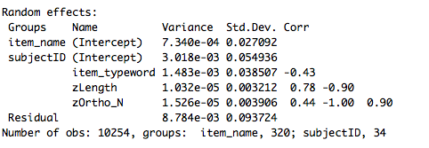
Model checks
Variance in intercepts and slopes can covary – e.g. as people get slower, effects get bigger… lmer assumes there is a correlation
Correlations between random effects are high (~0/1) - model cannot solve the variance problem - is looking for nothing

Slide 35
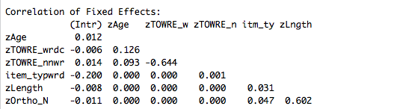
Correlation between different predictors (check for collinearity)
Mean centering & scaling (i.e. z scores of data) helps to reduce this problem

Slide 36

Logistic regression
Log odds as DV Odds = probability occurrence (1) probability non-occurrence (0) Log of odds of getting a 1 vs 0 Log odds because it allows linear modelling
Coefficients are in log odds Positive number = odds of accuracy go up Negative number = odds of accuracy go down

Slide 37
Recommended reading (for clarity)
Bolker, B. M., Brooks, M. E., Clark, C. J., Geange, S. W., Poulsen, J. R., Stevens, M. H. H., & White, J. S. S. (2009). Generalized linear mixed models: a practical guide for ecology and evolution. Trends in Ecology & Evolution, 24, 127-135.
Jaeger, T. F., Graff, P., Croft, W., & Pontillo, D. (2011). Mixed effect models for genetic and areal dependencies in linguistic typology. Linguistic Typology, 15(2), 281-320.
Gelman, A., & Hill, J. (2006). Data analysis using regression and multilevel/hierarchical models. Cambridge University Press.

Slide 38
Recommended reading (for clarity)
Papers by Reinhold Kliegl (Potsdam)
Dan Mirman’s R resources page (Alabama, Birmingham) http://www.danmirman.org/r-resources
Websites recommended in R Scripts for general R stuff

Slide 39
Hypothesis driven model selection

Slide 40
Hypothesis driven approach
“formulate your hypotheses and model without reference to the data (and ideally even prior to their collection)” (Roger Mundry, 2014, MPI EVA)
The problem of model complexity: even with a few predictors, there is a potentially huge number of different models that can be fit. E.g. main effects, interactions, non-linear patterns…

Slide 41
Model building
Identify ‘test’ predictors (fixed effects) that you have hypotheses about
Identify anything you want to control for (control fixed effects)
Identify random effects – this is independent from control vs test predictors. Random effects are groupings of data you expect to cause systematic variation.
Compare more complex model against ‘null’ model (e.g. RE and control variables only).

Slide 42
Model building
Interactions – think about what interactions might mean, and why you would test for them.
Mundry (2014) advice:
Write down:
why each of the terms in the model is in there
what the different terms in the model represent (i.e. what they mean, what process they represent)
what the model and the terms in it could reveal (and not reveal)
ask yourself (and all researchers involved) if the model represents what you're aiming at

Slide 43
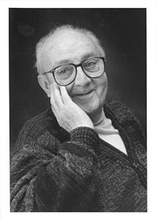
Thank you for listening
“Essentially, all models are wrong, but some are useful” George E.P. Box
Box, G. E. P. & Draper, N.R. (1987). Empirical Model-Building and Response Surfaces, p. 424, Wiley

