Slide 1
Getting started
Dr. Lotte Meteyard

Slide 2
Getting started
https://github.com/lottemeteyard/RWorkshops2018_September
You should be able to download everything. Save it somewhere sensible.

Slide 3
R Studio
A friendlier way to use R
Install from University app store – it runs from a cloud
This means it might stall and you need restart sometimes
Doing R is “intelligent copy paste”
HUGE online resources
Amazing open source community
If you have data analysis issue, most likely somebody somewhere has already built a package for it

Slide 4
R Studio
Document: R Workshops Norway_Navigating R Studio.pdf

Slide 5
Some initial practice in R
Open R and first script.. 0_Basic Statistics in R.R

Slide 6
R Workshops Day 1
Dr. Lotte Meteyard

Slide 7
Fundamentals of NHST / Frequentist
Testing for significance: Null hypothesis – (usually) no difference / no correlation Alternative hypothesis – difference / correlation
P values: The probability of finding your result (or an more extreme result) if the null hypothesis is true Smaller p = better Critical cut off: 0.05 p<0.05

Slide 8
Fundamentals of NHST / Frequentist
All tests do the same thing: Generate a ‘test statistic’ e.g. t, r, F Probability associated with that test statistic This probability = p value

Slide 9
Fundamentals of NHST / Frequentist
Critical differences: Correlation – association Comparing groups / conditions – between subjects or within subjects

Slide 10
Fundamentals of NHST / Frequentist
Parametric vs non-parametric – normality What is the normal distribution?
https://www.mathsisfun.com/data/quincunx.html
Key ideas: central tendency, dispersion, symmetry (or not)
Statistics is really about ‘shapes’ of data..

Slide 11
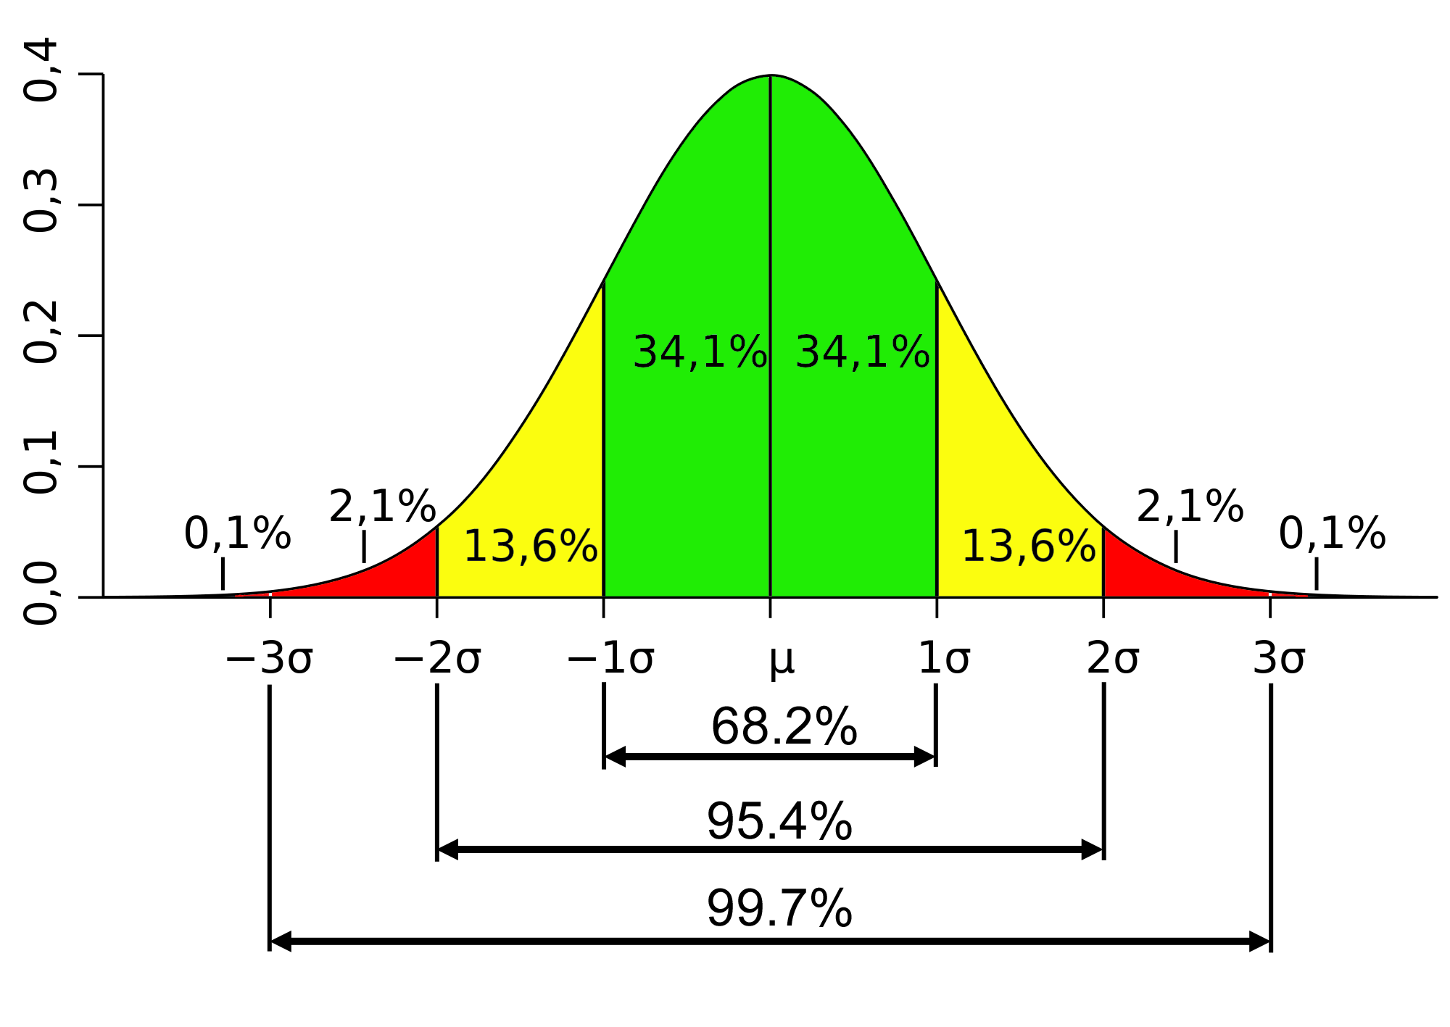
Fundamentals of NHST / Frequentist
Parametric vs non-parametric - normality

Slide 12
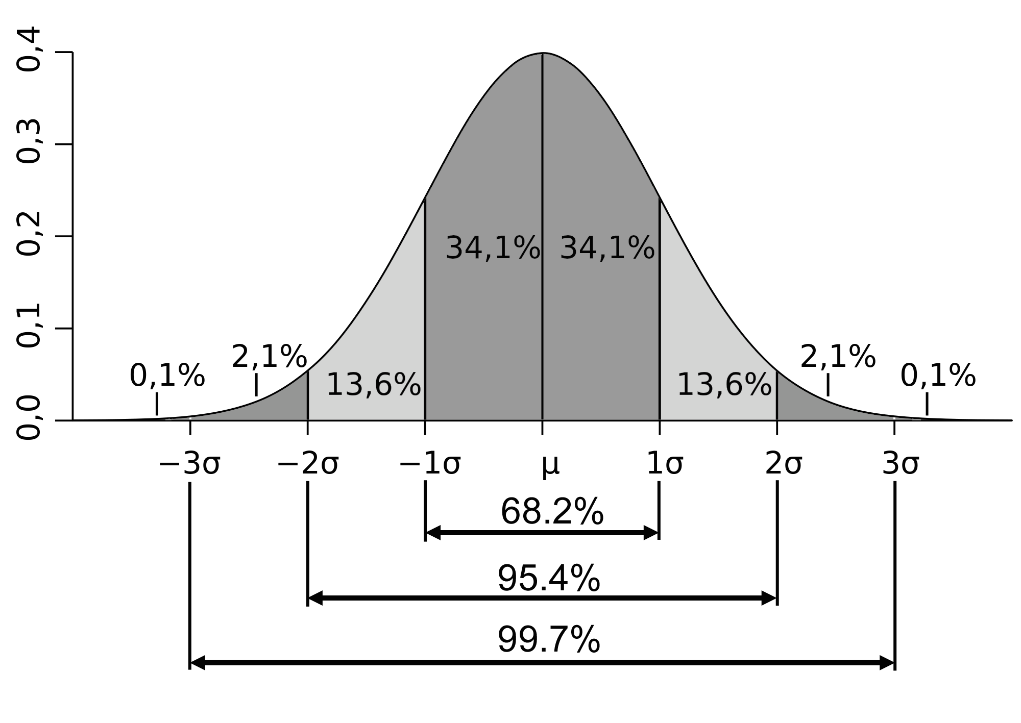
Fundamentals of NHST / Frequentist
Variance

Slide 13
Experiment structures
WITHIN subject designs
BETWEEN subject designs
MIXED designs

Slide 14
Within vs Between Subjects
Do speech exercises 2x week
Do muscle exercises 2x week
Do speech exercises 2x week
Do muscle exercises 2x week
One group of people, everyone does the tasks
Different groups of people, do different tasks

Slide 15
Fundamentals of NHST / Frequentist
Variance
Between subjects – data is independent
Within subjects – data is correlated

Slide 16
Group Designs
Between subjects Different people in different conditions (IV)
Group 1
Group 2
Cond 1
Cond 2
e.g. children vs adults
Group 1
Group 2
Group 3
Cond 1
Cond 2
Cond 3
e.g. children vs teenagers vs. adults
Group 1
Group 2
Group 3
Group 4
Cond 3
e.g. children vs teenagers vs. adults vs. older adults
Cond 1
Cond 2
Cond 4

Slide 17
Group Designs
Within subjects Same people in all conditions (IV)
Group
e.g. memory for this morning vs. last week
Cond 1
Cond 2
Group
e.g. memory for this morning vs. yesterday vs. last week
Cond 1
Cond 2
Cond 3
Group
e.g. memory for this morning vs. yesterday vs. last week vs. last month
Cond 1
Cond 2
Cond 3
Cond 4

Slide 18
Tests
Every test has the same principle. Null hypothesis (usually): samples are from the same population (no difference between them) / correlation is random / distribution is generated ‘randomly’
Probability associated with the value of the statistic, tells us probability that our sample fits with the null pattern.

Slide 19
Examples (see whiteboard)
Tell me your PhD experiments….

Slide 20
More than one IV
Group study…
More than one IV: can be entirely within or between.
Can have both within & between IVs = MIXED DESIGN
-Between subjects (different groups) IV: Presence of language impairment Two levels: SLI vs Typically developing
-Within subjects (different conditions) IV: Word type Two levels: Nouns vs Verbs
Notes:
This week they are being introduced to designs with more than on IV, This can be within or between subjects, but today they will focus on a mixed design (where on IV is within subjects, and one IV is between subjects).
An example is provided her that compares two groups (Specific Language Impairment with Typically Developing children) on their ability to produce nouns and verbs.

Slide 21
More than one IV Simplest is 2x2
IV 1
IV 2
Mixed designs
Some IV within subjects, some IV between
But also: between subjects designs or within subjects designs
Group 1
F
M
Cond 1
Cond 2
Group 2
Cond 1
Cond 2
Nouns Verbs
Old Young
Group
: bilingual SLI
F
Group 1
Cond 1
Cond 2
Group 2
L1
L2
Cond 1
Cond 2
Cond 1
Cond 2
M
Group 4
Group 3
Cond 1
Cond 2
Nouns Verbs
Notes:
This should animate so that you illustrate the two IVs (in red and green), the between subjects groups (labelled as ‘group’, in separated grey boxes) and the two within subjects conditions (labelled as conditions and illustrated by linked grey boxes with a black line between them). Walk through this very slowly.

Slide 22
Analysis
Only possible with ANOVA e.g. 2x2, 2x3 etc.
Data has to be parametric / meet assumptions of ANOVA

Slide 23
ANOVA in R
Dr. Lotte Meteyard (Dr Rob Davies)

Slide 24
Regression
Allows you to see how much variance in your DV is accounted for by an IV. You can put in more than on IV (e.g. does Age and/or Vocabulary predict MLU?
Change because of the independent variable
Change in the dependent variable
Change because of extraneous variables
Change because of chance
=
+
+
Notes:
Finally, you come onto regression. It’s included here as it’s a more complex form of correlation analysis. Like a correlation, but… you have a dependent variable and you can have more than one independent variable. It is usually used for making predictions about the dependent variable.

Slide 25
Regression
Usually for scale data (normally distributed)
Change because of the independent variable (IV)
Change in the dependent variable (DV)
Change because of extraneous variables (EV)
Change because of chance (e)
=
+
+
DV = IVxß + EVxß + e
Beta tells you how ‘important’ a variable is
Notes:
Walk through this slide, saying that regression equations have this structure. The beta value tells you how important an independent variable is in changing the dependent variable. Might be good to use a real life example here.
Just walk through these points: regression is usually for normally distributed data so scale data. When you calculate a regression equation, you get a Beta value for each predictor, this tells how important an independent variable is.
For example, if Beta was 2, this would mean a one unit increase in the independent variable results in a two unit increase in the dependent variable. Give a concrete example here (e.g. years in education and IQ? Something intuitive so the students can see how the predictor actually does cause change in the dependent variable)

Slide 26
ANOVA fundamentals
The specific hypotheses you test in ANOVA change the way to do the calculation
ANOVA is about calculating the variance you can attribute to different predictors (sums of squares)
There are different sums of squares: Type I – sequential (order of predictors matters) Type II – main effects only Type III – main effects and interactions (SPSS default)

Slide 27
Sums of Squares Types
The default anova in R (aov) reports Type I sums of squares (SS)
These are sequential SS.
SPSS uses Type III SS.
I don't know what software typically implements Type II
When data is balanced, factors are orthogonal, and types I, II and III SS all give the same results.

Slide 28
Sums of Squares Types
Type I SS tests for a difference in the weighted marginal means.
Weighted means assume the proportion of sample data in each cell is equal to the proportion in the population.
That is, values for means are weighted more heavily for higher n / more data in a cell.
Unweighted means assume the proportion / amount of data in each cell is the same (in the population)

Slide 29
Sums of Squares Types
If you have an UNBALANCED design (i.e. different n in each cell) the order you put things in the aov equation will matter
In other words, it is testing the first factor/IV without controlling for the other factors

Slide 30
ANOVA fundamentals
“R is written by experts in statistical computing who, despite popular opinion, do not believe that everything in SAS and SPSS is worth copying. Some things done in such packages... trace their roots back to the days of punched cards and magnetic tape, when fitting a single linear model may take several days because your first 5 attempts failed due to syntax errors in the code… this reflects the approach of “give me every possible statistic that could be calculated from this model, whether or not it makes sense”.. [In R] the underlying assumption is that the useR is thinking about the analysis while doing it.”
Douglas Bates, R-help (March 2007)

Slide 31
ANOVA fundamentals
The aov() function default is Type 1. NOT suitable for unbalanced designs (i.e. missing data points)
The car package gives options for Type 2 and 3

Slide 32
Reference reading
stat.ethz.ch/pipermail/r-help/2006-August/111854.html
goanna.cs.rmit.edu.au/~fscholer/anova.php
www.r-statistics.com/tag/unbalanced-design/
www.personal.psu.edu/mar36/stat_461/unbalanced/unbalanced_two_factor_ANOVA.html
sites.psu.edu/stat461psbsp2013/wp-content/uploads/sites/1906/2013/03/InteractionsAndTypesOfSS.pdf
www.personal.psu.edu/mar36/stat_461/unbalanced/unbalanced_two_factor_ANOVA.html

Slide 33
Contrasts and multiple comparisons
Dr. Lotte Meteyard (Dr Rob Davies)

Slide 34
Contrasts
Crawley, 2005, Ch.7, p35-36:
"There are two important points to understand about contrasts:
(1) There are absolutely loads of possible contrasts
(2) There are only k-1 orthogonal (statistically independent) contrasts”

Slide 35
Contrasts
Rules for constructing contrast coefficients are straightforward:
Treatments to be lumped together get like sign (+/-)
Groups of means to be to be contrasted get opposite sign
Factor levels to be excluded get a 0
The contrast coefficients must add up to 0 e.g. (0,1,-1,0) or (0,0.5,0.5,-1)

Slide 36
References
Crawley, M.J. (2005) Statistics: an introduction using R

Slide 37
Foundations of Linear Mixed Effects Models
Dr. Lotte Meteyard (Dr Rob Davies)

Slide 38
Mixed models
Analysis technique that includes both fixed and random effects.
Related terms.. Linear/generalised mixed models Multilevel models/analysis Heirarchical models

Slide 39
What is a LMM?
Used for any data where there is a hierarchical or multi-level structure. That is, groups & sub-groups.
All particiapnts
Males
Stimuli set 1
Stimuli set 2
Females
Stimuli set 1
Stimuli set 2
All particiapnts
Time 1
Stimuli set 1
Stimuli set 2
Time 2
Stimuli set 3
Stimuli set 4

Slide 40
Multilevel structures
When to use..
Pre and post tests
Multiple stimuli, multiple grouped samples
Repeated testing
For example - data collected from the same people at different times (correlated) - data collected from the same place/location (correlated) - data collected with different groups of items/stimuli (confound of different items)

Slide 41
What is a LMM?
Hierarchical structures are a problem because (1) Most analyses assume data is independent – standard errors smaller if data assumed to be independent when it isn’t (2) Averaging or aggregating across groups/sub-groups can ‘hide’ the true pattern in the data - we assume taking the average is OK, but this is usually a convenient oversimplification

Slide 42
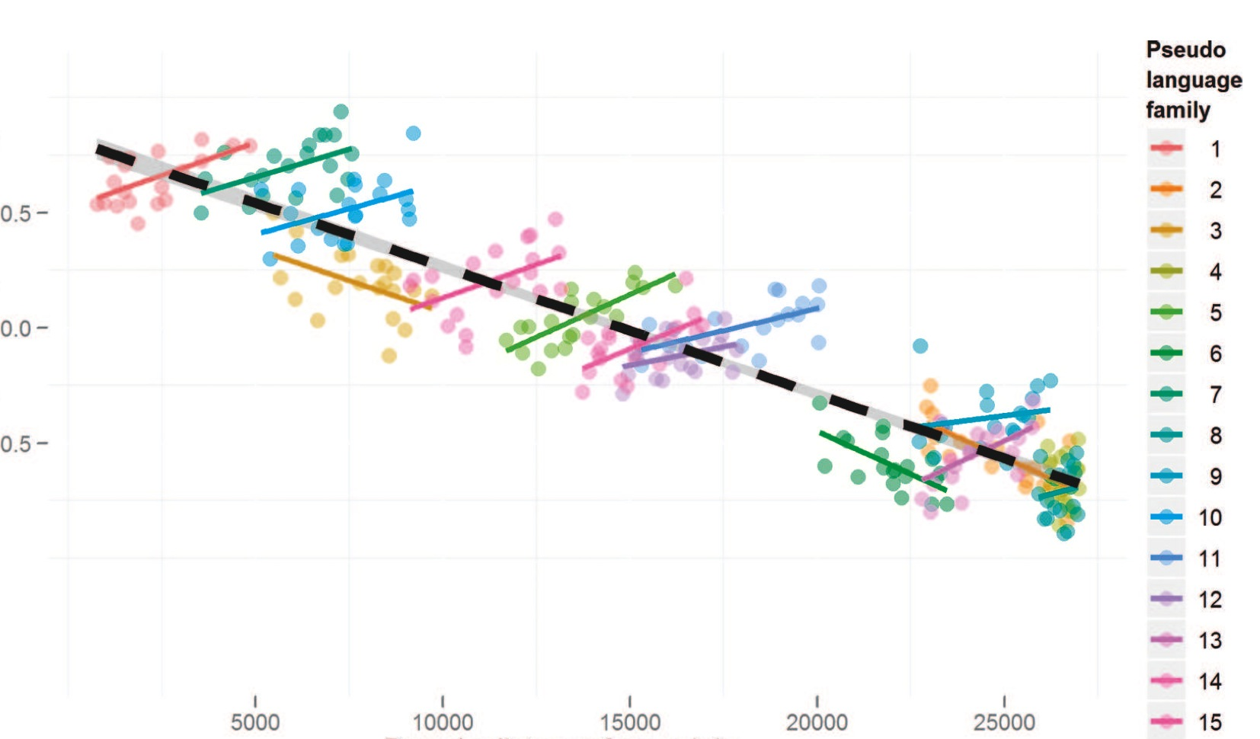
Jaeger et al (2011)
Jaeger, T. F., Graff, P., Croft, W., & Pontillo, D. (2011). Mixed effect models for genetic and areal dependencies in linguistic typology. Linguistic Typology, 15(2), 281-320.

Slide 43
When to use LMMs
Whenever you want to manage these problems… (1) Model subject & item variance (e.g. F1 vs F2) - may replace your usual ANOVA analysis (2) Model groupings in your data (e.g. over time, hierarchical designs) (3) Individual differences and effects within specific groups

Slide 44
What should my data look like?
LMMs should be seen as a form of REGRESSION So.. (1) Lots of data points to power the analysis (2) Good/sufficient variance in your data (2) Data meets assumptions of regression NB: linear mixed effects models
If you are planning on using LMMs, then design your experiment to fit LMM analysis.

Slide 45
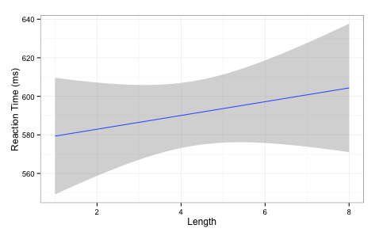
What do LMMs do?
Standard regression
slope of line
intercept
RT ~ intercept + slope(Length)

Slide 46
Regression
Experiment with RT by Length of Word (IV)
RT ~ intercept + slope(Length)
y ~ a + b(x)

Slide 47
LMM & regression
For LMMs we can model how the intercept and slope will vary across different groups
Because we are modeling variation these are called random effects (i.e. the group has some random variation associated with it). Measured in standard deviations Fixed effects are your normal predictors/IVs. Fixed because we want to know on average what they do. Measured in means.

Slide 48
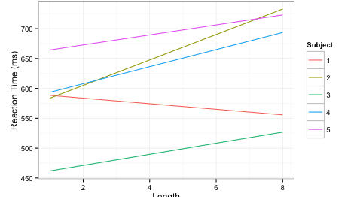
What do LMMs do?
slope is allowed to vary across groups e.g. subjects
intercepts are allowed to vary

Slide 49
What do LMMs do
For LMMs we can model how the intercept and slope will vary across different groups
For example, model the difference (i.e. the variance/deviation) for each subject from the average slope and the average intercept for all subjects. Similarly, model the difference for each item from the average slope and the average intercept for all items.

Slide 50
What do LMMs do?
That is basically it!
Gets complicated because you can end up with very large random effect structures e.g. intercepts +/- slopes for subjects, items, and more slopes varying for different predictors for different groupings slopes of interactions between fixed effects across different groups

Slide 51
Intercepts and slopes
Experiment with Subjects, Items and Length of Word (IV)
Random intercepts only
RT ~ Length + (1|Subjects) + (1|Items)
Random intercepts and slopes (nb: 1 = correlated)
RT ~ Length + (1 + Length|Subjects) + (1 + Length|Items)
Intercept varies by Subjects
Intercept varies by Items
Length varies by Subject (correlated)

Slide 52
LMMs in R
Models estimate values for fixed and random effects NB: you are modeling your data i.e. fitted values estimated from the data
Order of entry doesn’t matter (simultaneous)
Tries to find the solution that makes the observed data most likely (maximum likelihood) ML – assumes fixed effects are precise REML – averages fixed effects and then calculates random effects
Sometimes this modeling fails (convergence)

Slide 53
There is no recipe book
Each statistical analysis has “boundary conditions” (Baayen)
Identify boundary conditions and check them
Mixed models:
Variance / number data points
(2) Normality / distribution of data (e.g. residuals, outliers)
(3) Rationale & selection of random & fixed effects
(4) ‘Final’ model – Does it look sensible? Can you interpret it?

Slide 54
Random effects
Sampling groups: subjects, items, school, etc.
You expect or predict some variation e.g. interaction of subject ability with item
LMM will tell you how much variance associated with a grouping - if very small, consider removing it. - include random effect because it is part of experiment design - include random effect because it is something you are interested in - can test models with and without (Baayen et al 2008) LRTs comparing models with same FE, differing in RE.

Slide 55
There is no recipe book
Model checking and model selection
Say what model checking was done (e.g. residuals, optimization, re)
Say what approach and why (e.g. maximal to minimal; control/null model up; inclusion or not of higher order interactions)
Report model selection / testing / comparison process

Slide 56
A mixed-model workflow
Collect data
Model data
Large sample of items / trials
Check parameters / boundary conditions – outliers, scaling etc.
Maximise variance
Iterate
REPORT iterations
Most issues can be addressed by transparency..

Slide 57
Reporting models (thank you Rob Davies)
Report model comparisons and Likelihood Ration Tests (LRC) / AIC/ BIC for different models
Explain the model selection choice, based on aims of study and information criteria comparisons
Summary of fixed effects: like linear models, with CIs
Summary of random effects: variance and covariance (if applicable)

Slide 58
Convergence
This is not just a problem with the ‘mathematical engine’
“determine whether the problem lies in a failure of the…optimization stage, as opposed to a case of model misspecification or unidentifiability or a problem with the underlying PLS algorithm. To date we have only observerd PLS failures..” Bates et al (page 24; http://cran.r-project.org/web/packages/lme4/vignettes/lmer.pdf)
Optimiziation
Model misspecification
Variance or covariance in random effects (0/1)
Unidentifiability / PLS failures
Cf: Bates et al (2015) – parsimonious models (arXiv)

Slide 59
Building and choosing models
“There is no such thing as an all purpose statistical method” Nagin & Odgers, 2010, pg 132
Give rationale for the analysis & model choice
Be explicit about technical choices (e.g. random and fixed effects structures, model selection process, model checking)
Make programming script available
Report your basic data that are going into the model (e.g. central tendency, variance, distribution for the DV/response variable)

Slide 60
Building models: many methods
Simple model upwards: intercept only + random effects + fixed effects
Models with control variables + fixed effects
Models with main effects + interactions
Simple regression/ordinary least squares models for sub-groups/per subject/per item, to inform LMM (Gelman & Hill, 2006)
intercept = overall mean intercept assumed in lmer/R

Slide 61
Building models
Add in fixed effect predictors: should see random effect variance reduce if the predictors are doing any work
Compare successive models – does adding in a predictor make the model better?
Change either RE or FE for comparisons
Model comparison with AIC or LRT
Likelihood – of data given the model
Information criterion – trade off between likelihood of data and number of parameters
Notes:
Anderson & Burnham (early 200os) information criteria paper. (ecologists?)
Information theoretic criteria = distance between a model and observed outcomes will loose information. The real world to the simplification in your model - you have to drop complexity and loose information to make that leap.
Information Criteria are based around estimates of information lost in this move... Model selection aims to minimise information lost - the more negative the better.. Trade off between likelihood of data and number of parameters. Trade off between simplicity and complexity. Best OLS model will have minimum residuals and maximum R squared.
CF: Rob Davies stats slides (random effect structures revised pdf).
LRT = 2log likelihood-complex/likelihood-simple Usually LRT, AIC, BIC tend to move in same direction consistently – but AIC and BIC can diverge, especially with complex models – BIC can say ‘this added complexity does not add’ whereas AIC says it does Pinheiro & Bates (2000) says LRT is anti-conservative for comparing fixed effects, but OK for random effects. All parts of this computation are worked out well and model comparisons are well motivated. The LRT statistics give a distribution that is approximately X2 distributed.
For example: Kliegl, R., Hohenstein, S., Yan, M., & McDonald, S. A. (2013). How preview space/time translates into preview cost/benefit for fixation durations during reading. QJEP.
“Comparisons between models with different fixed effects are based on maximum likelihood (ML) statistics; comparisons between models with different random effects are based on restricted maximum likelihood statistics (REML); comparisons involve only strictly nested models (Pinheiro & Bates, 2000)”

Slide 62
Building models
Too many parameters = false positives
Complex to explain and understand
Too few…. Have you included all the important parameters? (hypotheses, motivation, previous evidence..)
Model that will replicate across samples?
What complexity do you want for your research questions?

Slide 63
Building models
Once have a reliable model, see if you can ‘break’ the effects you have e.g. change logRT to reciprocal (1/RT)? higher order interactions that modulate effects? other variables you expect to matter?

Slide 64
R interpretation / GLMMs

Slide 65
Significance and fitting
Calculation of p values is non-trivial, due to issues with identifying degress of freedom
Report confidence intervals for estimates
can simulate p values – mcmc / pval.fnc
lmerTest package in R
MuMIn (R² values for LMMs)

Slide 66
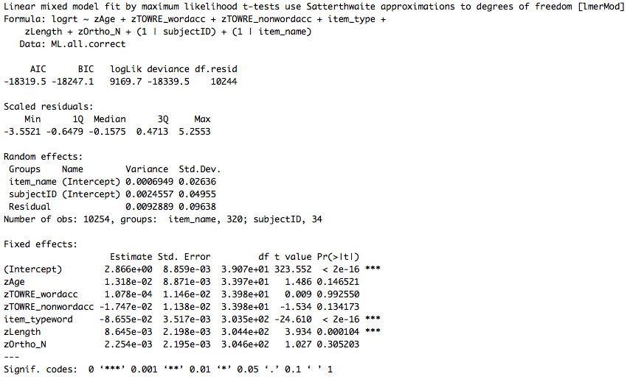
Random effects - varaince/SD associated with subject/item etc.
(e.g. difference between each subject and mean)
Fixed effects
Typically same coefficients estimates as OLS regression
Standard errors will be different
Get p values from lmerTest

Slide 67
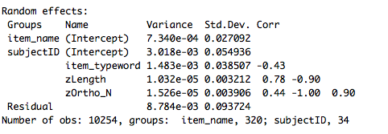
Model checks
Variance in intercepts and slopes can covary – e.g. as people get slower, effects get bigger… lmer assumes there is a correlation
Correlations between random effects are high (~0/1) - model cannot solve the variance problem - is looking for nothing

Slide 68
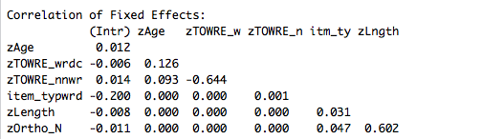
Correlation between different predictors (check for collinearity)
Mean centering & scaling (i.e. z scores of data) helps to reduce this problem

Slide 69

Logistic regression
Log odds as DV Odds = probability occurrence (1) probability non-occurrence (0) Log of odds of getting a 1 vs 0 Log odds because it allows linear modelling
Coefficients are in log odds Positive number = odds of accuracy go up Negative number = odds of accuracy go down

Slide 70
Recommended reading (for clarity)
Bolker, B. M., Brooks, M. E., Clark, C. J., Geange, S. W., Poulsen, J. R., Stevens, M. H. H., & White, J. S. S. (2009). Generalized linear mixed models: a practical guide for ecology and evolution. Trends in Ecology & Evolution, 24, 127-135.
Jaeger, T. F., Graff, P., Croft, W., & Pontillo, D. (2011). Mixed effect models for genetic and areal dependencies in linguistic typology. Linguistic Typology, 15(2), 281-320.
Gelman, A., & Hill, J. (2006). Data analysis using regression and multilevel/hierarchical models. Cambridge University Press.

Slide 71
Recommended reading (for clarity)
Papers by Reinhold Kliegl (Potsdam)
Dan Mirman’s R resources page (Alabama, Birmingham) http://www.danmirman.org/r-resources
Websites recommended in R Scripts for general R stuff

Slide 72
Hypothesis driven model selection

Slide 73
Hypothesis driven approach
“formulate your hypotheses and model without reference to the data (and ideally even prior to their collection)” (Roger Mundry, 2014, MPI EVA)
The problem of model complexity: even with a few predictors, there is a potentially huge number of different models that can be fit. E.g. main effects, interactions, non-linear patterns…

Slide 74
Model building
Identify ‘test’ predictors (fixed effects) that you have hypotheses about
Identify anything you want to control for (control fixed effects)
Identify random effects – this is independent from control vs test predictors. Random effects are groupings of data you expect to cause systematic variation.
Compare more complex model against ‘null’ model (e.g. RE and control variables only).

Slide 75
Model building
Interactions – think about what interactions might mean, and why you would test for them.
Mundry (2014) advice:
Write down:
why each of the terms in the model is in there
what the different terms in the model represent (i.e. what they mean, what process they represent)
what the model and the terms in it could reveal (and not reveal)
ask yourself (and all researchers involved) if the model represents what you're aiming at

Slide 76
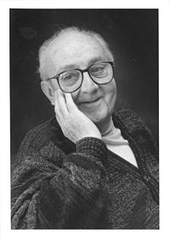
Thank you for listening
“Essentially, all models are wrong, but some are useful” George E.P. Box
Box, G. E. P. & Draper, N.R. (1987). Empirical Model-Building and Response Surfaces, p. 424, Wiley

